Slide 1

ICD PROJECT
Integrants:
Josue Cobos Salvador
Enmanuel Magallanes Pinargote

Slide 2
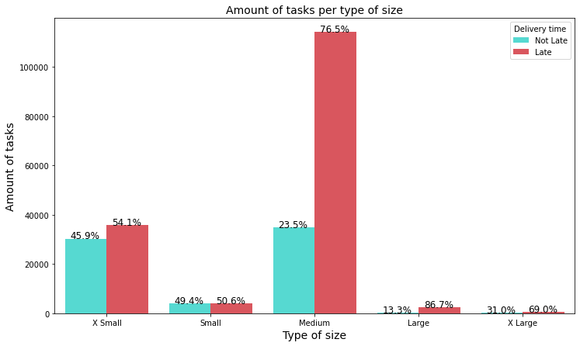
Is the total weight of packages a factor affecting the timeliness of deliveries?
In the graph we can see that there are more deliveries with size X Small and Medium than the others. However, what is important here is to analyze the percentage of tasks delivered on time and those that are not. There are no significant differences between Small and Small X-size tasks. In contrast, Medium, Large and X Large tasks have a significant difference in the percentage of on-time deliveries. This indicates that the size of deliverables affects on-time delivery when their size is equal to or larger than Medium.

Slide 3
Are tasks with fewer neighboring deliveries* taking longer to reach their delivery point?
To carry out this analysis we first have to determine what would be the time window (hours) and radius (kilometers) around a task to be used. For this we analyzed the distance and average time difference of a route in the delivery path, from the first package to the last one. The following results were obtained:
Mean time: 3.12 hours
Mean distance: 3.20 Km.
* We define neighboring deliveries as all those deliveries that are less than or equal to X Km away from the same and their delivery date is within T hours of the same.

Slide 4
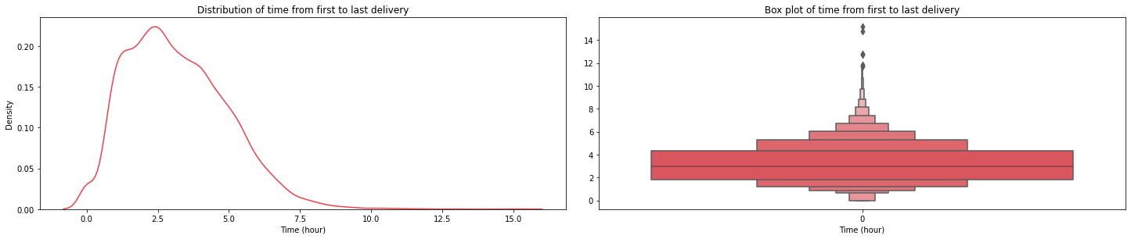
Mean time on drop off step
As we can see the scheduled time from the first delivery to the last delivery, on average, is 3.12 hours. This values will be our time window to use to determine the number of deliveries that exist around one.

Slide 5
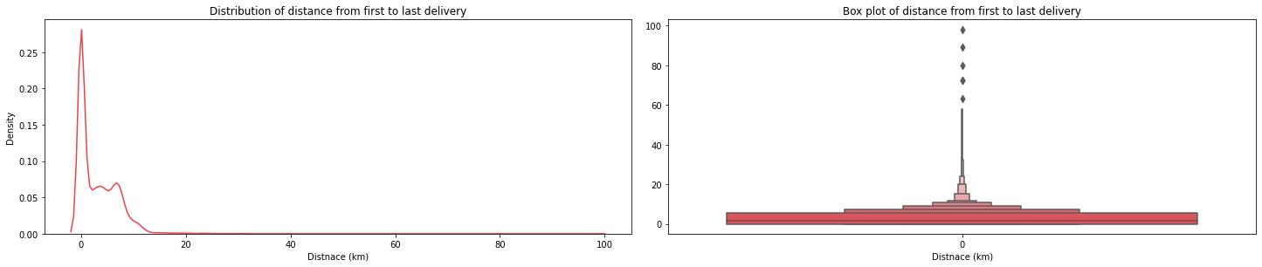
Mean distance on drop off step
As we can see the scheduled time from the first delivery to the last delivery, on average, is 3.12 hours. This values will be our time window to use to determine the number of deliveries that exist around one.

Slide 6
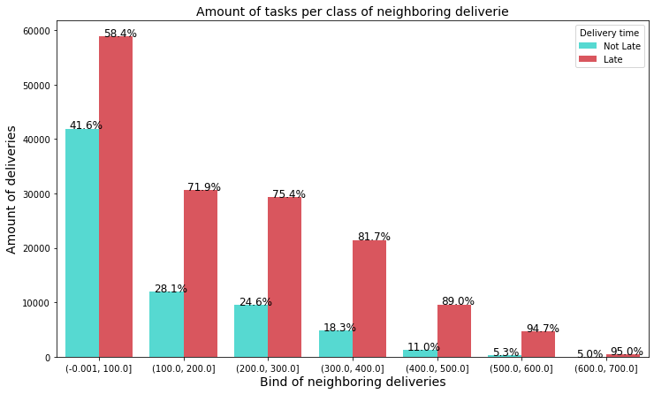
Responding to the question about neighboring deliveries
In the plot we can see that as the number of neighboring deliveries increases, the percentage of late deliveries also increases. This tells us that the higher the concentration or density of deliveries around you, the more likely it is that you will be late in reaching the final customer.

Slide 7
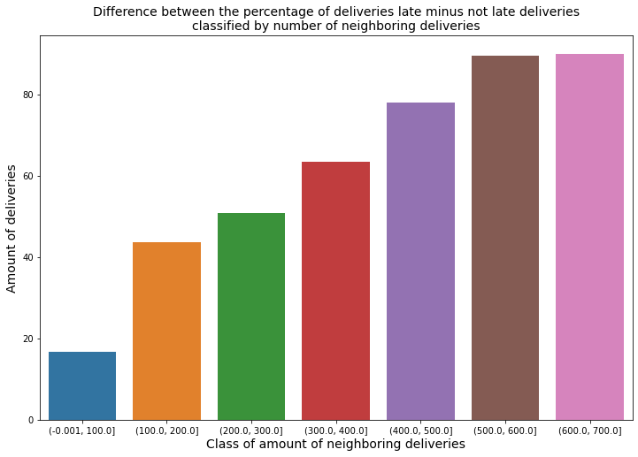
Plot of percentage differences
Here we can see more clearly how, as the number of neighboring deliveries increases, the difference between the percentage of overdue tasks minus those not overdue increases.

