Slide 1
AgenticTerminal
A terminal-first AI experience for developers who live in the shell.
• Embedded terminal on the left
• Copilot-driven agent workflow on the right
• Human approval for shell command execution
• Conversation persistence across sessions
Notes:
Start with the problem statement: most AI coding tools pull developers out of the terminal. This project keeps the agent in the same workspace.

Slide 2
Why build this?
• Developers already live in the terminal.
• AI helpers often feel detached from the shell they are supposed to guide.
• Command execution needs an approval boundary.
• We want visibility into what the agent suggests and runs.
• We want a workflow that feels closer to a REPL than to a modal chat app.
[INFO] Core idea
Keep the terminal, the agent, and the approval loop in one place.

Slide 3
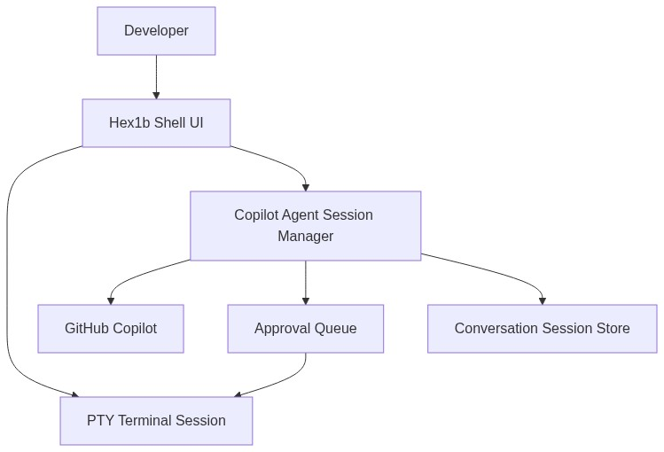
What the app does
• Starts an interactive shell session
• Connects to GitHub Copilot through `GitHub.Copilot.SDK`
• Sends prompts with terminal context
• Queues command approvals
• Persists saved conversations
• Supports smoke-test automation

Slide 4
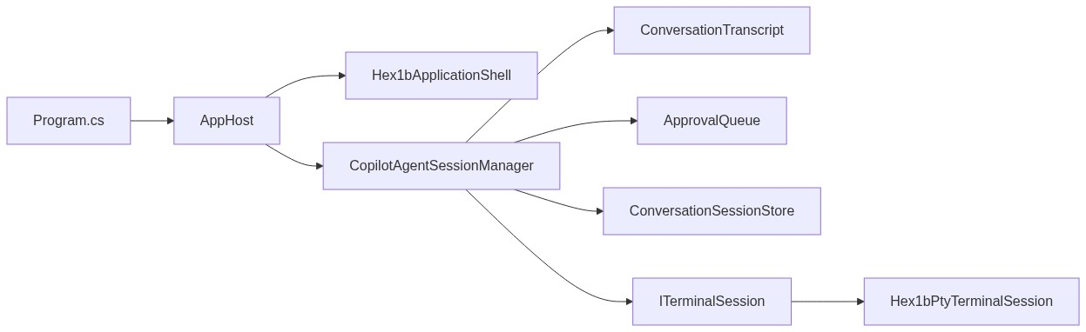
High-level architecture
Main areas
• `Agent/`
• `Terminal/`
• `Approvals/`
• `Persistence/`
• `Startup/`
• `UI/`
Runtime shape
• Hex1b host thread for terminal-first UI
• Avalonia app for companion panel support
• Session manager as the orchestration center

Slide 5
Startup flow
1. The app resolves whether it should run as the full terminal experience or as the `agt` wrapper.
2. It loads configuration and startup options.
3. It creates the terminal session.
4. It creates `CopilotAgentSessionManager`.
5. It initializes the application shell.
6. It waits for UI readiness, then starts Copilot and loads saved sessions.

Slide 6
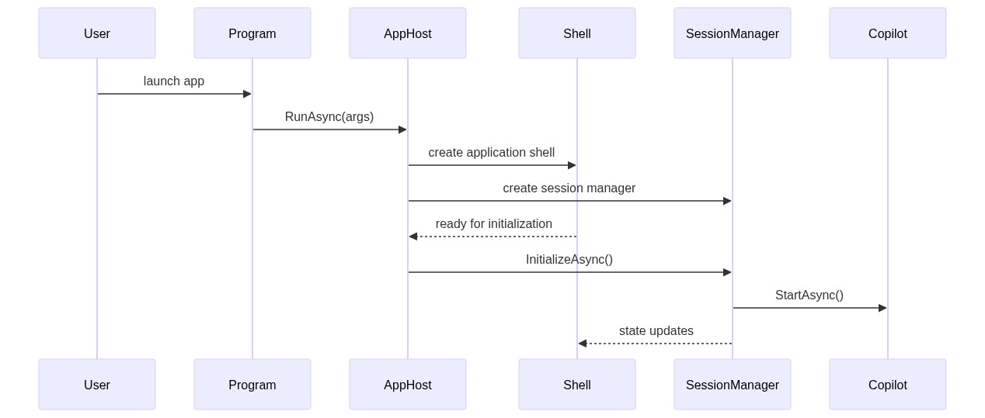
Startup flow

Slide 7
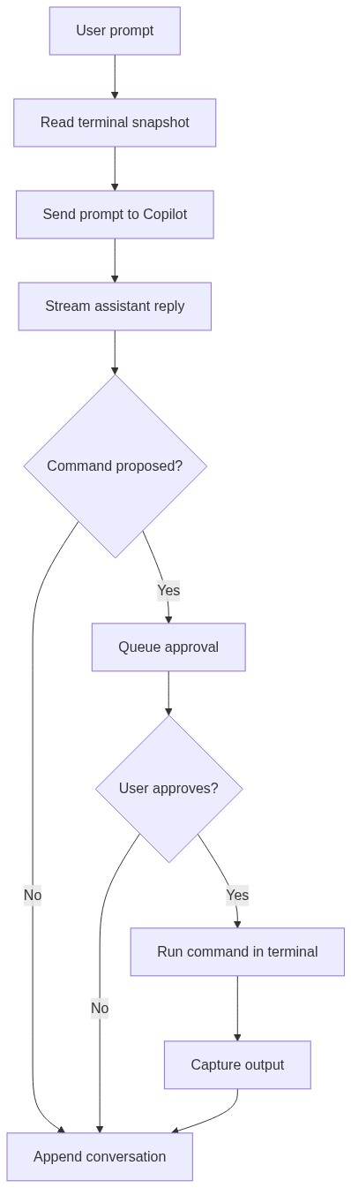
Prompt and approval loop
Prompt path
• User enters a prompt.
• The session manager captures a terminal snapshot.
• Prompt plus context is sent to Copilot.
• Responses stream back into the conversation transcript.
Approval path
• Agent proposes a shell command.
• The command enters the approval queue.
• The user approves or denies execution.
• Approved commands run in the terminal session.

Slide 8
Wrapper and backchannel design
The wrapper mode exists so the agent can run visible shell commands while still reporting lifecycle events back to the app.
• The wrapper executable name is short and shell-friendly: `agt`
• Backchannel events are defined with protobuf
• Commands can report start and completion details
• Output tails can be queried later for context and diagnostics
• The protocol leaves room for future expansion

Slide 9
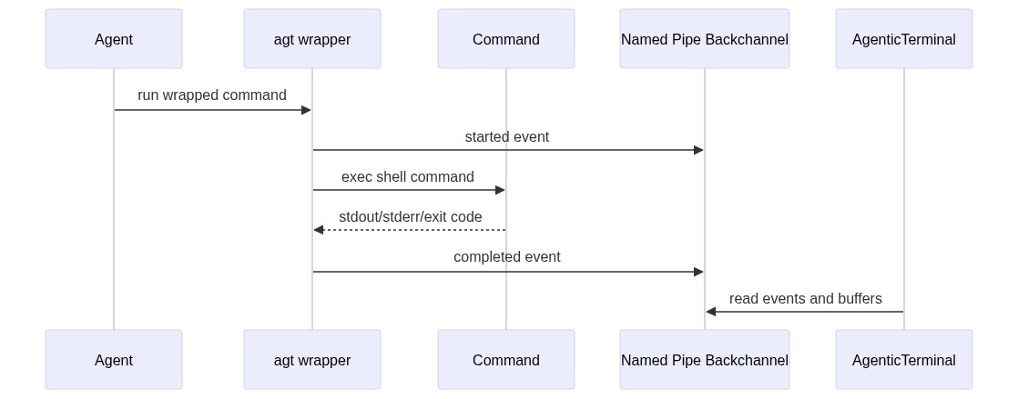
Wrapper and backchannel design

Slide 10
UI model
User experience
Technology choices
• Terminal pane on the left
• Agent interaction pane on the right
• Function-key shortcuts for terminal-safe global actions
• Compact approval and status text
• Session list and model picker integrated into the shell UI
• .NET 10
• Hex1b for terminal-style UI
• Avalonia for companion UI pieces
• `GitHub.Copilot.SDK` for agent integration
• PTY-backed terminal session support
> The project favors terminal-native interaction over fake modal dialogs.

Slide 11
Persistence and test strategy
Persistence
Testing
• Conversations are stored as saved sessions.
• Existing sessions are loaded during startup.
• Session summaries support quick reopening.
• xUnit test project
• terminal capture parsing tests
• PTY integration tests with a fake host
• startup and configuration tests
• persistence tests
• UI formatting tests
• interaction automation tests
Observability
• Prompt timing is tracked.
• Tool activity is surfaced.
• Smoke-test mode validates startup and basic agent behavior.

Slide 12
Interesting .NET choices
• Uses `net10.0` and modern C# features.
• Blends terminal UI and desktop UI in one application.
• Uses async orchestration heavily across startup, prompts, approvals, and terminal execution.
• Uses generated protobuf types for the command backchannel.
• Keeps the domain split into focused folders rather than one large service class.

Slide 13
Interesting .NET choices
await using var sessionManager = new CopilotAgentSessionManager( approvalQueue, conversationSessionStore, terminalSession, Environment.CurrentDirectory, options.CopilotModel, new CopilotSessionOptions(...));

Slide 14
Current challenges and lessons learned
• Terminal-first UX is powerful, but cross-thread UI updates require discipline.
• Input handling is harder than it looks, especially around dead keys and composed input.
• Approval UX must stay fast without hiding important command details.
• AI integration needs strong fallback paths, timeouts, and transparent status text.
• Testability improves when terminal, persistence, and startup concerns are abstracted early.
Notes:
Mention the recent collection-modified issue as an example of why thread ownership and snapshots matter in mixed-UI architectures.

Slide 15
Where this could go next
• Richer REPL-style history interaction
• More polished model selection and quota insights
• Expanded backchannel protocol for pipeline reporting
• Better diagnostics around terminal and agent timing
• More cross-platform terminal hosting options
• Packaging for easier community adoption

Slide 16
Takeaways
• AI workflows get better when they stay close to the developer's real environment.
• .NET is a strong fit for combining terminal integration, desktop UI, async orchestration, and testing.
• AgenticTerminal is a practical experiment in keeping humans in control while still benefiting from agent assistance.
Thank you.
Discussion topics

Slide 17
Takeaways
1. How much approval should an agent need?
2. What makes a terminal-native AI UX feel trustworthy?
3. Where would you take this architecture next?

