Slide 1
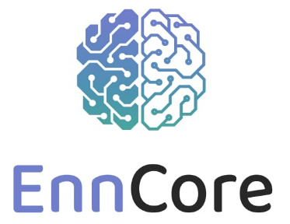
EnnCore: End-to-End Conceptual Guarding of Neural Architectures*
¹Department of Computer Science, The University of Manchester
²Department of Computer Science, University of Liverpool
*EPSRC Reference: EP/T026995/1
https://enncore.github.io/

Slide 2






EnnCore Team (partial list)
and others
L. Cordeiro
M. Mustafa
A. Freitas
E. Manino
ECAs
and others
X. Huang
Y. Dong

Slide 3
Projects under the call “Security for all in an AI enabled society”
CHAI: Cyber Hygiene in AI enabled domestic life
o Queen Mary University of London
o University of Bristol
o University of Greenwich
o University of Reading
SAIS: Secure AI assistantS
o Kings College London
o Imperial College London
AISEC: AI Secure and Explainable by Construction
o Heriot-Watt University
o University of Strathclyde
o University of Edinburgh
EnnCore: End-to-End Conceptual Guarding of Neural Architectures
University of Manchester
University of Liverpool
Today we have representatives from other projects!

Slide 4
EnnCORE: Vision and Challenges
Build explainable and fully-verifiable learning-based systems that are safe, transparent and robust
Trade-off between soundness and completeness to achieve scalability
Representational gap between the neural (flexibility) and the symbolic (explainability, control)
Trade-off between privacy protection and transparency / accountability

Slide 5
EnnCORE: Achievements by now
A snopshot on Researchfish:
In today’s talks:
Inverting Large Language Models, by Adrians Skapars, Edoardo Manino and Lucas Cordeiro (Manchester)
Robustness certification for deep learning, by Yi Dong and Xiaowei Huang (Liverpool)
Defending the Edge: Representative-Attention for Mitigating Backdoor Attacks in Federated Learning, by Chibueze Peace Obioma and Mustafa A. Mustafa (Manchester)
Formal Verification of Python and NumPy Programs Using ESBMC, by Bruno Farias and Lucas Cordeiro
and others

Slide 6
Activities Based on EnnCORE
Using LLM
Defending against backdoor attacks in Federated Learning
Privacy-friendly load shaping strategies in smart homes
Privacy-friendly local energy markets
Verification and testing of AI-generated code
Neural network verification as a programming language challenge
Formal verification of Python-based AI libraries
Counterexample-guided neural network quantization refinement
equivalence checking of encrypted ML models
LLM-generated invariants for formal verification
Automated program repair using LLMs and formal verification
Safe LLM-driven Multi-agent Systems
CRoCS: Certified Robust and Scalable Autonomous Operation in Cyber Space.
Adaptive Guardrails for LLM
Safe LoRA
Finetuning LLMs for software vulnerability detection
RobustifAI: Robustifying Generative AI through Human-centric integration of neural and symbolic methods
for LLM
Moving towards foundation models

Slide 7
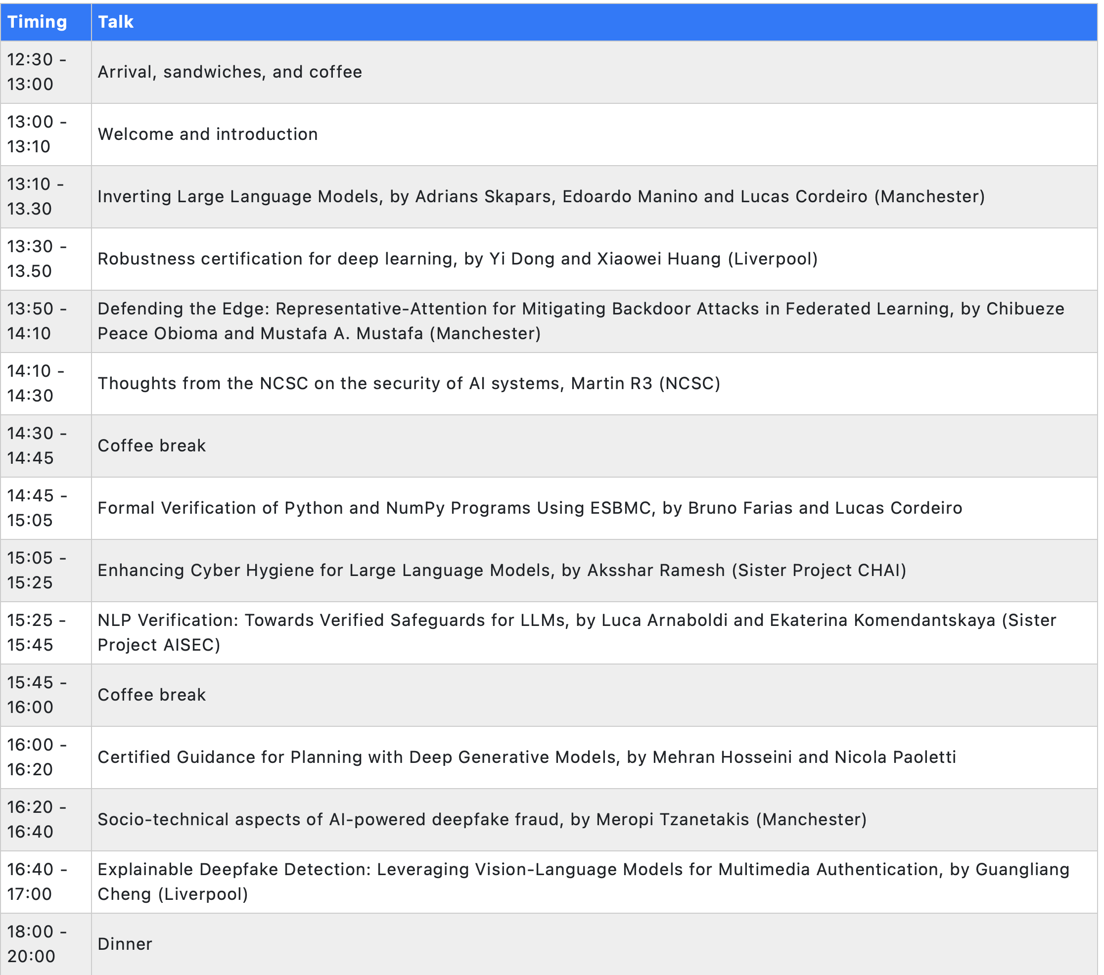
Workshop on General-Purpose AI: Prospects and Risks

