Slide 1


EnnCore: End-to-End Conceptual Guarding of Neural Architectures

Slide 2
Real Case-Studies
& Integrated Evaluation (WP1)

Slide 3
Real Case-studies
Two case-studies
Healthcare domain - Cancer Research UK
Energy domain - Urbainchain
Why do we need them?
To get end-users of our tools involved in the design stage
To better understand the needs of the end-users
To verify and validate our methods and tools on real-world AI systems
To maximise the impact of our research
Key to success
Engagement of the EnnCore team with Cancer Research UK and Urbanchain

Slide 4
Tasks in WP1
T1.1 Collection of the requirements and use cases.
Modelling of the target security scenarios and supporting end-user requirements and data collection.
T1.2 Creation of the evaluation benchmarks.
Creation of the evaluation benchmarks based on the scenarios, requirements and supporting collected data.
T1.3 Use case deployment & usability study.
Deployment of the use cases in the target scenarios. Analysis of the usability of the developed methods and tools focusing on the quality and interpretability of explanations from an end-user perspective.

Slide 5
Requirements Specification
Decide on the (security) requirements/properties EnnCore will focus
Standard security requirements
Confidentiality
Integrity
Availability
Security requirements related to Explainability / Interpretability
Transparency
Auditability
Traceability
Privacy
How sensitive the data is and who can access it?

Slide 6
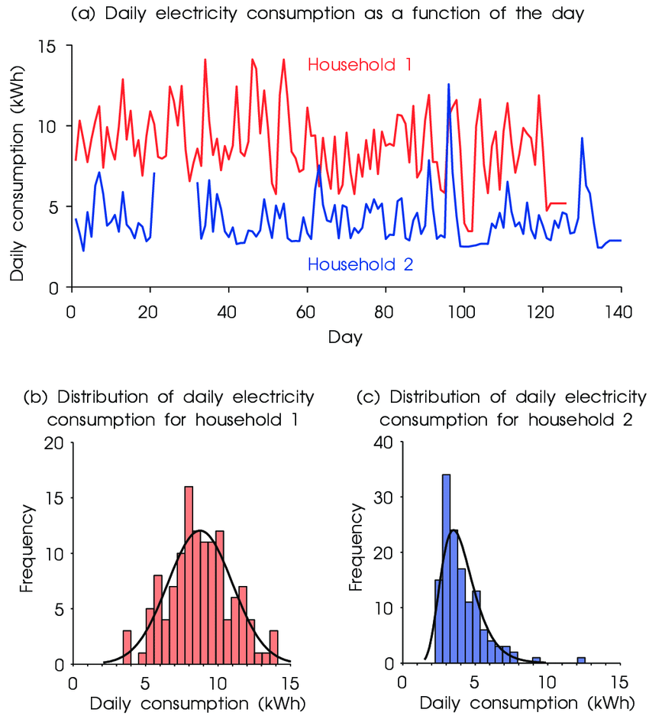
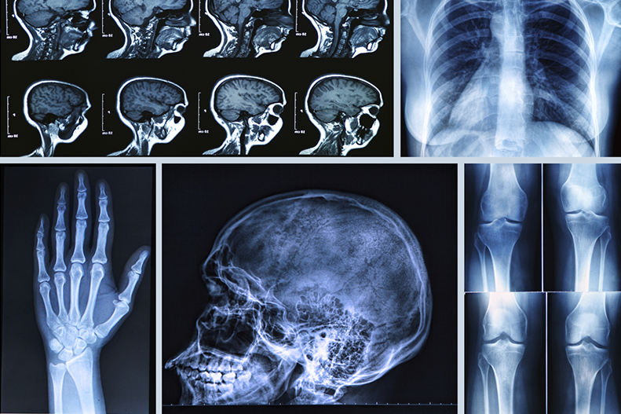
Diverse use case-studies
Cancer Research UK Urbanchain

Slide 7
Thank you

