Slide 1


EnnCore: End-to-End Conceptual Guarding of Neural Architectures

Slide 2
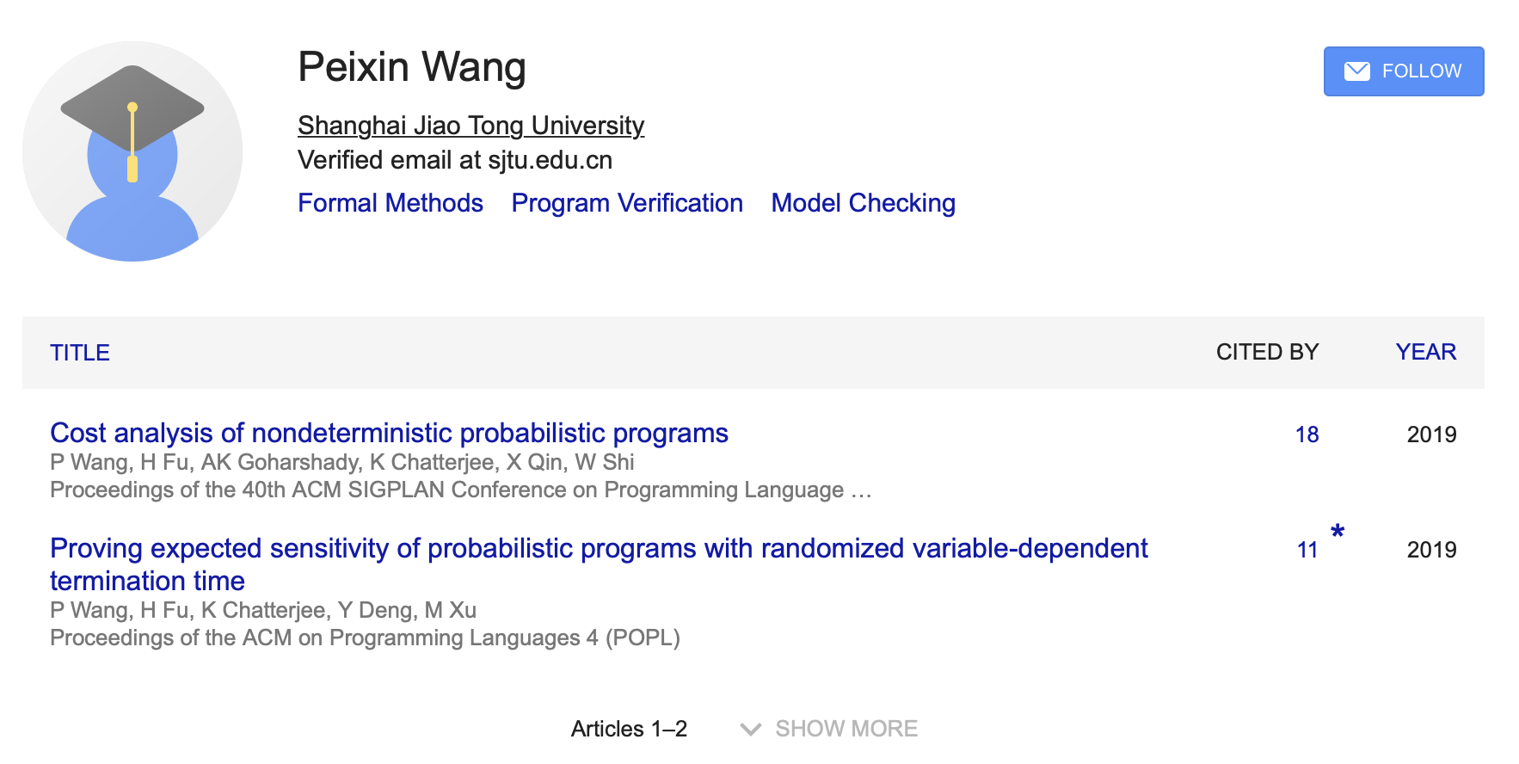
WP3: Symbolic Verification
Who is going to work (hard) on this as a busy bee?

Slide 3
WP3: Symbolic Verification
The following is me, who is going to look after with the busy bee
Dr Xiaowei Huang
AI Safety
Verification and Validation
Deep Neural Networks
Model Checking
Multiagent Systems

Slide 4
WP3: Symbolic Verification

Slide 5
WP3: Symbolic VerificationFramewor
Develop scalable SMT theories and invariant inference methods for DNNs (EnnCore-Sym)
(test time) SMT theory for probabilistic safety, or simply probabilistic safety
(training time) Invariance inference, for training process, to obtain a good performance DNN.
Performance: accuracy, generalization, energy consumption, etc.
(operational time) Incremental verification, for continual learning

