Slide 1


EnnCore: End-to-End Conceptual Guarding of Neural Architectures

Slide 2
Topics
Welcome, overview
Explainable Neuro-Symbolic Safeguard Framework (WP2)
Symbolic Verification Framework for AI (WP3)
Verifying Security in Embedded Software running in GPUs (WP4)
Management, Engagement, and Dissemination (WP5)

Slide 3
Topics
Real Case-Studies & Integrated Evaluation (WP1)
Case Studies from Cancer Research UK
Case Studies from Urbainchain
Next Steps

Slide 4
Overview

Slide 5
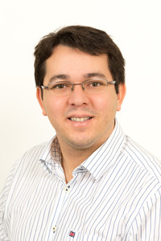
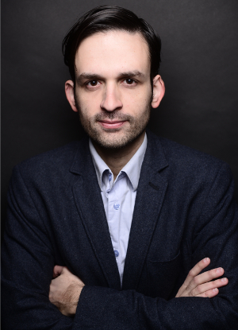


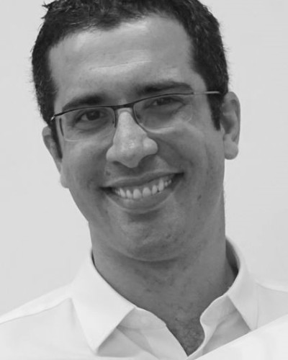

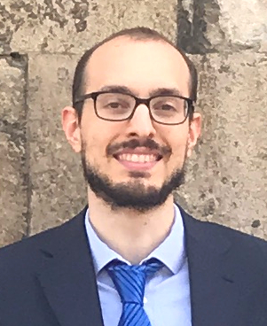

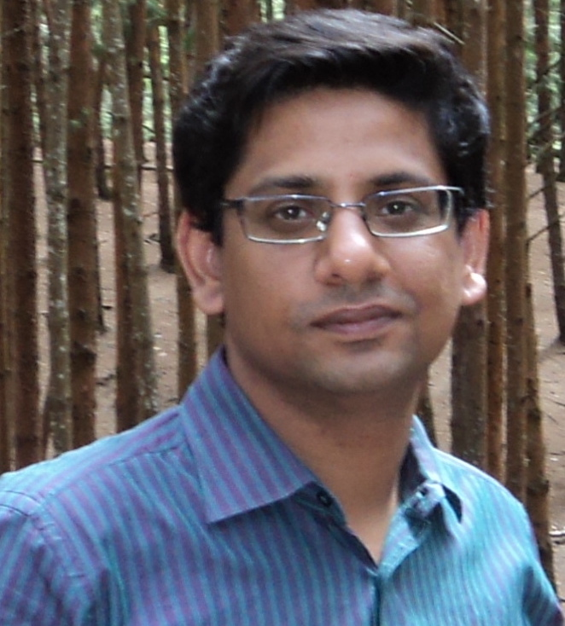
Project Team
L. Cordeiro
A. Freitas
M. Mustafa
X. Huang
G. Brown
M. Lujan
M. Manino
P. Wang
S. Mishra

Slide 6





Project Partners

Slide 7
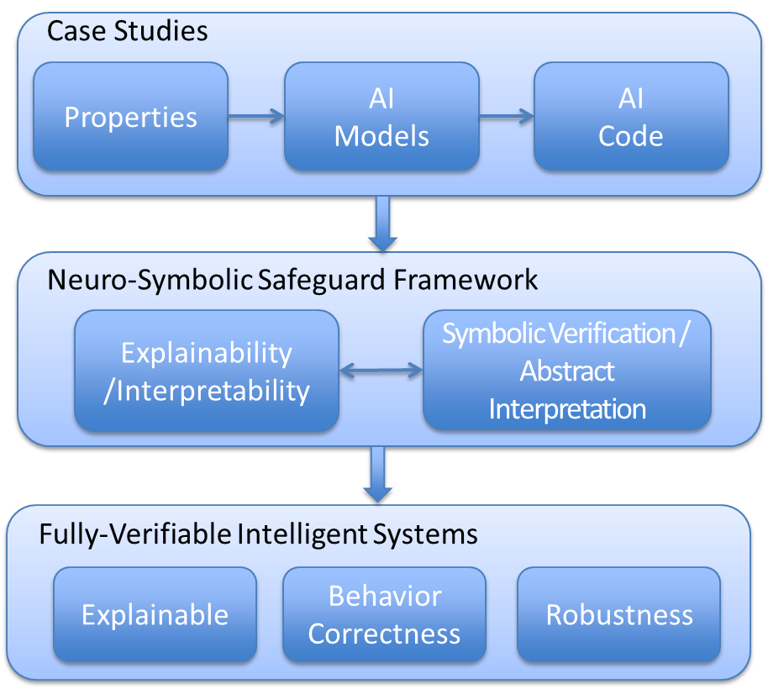
Proposed Research
Creation of the evaluation benchmarks
Use case deployment & usability study
Develop neural interpretability methods
Reason over security properties in DNN implementations
Evaluation of security properties in real case studies
Validation of the results

Slide 8
Objective 1
Develop a novel conceptual/symbolic safeguard mechanism for neuro-symbolic platforms
(EnnCore-EXP)
EnnCore will pioneer the use of neuro-symbolic architectures and explainability/interpretability mechanisms
support end-users specifying a conceptual safeguard core to neural-based AI systems
include the interpretation of high-dimensional embeddings, attentional mechanisms, decoding from intermediate representations, black-box debugging methods using artificially generated datasets

Slide 9
Objective 2
Develop scalable SMT theories and invariant inference methods for DNNs (EnnCore-Sym)
EnnCore will develop new SMT theories to reason about the safety and security of actual implementations of DNNs
mitigate security vulnerabilities and incorrect predictions, which make AI-based applications susceptible to errors
EnnCore will develop a new invariant inference method based on the structure of the DNNs
simplify the output computation for some input intervals using abstract interpretation and program synthesis

Slide 10
Objective 3
Grounding, deploying and evaluating high-impact/real-world use cases
EnnCore will be co-designed with industrial and clinical partners around exemplary use case scenarios
The selected use cases reflect standard security requirements for DNNs, which are transferable to other sectors such as automotive and consumer electronics
Usability is at the center of the unique value proposition of EnnCore, where the model can interface with end-users (system designers and security experts)

Slide 11
Case Studies
Secure an AI system for cancer diagnosis
(health- Digital Experimental Cancer Medicine Team)
Ensure ethical and legal behavior of a conversational agent
(health – Digital Experimental Cancer Medicine Team)
Secure an AI system for demand response
(energy – Urbanchain)

Slide 12
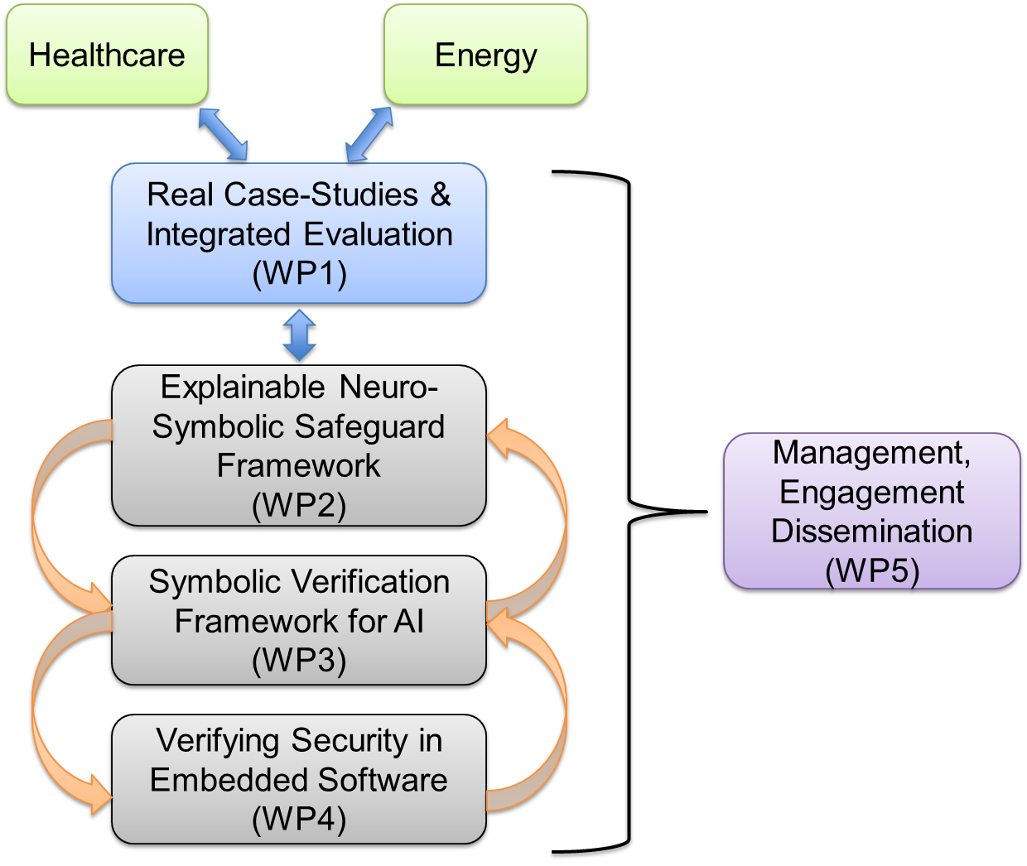
EnnCore Methodology

Slide 13
Explainable Neuro-Symbolic Safeguard Framework (WP2)

Slide 14
Symbolic Verification Framework for AI (WP3)

Slide 15
Verifying Security in Embedded Software running in GPUs (WP4)

Slide 16
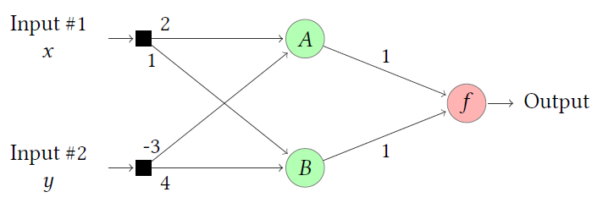


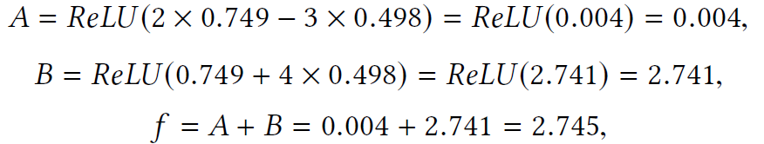

Motivating Example
numerical errors and disagreements between DNN implementations
and their quantized versions [ICML2019]

Slide 17
Verifying Security in Embedded Software running in GPUs
Tackle objectives O2 and O3, which will develop a neuro-symbolic safeguard framework to achieve verifiable AI systems
Address potential failures of DNNs due to bugs in the implementation of the embedded software of the DNNs
generic implementation errors: invalid memory access or division-by-zero, which can cause the implementation of the DNN to crash
failure of the implementation to behave according to the high-level rules, which may cause misclassifications
Extensive experiments to validate the implementations of DNNs for a set of case studies from our industrial partners
Validate the results and compare our approach using other state-of-the- art verification tools

Slide 18
Management, Engagement, and Dissemination (WP5)

Slide 19
Management and Engagement
Organise quarterly project meetings: academic, clinical and industrial partners
Organise annual review meetings with the support of an invited external advisory board in the areas of Secure & Trustworthy AI
These events can be collocated with workshops to be organised by the team
International Workshop on Explainable & Trustworthy AI
International Workshop on Debugging Neural Systems
International Workshop on AI Safety
All software and non-sensitive resources developed during the project will be available on open source/open data terms
Participate in the next four editions of SV-COMP and Test-COMP, which will fall into the duration of the proposed project

Slide 20
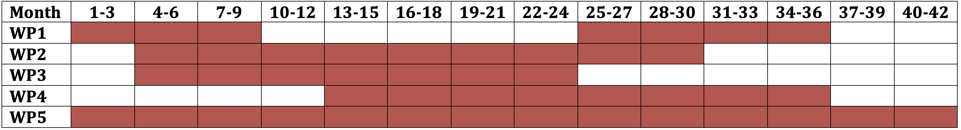
Work Plan
WP1 will have two phases:
Write requirements and use cases with industrial partners
Develop a demonstrator to exhibit our method effectiveness
WP2 will take 24 months
A software tool EnnCore-Exp will be developed
WP3 will take 21 months
A software tool EnnCore-Sym will be developed
WP4 will take 24 months
Integrate EnnCore-Exp and EnnCore-Sym
WP5 will take place for the entire duration of the project

Slide 21
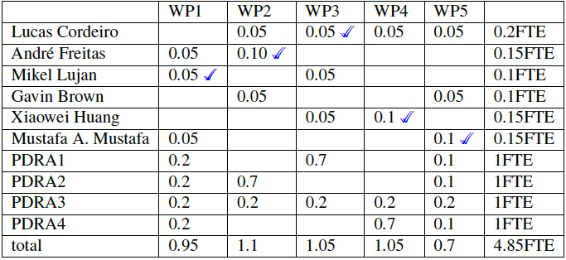
Work Package Assignment
PDRA 1: P. Wang
PDRA 3: J. Sales (TBC)
PDRA 2: S. Mishra
PDRA 4: M. Manino

Slide 22
Dissemination beyond Computer Science
Develop a high visibility publication with the application of the techniques
Educate and enthuse the public by using security and privacy for AI
transformative to the future of computing education in the UK
Considerations on ethical impact
Improve safety and trustworthiness in AI systems
Increase in productivity/automation for high-end cognitive work, impacting existing labor markets
Leverage our existing collaboration with Dstl on the verification of DNNs
Leverage a research group on Digital Trust & Security at UoM

Slide 23
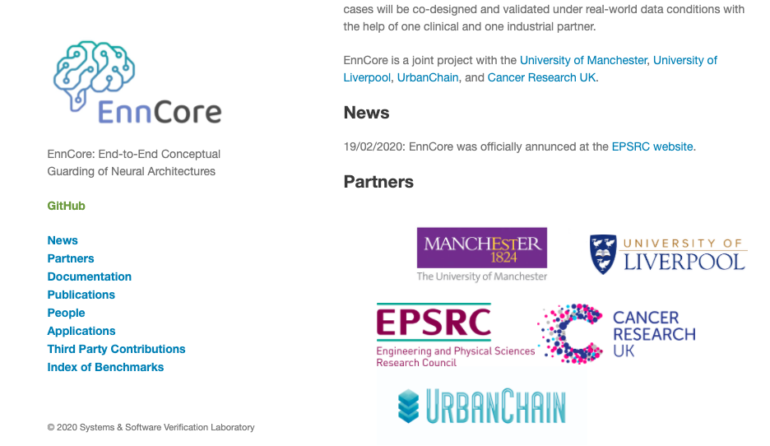
EnnCore Website
https://enncore.github.io/

Slide 24
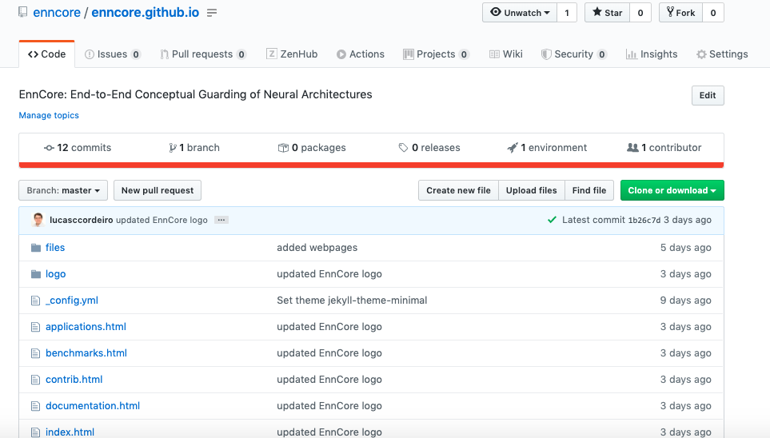
GitHub Repository
https://github.com/enncore/enncore.github.io

Slide 25
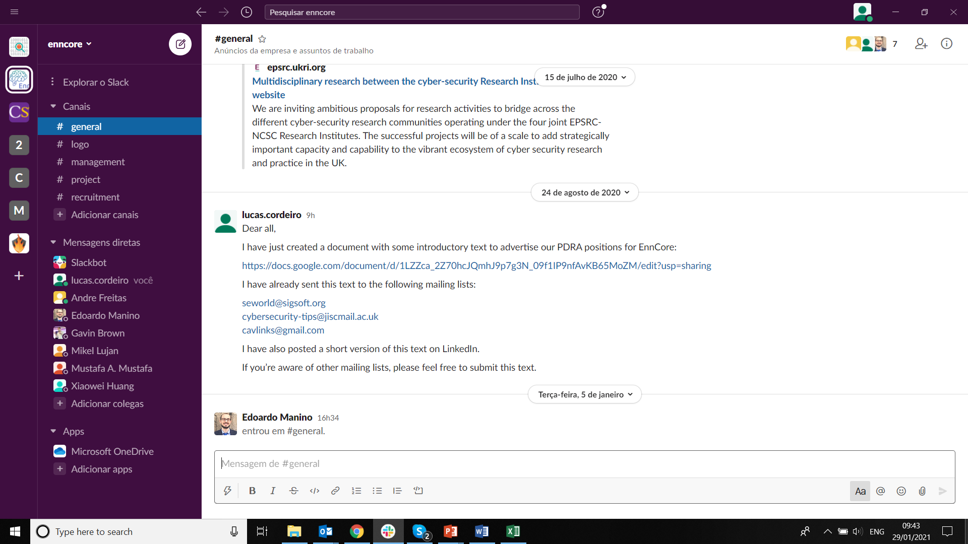
EnnCore Slack
enncore.slack.com

Slide 26
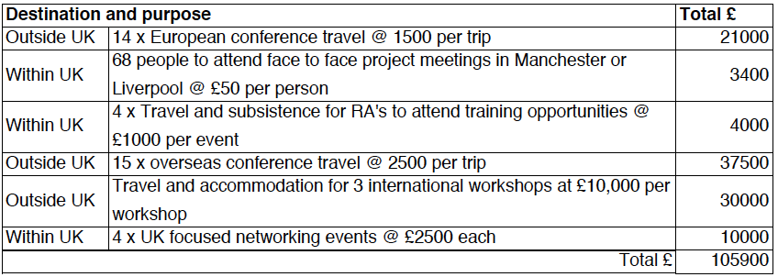
Travel and Subsistence

Slide 27
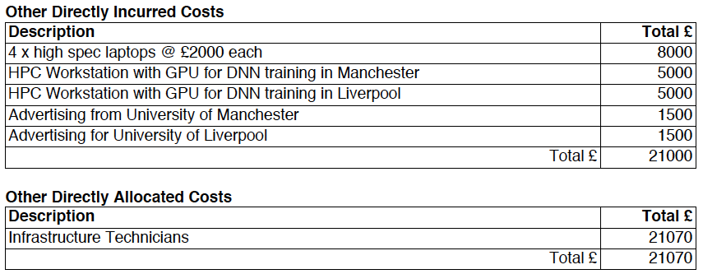
Other Directly Incurred Costs and Allocated Costs

Slide 28
Thank you

