Slide 1
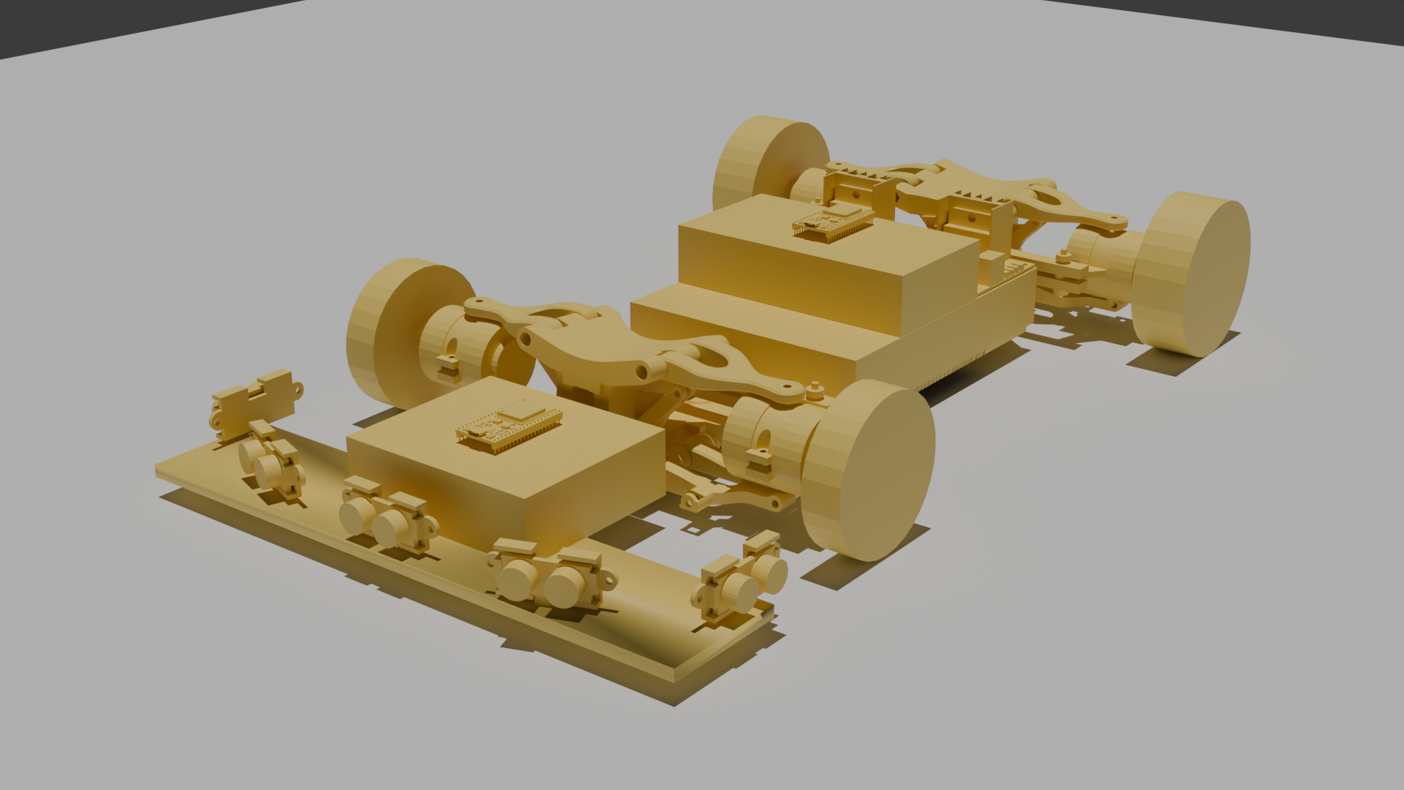
ROBO GRAND PRIX · ELIMINATION ROUND
Project Talos
An autonomous 4WD skid-steer robot that navigates a tunnel-style
track — walls both sides, static obstacles overhead — with zero human control.
Strategy: N.A.M.I. — Navigational Avoidance & Manoeuvrability Interface
TEAM ENIGMA
Nakokutemwa Mapala · Emmanuel Sibuyi · Fanuel Estifanos · Mfundo Motse
github.com/enneji022/Project-Talos

Slide 2
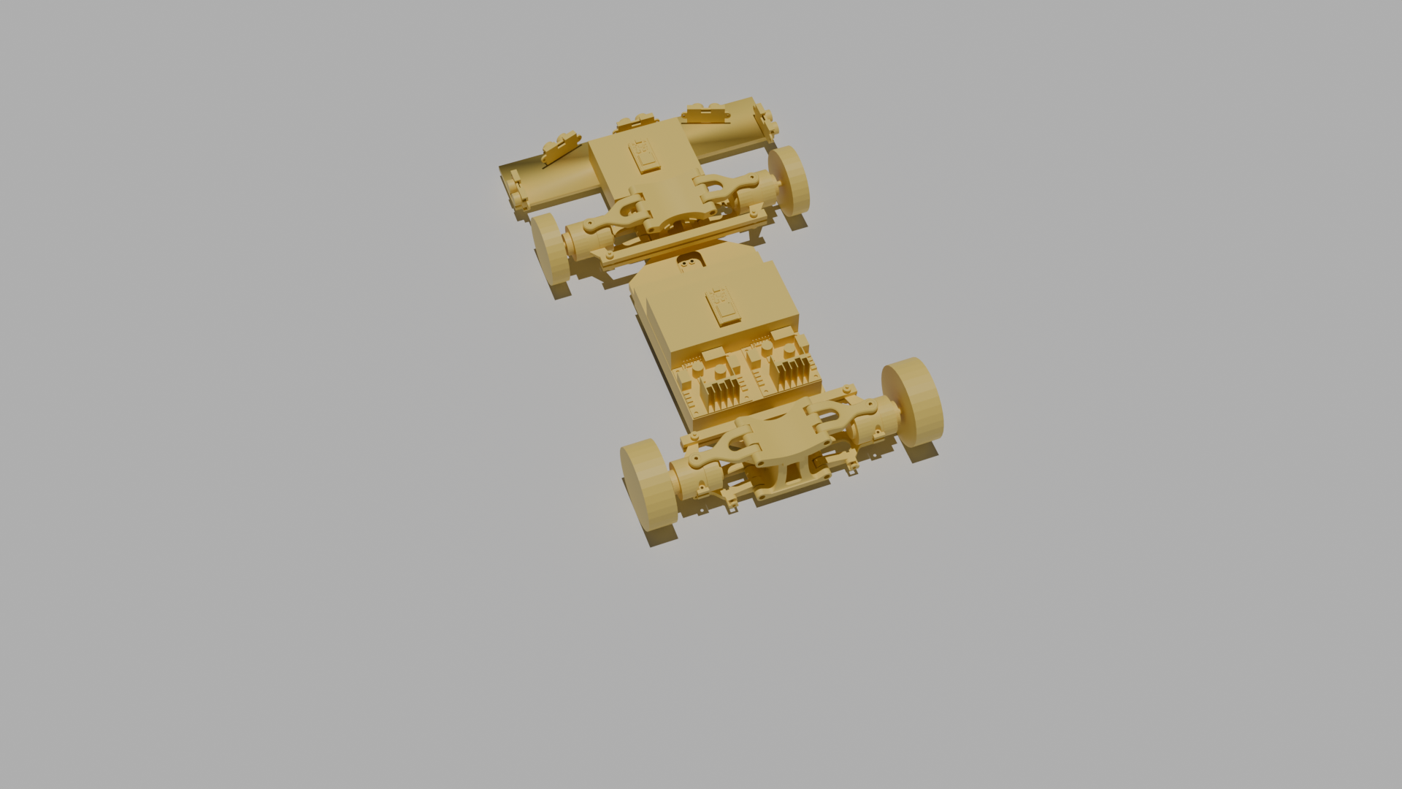
INTRODUCTION & PROBLEM STATEMENT
Fully autonomous navigation, zero margin for human help
1
2
3
Fully autonomous
Tunnel-style track
Hard size & safety limits
No remote control, no Wi-Fi link, no human contact once the run starts — any intervention forfeits the run.
Walls on both sides plus static obstacles overhead, so the robot must judge open space on the fly, not follow a fixed line.
50 × 50 cm footprint, sub-5 kg weight, and a mandatory dual E-Stop (physical + wireless) annotated in the design.
The competition penalty for getting this wrong is total: one human touch and the run is void — so the build has to trust its own sensing completely.
02 / 07

Slide 3
SOLUTION OVERVIEW
N.A.M.I. — the decision loop that gets Talos through the tunnel
1
2
3
4
Cruise
Detect
Decide
Remember
Drives straight at top speed by default while the front sensor array is clear.
→
5 ultrasonic sensors (0°, ±45°, ±90°) flag an obstacle or approaching corner and the robot slows.
→
Compares open space left vs right; steers toward more room, or picks randomly on a tie rather than stalling.
→
IMU heading + wheel-encoder distance track position, forcing the opposite choice if it revisits a spot.
Split across two ESP32 boards: a Sensor board runs all NAMI decision logic; a Motor board only executes drive commands — keeping safety-critical motor control isolated from decision logic.
03 / 07

Slide 4
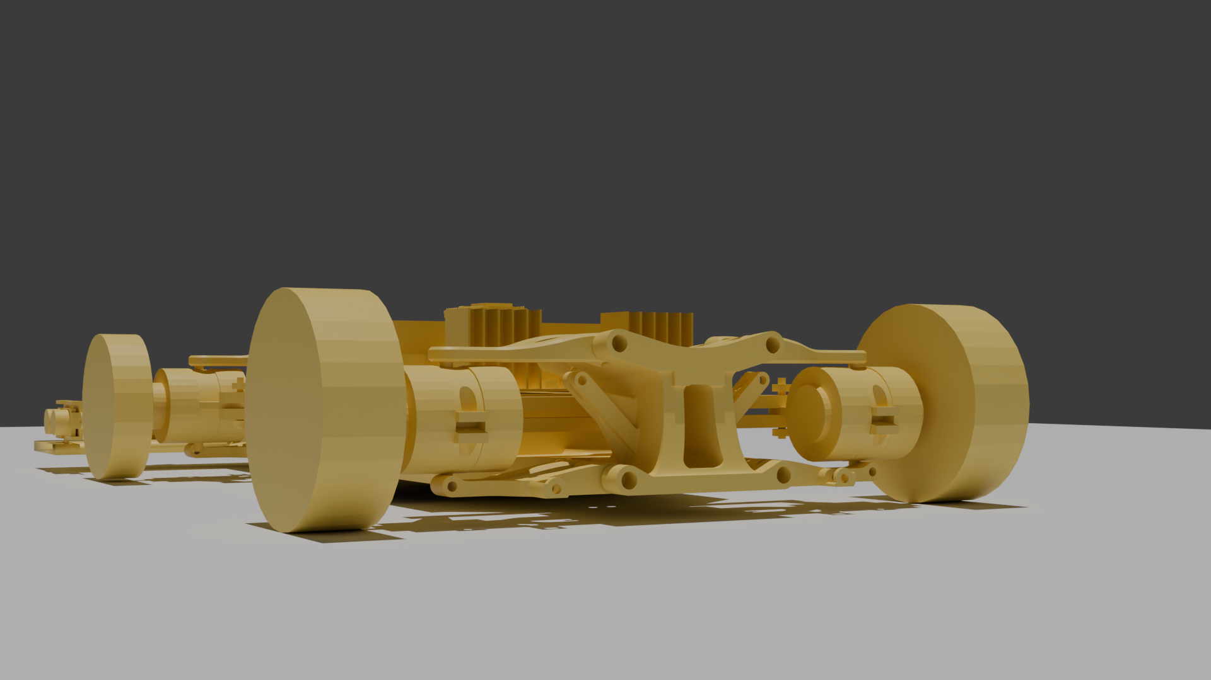
BUILDABILITY & TECHNICAL ARCHITECTURE
Two boards, one job split cleanly in two
CORE HARDWARE
SENSOR BOARD
4WD skid-steer chassis · 4× JGB37-520 geared DC motors w/ encoders
2× L298N motor drivers (one per differential side)
5× HC-SR04 ultrasonic array (front, near-180° coverage)
1–2× IR proximity sensors (backup obstacle detection)
MPU6050 IMU for heading / position tracking
2× ESP32 (sensor board + motor board) linked by UART
Dual E-Stop — physical mushroom switch + RF kill switch — on a shared cutoff relay
Runs all NAMI decision logic — reads the sensor array + IMU, chooses steer direction, and sends drive commands over UART.
Build: 6.8% RAM · 23.8% flash used (PlatformIO, esp32doit-devkit-v1) — zero warnings
MOTOR BOARD
Executes whatever drive command it's sent — keeps safety-critical motor control simple and isolated from decision logic.
Build: 6.7% RAM · 21.3% flash used — version-guarded LEDC macro fixes a real ESP32 3.x/older-toolchain API mismatch
04 / 07

Slide 5
TESTING & VERIFICATION
Proven in simulation before a wheel turns
5
0
2
Ultrasonic sensors
simulated in Wokwi
Compiler warnings
across both boards (Know)
Independent PlatformIO
builds verified
WHAT WAS DEMONSTRATED
HONEST LIMITS
Firmware run in the Wokwi simulator against a 5× ultrasonic + MPU6050 + IR rig
Confirmed CRUISE → DECISION transition when an obstacle enters range, steering toward the side with more space
Tie-break coin-flip & loop-prevention override are code-reviewed against spec, not yet individually triggered in a test run
Board-to-board UART link verified by direct struct byte-matching, not a live combined simulation (no Wokwi part for the TB6612FNG)
05 / 07

Slide 6
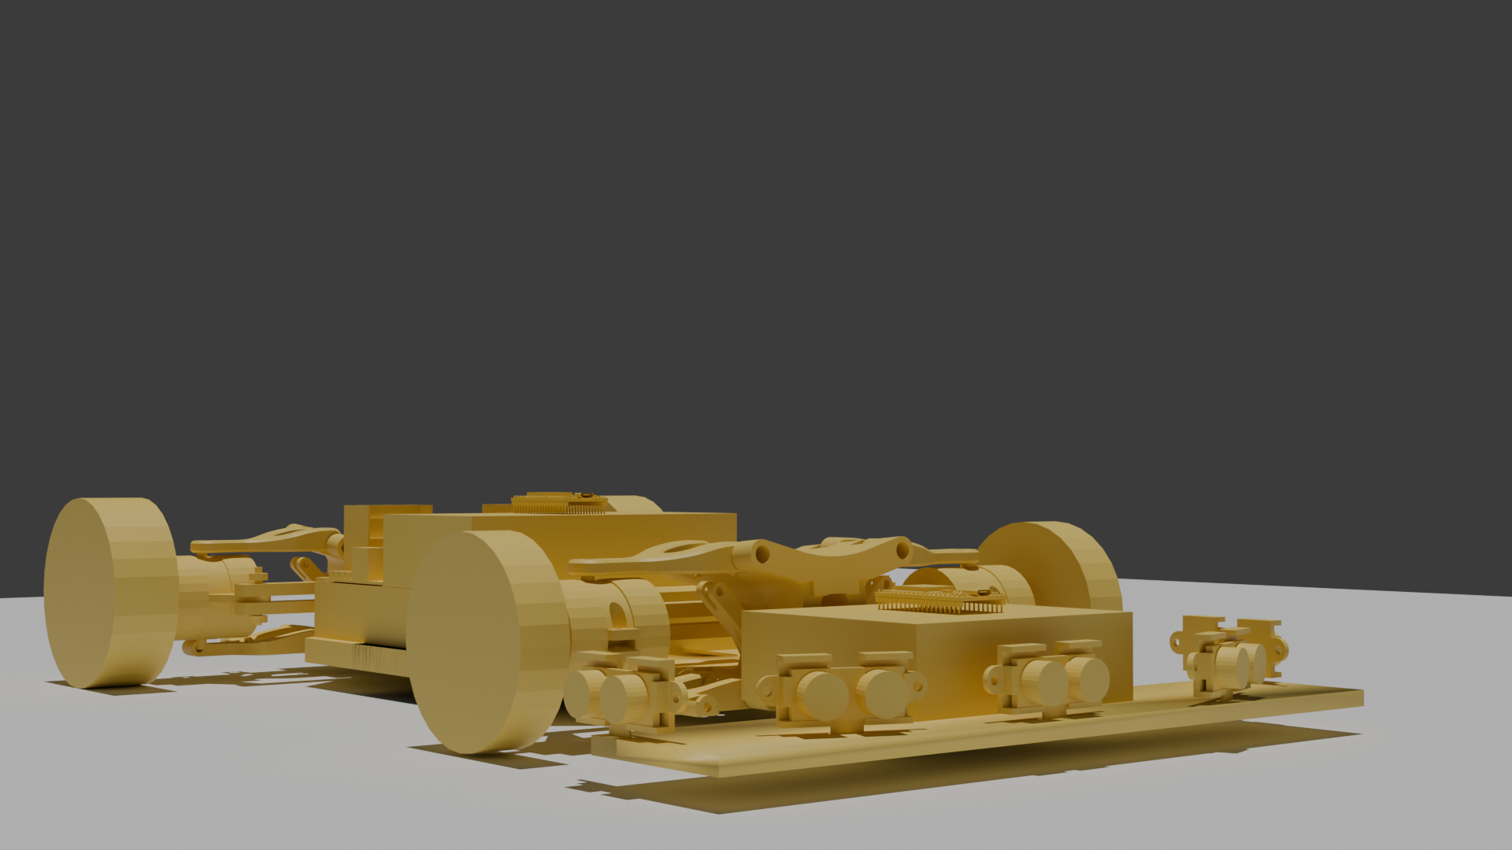
TOTAL COST OF IMPLEMENTATION
Budget-conscious build, full BOM traceability
Category | Item | Qty | Line Total (ZAR)
Compute | ESP32 Dev Board (WROOM-32) | 2 | R 196
Motor Control | L298N Dual H-Bridge Driver | 2 | R 72
Sensing | HC-SR04 Ultrasonic (5) + MPU6050 + IR (2) | 8 | R 360
Drive | 12V Gear Motors + Wheels | 4 + 4 | R 940
Safety | Mushroom E-Stop + RF Kill Switch | 2 | R 362
Power | 12V Battery Packs | 2 | R 560
Misc | Wiring, connectors, mounting hardware | 1 | R 150
TOTAL (ZAR)
R 2,640
~R500 confirmed live on-site · ~R2,140 estimated, to be re-checked in-cart before ordering
Full itemised Bill of Materials — component, qty, unit price, supplier, stock code, direct link — is in Folder C of the repo.
06 / 07

Slide 7
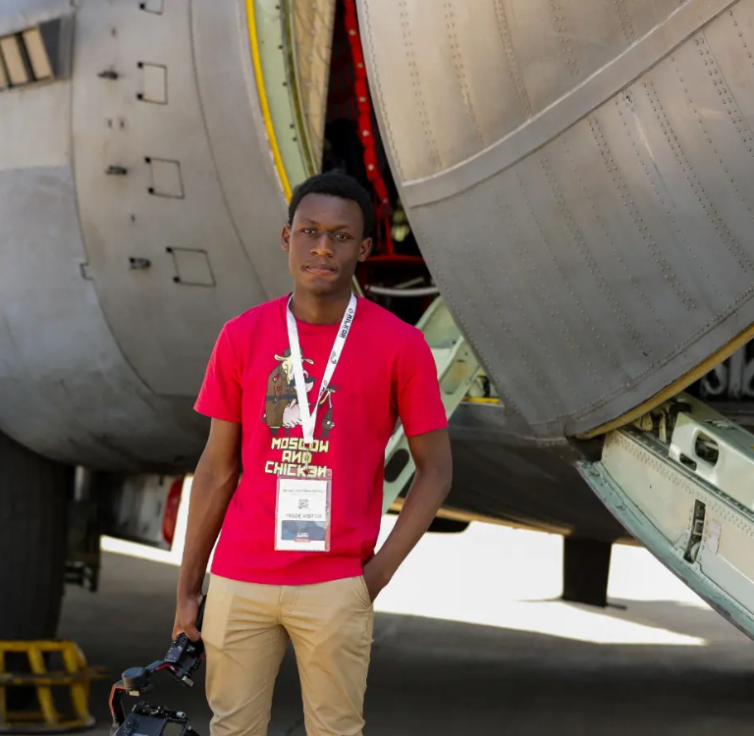
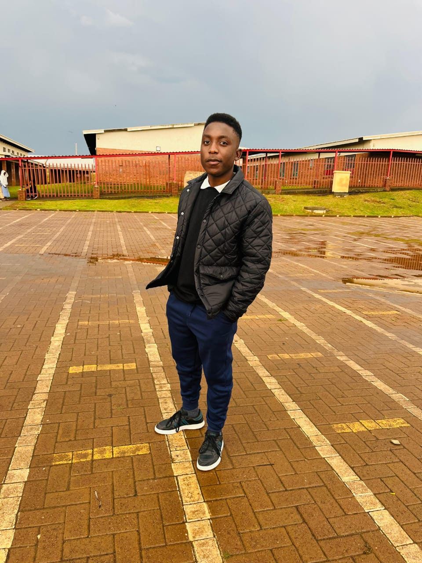
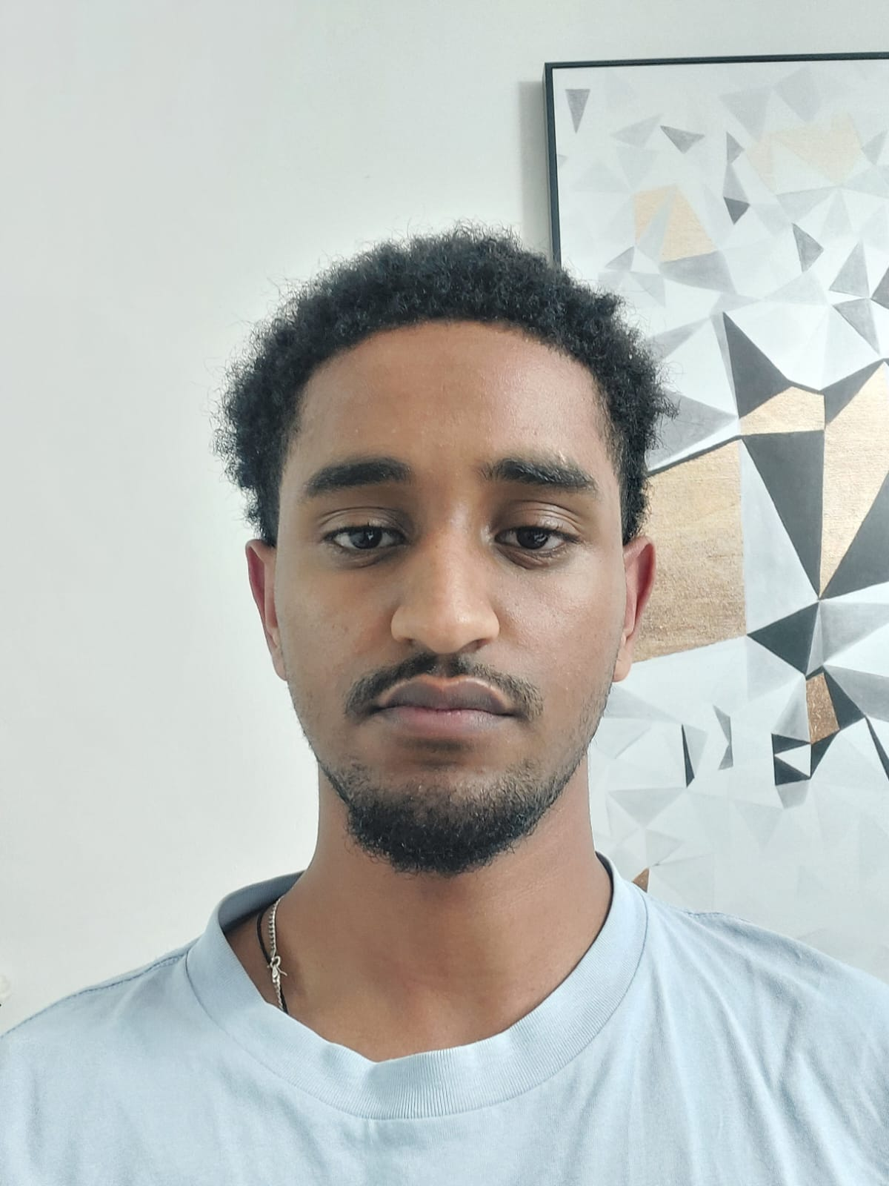

TEAM
Team Enigma
PHOTO
PHOTO
PHOTO
PHOTO
Nakokutemwa Mapala
Emmanuel Sibuyi
Fanuel Estifanos
Mfundo Motse
Lead · Background Research · 3D Modelling · Coding
Engineering
Assistant Researcher · Coding
Diagrams · Slide Deck · Technical Report · Documentation Lead
AlgoAtWork · Robo Rumble — Robo Grand Prix Elimination Round
07 / 07

