Slide 1



TIME SERIES SALES FORECASTING FOR TECOS GROUP OF COMPANIES
Leveraging Data for Business Growth
By Ene Ojaide

Slide 2


INTRODUCTION
PROJECT OVERVIEW:
This project focuses on leveraging time series forecasting models to predict future sales trends and drive data-driven decision-making for Tecos Group of Companies.
OBJECTIVES:
Develop predictive sales models.
Identify seasonal patterns and trends.
Optimize resource planning based on forecasts.
Evaluate model performance to support strategic insights.

Slide 3


BACKGROUND
CONTEXT:
Tecos Group of Companies faces challenges in predicting sales trends, resulting in inventory inefficiencies and missed revenue opportunities. The goal of this project is to provide accurate forecasts that support business growth.
KEY BUSINESS CHALLENGES:
Unpredictable demand fluctuations.
Lack of visibility into regional sales trends.
Inefficient inventory planning and resource allocation.
Achieving predictable revenue growth despite an expanding clientbase.

Slide 4


DATA SOURCES:
Sales transaction data.
Regional and customer segmentation data.
Product category and pricing information.
DATA COLLECTION AND PROCESSING
DATA PREPROCESSING STEPS:
Handling missing values and outliers.
Feature engineering to derive time-based patterns.
Data normalization and transformation for model training.

Slide 5

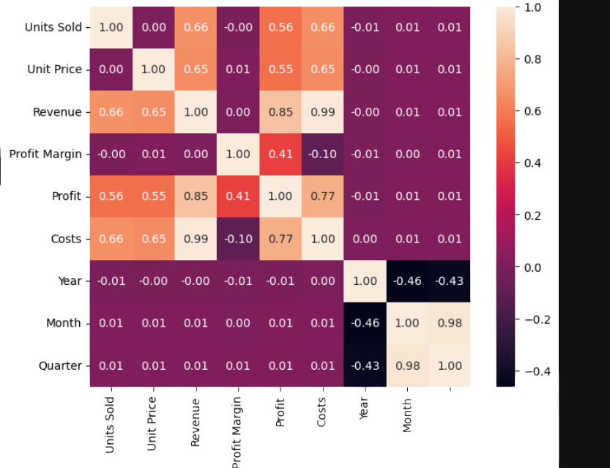
EXPLORATORY DATA ANALYSIS (EDA)
KEY INSIGHTS:
The correlation heatmap reveals strong relationships between revenue, costs, and units sold, highlighting key financial dependencies.

Slide 6
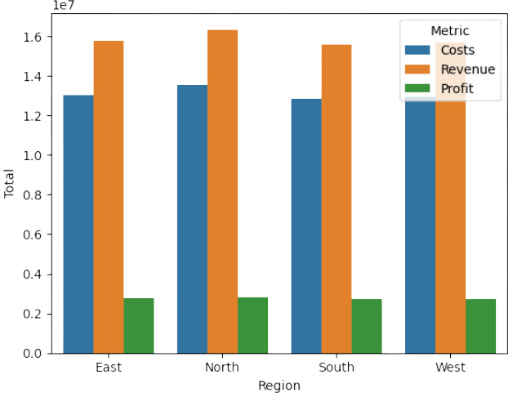
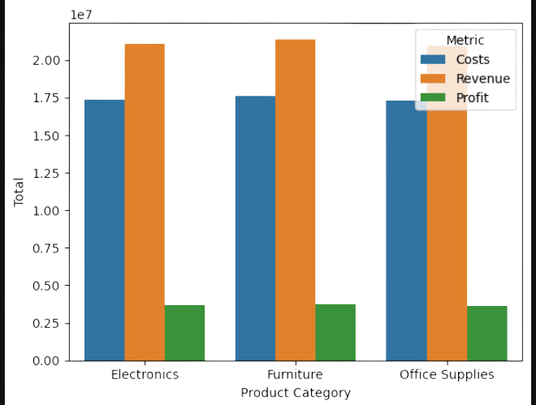
EXPLORATORY DATA ANALYSIS (EDA)
REGIONAL INSIGHTS:
Sales revenue is highest in the North region, followed closely by the East region.
Costs and profits show consistent distribution across regions.
Profit margins vary across product categories, with electronics showing the highest margins.

Slide 7
METHODOLOGY
ANALYTICAL METHODS USED:
ARIMA (AutoRegressive Integrated Moving Average): Captures linear trends and seasonality.
Exponential Smoothing (Holt-Winters): Identifies short-term trends and seasonality.
Facebook Prophet: Effective in capturing trends with custom seasonality.
Long Short-Term Memory (LSTM) Networks: Deep learning-based approach for complex patterns.

Slide 8



RESULTS
MONTHLY FORECASTING:
WEEKLY FORECASTING:
MODEL PERFORMANCE METRICS:
LSTM
Electronics: 15.84% MAPE
Furniture: 13.84% MAPE
Office Supplies: 16.25% MAPE
Exponential Smoothing (ES)
Electronics: 11.28% MAPE
Office Supplies: 11.73% MAPE
Furniture: 15.70% MAPE
Mean Absolute Error (MAE)
Root Mean Squared Error (RMSE)
Mean Absolute Percentage Error (MAPE)

Slide 9

RECOMMENDATIONS
Actionable Insights:
Implement LSTM for short-term planning and inventory adjustments.
Utilize ES Monthly for long-term trend analysis.
Continuously monitor and refine forecasting models.

Slide 10


FUTURE WORK
03
POTENTIAL IMPROVEMENTS:
Integration of external economic factors.
Deployment of models on cloud platforms.
Real-time forecasting and alert systems.

Slide 11
CONCLUSION
Summary:
The project successfully provides valuable insights into sales trends.
Forecasting models will help in optimizing inventory and improving decision-making.
Next Steps:
Implementation of forecast-driven business strategies.
Continuous improvement of models based on feedback.

Slide 12

THANK
YOU

