Slide 1
dashboard_penetrasi
File created on: 2/8/2024 3:12:40 PM

Slide 2
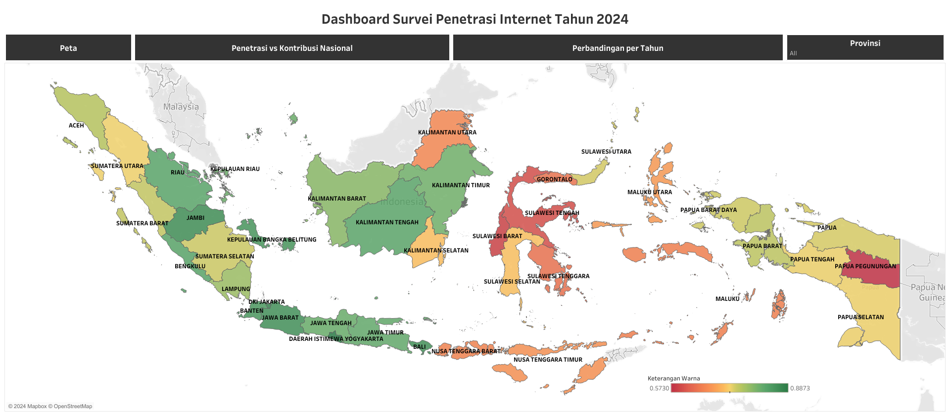

Slide 3
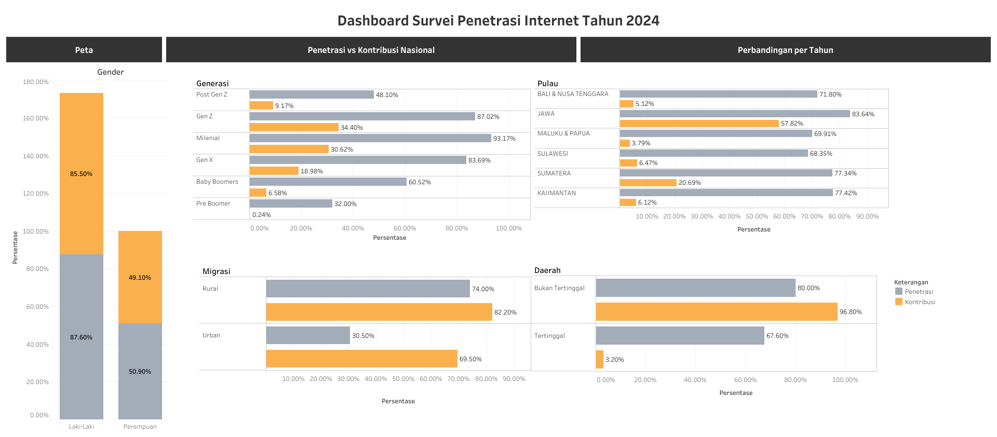

Slide 4
