Slide 1
Fakultät Elektrotechnik und Informationstechnik Institut für Informationstechnik
Professur Schaltkreis- und Systementwurf
ADVANCED RANGE ESTIMATION OF BATTERY ELECTRIC VEHICLES
System Reliability in Electromobility
Professorship of Circuit Design
Faculty of Electrical Engineering and
Information Technology
Editors : Enniyan Thangaraju – 329709
Sabarinathan Balasubramanian - 388573

Slide 2
Overview
Introduction
Task Completed
Slope Based Speed assignment.
Motor Support Control.
Implementation of Task 7 – C.
Simulation and Analysis.
Conclusion

Slide 3
Tasks completed
Calculation of Segment Time, Accumulated Time, Acceleration of both Mountain bike and racing bike and Slope.
Calculation of Vehicle Velocity based on the difference in the slopes and using them to find vehicle velocity at the instant.
The task to cut off the assistive power to the bike when its velocity crosses 25Km/hr is carried out using a comparator in power distribution block.
Exporting results to workspace
(Total Energy used by driver, Motor, Rest capacity of battery, Velocity).

Slide 4
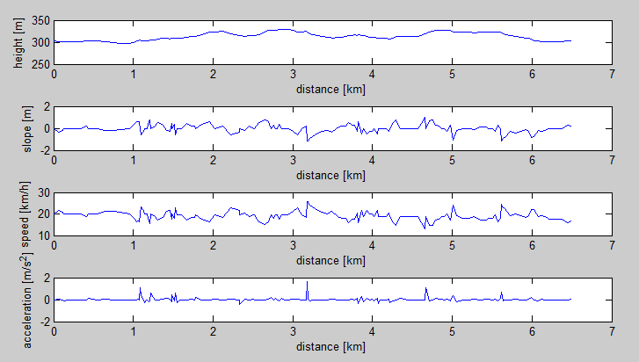
Slope based Speed assignment
Obtained realistic speed with in limits for E-Bikes. Between 15.4and 24.7km/h

Slide 5
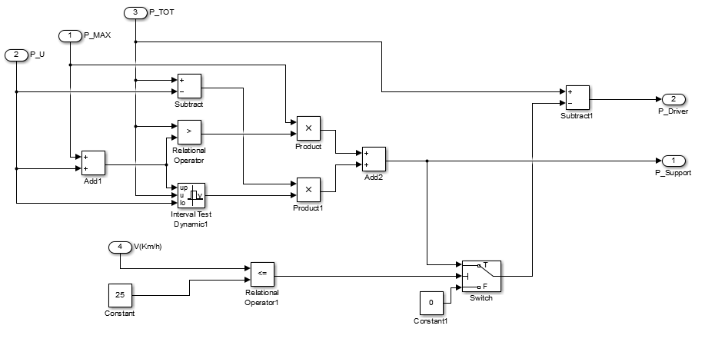
Motor Support Control.
The task is to cut off assistive power to the bike when the bike travels at speed greater then 25Km/hr.

Slide 6
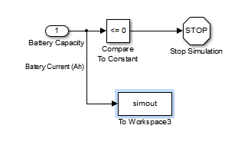
Implementation of Task 7 – C.
Task 7 : Task to terminate the simulation when the battery is completely drained to zero is taken.
By using a simple comparator and comparing the battery capacity to a constant value over a regular intervals of time and stopping the simulation when it reaches its critical state.
A warning message will be provided to user regarding battery state and simulation will be terminated

Slide 7
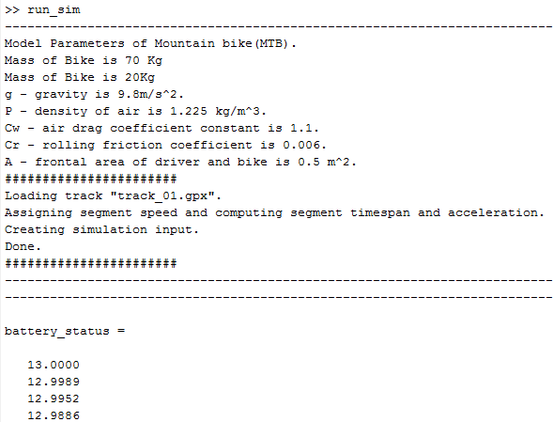
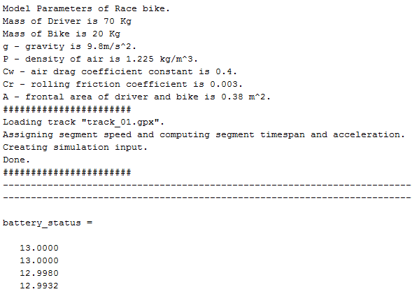
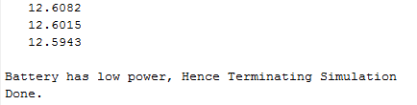
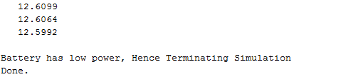
Simulation and Analysis – Full battery drain
.
.
.
.
.
.

Slide 8
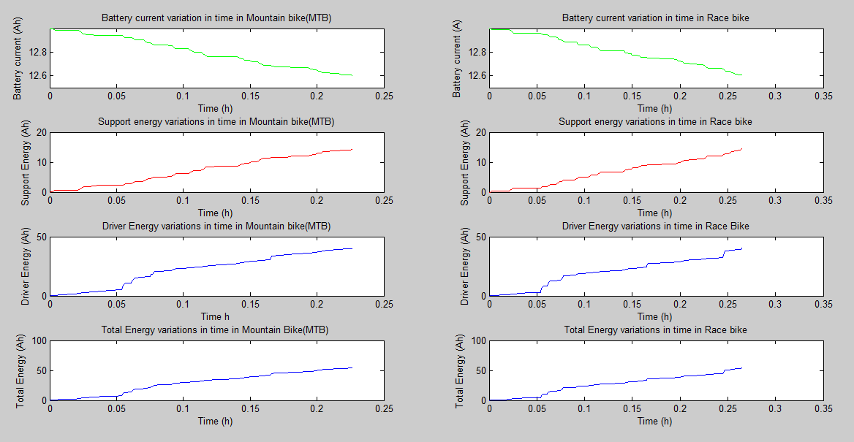
Simulation and Analysis – Full battery drain

Slide 9
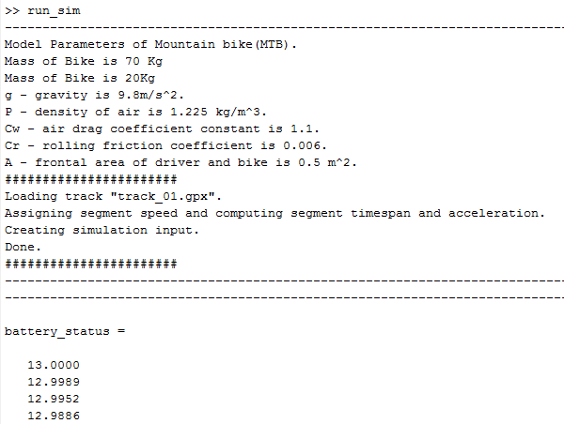



Simulation and Analysis – Without Full battery drain
.
.
.
.
.
.

Slide 10
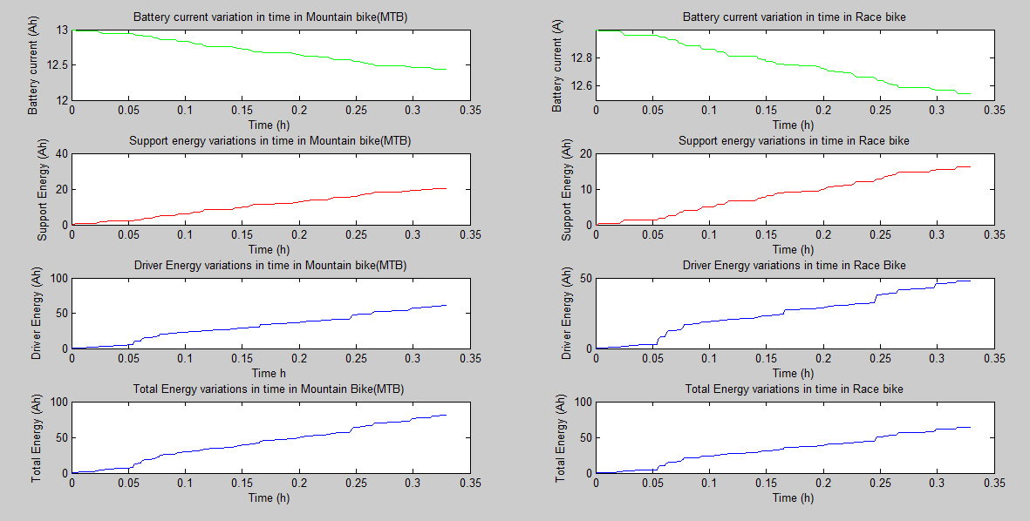
Simulation and Analysis – Without Full battery drain

Slide 11
Conclusion
The prerequisites mentioned in the lab manual are fulfilled and results are analysed.
Task from Section 7 is completed (Battery-Drain notification).
Battery assistance cut off after 25 km/hr is achieved.

Slide 12
THANKYOU !!

Slide 13
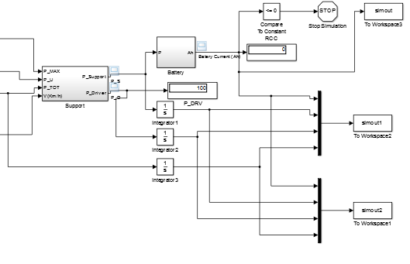
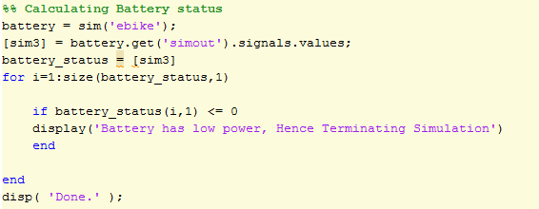
Battery Drain – Simulation Block and Code

