Slide 1
Bookings Data Analysis (2019-2020)
Insights on future strategies to maximize successful deals.
Report of a simple exploratory data analysis conducted to visualize the relationship between close successful rates and specific characteristics of the bookings, providing actionable insights.

Slide 2
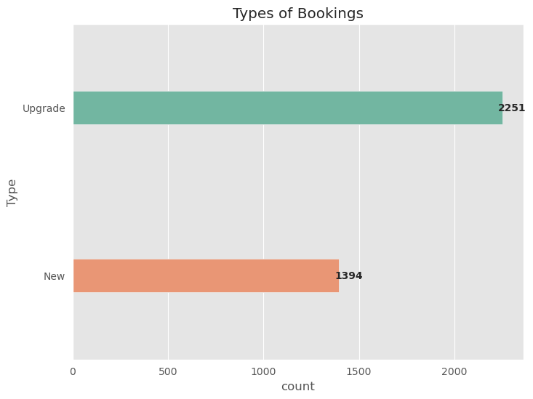
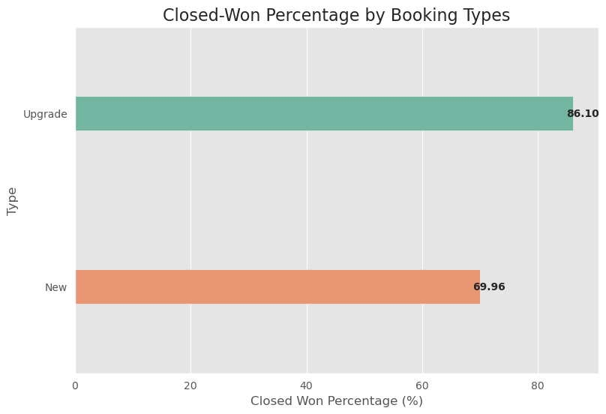
Analysis by types of bookings

Slide 3
Insights:
Overall it is easier to have deals consisting of upgrades. Upgrade deals show higher success rates compared to new bookings, suggesting a focus on upselling existing clients could be more profitable.

Slide 4
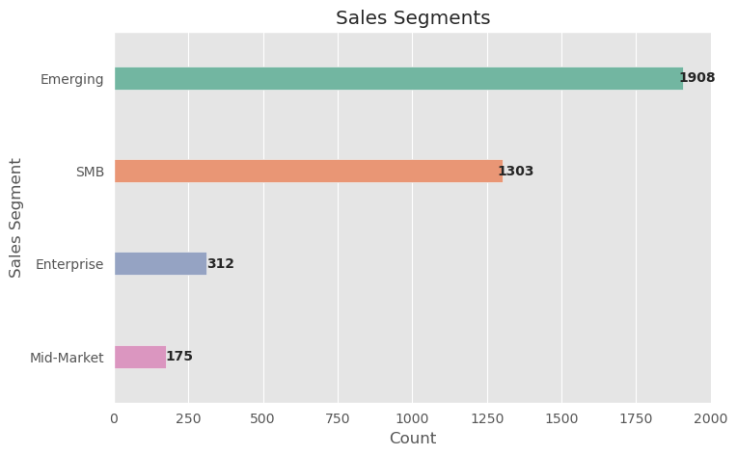
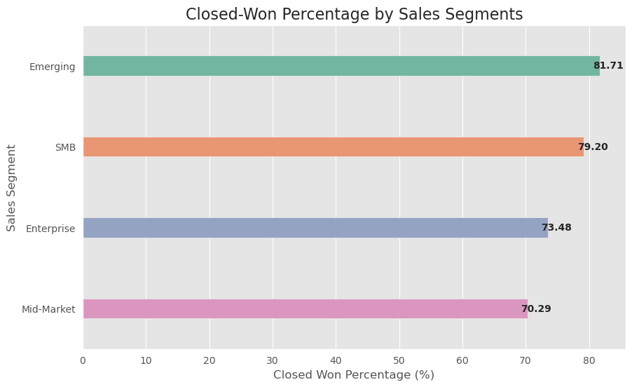
Analysis by sales segments

Slide 5
Insights:
The company demonstrates stronger performance in the small-to-medium and emerging business segments, indicating potential for targeted marketing and sales strategies in these areas.

Slide 6
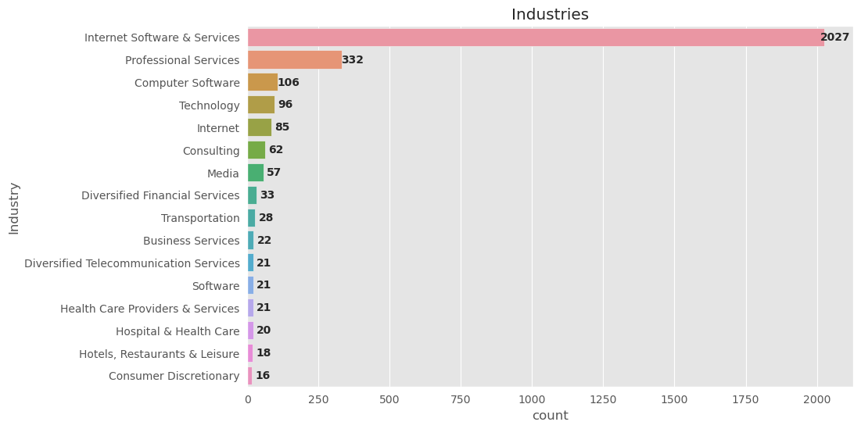
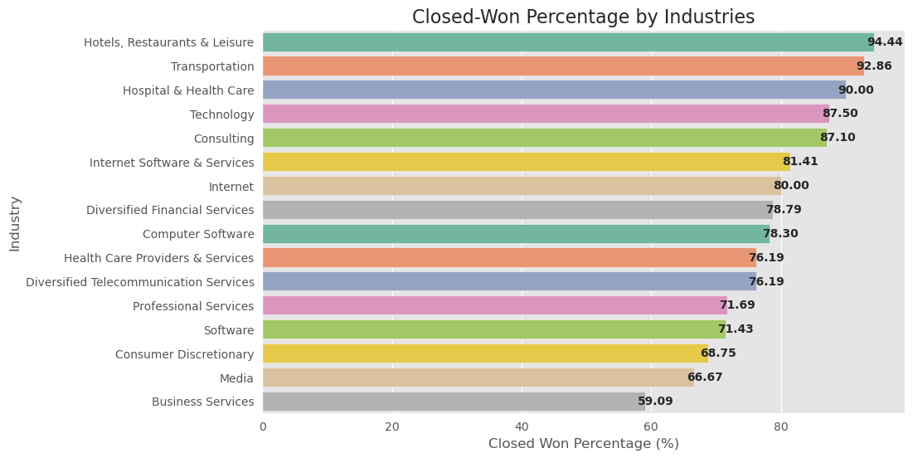
Analysis by Industries

Slide 7
Insights:
Internet & Software Services dominate the client base, potentially signaling a niche expertise. However, diversification into high-success rate industries like Hotels and Transportation could mitigate risk and open new revenue streams.

Slide 8
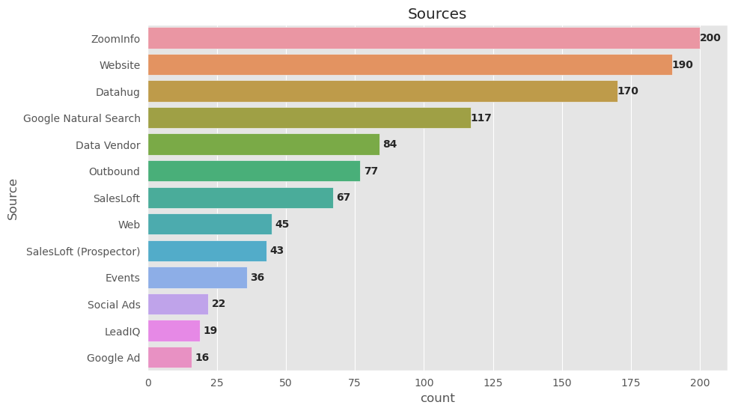
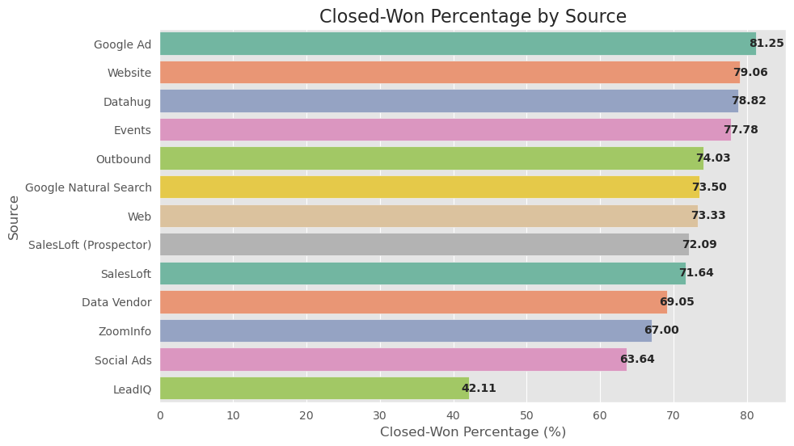
Analysis by lead sources

Slide 9
Insights:
While Zoominfo generates high lead volume, its low conversion rate suggests a need for reassessment. Shifting resources to more effective channels like Events, Google Ads, the company website, and Datahug could improve overall sales efficiency.

Slide 10
Summary
Target and collect more data from high-success rate industries (Hotels, Transportation, Health Care).
Focus more on events, Google Ads, the website and Datahug for advertising.
Be aware that the businesses with highest rate of successful deals are emerging and small-to-medium ones.

Slide 11
Further improvements
Predictive models can be developed to map key variables to success rates, offering deeper insights and helping to mitigate risks.
The analysis can be extended to take into consideration Total ARR, for example by defining new features that contain information about both the targets (ARR + success rate).

