Slide 1
BME590: Medical Device Software Design
Mark L. Palmeri, M.D., Ph.D.
Department of Biomedical Engineering
Pratt School of Engineering
Duke University
2016-08-30

Slide 2
Who am I?
Duke BME/ECE (1996-2000)
Duke BME Grad (2005)
Duke Med (2007) ← don’t do this anymore
Ultrasonic elasticity imaging
Medical instrumentation design
BME 354
BME 464
BME 790

Slide 3
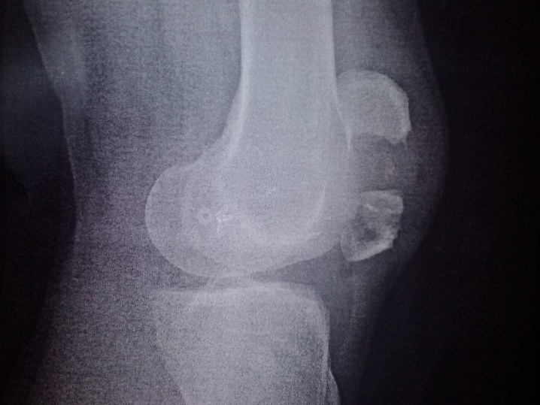

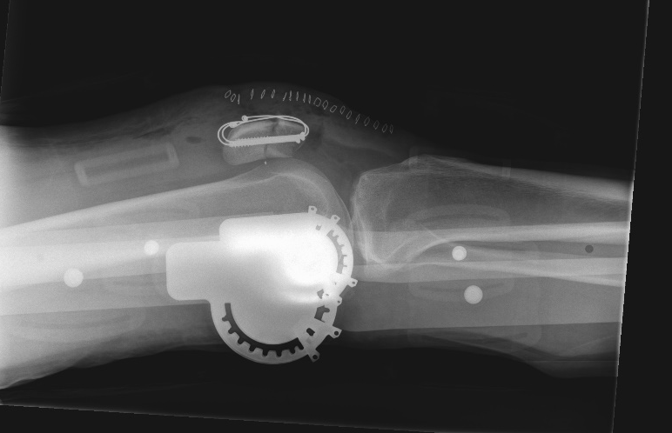
Outside of Duke

Slide 4

Outside of Duke

Slide 5
Who are you?
Name
Ugrad/Grad, Year
Hometown
Field of Study
Longterm Plans
Fun Fact
Why this class for you?

Slide 6
Why this class?

Slide 7
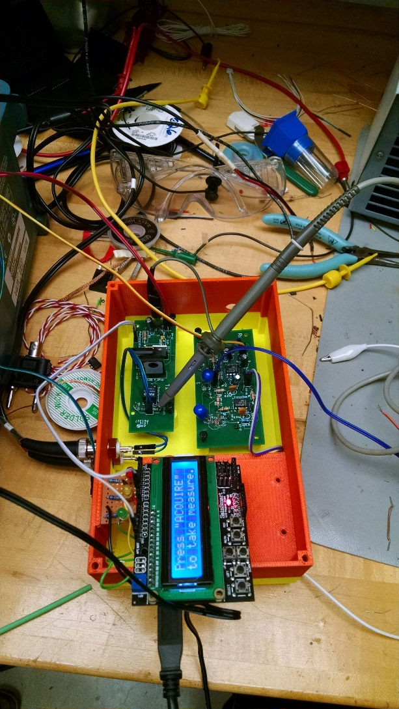
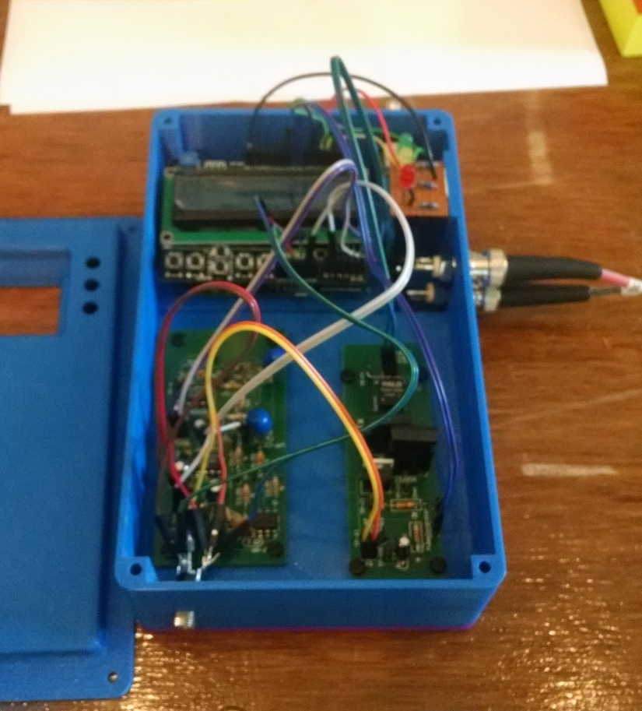
Student Projects
RMT Code
https://www.youtube.com/watch?v=p9GAEFTeWko

Slide 8
Class Poll
Novice/Expert?
Scores
Matlab?
Python?
C/C++?
Git?
Unit testing?
IDE?
1 – what is that?
2 – I can Google search through Stack Overflow to get it done
3 – Minimal web searching needed
4 – I just had an IPO for my startup based on that

Slide 9
Syllabus Review

Slide 10
Code Demo

Slide 11
Assignment #1

Slide 12
ECG & Pulse Plethysmograph Review

