Slide 1
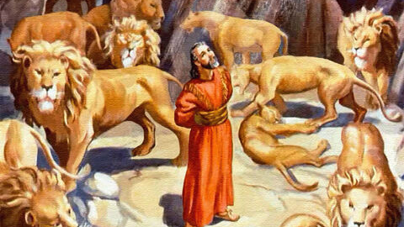
Daniel in the lions den

Slide 2
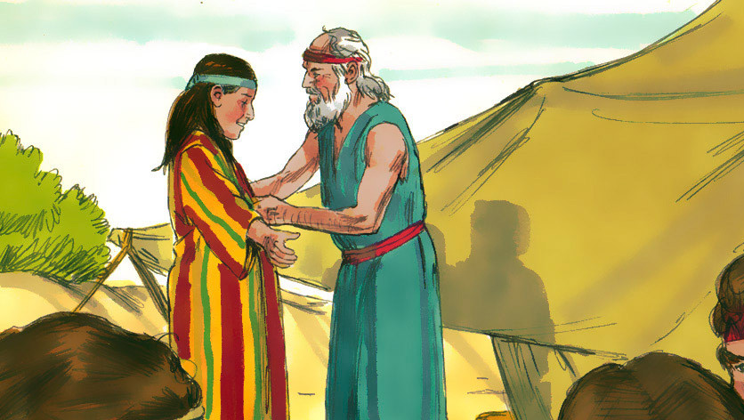
Joseph and the coat of many colours

Slide 3

Jonah and the whale

Slide 4
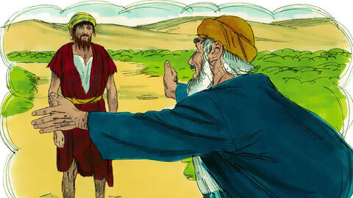
The Prodigal
Son

Slide 5
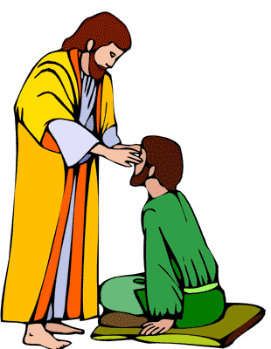
Blind Bartimaeus

Slide 6
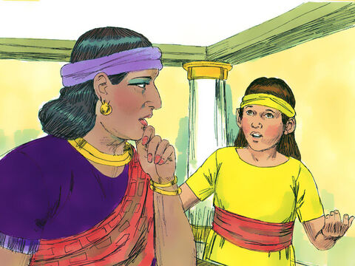
Naaman’s
Servant girl

Slide 7
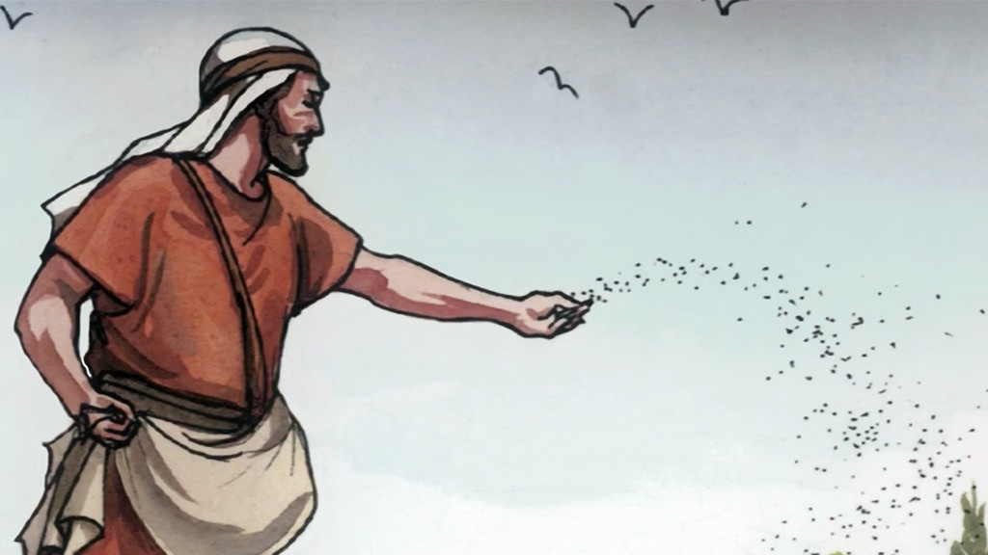
The Sower
and the seed

