Slide 1
{ }
OfficePlane
Agentic Runtime
Run #4,821 | Completed
SUCCESS
The open-source agentic runtime for deterministic document workflows
24
1.1s
42
Actions
Latency
Pages
Prettify -> extract structure 0.2s
Give your AI agents a proper framework to read, write, and transform office files -- with contracts, verification, and rollback built in.
Contract Request -> plan 0.4s
File assembly via LibreOffice 0.3s
Verify output against contract 0.2s
Verification passed | Confidence: 0.97
Open Source
DOCX
XLSX
PPTX
PDF
Plan-Execute-Verify
github.com/enoch3712/AgenticDocs

Slide 2
The Problem
Agents are everywhere. But they still can't reliably edit a spreadsheet.
The agentic AI market is exploding -- yet there's no proper OSS framework for file manipulation.
Traditional MCP Approach
What Agents Actually Need
Dozens of individual tool calls per document edit
No atomicity -- partial failures leave corrupted files
No verification -- agents can't confirm what they built
No rollback -- mistakes are permanent
Chaotic call graphs that are impossible to debug
Declare intent, not individual steps
Atomic execution -- all or nothing
Built-in verification with confidence scores
Transaction rollback on failure
Deterministic, auditable action contracts

Slide 3
Market Opportunity
Every AI agent needs to manipulate files. No one has built the infrastructure layer -- until now.
82%
$28B+
10x
0
of enterprise data lives in office documents (Gartner)
Agentic AI market by 2028 (Markets & Markets)
Growth in AI agent frameworks in the last 12 months
Open-source runtimes purpose-built for agentic file manipulation
The gap: Agents can call APIs, search the web, write code -- but editing a Word doc or Excel sheet? That's still broken. OfficePlane fills this gap as the first open-source agentic runtime purpose-built for deterministic document workflows.

Slide 4
Introducing
OfficePlane: the agentic runtime for deterministic document workflows
An open-source framework that gives AI agents reliable, verified control over office documents. Plan. Contract. Apply. Verify. Every time.
Prettify
Contract Request
Document Harness
Automatic structure detection
Plan-build-verify in one pass
Orchestrate long- running workflows
Point at any file. Get a clean, machine-readable representation of chapters, sections, pages, and metadata.
Agent declares intent. OfficePlane plans, executes atomically, and verifies the output against the contract.
Context management, parallel execution, checkpointing, and rollback. Plugs into any agent framework.

Slide 5
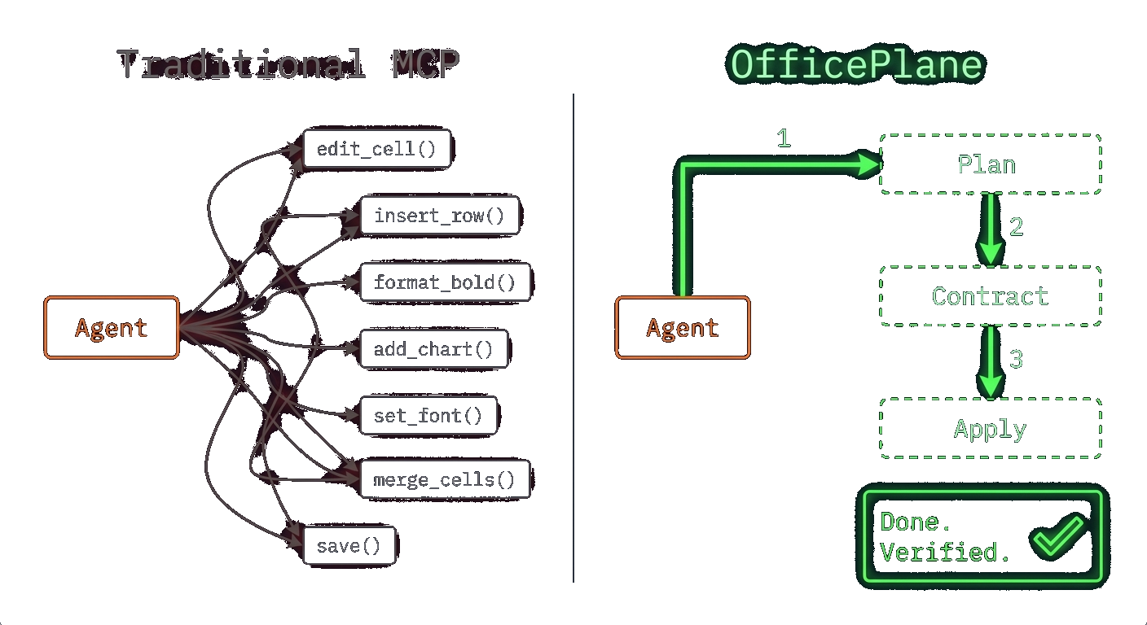
How It Works
The Contract Model: from chaos to determinism
Traditional MCP: N chaotic tool calls
edit_cell(), insert_row(), format_bold(), add_chart(), set_font(), merge_cells(), save()... hope it works.
OfficePlane: 3 deterministic steps
1
Plan
Agent declares intent and schema
2
Contract
Rules, validation, expected output locked in
3
Apply
OfficePlane builds, verifies, delivers

Slide 6
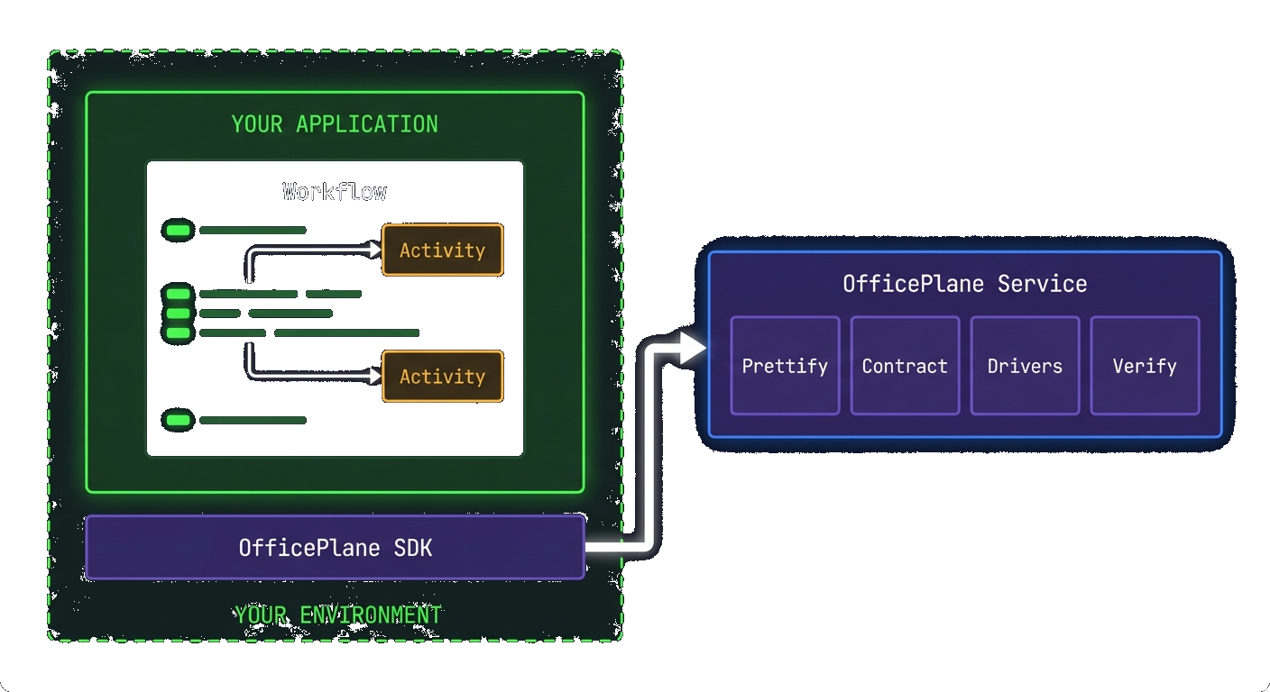
Feature Deep-Dive
Prettify: automatic document structure detection
Point OfficePlane at any DOCX, PPTX, XLSX, or PDF. Prettify extracts the full document structure into a clean, machine-readable representation.
Vision-powered extraction for complex layouts (Gemini API)
Detects chapters, sections, pages, metadata automatically
Works across all supported document formats
Returns structured JSON your agent can reason about
doc = await plane.prettify("report.docx") print(doc.chapters) # 8 chapters print(doc.sections) # 23 sections print(doc.pages) # 42 pages

Slide 7
Document Harness
Like an agent harness, but for documents. For your agentic flow.
Read, prettify, plan, build, verify. All in one deterministic loop with checkpointing, parallel execution, and contract validation.
OfficePlane Harness -- Q4 Board Deck Pipeline
Context Management
> /prettify-and-build is running... Read(Q4-board-deck.docx) -> Read 42 pages, 8 chapters detected Prettify() -> Extracted 8 chapters, 23 sections, 156 elements ContractRequest(exec_summary) -> Plan generated: 3 deliverables, 12 actions Launching parallel document tasks... -> Build executive summary (max 2 pages) -> Extract KPI tables from chapters 3-5 -> Assemble final deck via LibreOffice driver
Manages state across long-running document workflows
Parallel Execution
Multiple document tasks run concurrently with progress tracking
Atomic Rollback
Never leave documents in a half-edited state
Framework Agnostic
Plugs into Claude, LangChain, CrewAI, or any custom setup

Slide 8
SheetTools
Excel manipulation for agents. Plan-Execute-Rollback built in.
SpreadsheetEditor
Open, edit, save XLSX files. Pure Python -- no openpyxl dependency. Direct OOXML manipulation.
Transaction Support
Dependency-free XLSX editing with transactions, structured results, and full rollback support.
with editor.transaction() as tx: Automatic rollback on exception. Deep-copy backup & restore.
SheetReader
sheettools_example.py
list_sheets(), get_row(), get_column() get_used_range(), get_sheet_summary()
from officeplane.sheettools import ( SpreadsheetEditor, SpreadsheetPlan, PlanExecutor ) with SpreadsheetEditor("sales.xlsx") as editor: plan = SpreadsheetPlan("Q4 Sales Report") plan.add_sheet("Data") plan.create_table( "Data", "A1", headers=["Month", "Revenue", "Growth"], rows=[["Oct", 42000, "12%"], ["Nov", 48000, "14%"], ["Dec", 55000, "15%"]] ) executor = PlanExecutor(editor) result = executor.execute(plan) # Atomic! Rolls back on any failure.
CellModifier
set_values(), set_formula(), clear_values(), replace_in_sheet()
TableBuilder
create_table() with headers & rows. add_totals_row() with SUM formulas.
PlanExecutor
Validate -> Execute -> Verify. Dry-run mode. Step callbacks. Full result tracking per step.

Slide 9
Architecture
Modular, extensible, production-ready
DocTools
SheetTools
Ingestion
Drivers
Word/DOCX editing with transactions
Excel/XLSX editing with plan-execute
Vision-powered structure extraction
LibreOffice | Rust Mock | Custom
Planning
Management
Memory/RAG
Observability
LLM-based action graph generation
Instances, tasks queue, orchestration
Vector store embeddings, search
Logging, metrics Prometheus, traces
FastAPI
PostgreSQL + pgvector
Next.js Dashboard
Docker
REST + WebSocket Real-time updates
Documents, vectors Prisma ORM
Management UI Task monitoring
One-command deploy All-in-one container

Slide 10
Developer Experience
One intent. Full lifecycle. Zero guesswork.
example.py
Declare intent, not steps
from officeplane import OfficePlane # Initialize with a driver plane = OfficePlane(driver="libreoffice") # Prettify: extract document structure doc = await plane.prettify("report.docx") print(doc.chapters, doc.sections) # Contract Request: agent defines the plan contract = plane.contract_request( schema="exec_summary", source=doc, rules=["max 2 pages", "include KPIs"] ) # OfficePlane builds the file result = await plane.execute(contract) print(f"Confidence: {result.confidence}") # Confidence: 0.97
Let the runtime figure out the action graph. You say what, OfficePlane says how.
Atomic execution with rollback
Never leave documents in a half-edited state. Every operation is all-or-nothing.
Built-in verification
Confidence scoring and outcome validation included. Know what you got.
Result types, not exceptions
Ok/Err pattern throughout. Structured error codes. No surprises.

Slide 11
Open-Source Strategy
Open-source core. Commercial execution.
Self-host free forever. The moat is deterministic edit contracts + fidelity verification, not file storage.
Open Source (Permissive License)
Commercial (Managed + Enterprise)
Edit Program IR spec + validators + compiler
Deterministic execution engine (runs, events, retries)
Driver interfaces + reference drivers (DOCX, XLSX)
Verification toolkit (render + visual diff + structural checks)
SDKs + CLI + local docker-compose runner
SheetTools, DocTools, Ingestion pipeline
Hosted runtime: scalable render farm, queues, observability
Enterprise: SSO/SAML, SCIM, RBAC, approval workflows
Policy packs, private networking, SLAs
Commercial drivers: high-fidelity rendering engines
Specialized verifiers, regulated connectors
Volume discounts, dedicated infrastructure

Slide 12
Enterprise Integration
Works alongside your existing ECM. No rip-and-replace required.
OfficePlane runs as a sidecar to Alfresco, SharePoint, or any document management system. Customers keep their governance. You add deterministic agent capabilities.
ECM -- System of Record
OfficePlane -- System of Change + Proof
Stores canonical documents and versions
Permissions / RBAC and access control
Metadata, folders, lifecycle management
Audit logs (repository events)
Integration surface (REST / CMIS)
Executes Plan -> Contract -> Apply -> Verify runs
Policy-aware contracts (what may be edited)
IR compiler + deterministic drivers (DOCX/XLSX/PDF)
Run ledger: immutable event history + provenance
Verification bundle: visual diff + structural checks

Slide 13
Pricing
Self-host free forever. Managed service starts at $0.
Free
Developer
Scaler
Pro
$0
$9 /month
$49 /month
$199 /month
1,000 Actions
25,000 Actions
200,000 Actions
1,000,000 Actions
500 Prettify pages
10,000 Prettify pages
100,000 Prettify pages
500,000 Prettify pages
50 Contract Requests
1,000 Contract Requests
10,000 Contract Requests
100,000 Contract Requests
1 GB Storage
10 GB Storage
50 GB Storage
200 GB Storage
LibreOffice driver
All drivers
All drivers
All + custom drivers
Community support
Email support
Priority support
Dedicated support
Enterprise: Volume discounts, SSO, dedicated infra, custom drivers, SLA
Talk to us ->

Slide 14
Ready to build the future of document automation?
Join the community building the agentic runtime for office workflows. Star the repo, contribute drivers, and shape the future of agentic document workflows.
Star on GitHub
Read Documentation
github.com/enoch3712/AgenticDocs
Get early access to the Scale tier
Join the waitlist for hosted agentic runs with audit logs, team features, and premium support. Early access includes $200 in free agentic actions.

