Slide 1
Layer-refined Graph Convolutional Networks for Recommendation
Xin Zhou (Nanyang Technological University, xin.zhou@ntu.edu.sg)
Donghui Lin (Okayama University)
Yong Liu (Nanyang Technological University)
Chunyan Miao (Nanyang Technological University)

Slide 2
Outlines
Introduction
Research Issues
The Proposed LayerGCN
Degree-sensitive Edge Pruning
Layer-refinement
Experimental Results
Conclusion
Notes:
First, I will introduce the background of Recommender Systems.
Following that, I will state the research issues of this paper.
To address the issues, we proposed LayerGCN, which includes two modules: Degree…. And Layer-refinement.
Then, we report the experimental results compared with serval baselines.
Finally, we round off this report with conclusion.
Okay, buckle up, let’s get started with two questions.

Slide 3

Introduction
Do you have experience with Online Shopping?
Yes, for most people.
Do you know how your shopping behavior would shape the Recommender System?
Yes/No?
Notes:
The first is that: Do … ?
With the popularity of e-commerce platforms, such as Amazon, ebay, Taobao. Most people choose online shopping, because it is convenient. And especially during the COVID-19 period.
Please allow me to confirm that Is there anyone here who NEVER buy products online?
Please raise you hand~?
Ok, great. But do you know ….?

Slide 4


Online Shopping
Type-C Cable
A typical shopping process:
Search
Click
Purchase
Add to Cart
Interactions
Fig 1. Online shopping process.
Notes:
Here is a typical online shopping process:
Users search product, and click one of the candidates, add it into Cart and make payment.
Recommender Systems usually log your behaviors, such as the click, payment, which we termed as interactions.

Slide 5
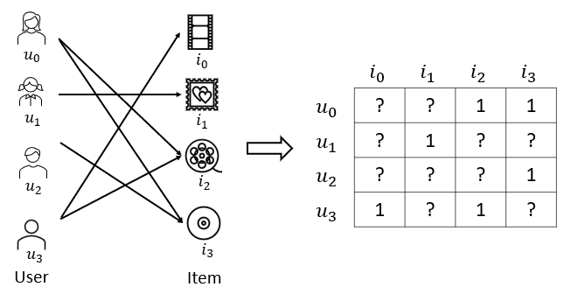
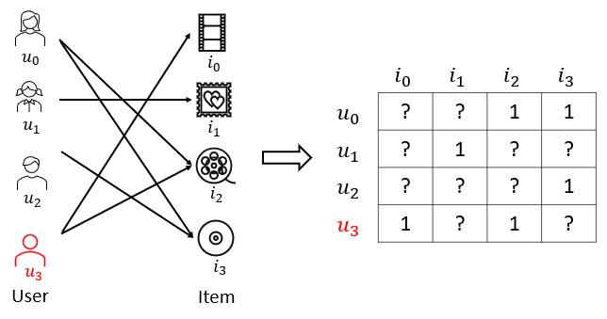
Recommender Systems (RSs)
Implicit feedback
RSs transform your interactions / ratings into implicit feedbacks
User-Item bipartite graph/Interaction matrix
General models perform recommendations solely based on implicit feedbacks.
Fig 2. From implicit feedback to interaction matrix.
Notes:
RS transform …, because your feedback is not visible for others.
And we can treat the feedbacks into a user-item …
General …
For recommendation task, given the observed interactions, RS are used to inference which item will be interest for this user, for example, user 3.

Slide 6
Outlines
Introduction
Research Issues
The Proposed LayerGCN
Degree-sensitive Edge Pruning
Layer-refinement
Experimental Results
Conclusion
Notes:
You are getting familiar with the research problem of RS, let us move to the research issues.

Slide 7
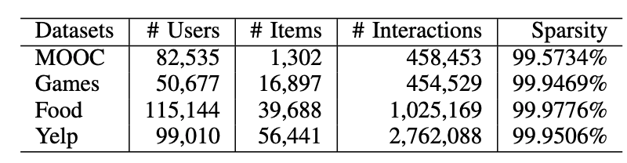
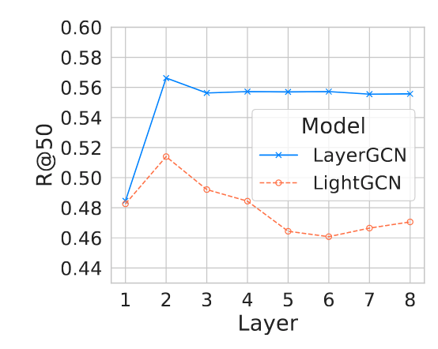
Research Issues
Data Sparsity
Graph neural networks (GNN)-based recommendation models[1][2].
Over-smoothing in Graph-based models
Best performance is achieved with a few layers
Fig 3. Over-smoothing of LightGCN[2] w.r.t. the MOOC dataset.
Notes:
The first issue is the data sparsity.
Most users have a few interactions observed in the platforms/datasets.
That is why GNN-based … to capture the high-order interactions between u-i.
The second issue is the over-smoothing …
The best …, after that, it begin to decline.

Slide 8
Research Issues
Noise in user-item interactions [3]
Existing models usually assume the implicit feedback can be treated as ground truth of the user’s taste and failed to tackle this problem.
Notes:
The last issue is that there is noise in user-item interactions.
And existing …

Slide 9
Outlines
Introduction
Research Issues
The Proposed LayerGCN
Degree-sensitive Edge Pruning
Layer-refinement
Experimental Results
Conclusion
Notes:
To address the issues, we propose LayerGCN.
With degress-sensitive … to address the noise in interactions.
And layer-refinement to address the over-smoothing in GNN.

Slide 10
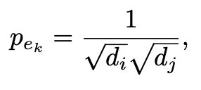
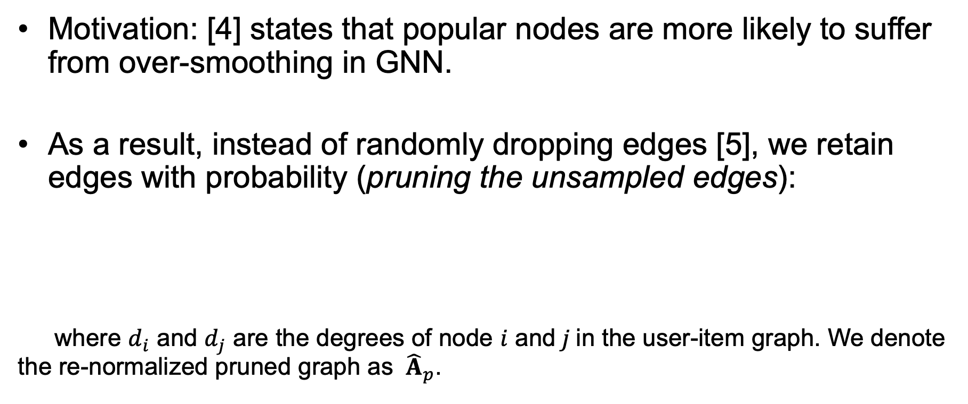
Degree-sensitive Edge Pruning
Motivation: [4] states that popular nodes are more likely to suffer from over-smoothing in GNN.
As a result, instead of randomly dropping edges [5], we retain edges with probability (pruning the unsampled edges):
where $d_{i}$ and $d_{j}$ are the degrees of node $i$ and$j$in the user-item graph. We denote the re-normalized pruned graph as ${\hat{A}}_{p}$.
Notes:
The motivation we design degree sensitive edge pruning is that:

Slide 11
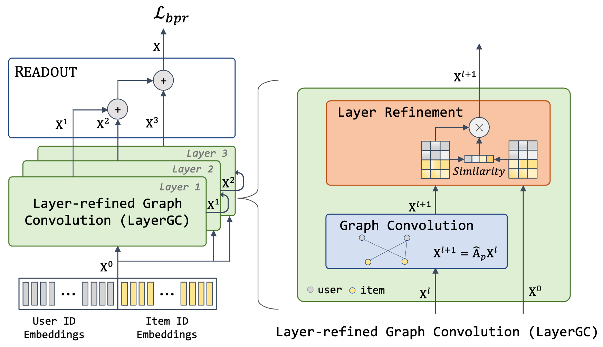
LayerGCN
Fig 4. Overall framework.
Notes:
After we obtain the pruned user-item graph, we perform information propagation/aggregation on this graph.
Fig.4 shows the overall framework of our model.
We use the ego layer to refine the hidden layers in GCN before its propagation to the next layer.

Slide 12
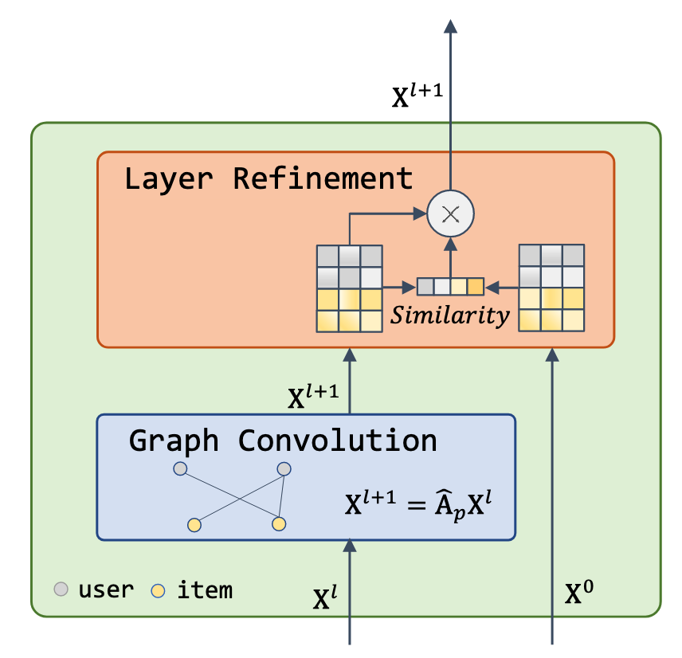
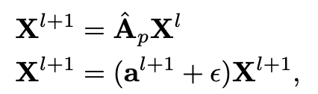

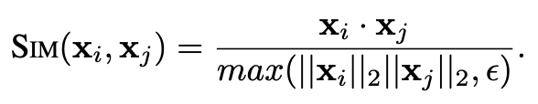
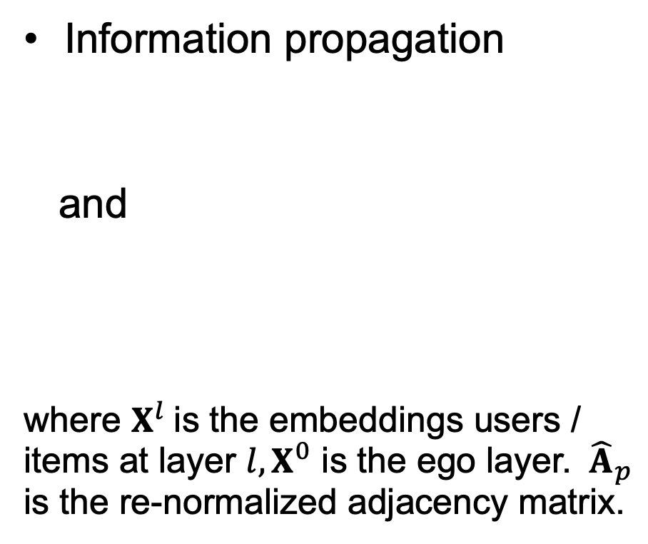
Details in Layer-refinement
Information propagation
and
where $X^{l}$is the embeddings users / items at layer $l, X^{0}$ is the ego layer. ${\hat{A}}_{p}$ is the re-normalized adjacency matrix.
Fig 5. Layer refinement module.
Notes:
That is, after information propagation stage, we calculate the similarity score between the hidden layer and the ego layer.
We use the score to refine the information contained in this hidden layer before propagate to the next layer.

Slide 13

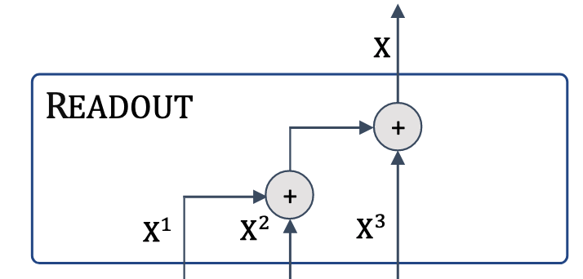
Details in Layer-refinement
Information aggregation
The final embeddings of users/items are readout without the ego layer.
Fig 6. Readout.
Notes:
After informaiton propagated for serval layers, we obtain a list of hidden layer representations.
We readout the final embedding without the ego layer.

Slide 14

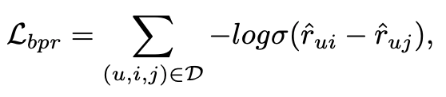

The Loss Function
Sum of BPR loss and regularization loss:
Bayesian Personalized Ranking (BPR) loss:
Notes:
In LayerGCN, the loss function is a sum of the BPR loss and regularization loss on user/item representations.
In BPR loss, we maximize the distance a user interact with positive item to a negative item.

Slide 15
Theoretical analysis of LayerGCN
Proposition 1. The representational capacity of LayerGCN is as powerful as the Weisfeiler-Lehman (WL) test.
Proposition 2. LayerGCN is able to alleviate the over- smoothing of LightGCN.
Notes:
We conduct theoretical analysis to show the merits of our design in LayerGCN.
First, …
Second, …
As the time is limited here, I skip the proof here.

Slide 16
Outlines
Introduction
Research Issues
The Proposed LayerGCN
Degree-sensitive Edge Pruning
Layer-refinement
Experimental Results
Conclusion
Notes:
We report our experimental results conducted on 4 datasets.

Slide 17
Datasets
Table 1. Experimental datasets statistics.
Notes:
The datasets are varied in number of interactions and sparsity.

Slide 18
Evaluation Metrics & Settings
We use Recall@K and NDCG@K computed by the all-ranking protocol as the evaluation metrics for recommendation performance comparison.
To alleviate data leakage [5], we split the user-item interactions following a global timeline with ratio 7:1:2 for training/validation/testing.
Notes:
We use Recall@K and NDCG@K as the evaluation metrics.
Also, to alleviate data leakage, we split the user-item interactions following a global timeline

Slide 19
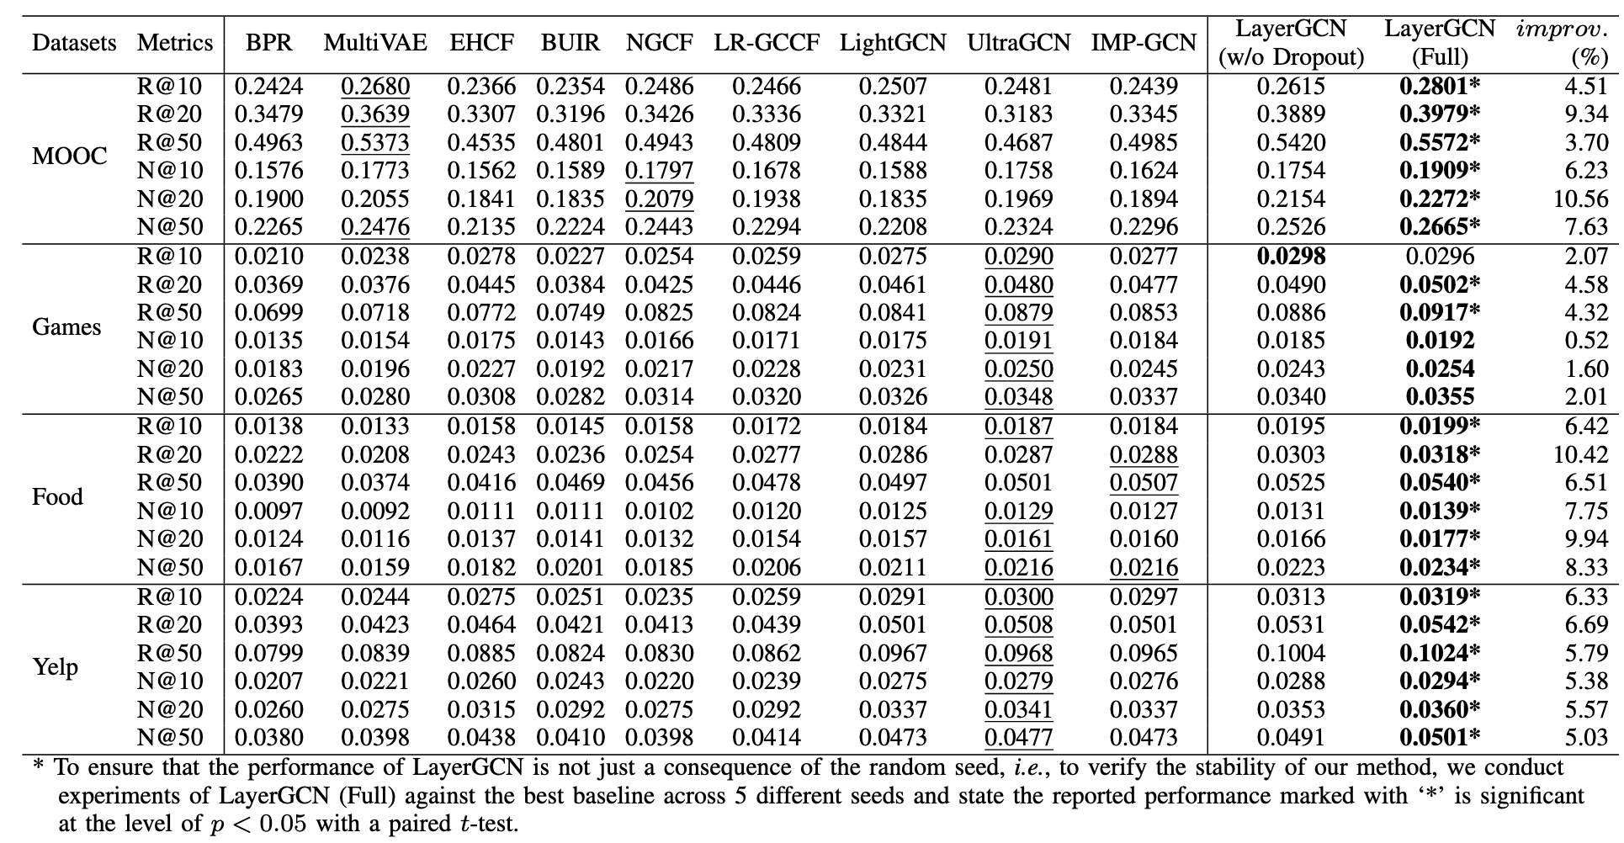
Overall Performance
Notes:
Here is the overall performance of LayerGCN compared with 9 baselines.
We observe LayerGCN even without the edge dropout component can outperform almost all baselines.

Slide 20
Behavior of LayerGCN
Insights
LayerGCN drops the ego layer and distils the propagated information with the layer refinement enabling the model to address over-smoothing problem.
The degree-sensitive edge pruning can filter out irrelevant signals in neighbors and achieve better performance.
Notes:
From the results, we have the following insights:

Slide 21
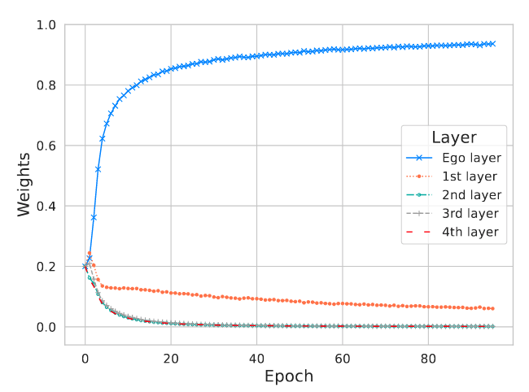
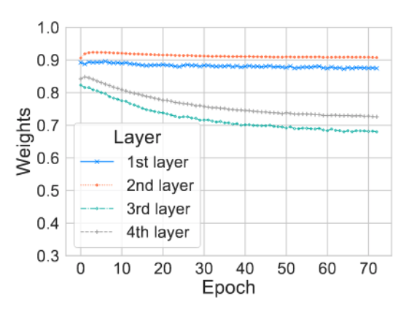
One more thing
How different layers contribute to the final embeddings of users/items.
In LightGCN, we replace learnable weights on layers for dynamic node updating.
In LayerGCN, we use the similarity scores.
The ego layer always dominate other layers in LightGCN.
Even layers contribute more in LayerGCN, or homogenous neighbors contribute more than others.
LightGCN
Fig 7. Weights of layers.
LayerGCN
Notes:
We have conducted extensive experiments to evaluate the behavior of LayerGCN.
One interesting thing is that: we are curious about How ….

Slide 22
Conclusion & Take-Home Messages
We proposed LayerGCN to address the recommendation issues of:
Over-smoothing in graph-based models
Noise in user-item interactions
What we have learned:
Layer-refinement is effective in addressing over-smoothing.
Differentiate the importance of hidden layers.

Slide 23

Conclusion & Take-Home Messages
We open source our code/datasets and all baselines to advance the research in this field. (https://github.com/enoche/ImRec)

Slide 24
Thanks
Q&A

Slide 25
References
[1]. | Zhou, Xin, Aixin Sun, Yong Liu, Jie Zhang, and Chunyan Miao. “Selfcf: A simple framework for self-supervised collaborative filtering.” ACM Transactions on Recommender Systems, 2023
[2]. | He, Xiangnan, Kuan Deng, Xiang Wang, Yan Li, Yongdong Zhang, and Meng Wang. "Lightgcn: Simplifying and powering graph convolution network for recommendation." In Proceedings of the 43rd International ACM SIGIR conference on research and development in Information Retrieval, pp. 639-648. 2020.
[3]. | Yera, Raciel, Jorge Castro, and Luis Martínez. "A fuzzy model for managing natural noise in recommender systems." Applied Soft Computing 40 (2016): 187-198.
[4]. | Chen, Ming, Zhewei Wei, Zengfeng Huang, Bolin Ding, and Yaliang Li. "Simple and deep graph convolutional networks." In International conference on machine learning, pp. 1725-1735. PMLR, 2020.
[5] | Ji, Yitong, Aixin Sun, Jie Zhang, and Chenliang Li. "A critical study on data leakage in recommender system offline evaluation." ACM Transactions on Information Systems 41, no. 3 (2023): 1-27.

