Slide 1
Title: Intelligent Agent for Box and dots Subtitle: Reinforcement Learning-Based Agent Implementation Name: Buys Enock Onkarabile Student Number: 219013044 University of Johannesburg

Slide 2


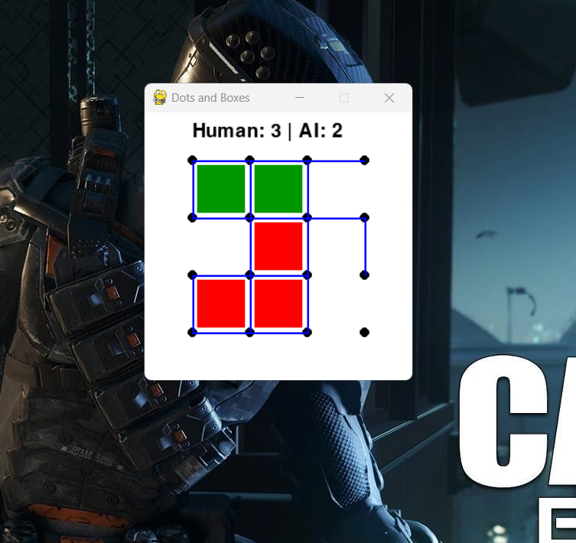
Problem domain
Strategic two player turn based game.
Objective:Complete more boxes than the opponent.
Challenge for AI:
Reward sparsity
Long-term planning
Exploration-exploitation tradeoff
Motivation:Build an agent that can learn to win using reinforcement learning

Slide 3
Project Objectives and design
Build an intelligent agent that learns to play Dots and boxes using Reinforcement learning
Ensure the agent improves over time through self-play and real games
Use an efficient architecture with tabular Q-learning
Decision-making based on:
State features (board lines, score diff, boxes with 3 sides)
Exploration-exploitation (epsilon-greedy )

Slide 4
Sensors and actuators
Sensors: Agent perceives game board state. Actuators: Agent places lines on board. get_state_key() encodes board state for Q-table.

Slide 5
Knowledge Representation
State represented as:
Flattened h_lines + v_lines
Score difference
Boxes near completion
Q-values stored in a Python dictionary (Q-table).

Slide 6
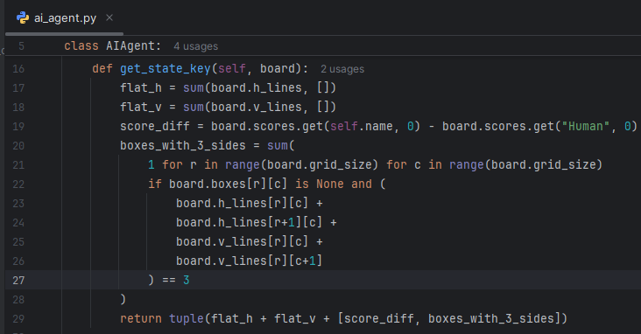
Q-learning methodology
Q-Learning update rule: 𝑄(𝑠,𝑎)=𝑄(𝑠,𝑎)+𝛼[𝑟+𝛾max⁡𝑎𝑄(𝑠′,𝑎)−𝑄(𝑠,𝑎)]
Rewards:
+1 for box completion
-0.1 for others (in training mode)
Exploration decay over games (epsilon decreases).

Slide 7
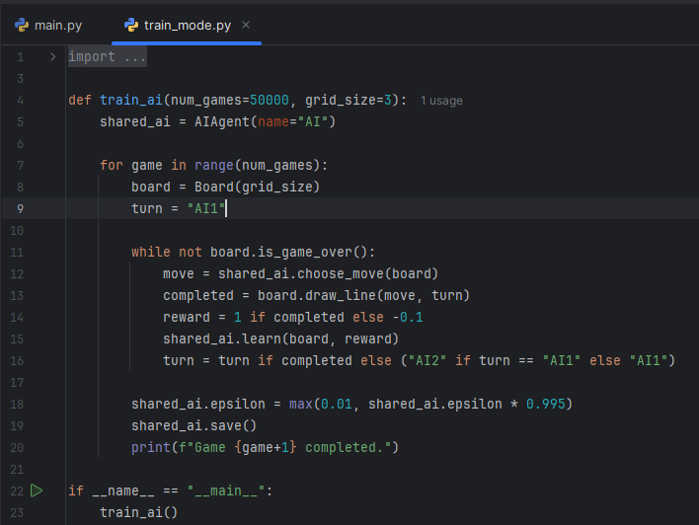
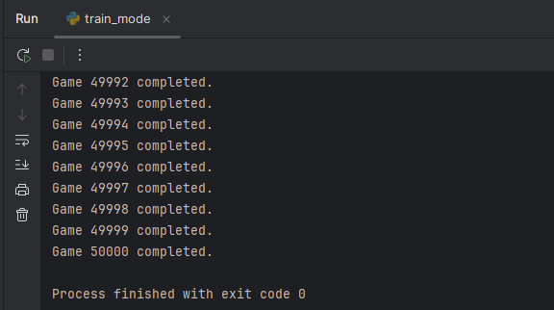
Training the agent
Self-play with two AIs (train_mode.py).
Learns over thousands of games.
Saves Q-table after each game.
Simple training loop allows long-term learning.

Slide 8
Interface
Built in Pygame.
Shows dots, lines, boxes, scores.
Human interacts with mouse clicks.

Slide 9
Real-world application & innovation
Reinforcement learning techniques transferable to:
Strategic planning
Robotics
Game-playing AI (e.g., AlphaGo)
Innovation: State design, adjustable training parameters.

Slide 10
Evaluation
Logs show Q-table growth and win ratios.
Demonstrated learning over time.
Still room for enhancement (e.g., DQN in future).

Slide 11
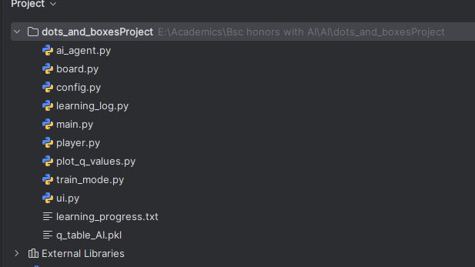
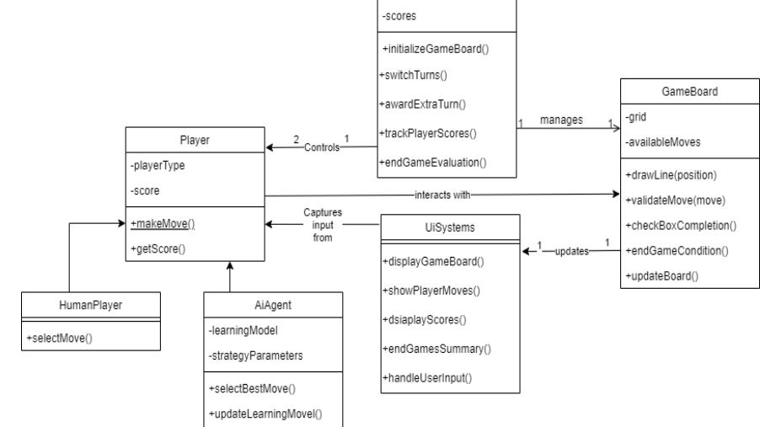
System Architecture
Modules
Board: game logic and rules
AIAgent: decision making
UI: Visual interface (Pygame)
Train_mode: self play training
Learning_log: learning feedback

Slide 12
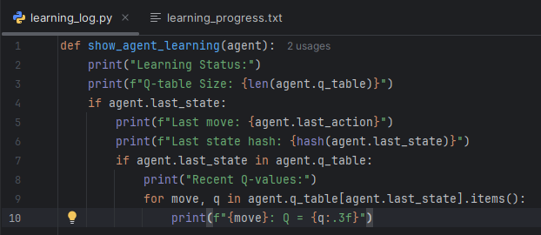
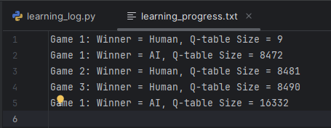
Intelligence demonstration
Makes smarter choices as Q-table grows
Learns to avoid helping Opponent
Showcase basic strategic play

Slide 13
Tools and appropriateness
Language: Python
Visualization: Pygame
Learning Algorithm: Q-learning
Reasons for Q-learning
-appropriate for discrete games
Tabular efficient for small grid sizes
Conclusion: Achieved goal of building a strategic AI for Dots and Boxes.
Learned through environment interaction.
Ready for live demonstration.

