Slide 1
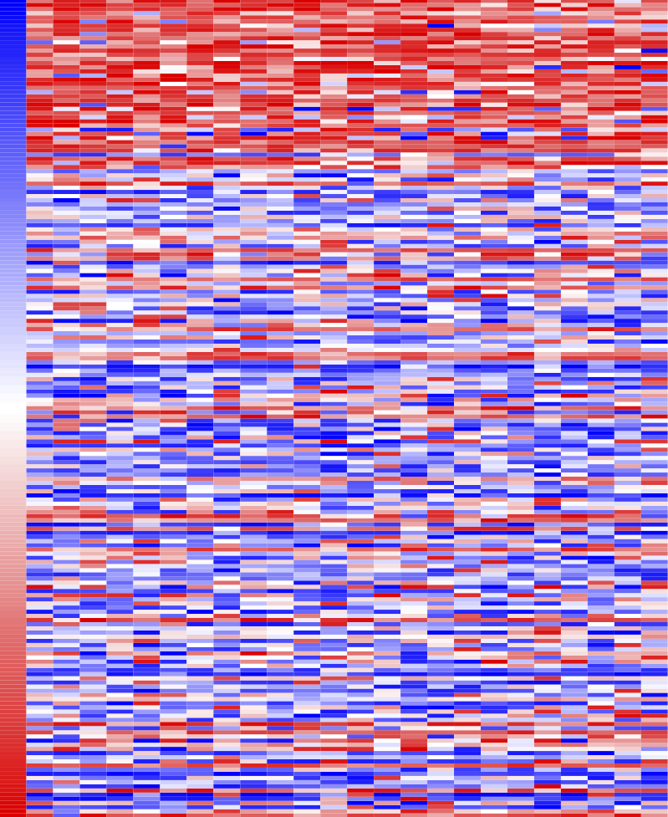

Bulk Gene Expression Data: 105 microarray samples from GEO normalized and batch corrected using justRMA and ComBat
Differential expression signatures (disease vs. control): Limma FDR < 0.05, log2FC > 1.1
Connectivity Map:
gene expression profiles
Un-
stratified
Stage Stratified
Phase Stratified
~22,000 genes
1309 compounds
All Samples
1/2 3/4
PE ESE MSE
For all signatures: Rank-based, non-parametric search algorithm used to identify disease-drug pairs with opposite transcriptomic effects (q-value < 0.0001)
Drug Expression Similar to Disease
DISEASE
Drug Expression Opposite to Disease
DRUGS
299 unique drug hits identified
221 common across all six signatures
Validation of fenoprofen in animal model

