Slide 1
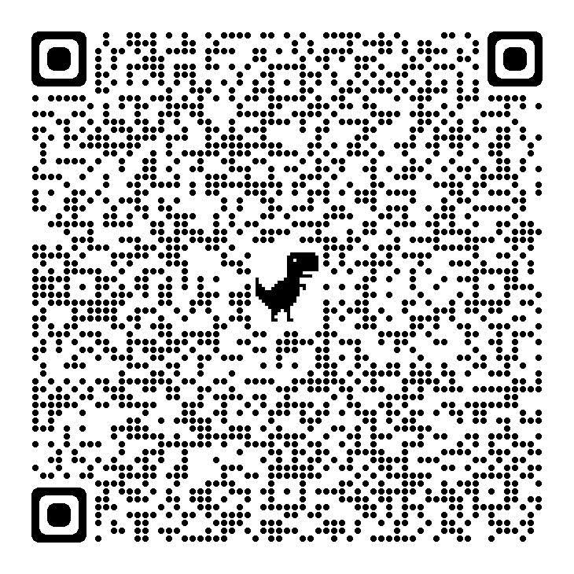

Puppet Debugger
Campinas, 06Mai22

Slide 2

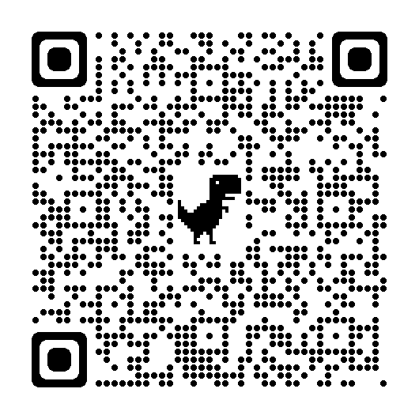
Puppet Debugger
About myself
Systems Specialist at Daitan (now Encora) since 2021. Graduated in Software Engineering and Telecommunications, with more than 25 years of experience in the area and Experienced Integrator certified by Ericsson
Email : roberto.nogueira@encora.com LinkedIn: https://www.linkedin.com/public-profile/settings?trk=d_flagship3_profile_self_view_public_profile

Slide 3
Puppet Debugger
Contents
Objective
Puppet
Puppet Language Basics
Puppet Debugger
Pupper Debugger Commands
Puppet and Ruby Extensions
References

Slide 4
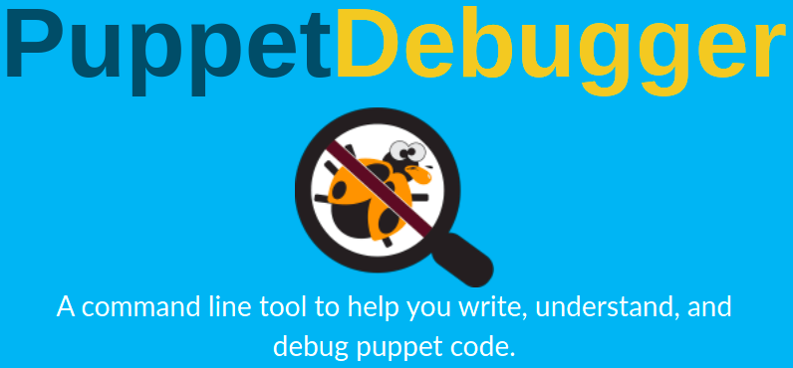
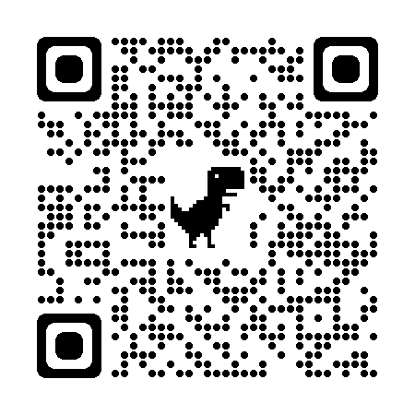
Puppet Debugger
Objective
It is to introduce a Pupper Debugger, a command line tool to help you write, understand, and debug Puppet code. In order to achieve that the Puppet and its language is revised.
Demo is an Online Puppet Debugger.

Slide 5
A command line tool to help you write, understand, and debug Puppet code

Slide 6
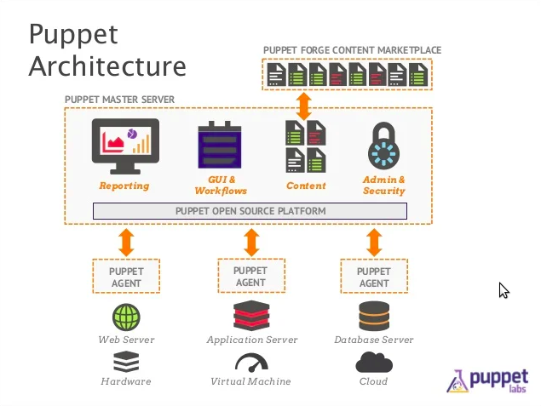
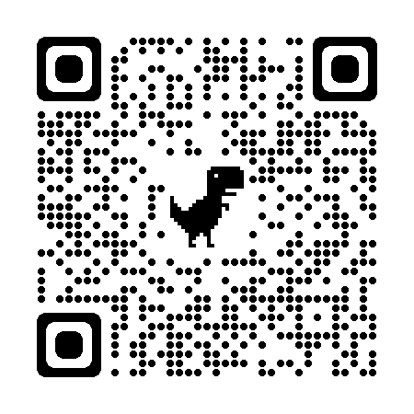
Puppet
Architecture
Puppet is a software configuration management tool which includes its own declarative language to describe system configuration.

Slide 7
Puppet
Installation
Install Puppet and Puppet Debugger
$ docker run --name=debian11 -t -i --rm debian:11 bash $ update $ apt install systemctl wget lsb-release -y $ wget https://apt.puppetlabs.com/puppet7-release-bionic.deb $ dpkg -i puppet7-release-bionic.deb $ apt update $ apt-get install puppet-agent -y $ echo 'export PATH=$PATH:/opt/puppetlabs/puppet/bin' >> ~/.bashrc $ source ~/.bashrc $ gem install --no-document puppet-debugger
Puppet relevant commands
# print puppet configuration, usually has to be execute with sudo $ puppet config print # set log level to debug, usually has to be execute with sudo $ puppet config set log_level debug $ puppet --help
In order to install Puppet the way it is described here Docker is required see Ref.1 for further installation.

Slide 8
Puppet Debugger
Puppet Language Basics
Introduction
Resources
Classes
Modules
Variables
Metaparameters

Slide 9
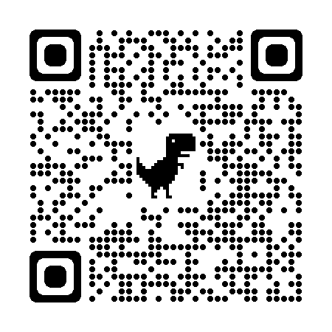
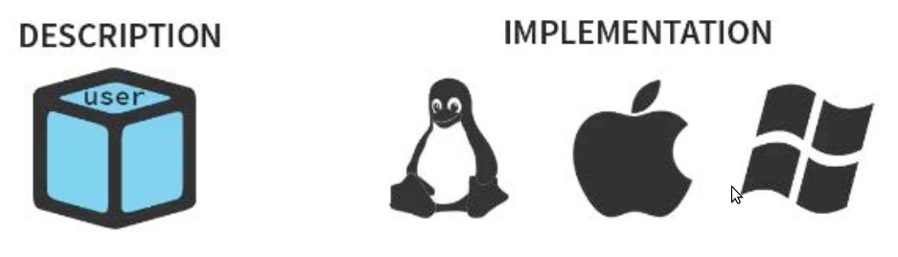
Puppet Language Basics
Introduction
Puppet consists of a custom declarative language to describe system configuration, which can be either applied directly on the system, or compiled into a catalog and distributed to the target system via client–server paradigm (using a REST API), and the agent uses system specific providers to enforce the resource specified in the manifests. The resource abstraction layer enables administrators to describe the configuration in high-level terms, such as users, services and packages without the need to specify OS specific commands (such as rpm, yum, apt).

Slide 10
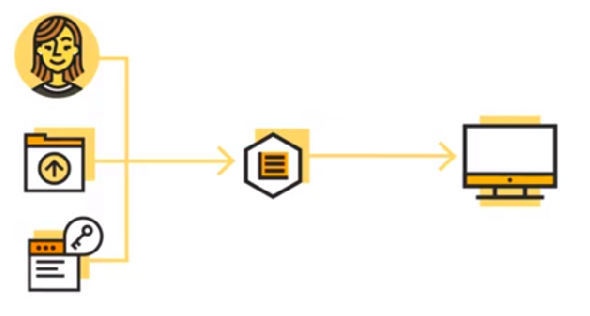
Puppet Language Basics
Resources
Are the fundamental building blocks of the Puppet Language.
Is characteristic of a node that needs to be managed overtime.
Resorces Types are e.g. User, Package and Service.

Slide 11
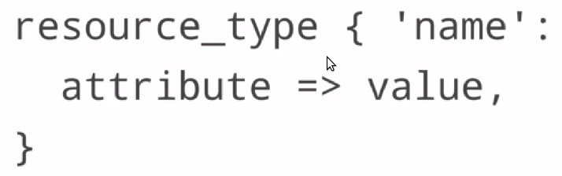
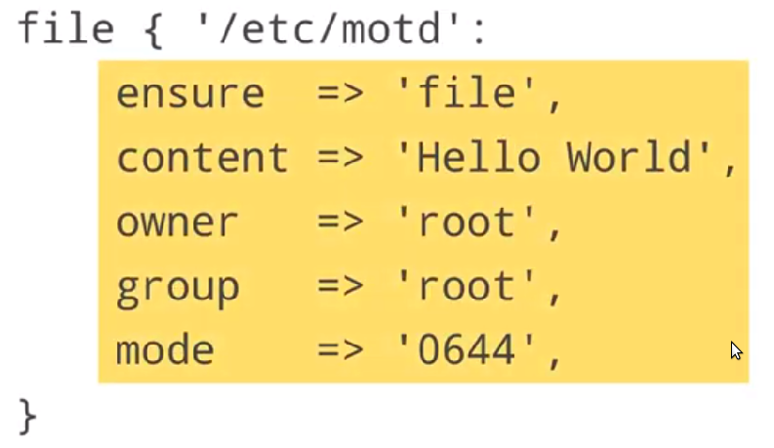
Puppet Language Basics
Resources
Resource Declaration adds a resource to the catalog and tells Puppet to manage that resource state.

Slide 12
Puppet Language Basics
Resources
Applying the manifest
$ cat << 'EOF' > motd.pp file { '/etc/motd': ensure => 'file', content => 'Hello World', owner => 'root', group => 'root', mode => '0644', } EOF $ ls –la motd.pp -rw-r--r-- 1 root root 144 May 25 09:04 motd.pp $ puppet parser validate motd.pp $ puppet apply motd.pp Notice: Compiled catalog for c5cd51c14f8a.br in environment production in 0.01 seconds Notice: /Stage[main]/Main/File[/etc/motd]/content: content changed '{sha256}a378977155fb42bb006496321cbe31f74cbda803c3f6ca590f30e76d1afad921' to '{sha256}a591a6d40bf420404a011733cfb7b190d62c65bf0bcda32b57b277d9ad9f146e' Notice: Applied catalog in 0.01 seconds root@c5cd51c14f8a $ ls -la /etc/motd -rw-r--r-- 1 root root 11 May 25 09:04 /etc/motd $ cat /etc/motd Hello World

Slide 13
Puppet Language Basics
Resources Examples in Debian
Check the existent resources types
$ puppet resource --typesadd : file package :
Check the existent resources file type
$ puppet resource file '/etc/hosts' : file { '/etc/hosts': ensure => 'file', content => '{sha256}674a2d0859a6ed81ce1e3513f6ee1f710b47c3b97301b284124d5b95cf566b47', ctime => '2022-05-21 12:17:40 +0000', group => 0, mode => '0644', mtime => '2022-05-21 12:17:40 +0000', owner => 0, provider => 'posix', type => 'file', }

Slide 14
Puppet Language Basics
Resources Examples in Debian
Check the existent resource service type
$ service --status-all [ ? ] hwclock.sh [ - ] procps
$ puppet resource service 'procps' service { 'procps': ensure => 'running', enable => 'false', provider => 'debian', }
Installing a resources package type
$ puppet resource package 'tree' ensure=present Notice: /Package[tree]/ensure: created package { 'tree': ensure => 'purged', provider => 'apt', }
See also in Resources of Puppet Language Basics in Puppet channel in YouTube and homepage.

Slide 15
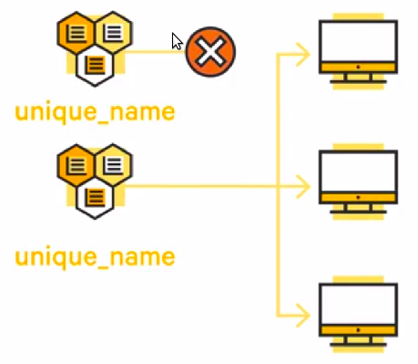
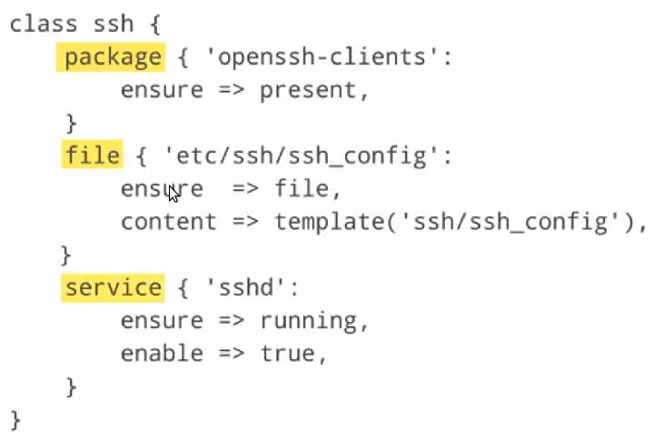
Puppet Language Basics
Classes
Multiple Puppet Resources can be collected and distributed together using Classes, by combining Resources into a Class. A Class can configure a large block of functionality.
See also in Classes of Puppet Language Basics in Puppet channel in YouTube and homepage.

Slide 16
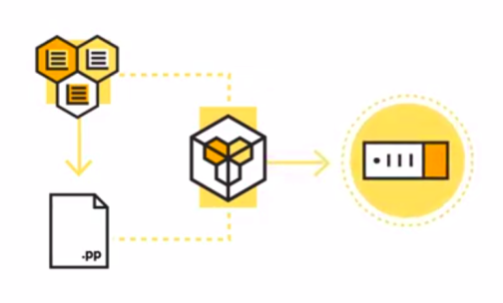
Puppet Language Basics
Modules
Modules are one of the most basic building blocks of the Puppet Language. They are used to manage o specific task or an application such as installing or configuring a piece of software.

Slide 17
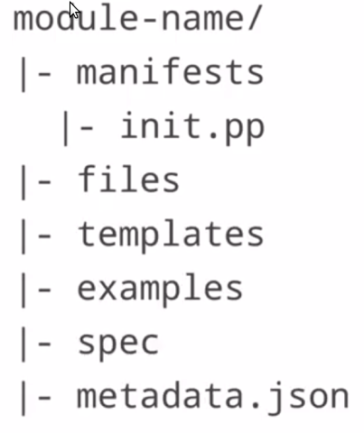
Puppet Language Basics
Modules
Module is simply a directory tree that contains the files needed for a given configuration. This directory structure allows nodes to discover and loads Classes, Resources Types and more.
module-name is the name of the top's directory tree. If a Class is defined in a Module you can declare that name in any Manifest. When Puppet Master compiles the catalog it wil dynamic load the Manifest that contain the Class definition.

Slide 18
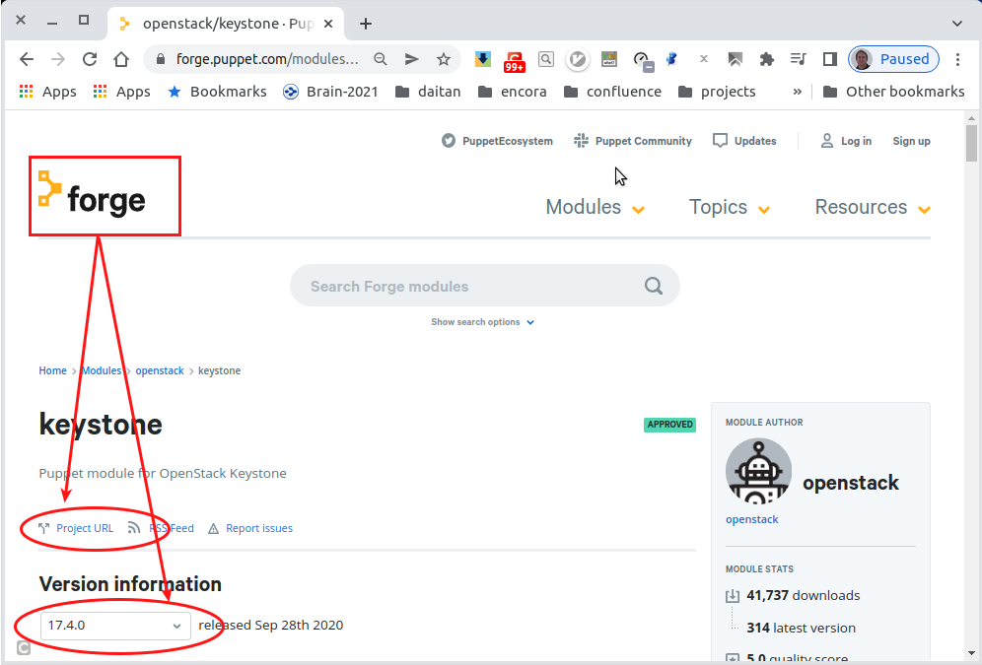
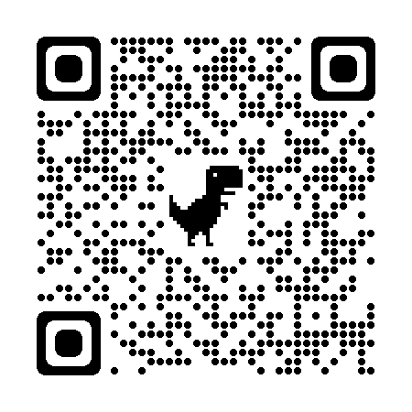
Puppet Language Basics
Modules
There are thousand of Modules available for downloading at Puppet Forge, written by Puppet developers and community members. There are compatible with multi-platforms.

Slide 19
Puppet Language Basics
Modules
Puppet Module relevant commands
# list puppet modules and its path, usually has to be execute with sudo $ puppet module list /home/rnogueira/.puppetlabs/etc/code/modules ├── puppet-nodejs (v9.0.1) ├── puppetlabs-apt (v8.3.0) └── puppetlabs-stdlib (v4.25.1) /opt/puppetlabs/puppet/modules (no modules installed) $ puppet config print modulepath modulepath/home/rnogueira/.puppetlabs/etc/code/modules:/opt/puppetlabs/puppet/modules # install puppet modules, usually has to be execute with sudo $ puppet module install stdlib :
See also in Modules of Puppet Language Basics in Puppet channel in YouTube and homepage.

Slide 20
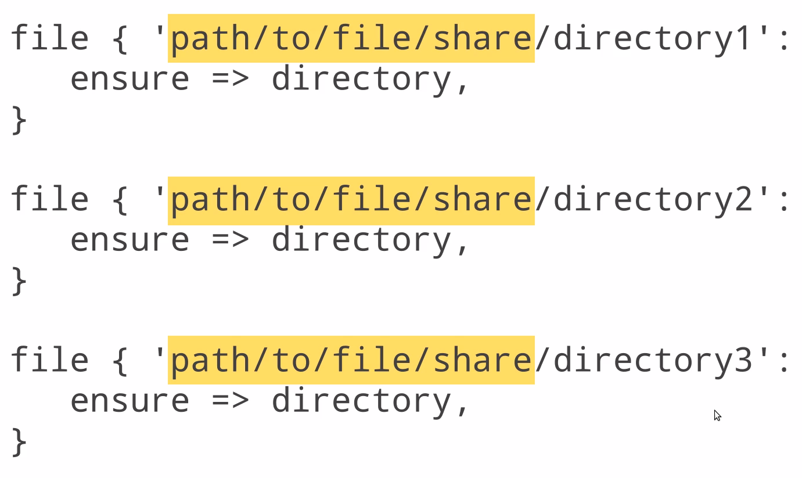
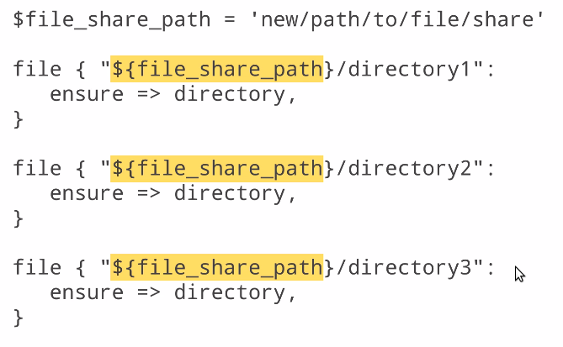
Puppet Language Basics
Variables
Variables exists in order to be interpolated in strings to avoid rework in case the value is updated.
See also in Variables of Puppet Language Basics in Puppet channel in YouTube and homepage.

Slide 21
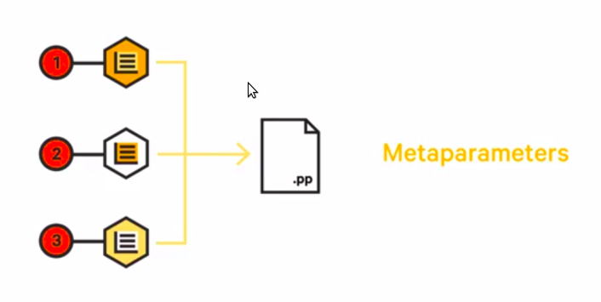
Puppet Language Basics
Metaparameters
When a Puppet manifest is loaded the resources inside the manifest are managed the order they are declared. But when you need a group of resources to be managed in different or specific order you must explicit declare the relationships there where the Metaparameters come in. Metaparameters are special attributes that can be used in any resource type, and specify how your system act to the resource rather than mapping directly to the system state.

Slide 22
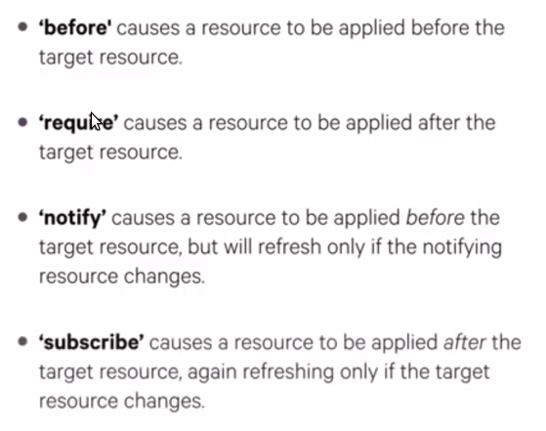
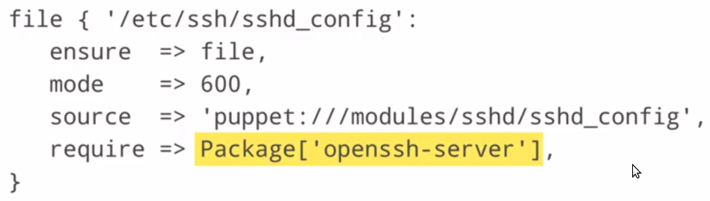
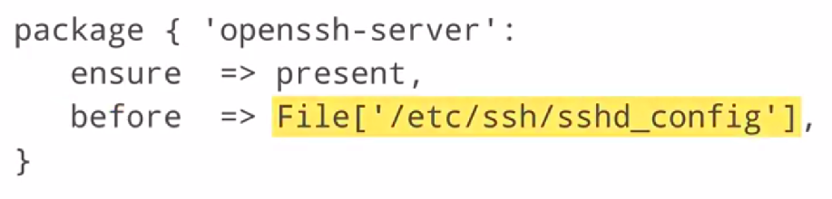
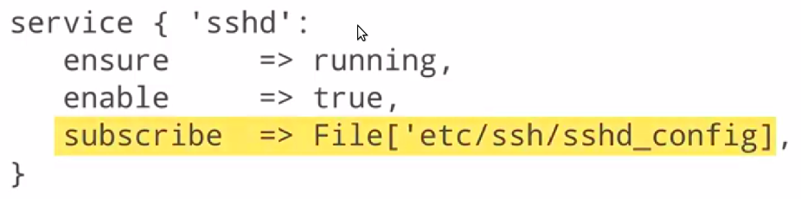
Puppet Language Basics
Metaparameters
The Puppet Language uses four Metaparameters to establish relationships.
See also in Metaparameters of Puppet Language Basics in Puppet channel in YouTube and homepage.

Slide 23
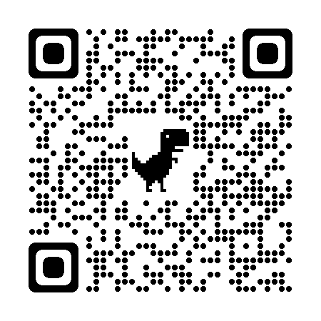
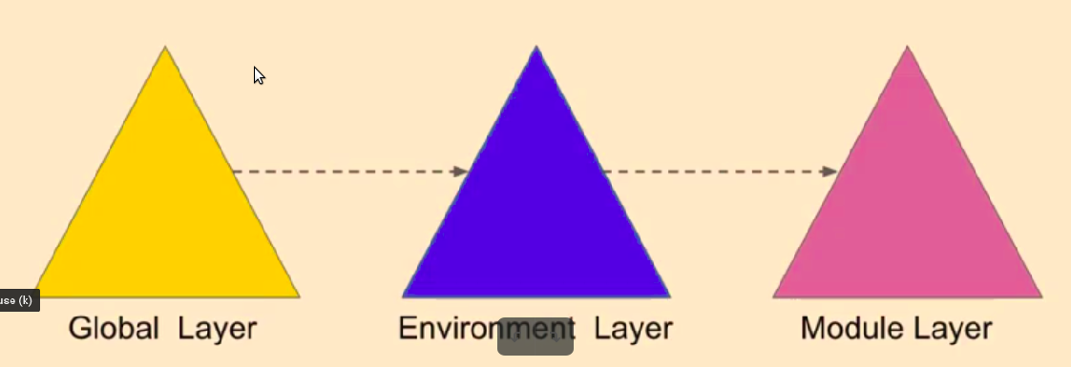
Puppet Language Basics
Hiera
A way to plug data in your puppet code e.g. build-in key value store configuration data lookup system.
It separates data from puppet code.
Make more reusable puppet modules.
Supports json, yaml and eyaml(encripted).
Hiera's 5 has three config layers(Hiera 3 had just the Global).

Slide 24
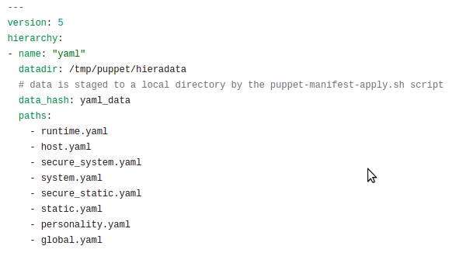
Puppet Language Basics
Hiera
Global layer $confdir/hiera.yaml
$ sudo puppet lookup keystone::admin_password --explain : Hierarchy entry "secure_static" Path "/tmp/puppet/hieradata/secure_static.yaml" Original path: "secure_static.yaml" : Found key: "keystone::admin_password" value: "Li69nux*"

Slide 25
Puppet Debugger
Features
Puppet Code and Language Evaluator
Fully Featured REPL
Mock real or fake systems using facterdb
Works with puppet 4.x, 5.x, 6.x and 7.x
Easy Gem installation
Easy Code Playback
Set Breakpoints
List all functions, datatypes, types
Plugin system for additional functionality
Test snippets of code in realtime

Slide 26
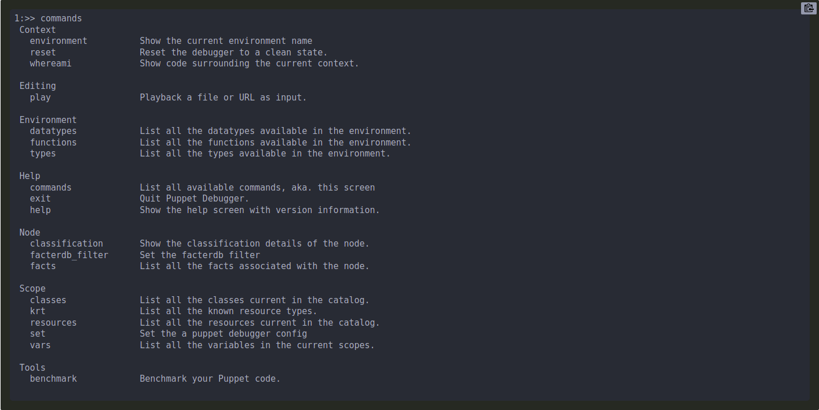
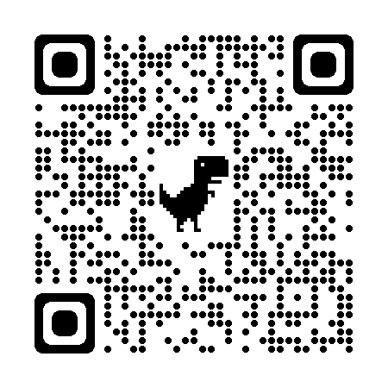
Puppet Debugger
Puppet Debugger Commands
The debugger comes with many commands that allow you to inspect the catalog, your code or reference items currently in scope.

Slide 27
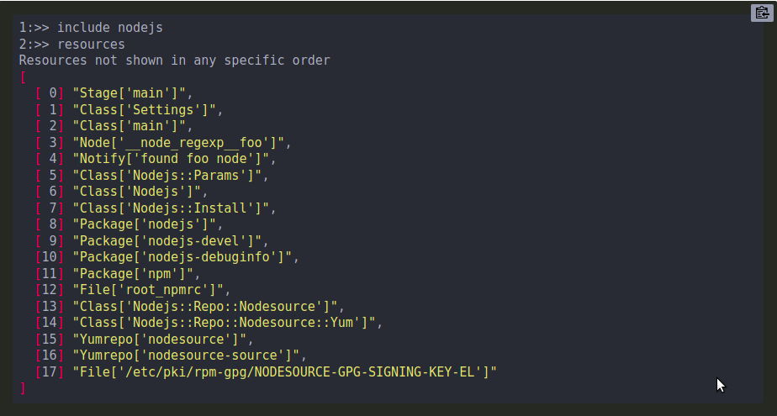
Puppet Debugger Commands
Resources
List all the resources currently in the catalog. Remember the puppet debugger is like an interactive manifest file. When you type puppet code, puppet will evaluate it and add it to the catalog.

Slide 28
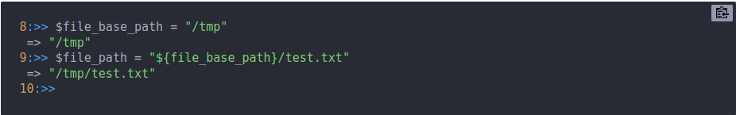
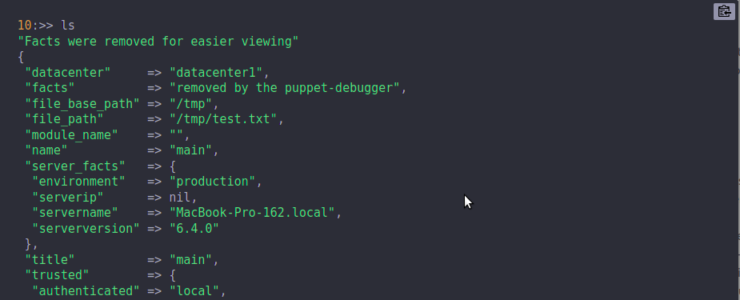
Puppet Debugger Commands
Variables
Variables in puppet code help us remove statically defined data.
Listing all the variables

Slide 29
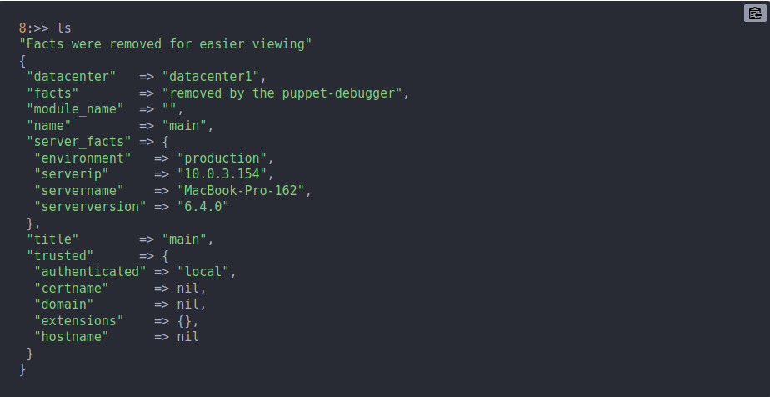
Puppet Debugger Commands
Ls <filter> or Vars
The ls or vars command will list all the variables currently set, in the current scope and even an the scope of a evaluated resource.

Slide 30
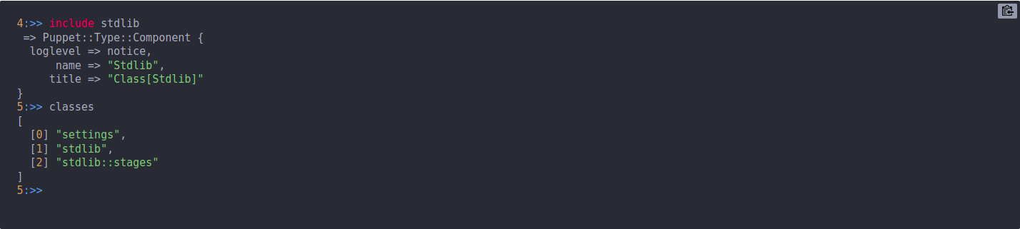
Puppet Debugger Commands
Classes
The classes command list all the class level resources found in the current catalog. A new catalog is compiled with each entry so the list will grow over as you use more classes.

Slide 31
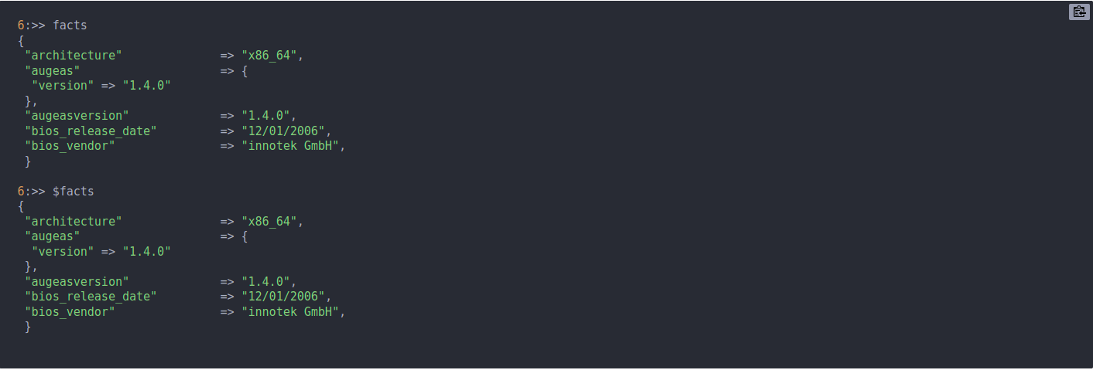
Puppet Debugger Commands
Facts
The debugger will get facts from FacterDB to speed up the inital loading process. These facts are then used in the scope during compilation. To list the facts in the scope simply run the facts command or $::facts
You can force the debugger to use real facts from the current node by disablabling FacterDB:
puppet debugger --no-facterdb --test -e '$os[family]'

Slide 32
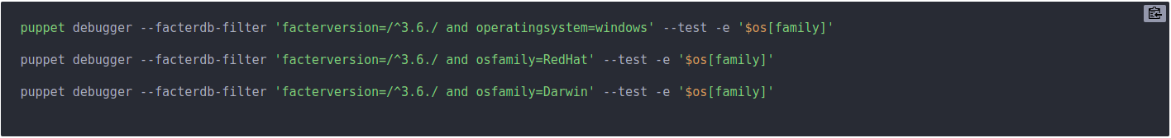
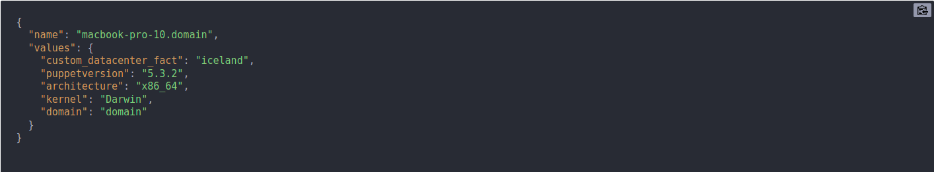
Puppet Debugger Commands
FacterDB
The puppet-debugger internally leverages the facterdb gem to load pre-cached facts into the debugger session. You can tell the debugger to use a different set of facts from a different kernel, OS version, facter version or any custom combination that facterdb supports. This is all controlled via the facterdb-filter.
You can force the debugger to use real facts from the current node too:
puppet debugger --no-facterdb --test -e '$os[family]'

Slide 33
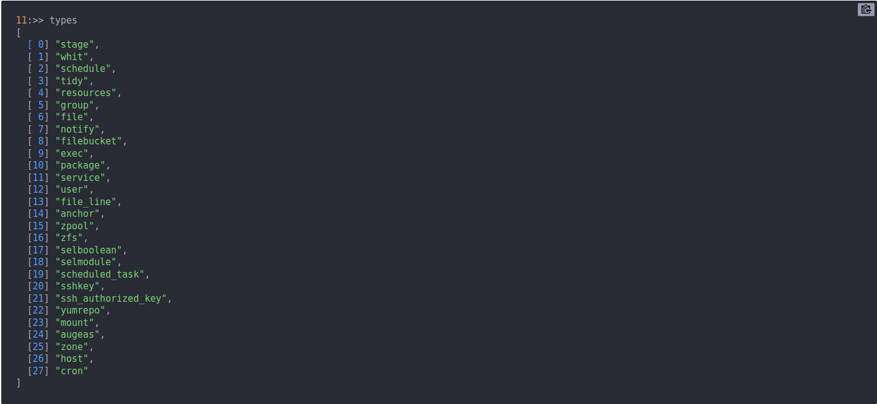
Puppet Debugger Commands
Types
The types command is used to list all the discoverable native resource types you can use in your puppet code.

Slide 34
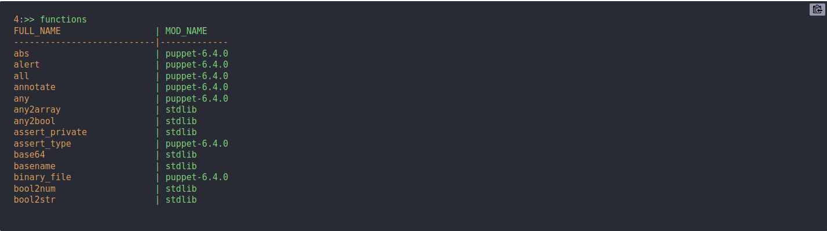
Puppet Debugger Commands
Functions
Puppet Debugger was designed to help you determine what a function returns in real time as well as what functions are available from each module. The debugger will search your module path for functions and present you with a nice list of functions for you to explorer and execute. To list the functions just use the command functions.

Slide 35
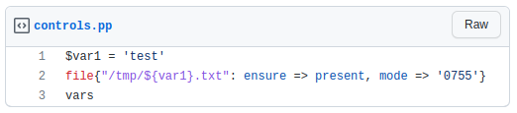
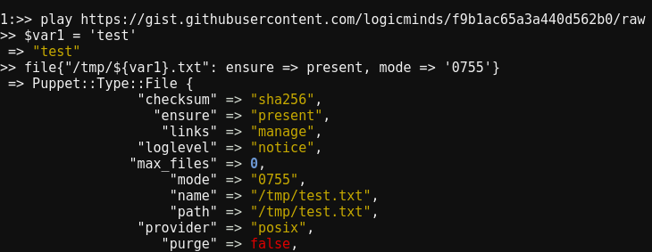
Puppet Debugger Commands
Play (Playback Support)
Playing back files or urls simply loads the content into the debugger session.
https://gist.githubusercontent.com/logicminds/f9b1ac65a3a440d562b0/raw

Slide 36
Puppet Debugger Commands
Play (Web Based Playback Support)
If using the web based debugger you can playback a shared url which would start a debugger session and then load the content from the url or parameter. Examples: Urls https://demo.puppet-debugger.com/play?url=https://gist.github.com/logicminds/64f0fe9f64339f18f097a9f42acd6276 https://demo.puppet-debugger.com/play?url=https://gist.github.com/logicminds/4f6bcfd723c92aad1f01f6a800319fa4 Simple commands https://demo.puppet-debugger.com/play?content=vars Content Parameter https://demo.puppet-debugger.com/play?content=md5('dafsdfdsfasdfds')
The demo site is a web application that runs a local instance of the debugger per session. So create a link, test it and share it.

Slide 37
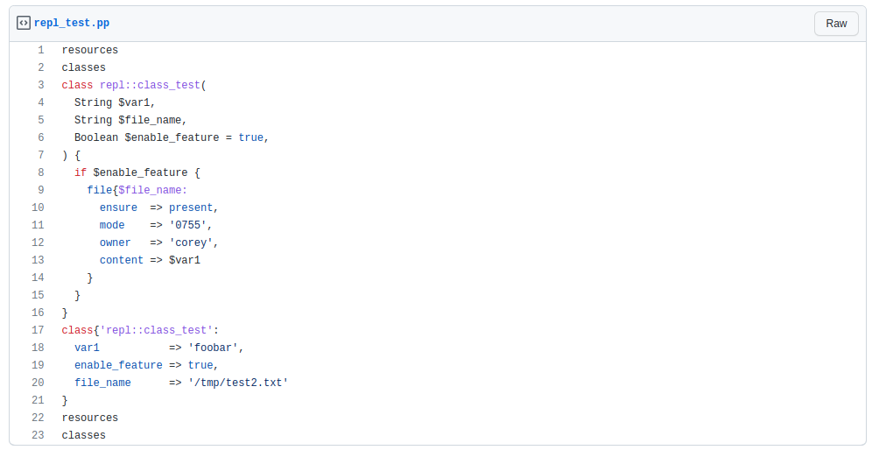
Puppet Debugger Commands
Play (Web Based Playback Support)
https://gist.github.com/logicminds/4f6bcfd723c92aad1f01f6a800319fa4
https://demo.puppet-debugger.com/play?url=https://gist.github.com/logicminds/4f6bcfd723c92aad1f01f6a800319fa4

Slide 38
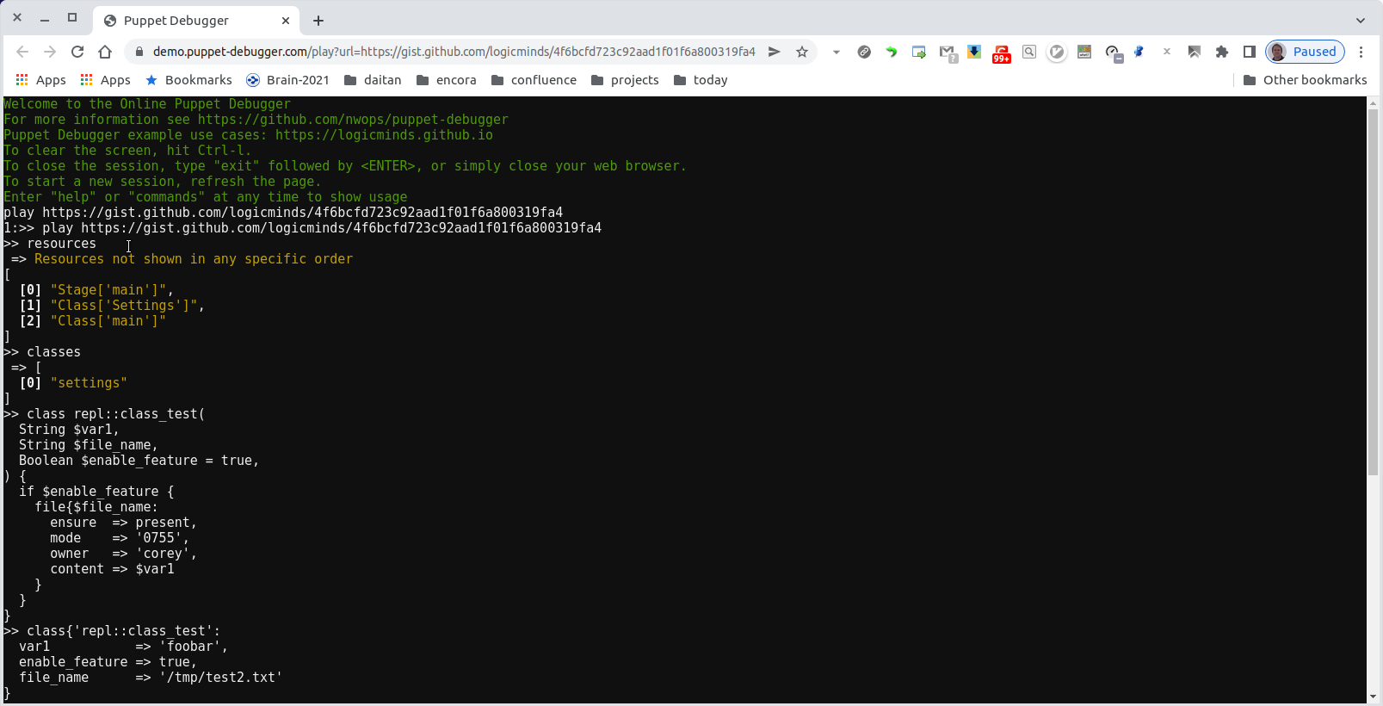
Puppet Debugger Commands
Play (Web Based Playback Support)

Slide 39
Puppet Debugger Commands
Lookup (Hiera Debugging)
You can use the debugger to help figure out how hiera is resolving the keys in addition having access to the data it returns. Hiera lookups are nothing more than a call to a function. In fact the name of the function is called lookup.
$ git clone https://gitlab.com/puppet-debugger/puppet-debugger-hiera-examples.git $ cd puppet-debugger-hiera-examples $ mkdir -p $(puppet config print confdir) $ puppet config set hiera_config ${PWD}/hiera.yaml
1:>> lookup('complex_type1') => [ [0] { "name" => "value1" }, [1] { "name" => "value2" }, [2] { "name" => "value3" } ] 2:>>

Slide 40
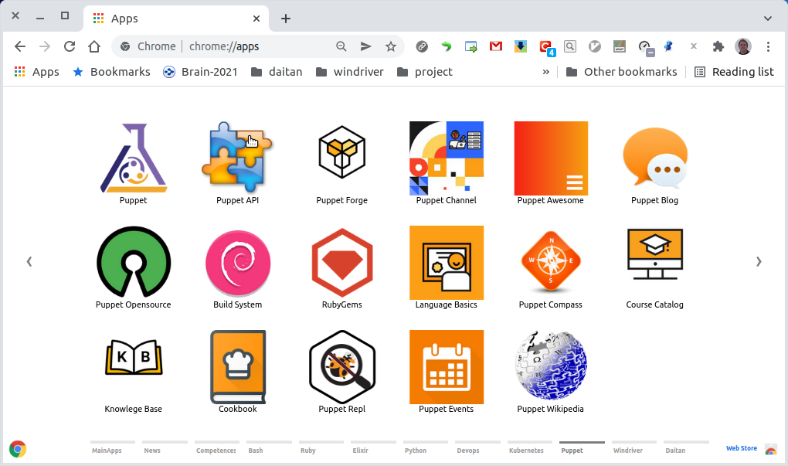
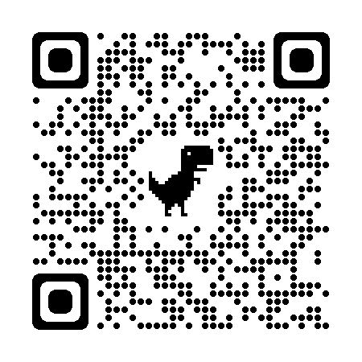
Puppet Debugger
Puppet Extensions
Chrome ans VSCode can help you stay productive and get more out of your browser and code editor.
Puppet - Chrome apps for Puppet configuration management. For futher info about Chrome Apps check Create and publish custom Chrome apps & extensions. puppet.puppet-vscode - Puppet Visual Studio Code Extension. For further extensions check VSCode marketplace.

Slide 41
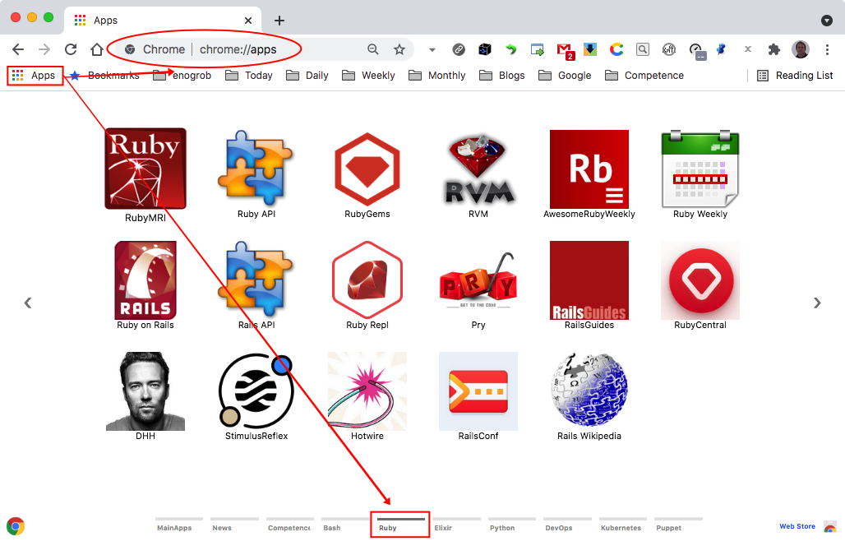
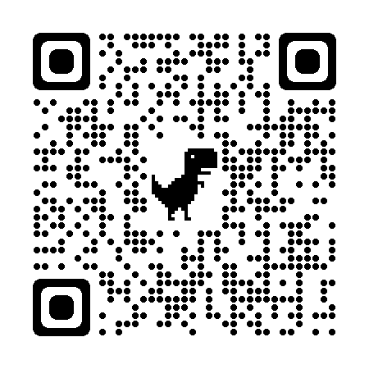
Puppet Debugger
Ruby Extensions
Chrome ans VSCode can help you stay productive and get more out of your browser and code editor.
Ruby - Chrome apps for Ruby programming language. For futher info about Chrome Apps check Create and publish custom Chrome apps & extensions. rebornix.ruby - This extension provides enhanced Ruby language and debugging support for Visual Studio Code. For further extensions check VSCode marketplace.

Slide 42
Puppet Debugger
References
1. Puppet in Wikipedia 2. Docker Installation 3. Puppet Language Basics 4. Puppet Forge 5. Puppet Debugger 6. Using the Puppet Debugger for Lightweight Exploration -Corey Osman 7. Puppet VS Code Tips and tricks 8. Puppet YouTube Channel 9. Puppet Cookbook 0. Awesome Puppet

Slide 43
Accelerate with Confidence
Experience with Hundreds of tools and Platforms
Our experience with software development tools and technologies accelerates deliverables and remove risks from schedules and budgets

Slide 44
Thank you!

