Slide 1

Emotion Recognition
from Facial Images
Daniel Wei, Enogayin Imasuen, Suffian Haroon
GROUP 4 | May 2026
EDA, Baseline Modeling, Pipeline Development and Conclusion

Slide 2
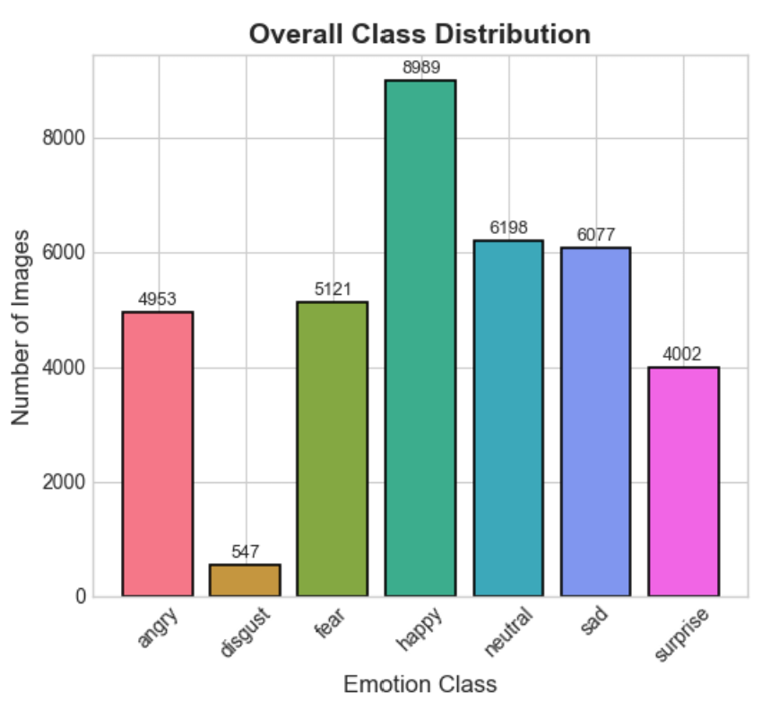

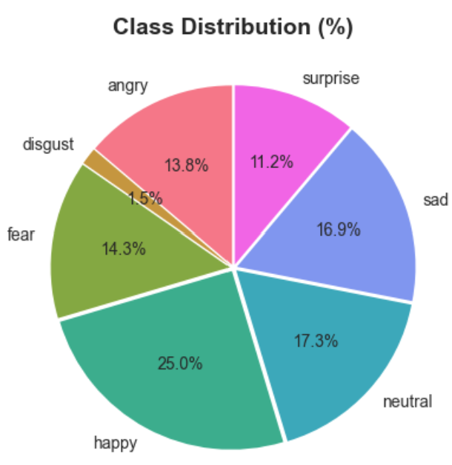


Introduction
Facial Expression Recognition (FER) from low-resolution FER-2013 Dataset:
"Does transfer learning improve facial emotion classification performance over a baseline CNN on a low-resolution and class-imbalanced facial emotion dataset?"
35,887 images (28K train / 7K test)

Slide 3
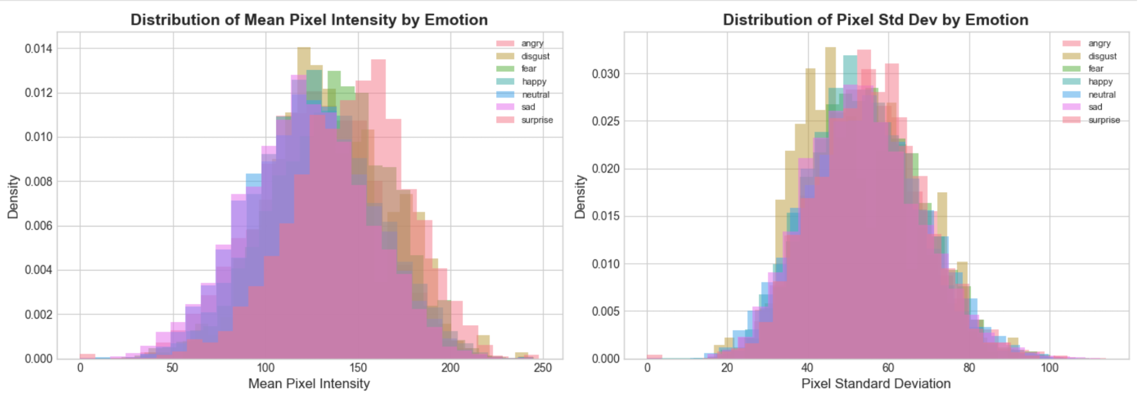
EDA
Pixel Statistics - similar brightness and contrast

Slide 4
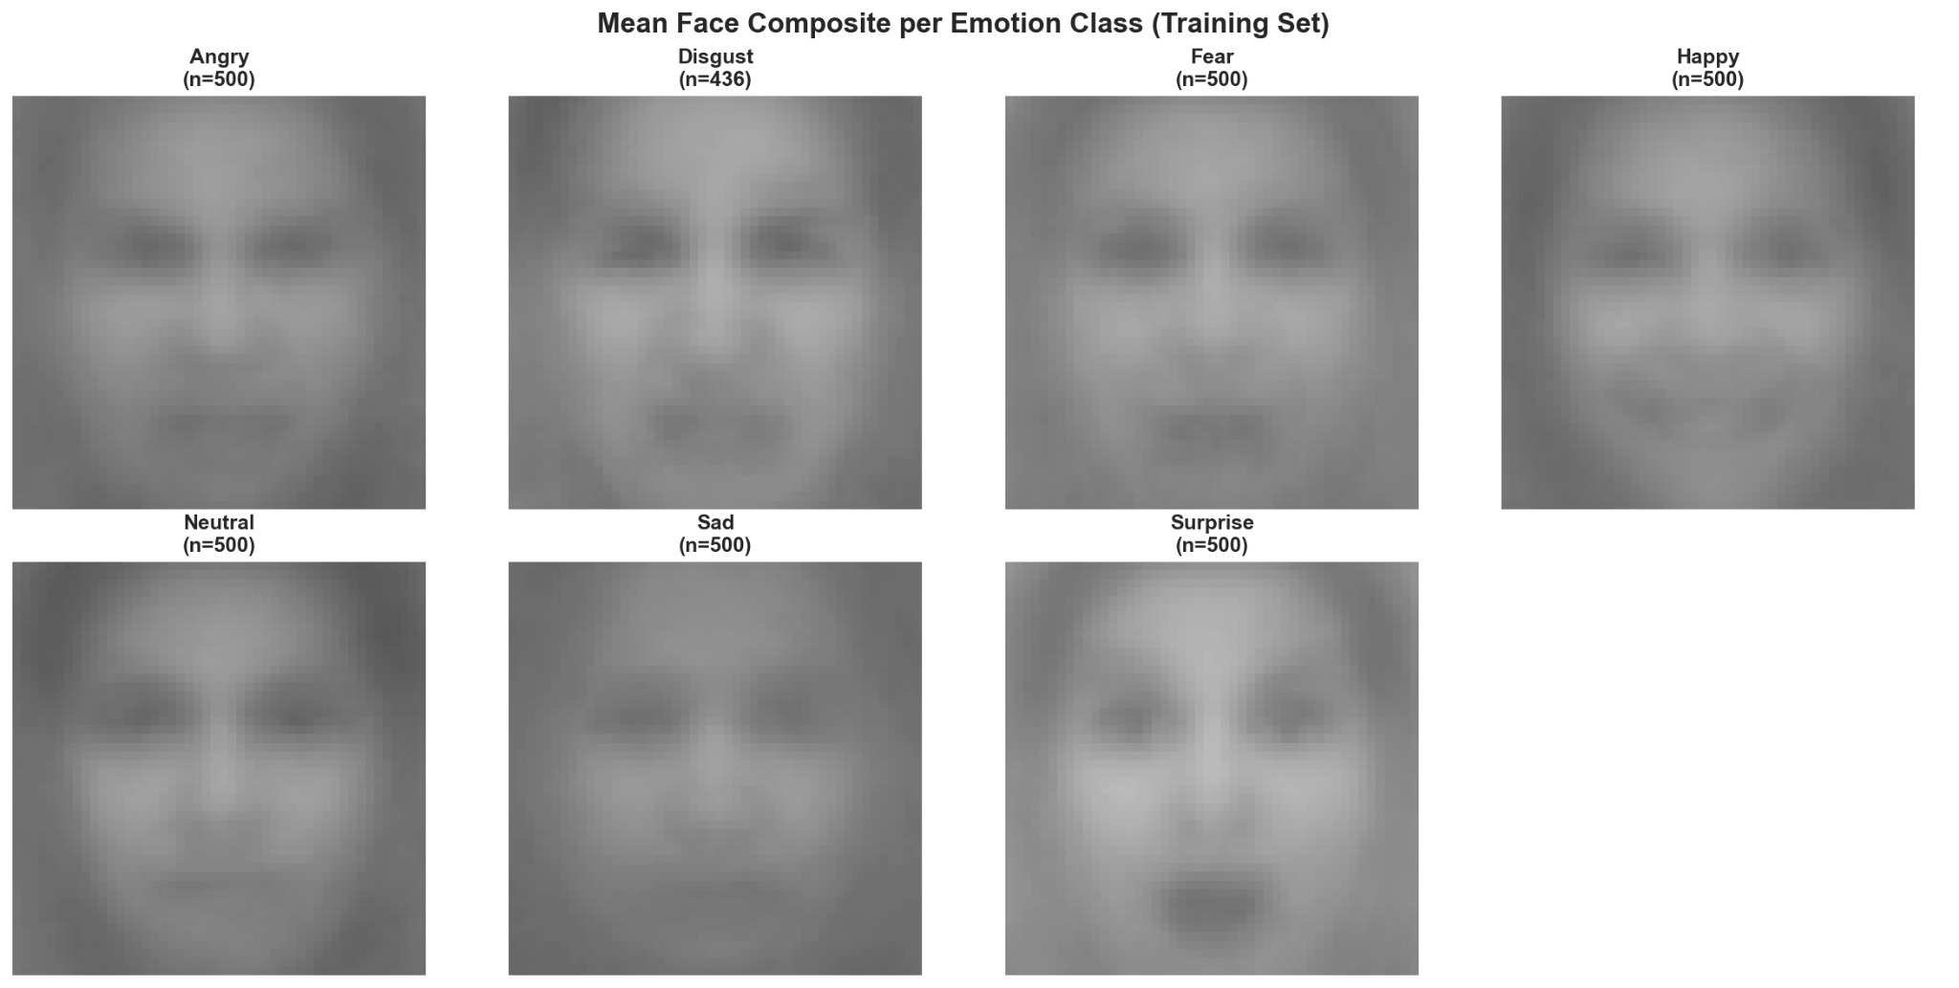
EDA
Mean Face Composite per Emotion Class

Slide 5
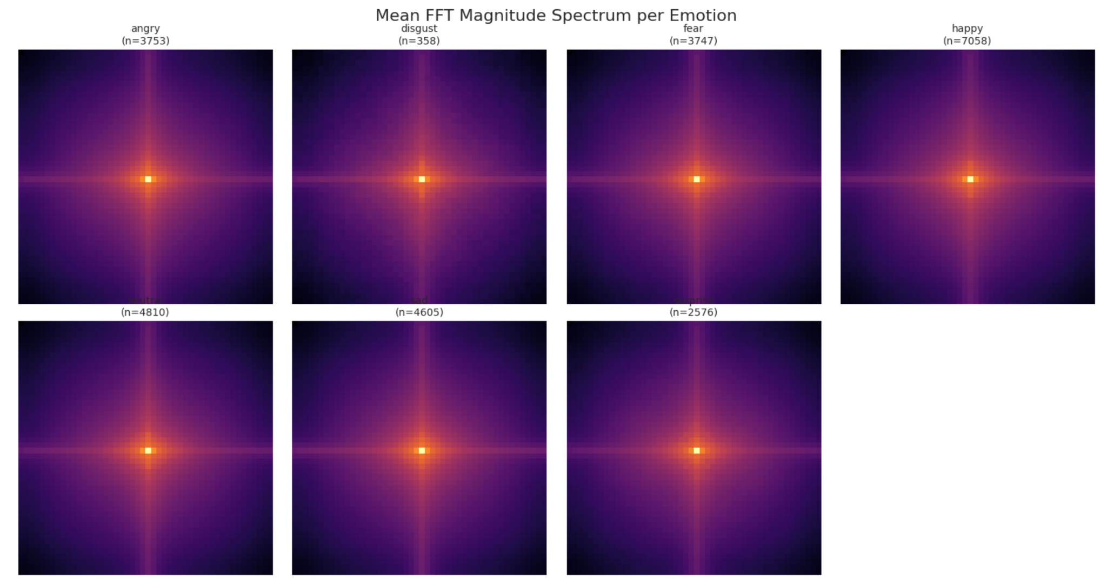
EDA
FFT Spectrum - emotions share nearly identical frequency structure

Slide 6
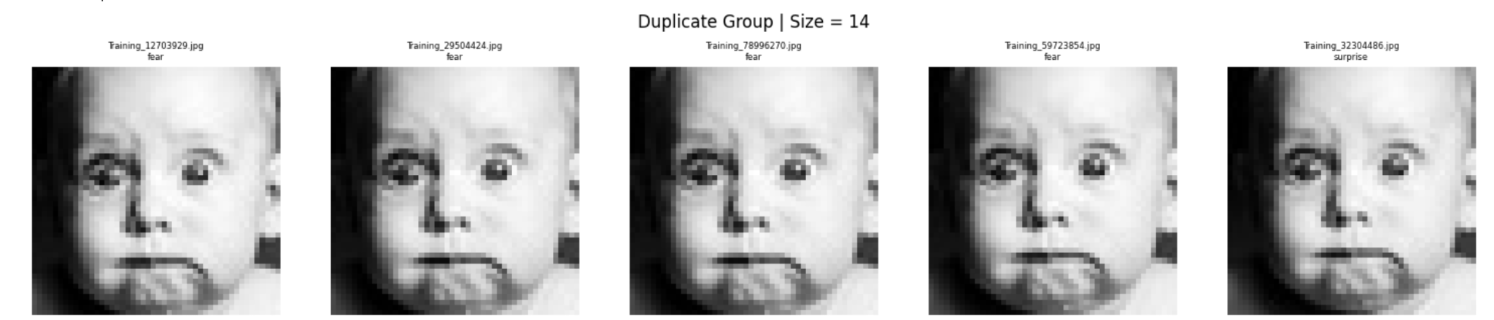
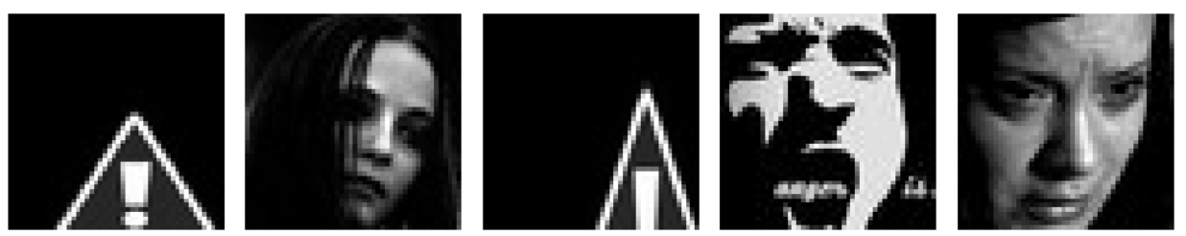
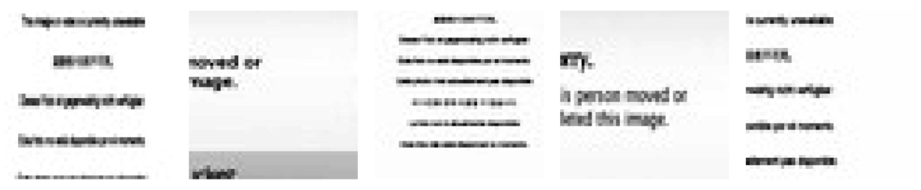
EDA
Data Quality - duplication and noise

Slide 7
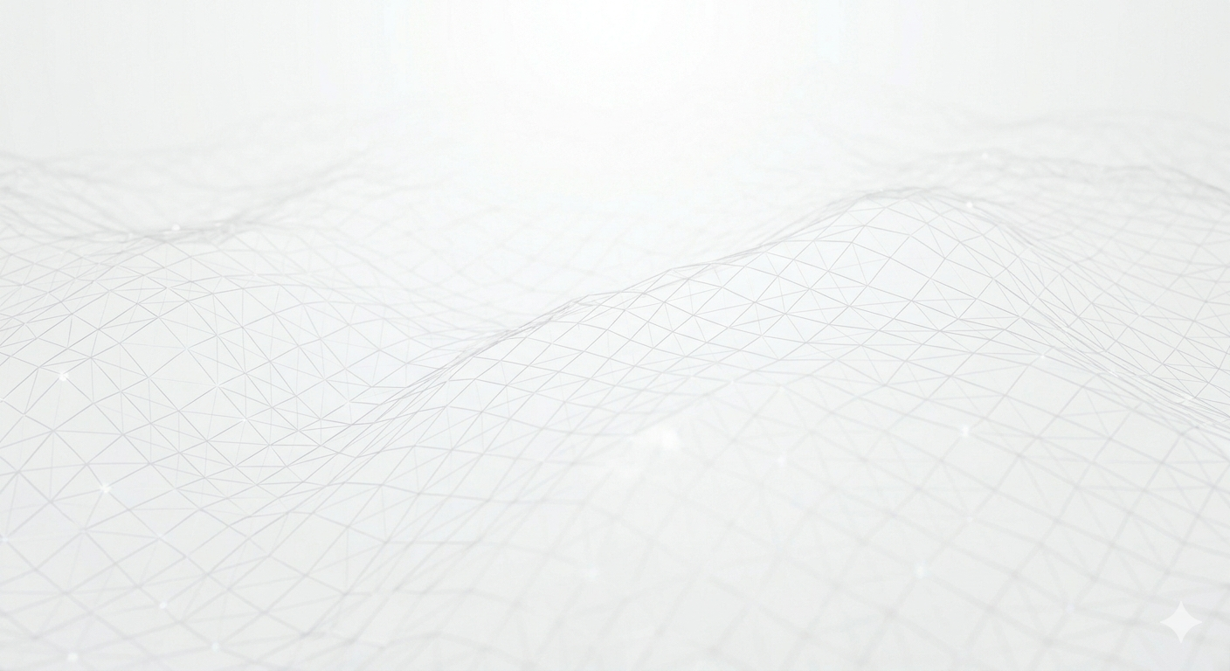
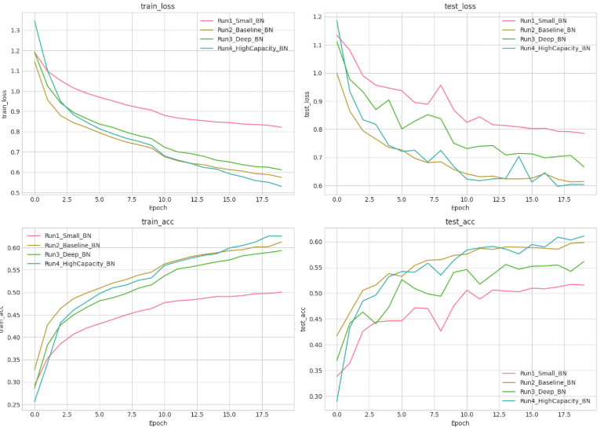
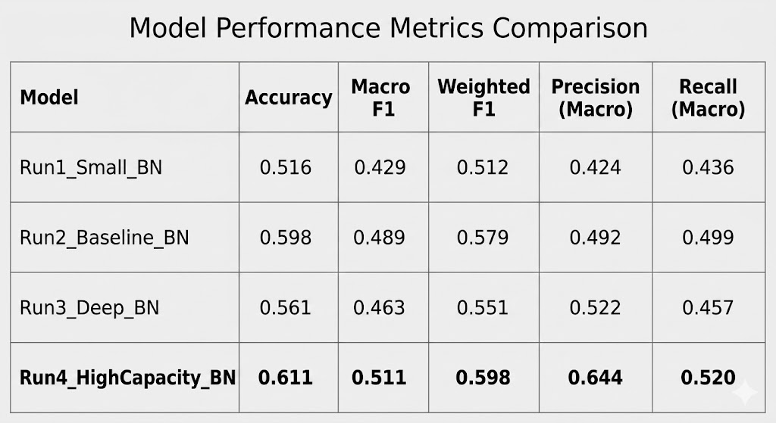
CNN - Baseline Model Selection
4 CNN architectures to study effect of model capacity on FER performance

Slide 8
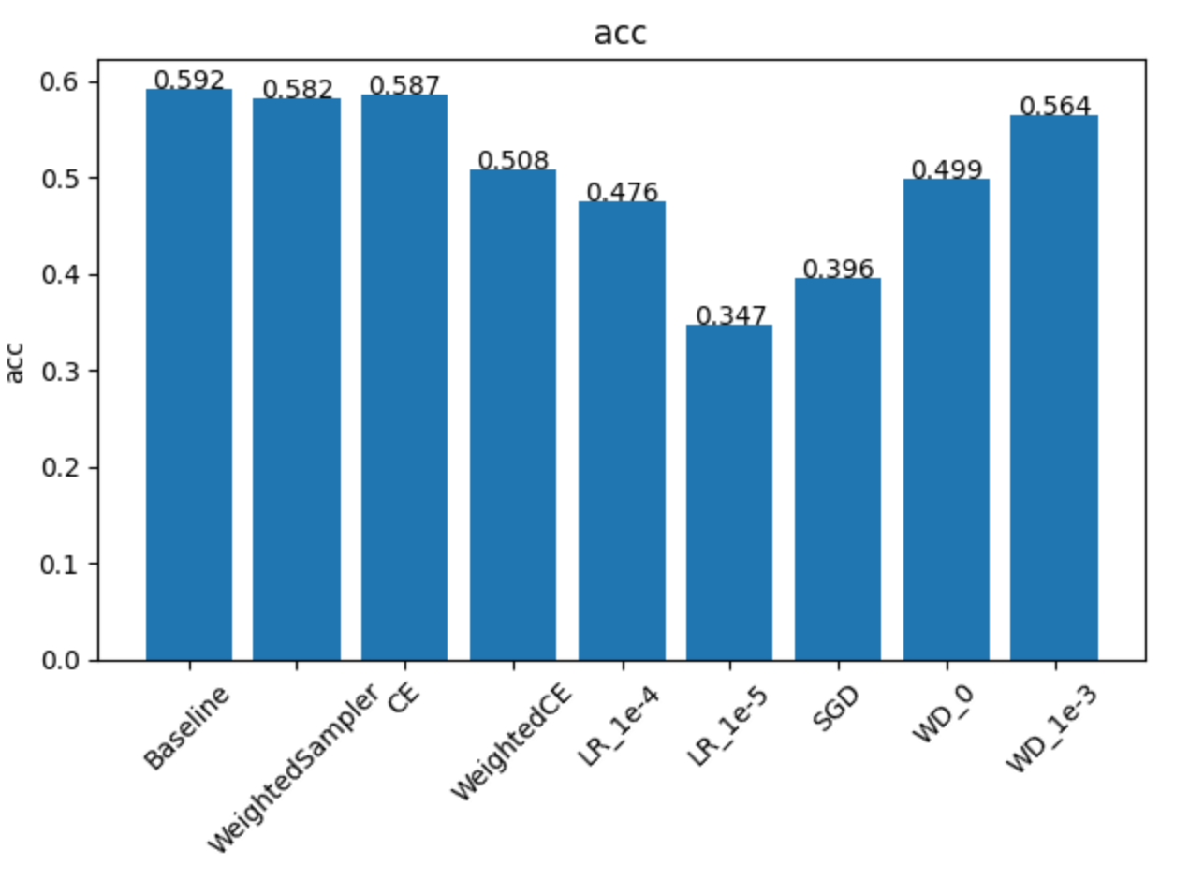
CNN Ablation Study
Accuracy

Slide 9
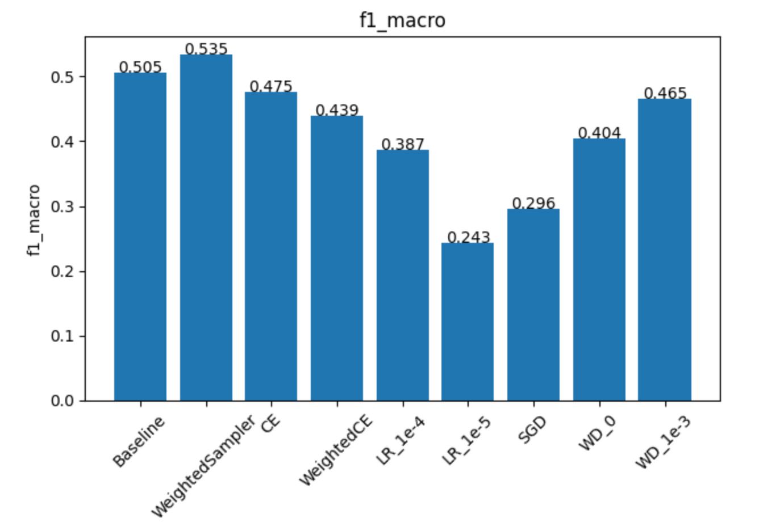
CNN Ablation Study
F1 Macro

Slide 10
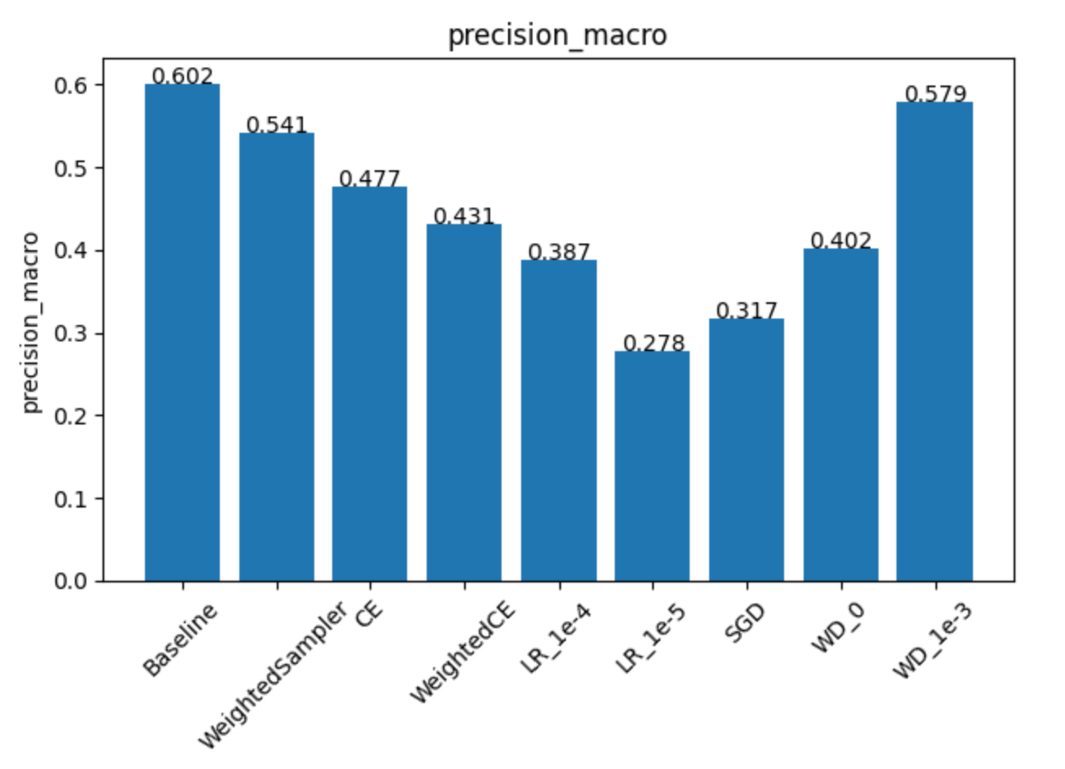

CNN Ablation Study
Precision and Recall Macro

Slide 11
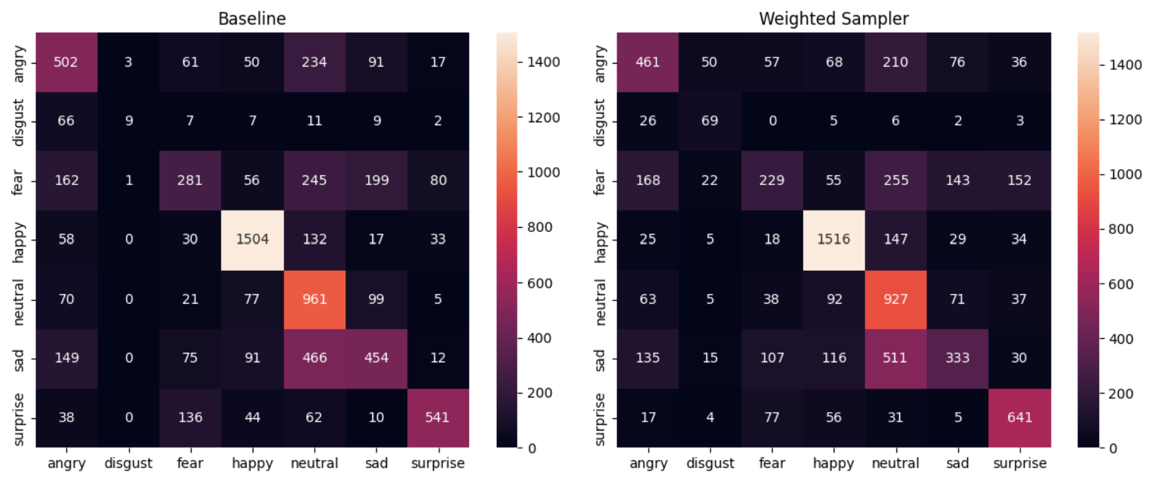
CNN Ablation Study
Confusion Matrix

Slide 12
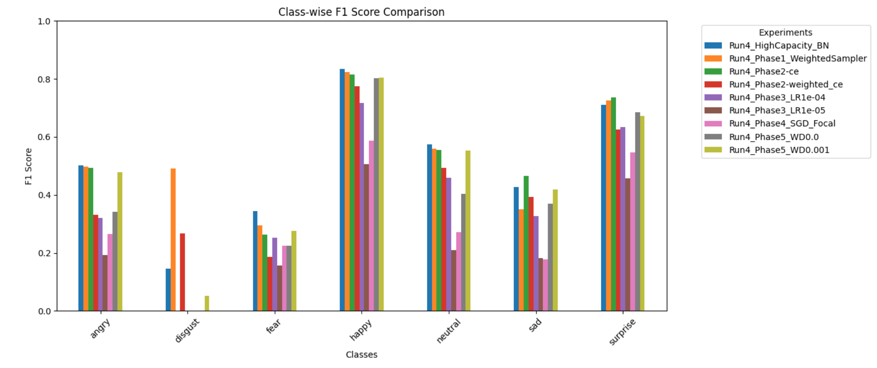
CNN Ablation Study
Class-wife F1 score comparison

Slide 13
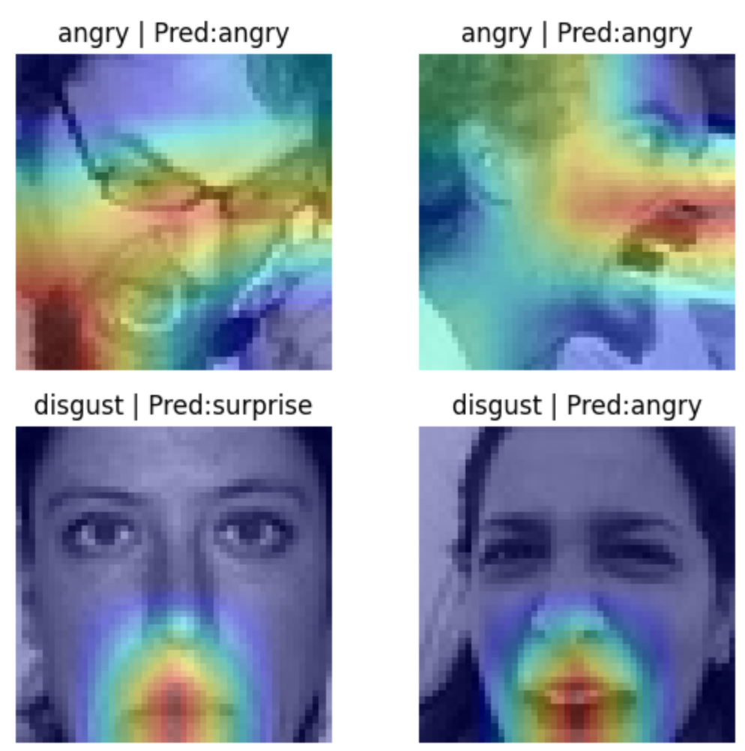
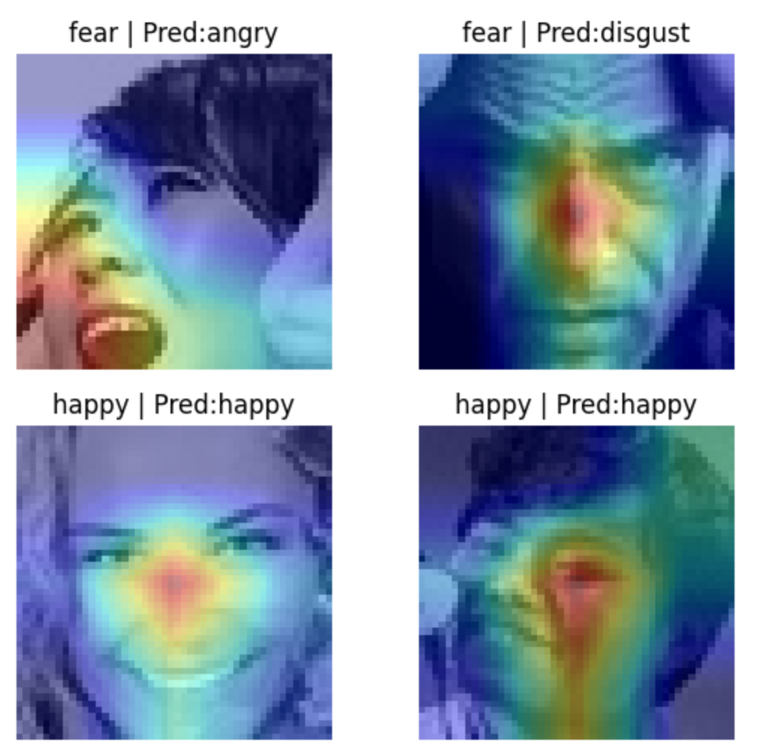
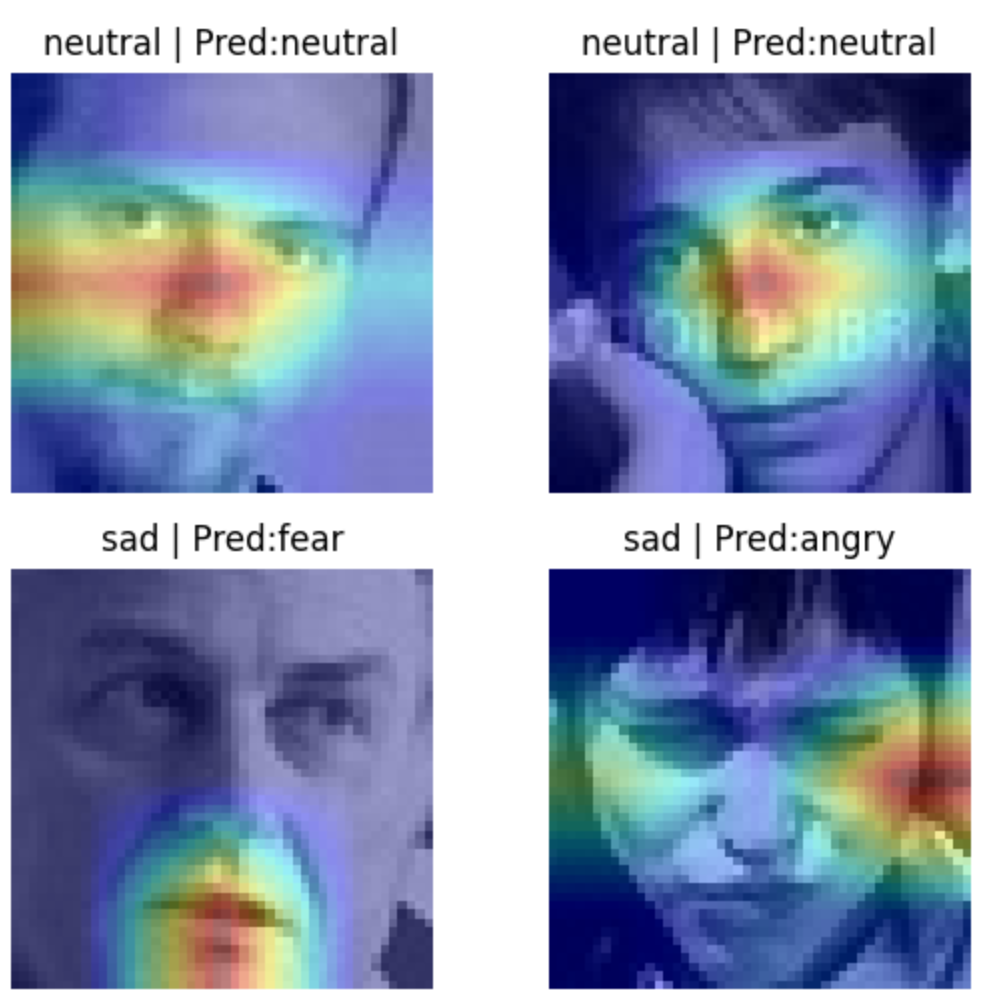
CNN Ablation Study
Grad-Cam Interpretation

Slide 14
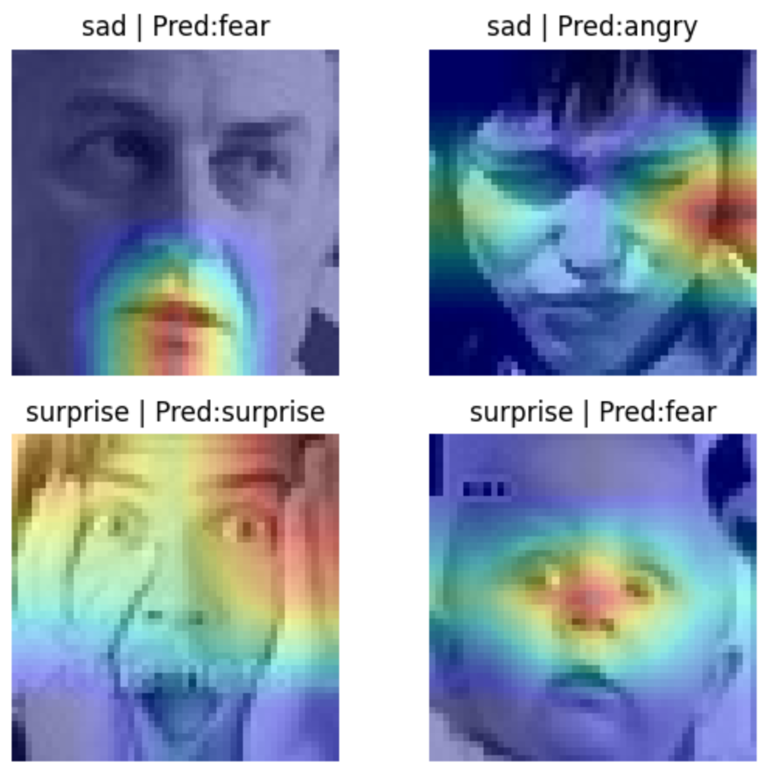
CNN Ablation Study
Grad-Cam Interpretation

Slide 15

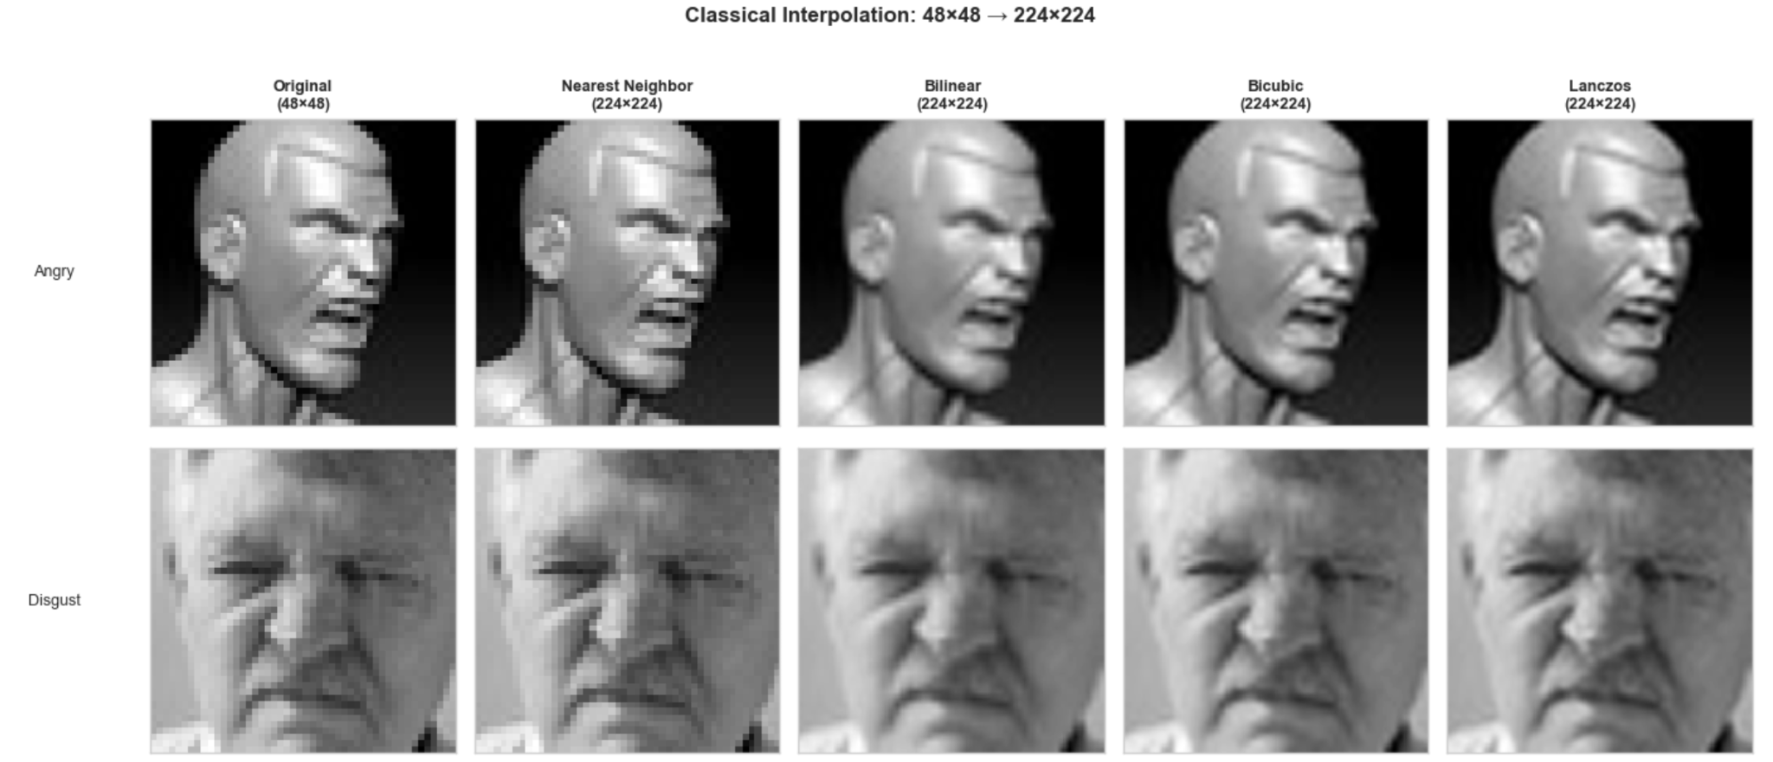
Transfer Learning
Classical Interpolation

Slide 16
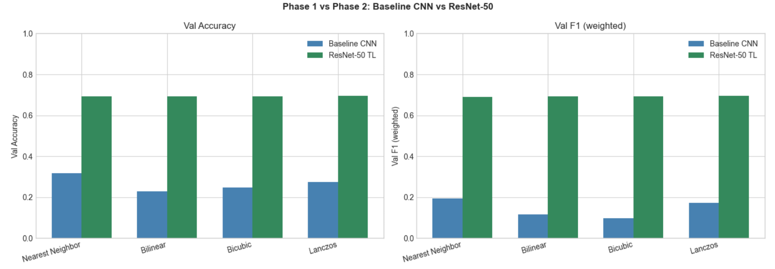
Transfer Learning
Baseline CNN vs ResNet-50 Interpolation comparison

Slide 17
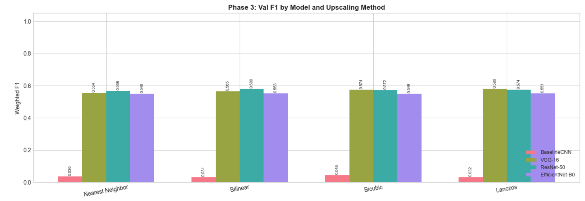
Transfer Learning
Interpolation Comparison F-1

Slide 18
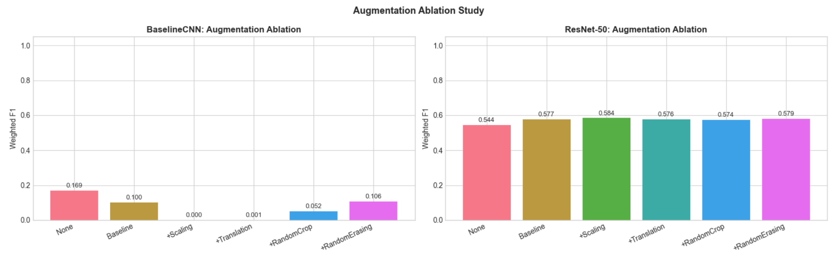
Transfer Learning
Augmentation Experimentation - CNN vs Resnet-50

Slide 19
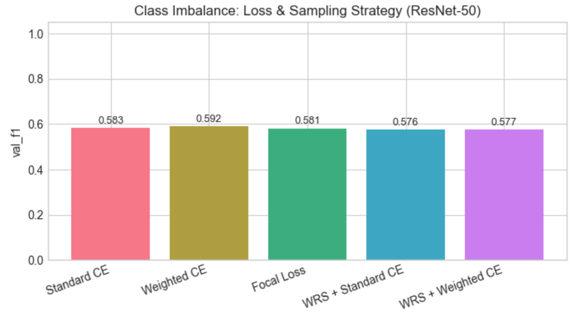
Transfer Learning
Loss Experimentation - ResNet-50

Slide 20
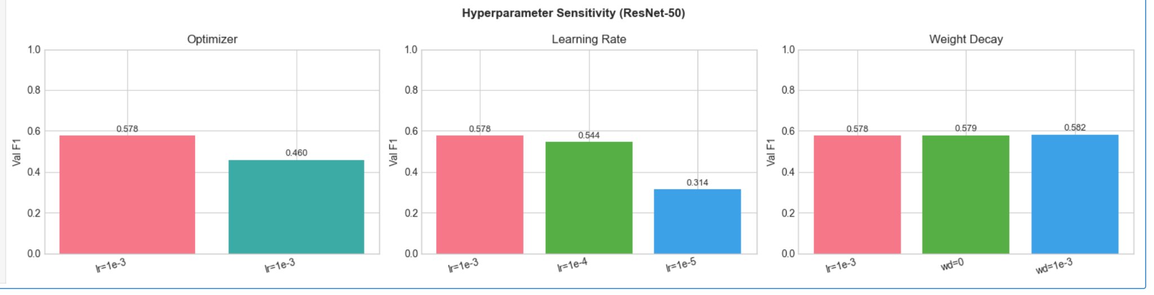
Transfer Learning
Hyperparameter Sensitivity

Slide 21
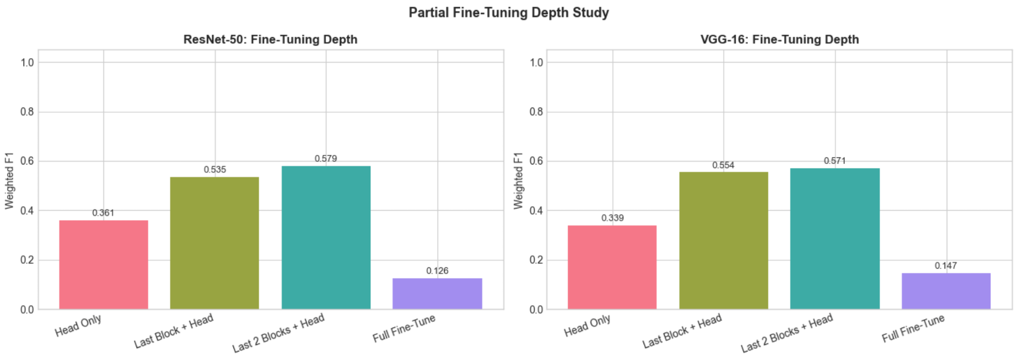
Transfer Learning
Fine Tuning Depth Study

Slide 22
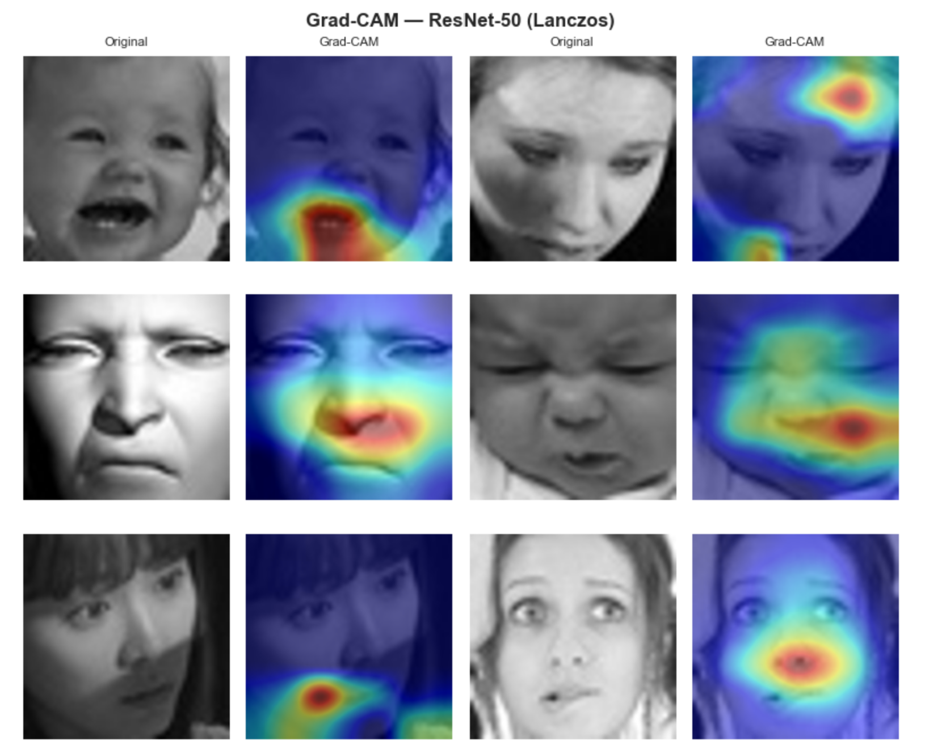
Transfer Learning
Grad-Cam

Slide 23
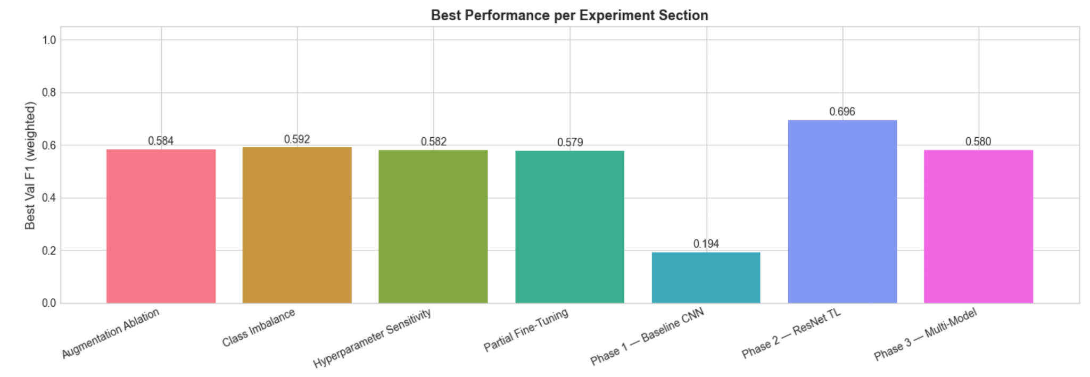
Transfer Learning
Conclusion

Slide 24
Transfer Learning
Conclusion
Transfer learning (ResNet-50, 70% accuracy) outperforms custom CNNs trained from scratch (60%).
Model architecture is the main performance driver; scaling/interpolation methods impact F1 score by only 1–3%.
Baseline augmentation (flip/rotation) yields the largest gains; complex geometric methods show diminishing returns.
Focal Loss provides the most stable performance boost for minority classes (Disgust, Fear).
Partial fine-tuning (last 1–2 blocks) prevents overfitting on noisy, high-variance datasets.
Grad-CAM confirms the model focuses on key facial features (eyes/mouth), not background noise.

