Slide 1

School of Electronics Engineering
Kalinga Institute of Industrial Technology, Bhubaneswar
SENTIVISION
Image-based sentiment intelligence: reading opinions from screenshots
B.Tech, Electronics & Computer Science Engineering · Academic year 2026–27 · November 2026
Abhipriya Mukherjee
2330206
OCR pipeline, preprocessing, segmentation
Shreyam Kumar Tiwari
2330267
Sentiment model, evaluation CLI, metrics
Rishita Dhar
2330330
FastAPI backend, database, tests
Natasha Bag
2330242
React dashboard, charts, report

Slide 2
Opinions are shared as images, and images can’t be analysed
PROBLEM, MOTIVATION AND SCOPE
People share opinions about products as screenshots: a page of reviews, a comment thread, a social post. The text inside is locked up. You can’t search it, count it or run it through a sentiment tool until someone types it out.
OCR turns pixels into characters; sentiment analysis judges the words. Each is well studied alone, but chaining them is messy: a small OCR mistake can flip a sentence’s meaning, and a screenshot rarely holds just one comment.
Scope and assumptions
English only, three classes: negative, neutral, positive
No training or fine-tuning of any model
No fake-review detection: it doesn’t judge whether a review is genuine
Legible input: text readable without heavy zooming
Fully local: after one-time model downloads, nothing leaves the machine
Why now
Feedback often only exists as images: app store reviews, chats, survey captures
Reading them by hand is slow and inconsistent between people
Pretrained transformers make the sentiment step easy; the hard part is clean text

Slide 3
Six objectives set at the start of the project
OBJECTIVES AND EXPECTED OUTCOMES
1
Read the screenshot
2
Separate the comments
Expected outcomes
Accept JPG, JPEG or PNG and extract text with OCR
Split text into individual comments, not one block
Web app and CLI that go from screenshot to sentiment in one step
Per-comment labels with class probabilities, plus summary charts
Reproducible evaluation reports: accuracy, precision, recall, F1, confusion matrix
A documented GitHub repository others can clone and run
3
Classify each comment
4
Show and correct
Negative, neutral or positive, with a confidence score
Dashboard where users fix OCR mistakes and re-run
5
Measure honestly
6
Keep a history
Evaluate on a labelled public dataset via a CLI
Store past analyses for later review

Slide 4
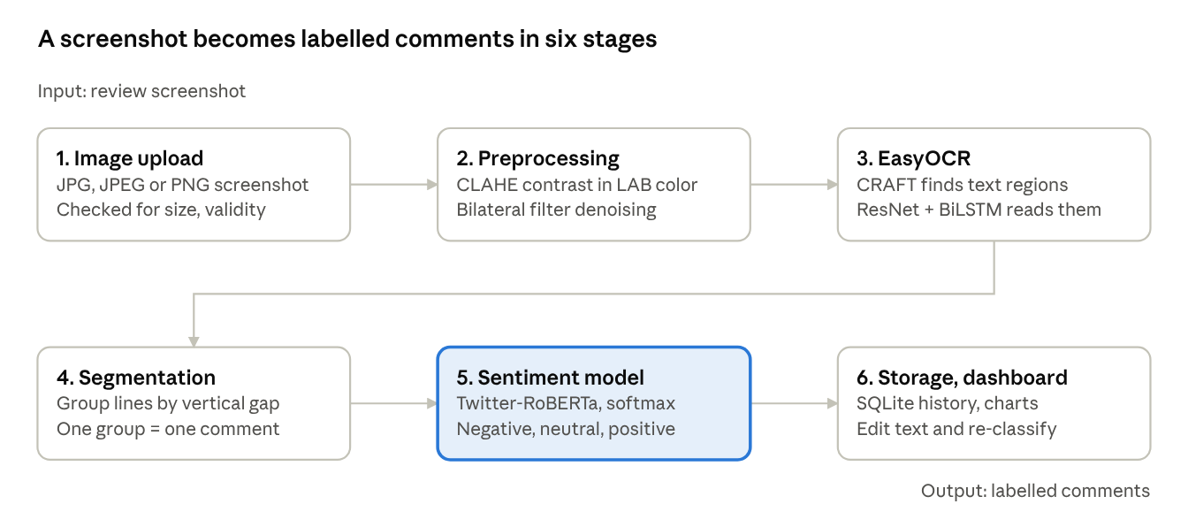
A screenshot becomes labelled comments in six stages
METHODOLOGY
Figure 1. Read the top row left to right, then the bottom row. The sentiment model (highlighted) is the only machine-learning step run for classification; no model was trained for this project.

Slide 5
What happens inside each stage
METHODOLOGY: STAGE BY STAGE
1
Upload and validation
2
Preprocessing
3
Text detection and recognition
JPG/JPEG/PNG checked for validity and size; corrupted files rejected. Batch mode takes up to 20 images, processed one at a time to keep memory low.
Convert to LAB and apply CLAHE to the lightness channel only, so faint text sharpens without colour shift. A bilateral filter removes noise but keeps letter edges.
EasyOCR: CRAFT finds text regions, ResNet + BiLSTM + CTC reads them. Each line returns a box, text and confidence; lines below 0.40 are dropped.
4
Comment segmentation
5
Sentiment classification
6
Storage and display
Lines sorted top to bottom; close lines are grouped, a large vertical gap starts a new comment. Purely geometric, so it needs no model and runs instantly.
Twitter-RoBERTa scores each class; softmax turns scores into probabilities. Top class = label, its probability = confidence. Label order read from the model config.
Results saved to SQLite and shown as cards with label, confidence and probabilities. Users can edit misread text and the comment is re-classified instantly.

Slide 6
How a comment is scored, and the choices behind the build
METHODOLOGY: KEY DETAILS
The model returns one raw score z per class. A softmax converts them into probabilities that sum to 1:
Design decisions
Pretrained models only
A strong classifier exists, so effort went into the pipeline around it.
P(c_{i}) = exp(z_{i}) / [ exp(z₁) + exp(z₂) + exp(z₃) ]
Labels read from the model
Hardcoding label order could silently swap results with another model.
The highest probability is the prediction and is shown as the confidence. Inference runs without gradient tracking, so the same text always gives the same answer. Corrected text from the editable cards is what gets saved to history.
One image at a time
Sequential batches keep memory low on an ordinary laptop.
0.40
default OCR confidence cutoff, set by OCR_CONFIDENCE_THRESHOLD in .env, so stray marks and icons don’t become fake comments
Mocked models in tests
Tests finish quickly and run fully offline.

Slide 7
Two pretrained models and a laptop-friendly stack
MODELS AND TOOLS
Task | Model
Sentiment | cardiffnlp/twitter-roberta-base-sentiment-latest
Text detection | CRAFT (inside EasyOCR)
Text recognition | ResNet + BiLSTM + CTC (inside EasyOCR)
Evaluation data | TweetEval sentiment test split (cardiffnlp/tweet_eval)
Area | Tools
Frontend | React 18, TypeScript, Vite, Tailwind, Recharts
Backend | FastAPI, Pydantic v2, Uvicorn, SQLAlchemy + SQLite
ML / vision | PyTorch, HF Transformers, OpenCV, Pillow
Evaluation | Scikit-learn, Pandas, NumPy, Matplotlib
CLI / tests | Typer, Rich, HF datasets / pytest
125M
12
12
~124M
parameters
layers
attention heads
tweets pretrained
Python 3.11+, Node 18+. Runs on CPU, uses a CUDA GPU if found. First run downloads ~100 MB OCR weights and ~500 MB for RoBERTa.
Trained on short, informal social media text, so it handles comment-style reviews well. Self-attention lets it tell “not good” from “good”.

Slide 8
Four parts, six pages, eight API routes
IMPLEMENTATION AND USABILITY
Backend
FastAPI; models load once at startup so each request only pays for inference
Pages
 | Route
GET | /api/health
GET | /api/model/info
POST | /api/analyze/text
POST | /api/analyze/image
POST | /api/analyze/batch
POST | /api/evaluate
GET | /api/history
DELETE | /api/history/{id}
Overview: readiness and sentiment charts
Analyze: one image, editable cards
Batch: up to 20 images, CSV export
Evaluation Lab: metrics from a labelled CSV
History: reopen or delete past runs
Settings: model, device, labels, OCR
Frontend
React + Vite; donut, grouped bars and trend charts; light and dark themes
CLI
Typer; predicts text or CSV, downloads datasets, runs evaluations
Database
SQLite via SQLAlchemy; stores every analysis for the History page
pytest suite with mocked models covers OCR, sentiment, API routes and evaluator maths.

Slide 9
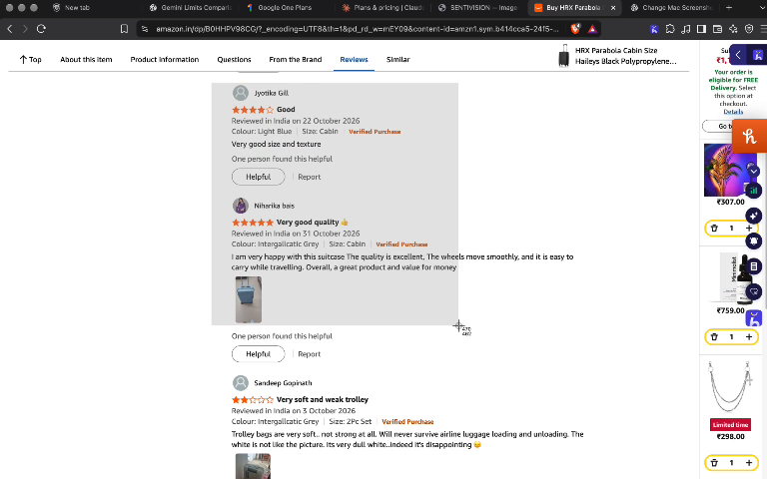
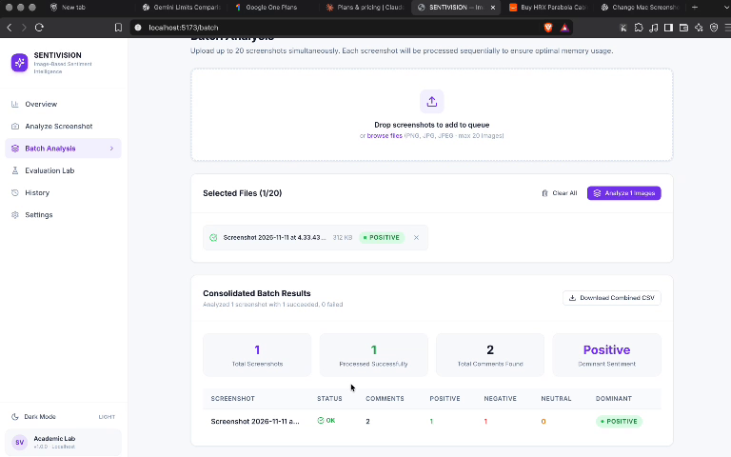
From a single sentence to a real Amazon screenshot
RESULTS: SAMPLE OUTPUTS
“The product quality is superb! Highly recommend.”
POSITIVE 96.8% confidence
Figure 2. Input: two Amazon product reviews.
Figure 3. Batch Analysis: 2 comments, 1 positive, 1 negative.
Each detected comment gets a card with OCR text, label, confidence and all three probabilities, plus a summary donut for the image. Both reviews were rated 4 and 5 stars, yet one was labelled negative: a reminder that an OCR misread, or a line that isn’t a review, can change the outcome.
CLI prediction; class probabilities sum to 100%.

Slide 10
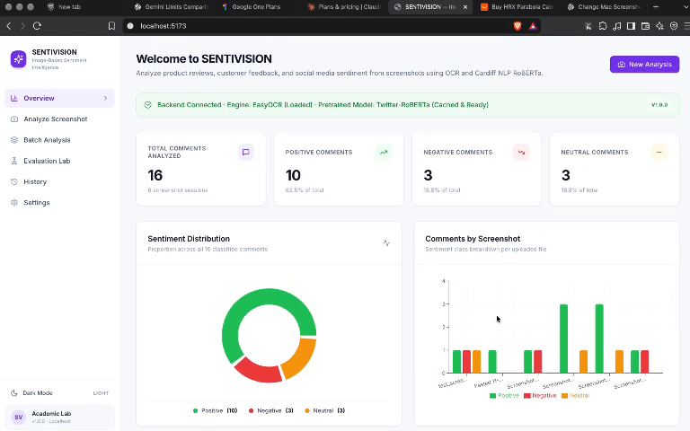
16 comments across 8 screenshot sessions
RESULTS: DASHBOARD AND OBSERVATIONS
10 positive
3 negative
3 neutral
Observations
Clear comments, high confidence: strongly worded text is classified with ease
Neutral is hardest: mixed or factual comments sit between labels
OCR drives the result: misreads can change sentiment, hence editable cards
Spacing-based splitting works when comments have clear gaps between them
Figure 4. Overview dashboard. Settings: CPU inference, labels 0 neg · 1 neu · 2 pos, OCR cutoff 0.40.

Slide 11
Measured on TweetEval, with known weak spots
EVALUATION AND LIMITATIONS
Metric | Value
Samples evaluated | [from metrics.json]
Accuracy | [from metrics.json]
Macro F1 (headline) | [from metrics.json]
Weighted F1 | [from metrics.json]
Macro precision / recall | [from metrics.json]
Limitations
Domain gap: fine-tuned on tweets, so long or technical reviews may score lower
Three classes only: no sarcasm detection or aspect-level sentiment
Hard images: stylised fonts, tiny text, low resolution and emoji trip up OCR
Layout-sensitive: packed or multi-column layouts can be split wrongly
English only, and large batches are slow on CPU
F1 = (2 × Precision × Recall) / (Precision + Recall)
Macro F1 weights the three classes equally, so a large neutral class can’t hide weak results. Each run saves metrics.json, a confusion matrix, predictions and misclassified samples under reports/.

Slide 12
CONCLUSION AND FUTURE SCOPE
Useful tools come from well-chosen pretrained models joined with careful engineering
SENTIVISION meets its objectives: it reads text from screenshots, separates comments, classifies them, shows results clearly and reports accuracy on a public dataset.
The hardest part sat between the two models, not inside them. Letting users correct text before scoring fixed many problems; reading label order from the model config avoided silent errors.
Future scope
Fine-tune on product review data
Multilingual OCR and sentiment
Aspect-level sentiment (price, delivery, quality)
Layout analysis for multi-column pages and chat bubbles
Stronger OCR: deskewing, upscaling, other engines
Parallel GPU batches and CSV/PDF export
github.com/enort3533/sentivision
Key references: Liu et al. 2019 (RoBERTa) · Barbieri et al. 2020 (TweetEval) · Loureiro et al. 2022 (TimeLMs) · Baek et al. 2019 (CRAFT) · Zuiderveld 1994 (CLAHE) · Wolf et al. 2020 (Transformers) · EasyOCR · FastAPI

