Slide 1
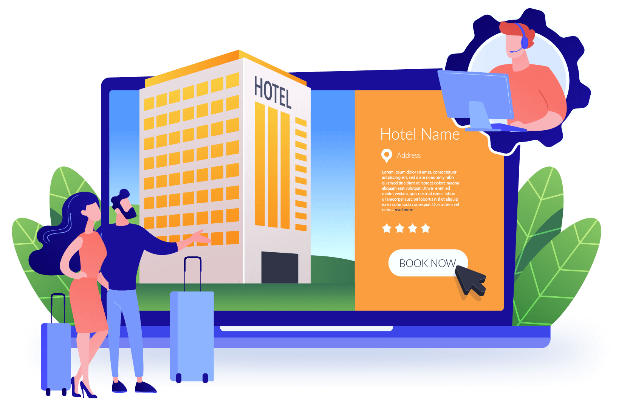
HOTEL MANAGEMENT
HOTEL MANAGEMENT
SYSTEM
- Project Report -

Slide 2
Contents
INTRODUCTION
Introduction
Product Scope
Methodology
ER diagram
Diagrams
Our project proposal is for the development of a hotel management system for Rico Shadow Guesthouse and Restaurant, located in Kammala North, Waikkala. Our proposed system aims to modernize the hotel's manual file-based system and provide a more efficient and secure way of managing hotel operations.​

Slide 3

Product Scope
INTRODUCTION
Our project report is for the development of a hotel management system for Rico Shadow Guesthouse and Restaurant, located in Kammala North, Waikkala. Our proposed system aims to modernize the hotel's manual file-based system and provide a more efficient way of managing hotel operations.​

Slide 4
Product Scope
Our project aims to develop a web-based hotel management system that addresses the challenges of their current manual system. The system will encompass various key functionalities, including room booking and food ordering
Requirements and Analysis
we conducted in-depth discussions with hotel staff, management to gather their input and understand their needs

Slide 5


Our project aims to develop a web-based hotel management system that addresses the challenges of their current manual system. The system will encompass various key functionalities, including room booking and food ordering
Methodology
Requirements and Analysis
we conducted in-depth discussions with hotel staff, management to gather their input and understand their needs
Design
visualize the user interfaces of the room booking module and the kitchen system. Additionally, we designed the database schema to store information

Slide 6
Methodology
Design
visualize the user interfaces of the room booking module and the kitchen system. Additionally, we designed the database schema to store information
Implementation
we transformed the design specifications into a working hotel management system. We developed the backend and frontend components of the room booking and kitchen

Slide 7
Methodology
Implementation
we transformed the design specifications into a working hotel management system. We developed the backend and frontend components of the room booking and kitchen
Testing
We performed unit testing to verify the individual components, integration testing

Slide 8
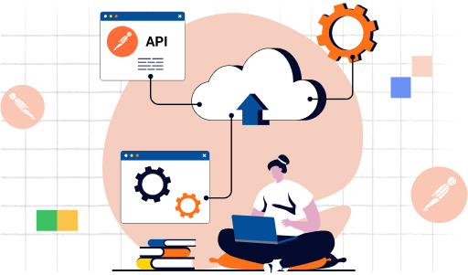
Methodology
Testing
We performed unit testing to verify the individual components, integration testing

Slide 9
Methodology
Testing
We performed unit testing to verify the individual components, integration testing

