Slide 1

Pacman by TiM

Slide 2
Team project
What is our game
Our adaptation of the classic arcade game pacman
Who would love our game
Fans of classic arcade games and casual gamers will love our game for its nostalgic charm
Where can it be found:
https://github.com/enoxum/UbiBelPMF_2024/tree/TiM
Notes:
You should have a working knowledge
of basic object-oriented programming concepts and at least some experience
programming in C++.

Slide 3
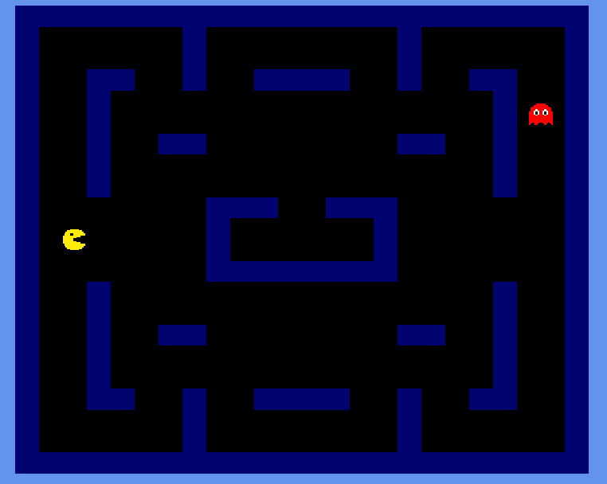
screenshots
The race is about to begin!
Notes:
The two players are getting ready for the race.

Slide 4
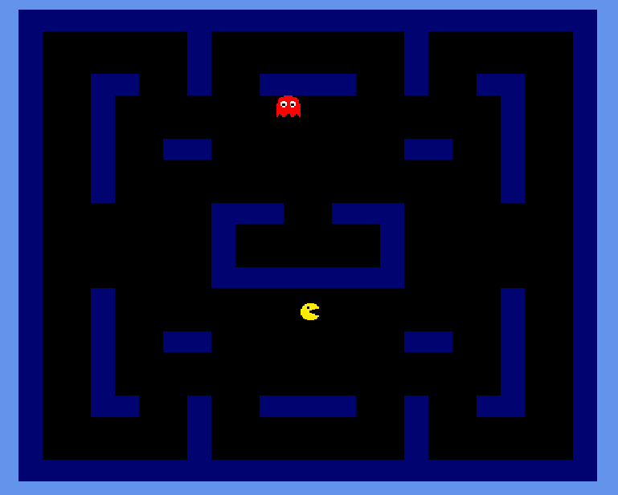
screenshots
Notes:
Race begins, player 2 in the lead.

Slide 5
Team members
Tihomir Stojkovic 283/2018
Minja Stankov 391/2021
Notes:
You should have a working knowledge
of basic object-oriented programming concepts and at least some experience
programming in C++.

Slide 6
Game description
The player has agency through controlling the main character, Pacman, to navigate through the maze, consume pellets, avoid ghosts
The game is situated within a maze-like environment filled with pellets and ghosts
In our game, players are expected to use their skills of strategy, timing, and quick reflexes to navigate Pacman through the maze, consume pellets to clear levels, avoid ghosts, and ultimately achieve the highest score possible within the given constraints of each level
Notes:
You should have a working knowledge
of basic object-oriented programming concepts and at least some experience
programming in C++.

Slide 7
Game description
Our mission is not easy because as players progress through the game, the maze becomes increasingly complex, with faster and more aggressive ghosts, tighter spaces, and limited opportunities to evade capture. Additionally, players must contend with time constraints and the pressure to achieve high scores, adding to the challenge.
players can strategically plan their routes to maximize pellet consumption and minimize encounters with ghosts. They can also rely on quick reflexes and decision-making skills to navigate the maze effectively
Notes:
You should have a working knowledge
of basic object-oriented programming concepts and at least some experience
programming in C++.

Slide 8
Game features
Controls: Pacman can move by using
‘W’, ‘A’, ‘S’, ‘D’ keys Implemented by Tihomir
Notes:
You should have a working knowledge
of basic object-oriented programming concepts and at least some experience
programming in C++.

Slide 9
Game features
Controls: Ghosts move :
autonomously
Implemented by Minja
Notes:
You should have a working knowledge
of basic object-oriented programming concepts and at least some experience
programming in C++.

Slide 10
Game features
Maze, Collision
Implemented by Minja & Tihomir
Notes:
You should have a working knowledge
of basic object-oriented programming concepts and at least some experience
programming in C++.

Slide 11
Game features
Win Conditions:
Players win by clearing all the pellets from the maze, completing the current level.
Lose Conditions:
Players lose a life if Pacman comes into contact with a ghost
Implemented by Tihomir & Minja
Notes:
You should have a working knowledge
of basic object-oriented programming concepts and at least some experience
programming in C++.

Slide 12
Postmortem
What went well?
Effective Communication
Code Consistency
Division of Tasks
Problem-solving
Notes:
You should have a working knowledge
of basic object-oriented programming concepts and at least some experience
programming in C++.

Slide 13
Postmortem
Features not implemented:
Power-ups for consuming ghosts
Notes:
You should have a working knowledge
of basic object-oriented programming concepts and at least some experience
programming in C++.

Slide 14
Postmortem
What went wrong?
In case we had multiple ghosts, they always moved identically; we couldn't separate them. We were stuck on this problem for a long time
Notes:
You should have a working knowledge
of basic object-oriented programming concepts and at least some experience
programming in C++.

Slide 15
Postmortem
If we could start over, we would:
start earlier
Notes:
You should have a working knowledge
of basic object-oriented programming concepts and at least some experience
programming in C++.

Slide 16
Postmortem
What have we learned?
Working in teams can be fun but also challenging
Dagger can be confusing in the beginning, but once you get used to it, it is great
Notes:
You should have a working knowledge
of basic object-oriented programming concepts and at least some experience
programming in C++.

Slide 17
Thank you!
Notes:
You should have a working knowledge
of basic object-oriented programming concepts and at least some experience
programming in C++.

Slide 18
Questions
Notes:
You should have a working knowledge
of basic object-oriented programming concepts and at least some experience
programming in C++.

