Slide 1

Customer Churn Analysis in Banking Sector
Yinong Yao
Notes:
Good Afternoon Everyone!
Our dynamic business consulting team: Cristin, Eno, Angga, and I, recently took on the challenge on addressing customer churn issue for a leading bank.

Slide 2
FLOW CHART INFOGRAPHICS
The key is always you
Notes:
Now, picture this: a continuous stream of people flooding out of a bank. When customers leave, switching sides or shutting their accounts, that’s what we call customer churn. And it’s a big roadblock for banks aiming for solid growth and profitability.

Slide 3

Let’s help Tommy!
We are losing customers!!!
High Service Fees
Peer Competition
Low Interest Rates
A Lack of Relevant Financial Products
...
Poor Services
Customer Services Manager at ABC Bank
Notes:
This brings us to our client–Tommy, a customer services manager at ABC Bank. Seeing these numbers and trends, he was quite troubled. While there are numerous factors contributing to the customer churn, a key churn rate can often highlight underlying issues in customer services. So, he came to us and hoping we could find ways to turn the tide.

Slide 4

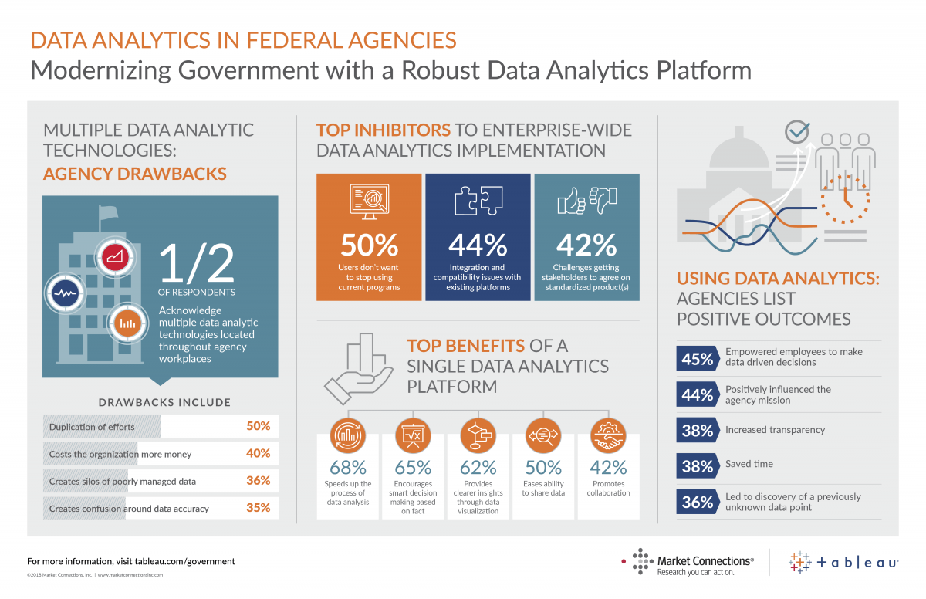


Executive Summary
Problem
Data Analysis & Visualization
Recommendation
Product & Service Improvement
Target Group Focus
Business Expansion Analysis
In Banking sector, the organic growth nowadays is greatly hindered by high customer churn rate
Using Excel to carry out data cleaning
Using Tableau to create data visualization
Notes:
Well, here’s a quick summary for you.
The big challenge? ABC bank is losing customers.
Our game plan? We’re harnessing the power of R and Excel to filter customer data and using tableau to draw a clear picture.
And the end goal? To arm Tommy and his team with a detailed analytics report, complete with strategic recommendations that can make a real difference.

Slide 5
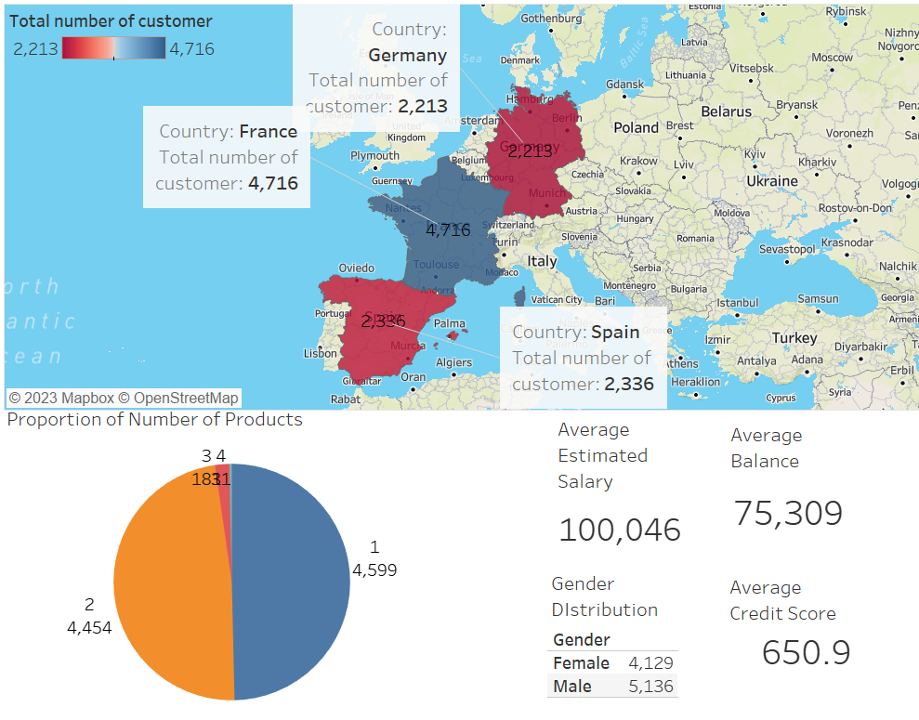
Overview
There are many variations
There are many variations
There are many variations
There are many variations

Slide 6
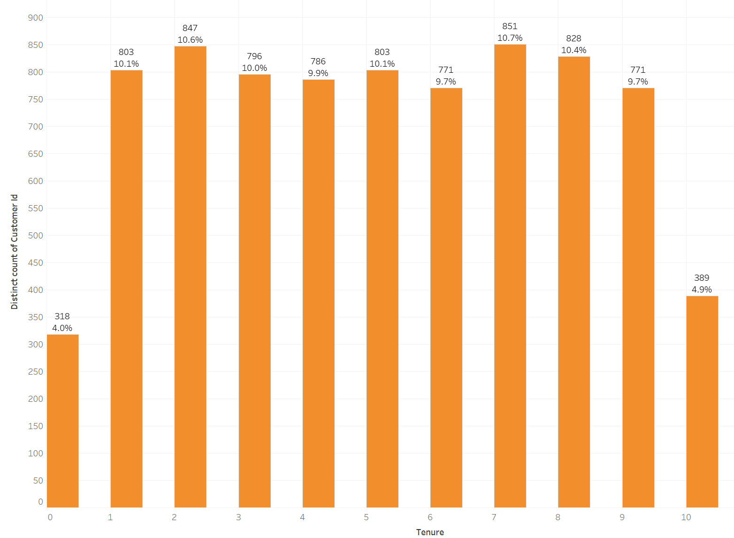
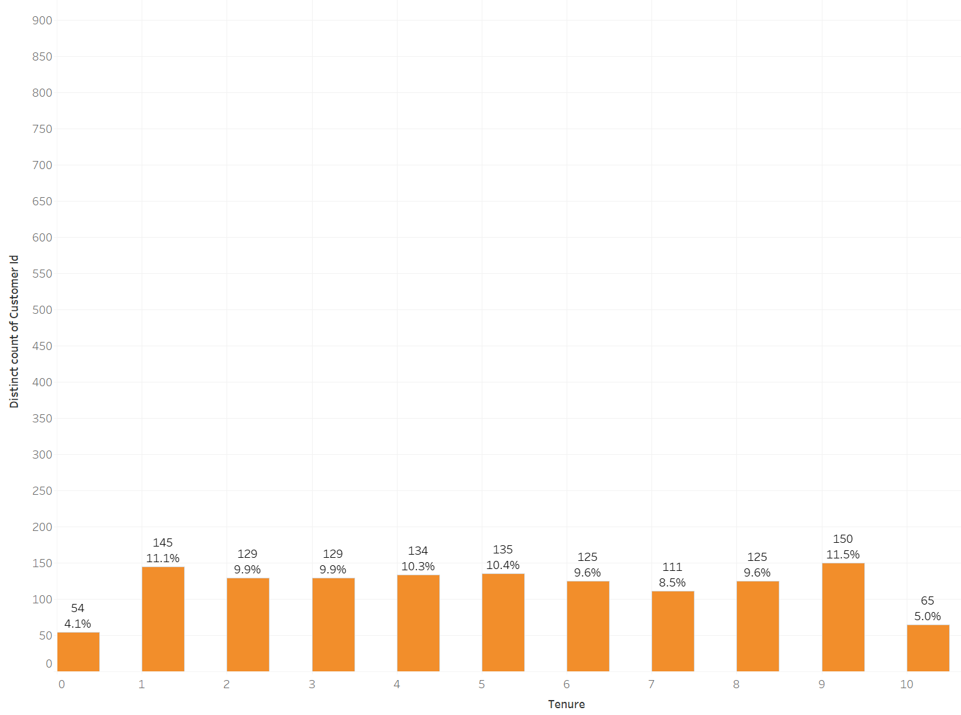
Numbers of Customers Categorized by Customer Relationship with Bank
Non-Churned Group
Churned Group
The distribution has a high level similarity for both groups.
Tenure might have low correlation with customer churn rate.

Slide 7
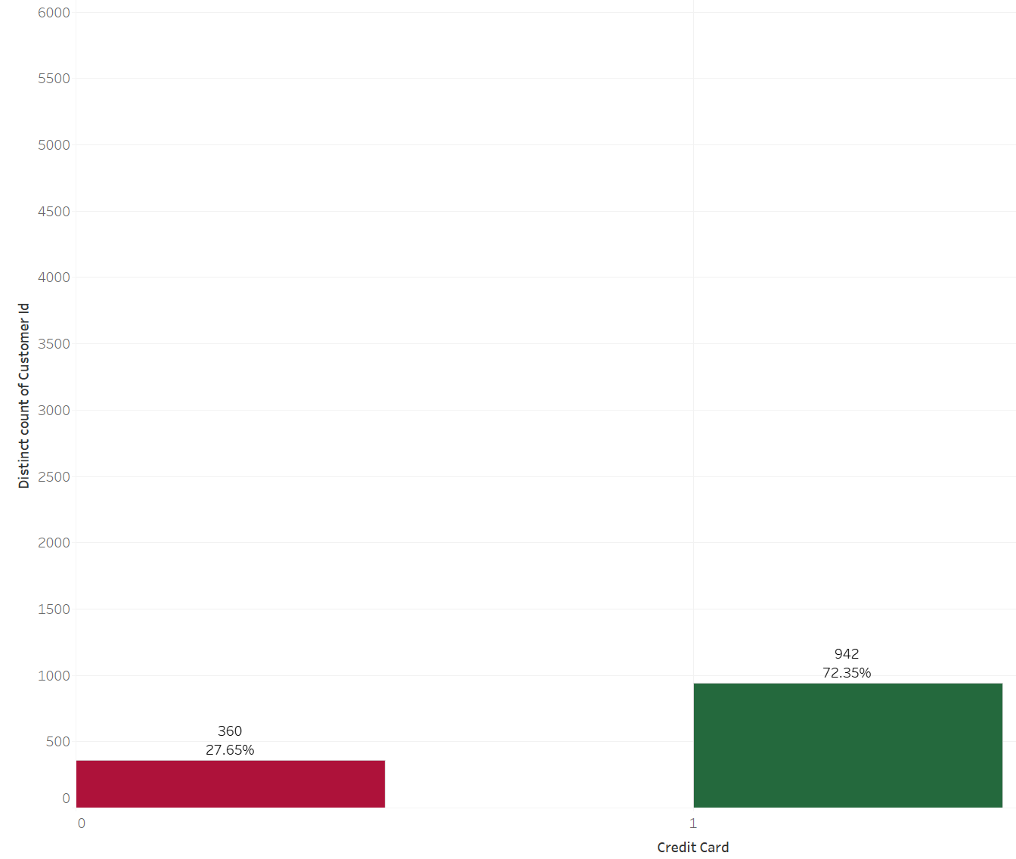
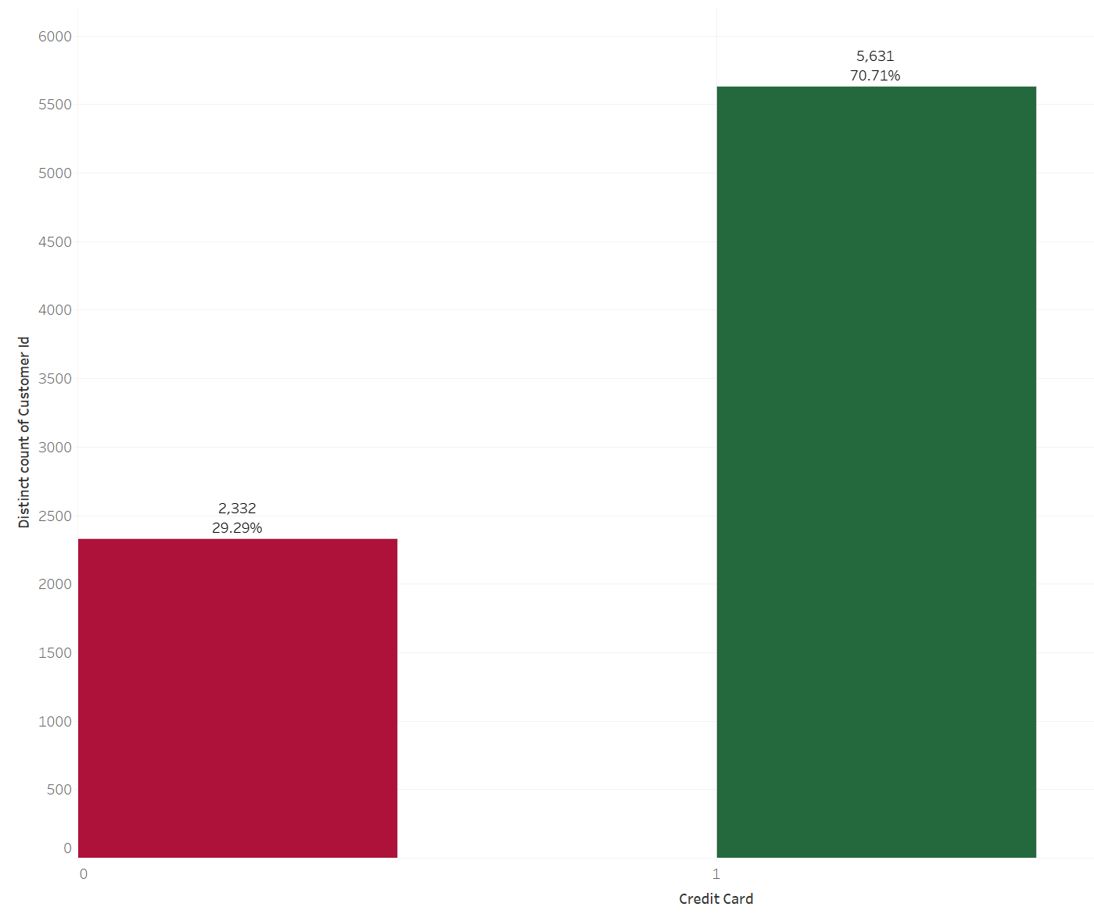
Customers Amount by Credit Card Ownership
Non-Churned Group
The percentage of having credit card in non-churned group is similar to the churn group.
Churned Group
It can be predicted that ownership of credit card has little effect on churn rate.

Slide 8
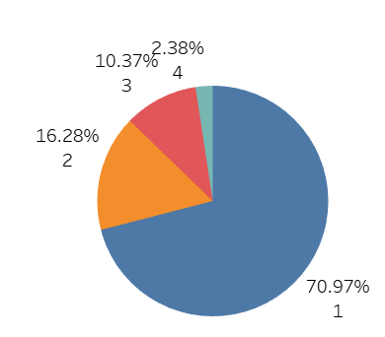
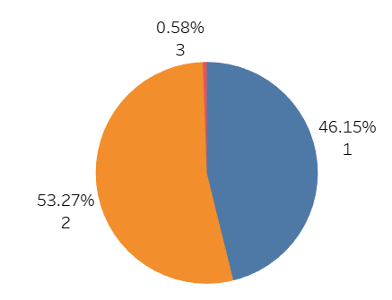
Customers Amount by Number of Products Purchased
For Non-Churned Customers
99% of customers will choose one or two products
For Churned Customers
The customers who have more than 2 products are more likely to churn

Slide 9
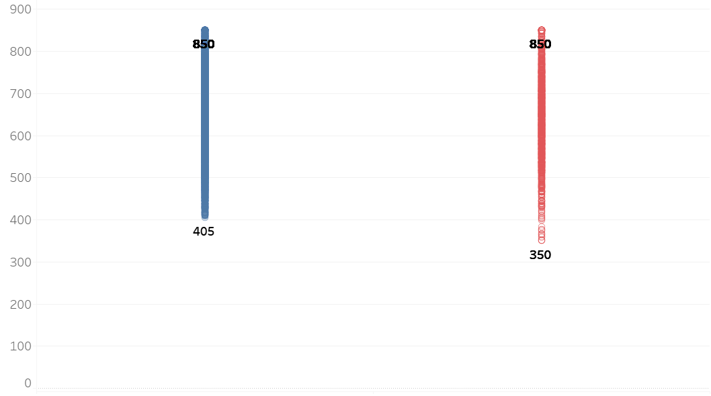
Credit Score Comparison: Non-Churned vs. Churned Customers
Credit Score
404
Credit Score < 405
Non-Churned
Churned
Similar Credit Score range between Non-churned & Churned customers
Exercise caution concerning customers with Credit Score < 405

Slide 10
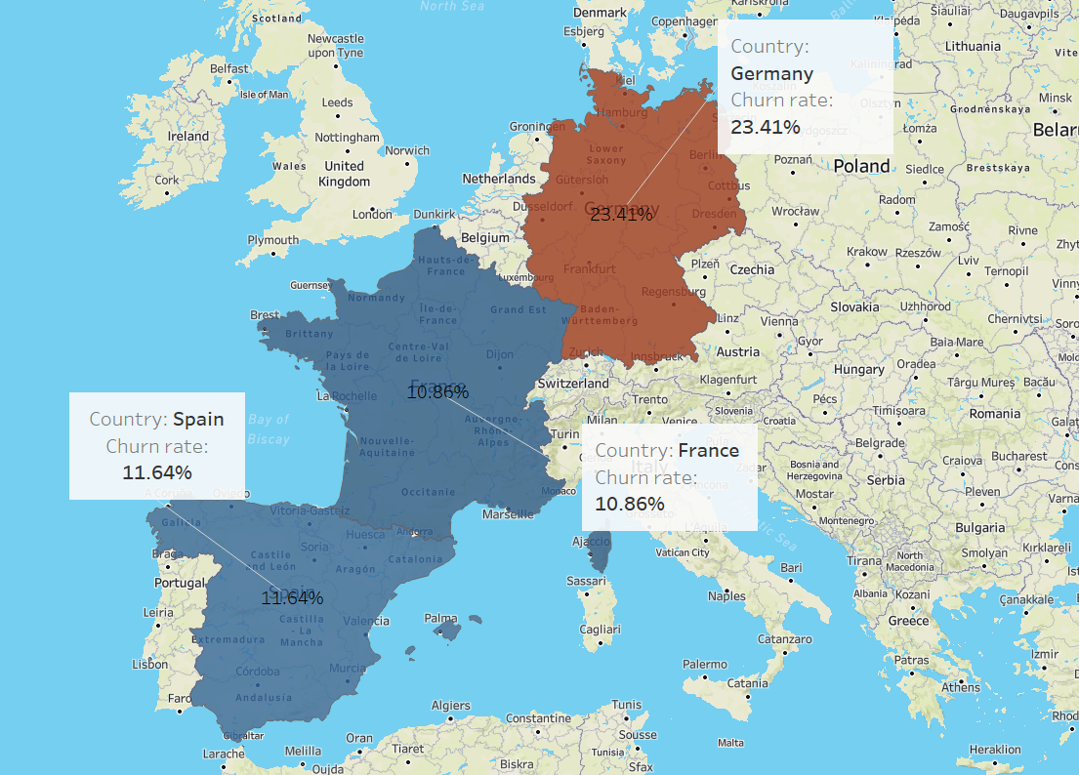
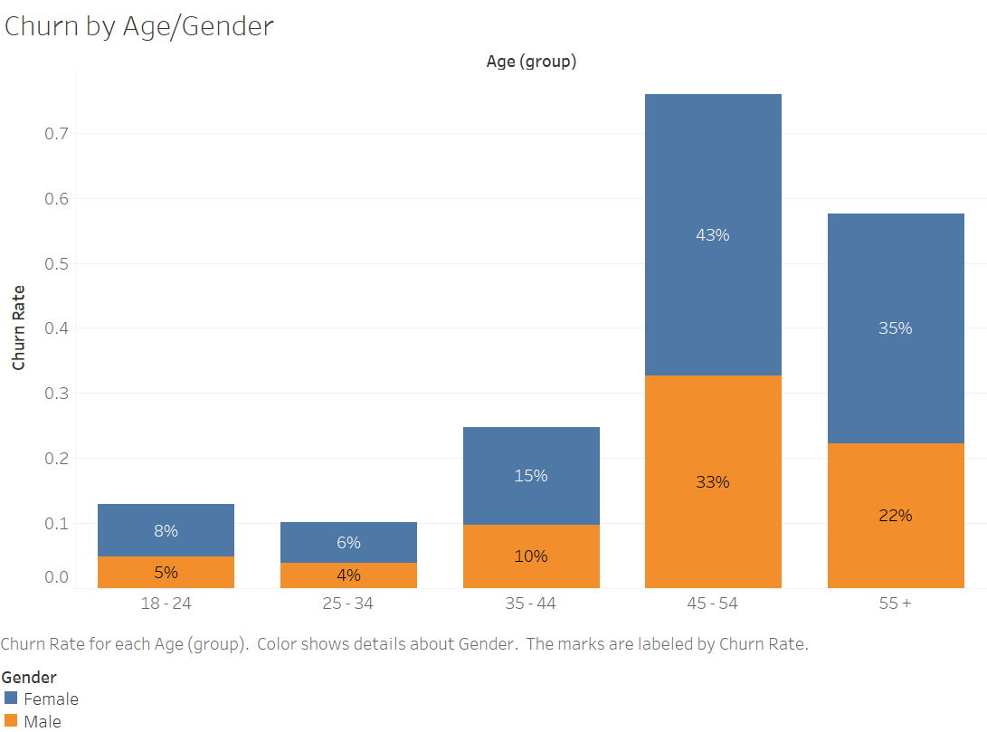
Churn Rate Across Countries
Churn Rate grouped by Age & Gender
Germany has the highest churn rate which is more than double of the other countries.
The group of age 45-54 has the highest churn rate, higher amongst female demography.

Slide 11
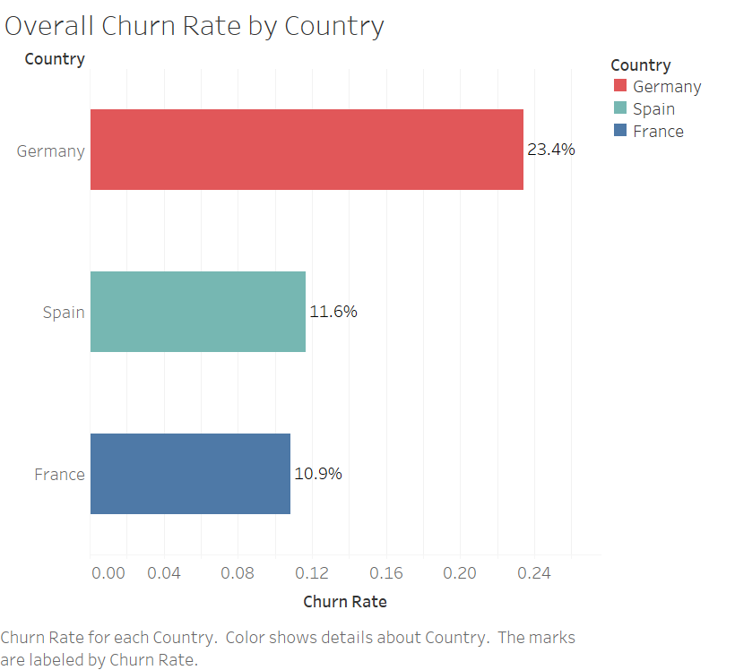
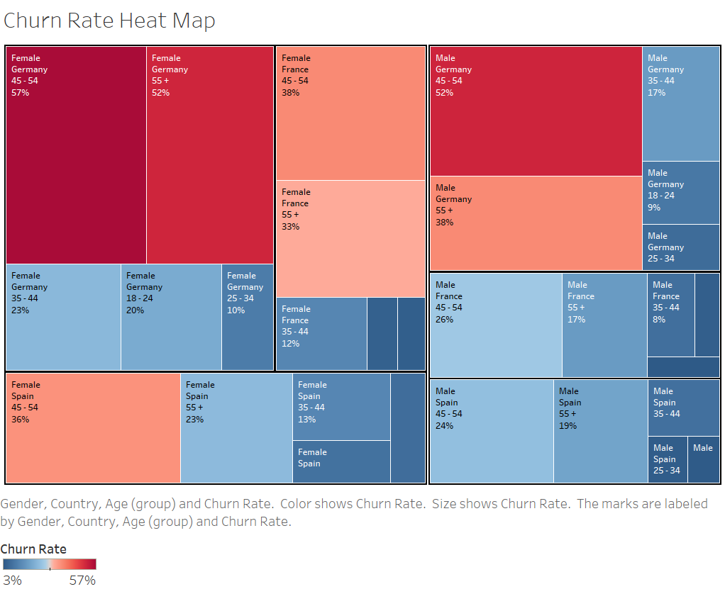
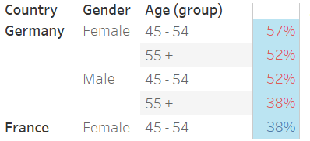
Churn Rate Comparison Between Segments
Overall Country Churn Rate
Heat Map
Top 5 Highest Churn Rate by Segment
Significant churn rate in Germany driven by Female aged 45 ≤

Slide 12
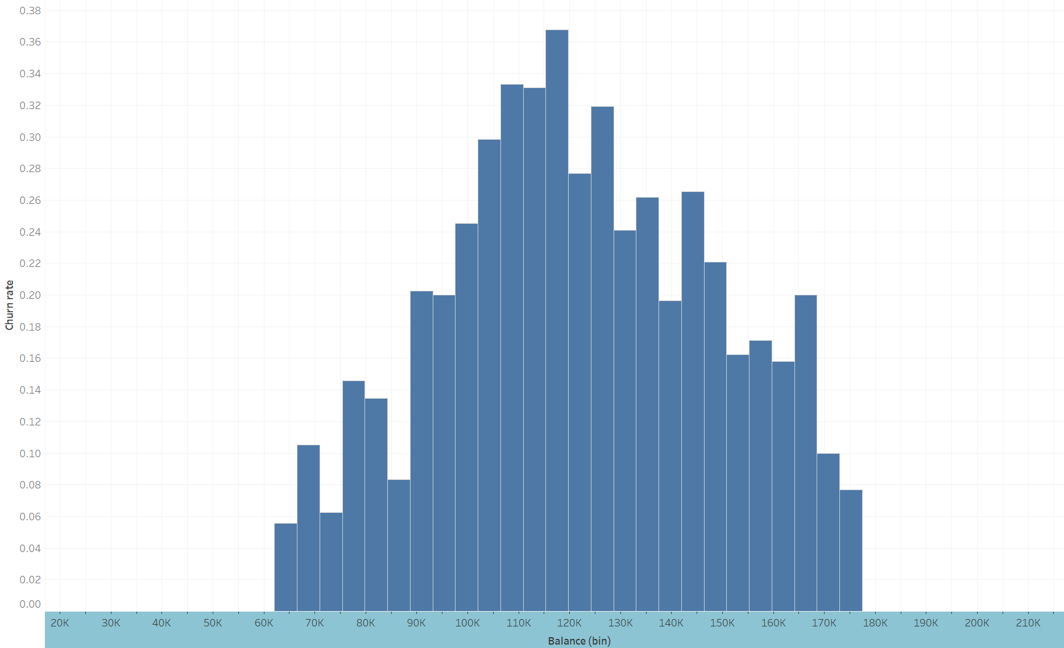

Taking A Deeper Look At Germany
Churn Rate Across Balance for Germany
Germany
The balance range from 100k to 130k has the highest churn rate.

Slide 13
Findings
Recommendations
Improving
Products & Services
Product Subscription
Focusing on
Middle Class & Generation X
Customer Segments
Market Analytics &
Business Expansion
Location Dynamics
Notes:
finding: alarming trend observed with customers subscribed to more than 2 products. recommendation:dive deeper into the product subscription trend. develop a Focus group discussions which can unveil the causes behind the high churn in this segment.
finding： middle-aged customers (aged 45-54 years) showed a higher tendency to leave, while younger customers formed the majority of the retained clients. Gender discrepancies were also noted, with females being more inclined to churn. recommendation: develop targeted strategies for the 45-54 age group and Financial planning seminars focused on their specific needs. Given the higher churn among females, a gender-specific analysis should be conducted to tailor products and services better.
finding: French branches dominate the customer base but German branches stand out with the highest churn rate, suggesting underlying issues specific to this location. after analyzing deeper into German branches, recommendation: we should pay more attention and develop targeted strategies for the customers with the balance range from 100k to 130k since this range has the highest churn rate. Additionally, we could develop expansion strategies targeting Germany, Spain, and potential surrounding countries.

Slide 14
Q & A Session
Thank You!!!

