Slide 1

CanadaRetail's Strategic HR Challenge
Yinong Yao

Slide 2

Improve employer branding

Slide 3
CONTENT
01
04
Introduction
Training and development
02
05
Recruitment
Payment and Compensation
03
06
Selection
Conclusion

Slide 4
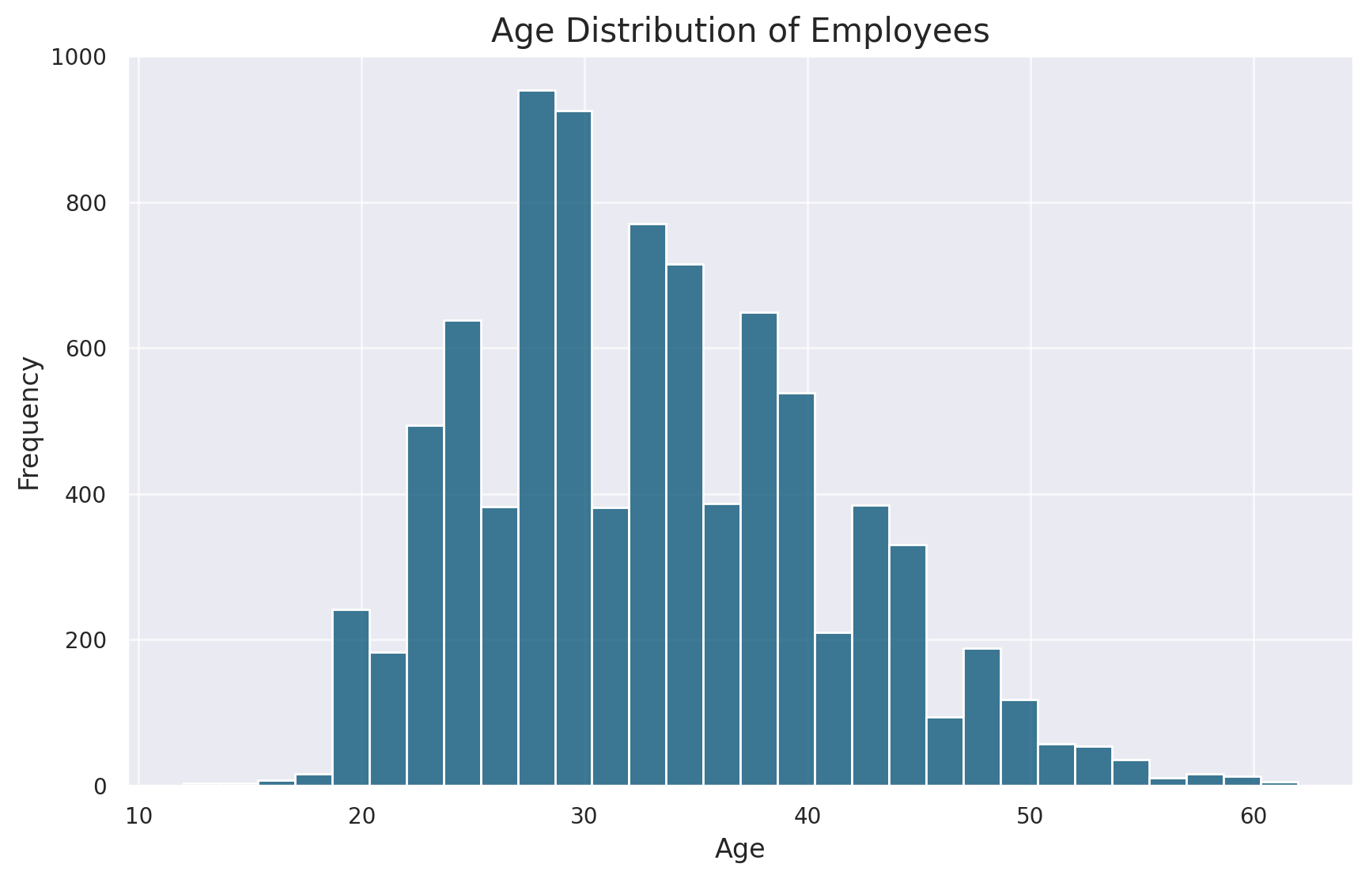
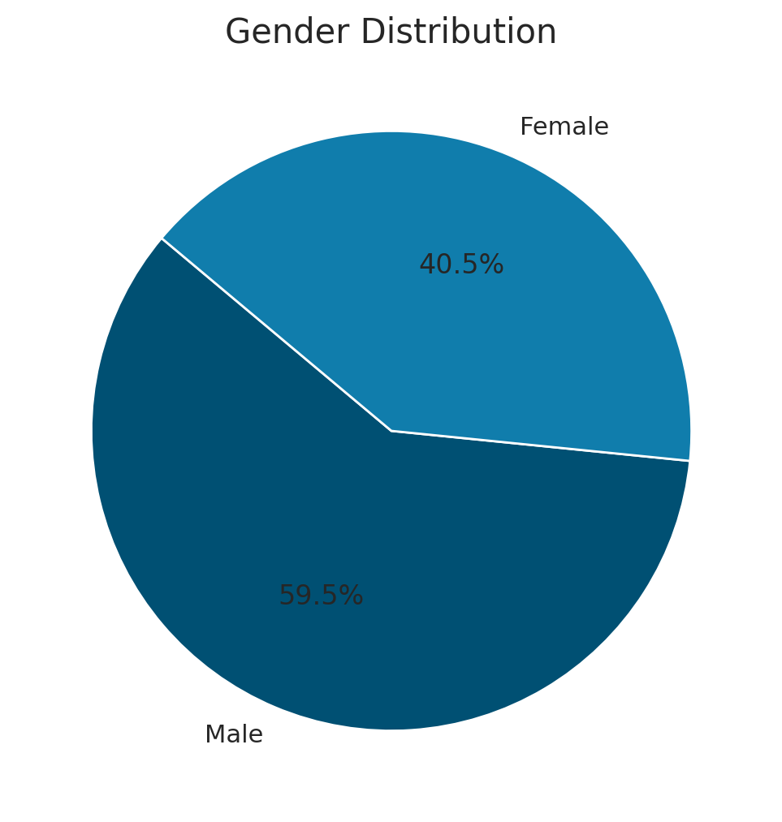
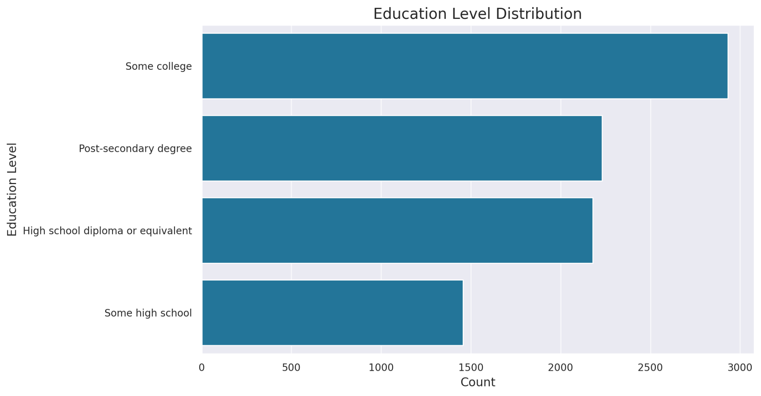
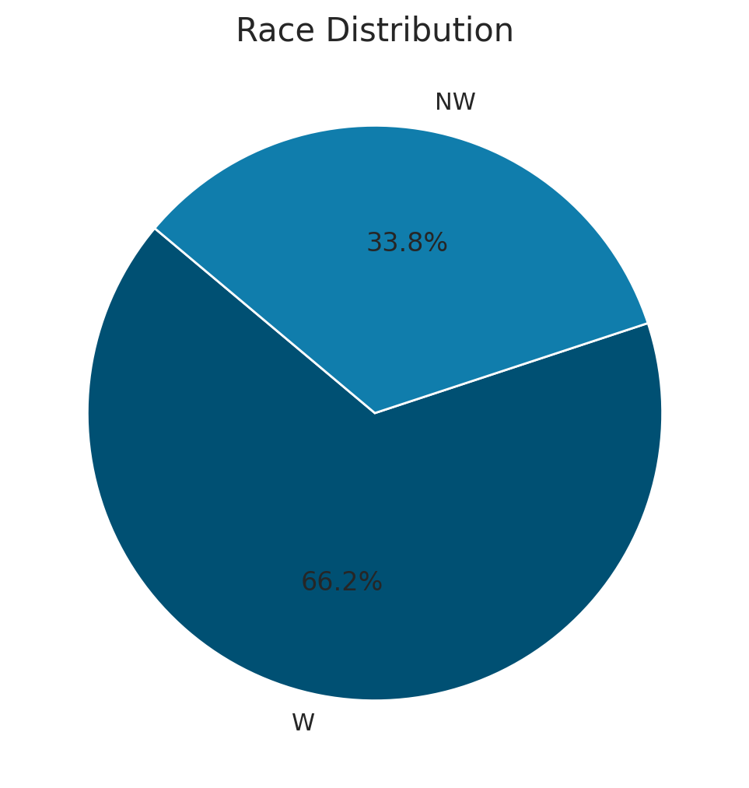
Part 1 – Introduction
Demographics of the firm
Third
Second

Slide 5
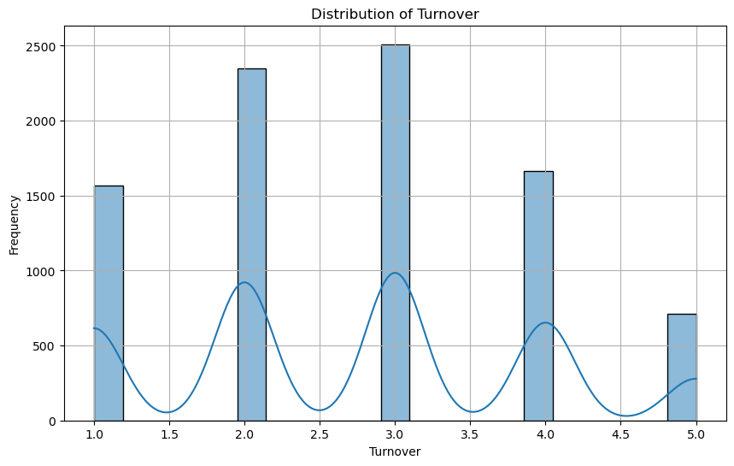
Part 1 – Introduction
Distribution of Turnover
How likely is that you will quit your job in the next several months? (5 = very likely, to 1 = very unlikely)

Slide 6
Part 2 – Recruitment
Diverse Talent Recruitment
Forge partnerships with diversity-focused groups.
Target diverse talent pools through specialized job platforms.
Highlight inclusivity in CanadaRetail's job descriptions.
Third
Second

Slide 7
Part 2 – Recruitment
Women's leadership development in recruitment
Incorporate leadership potential assessments.
Design interview processes to identify strategic thinking and decision-making skills.
Prioritize internal promotions and mentorship pairings for capable female employees.
Third
Second

Slide 8
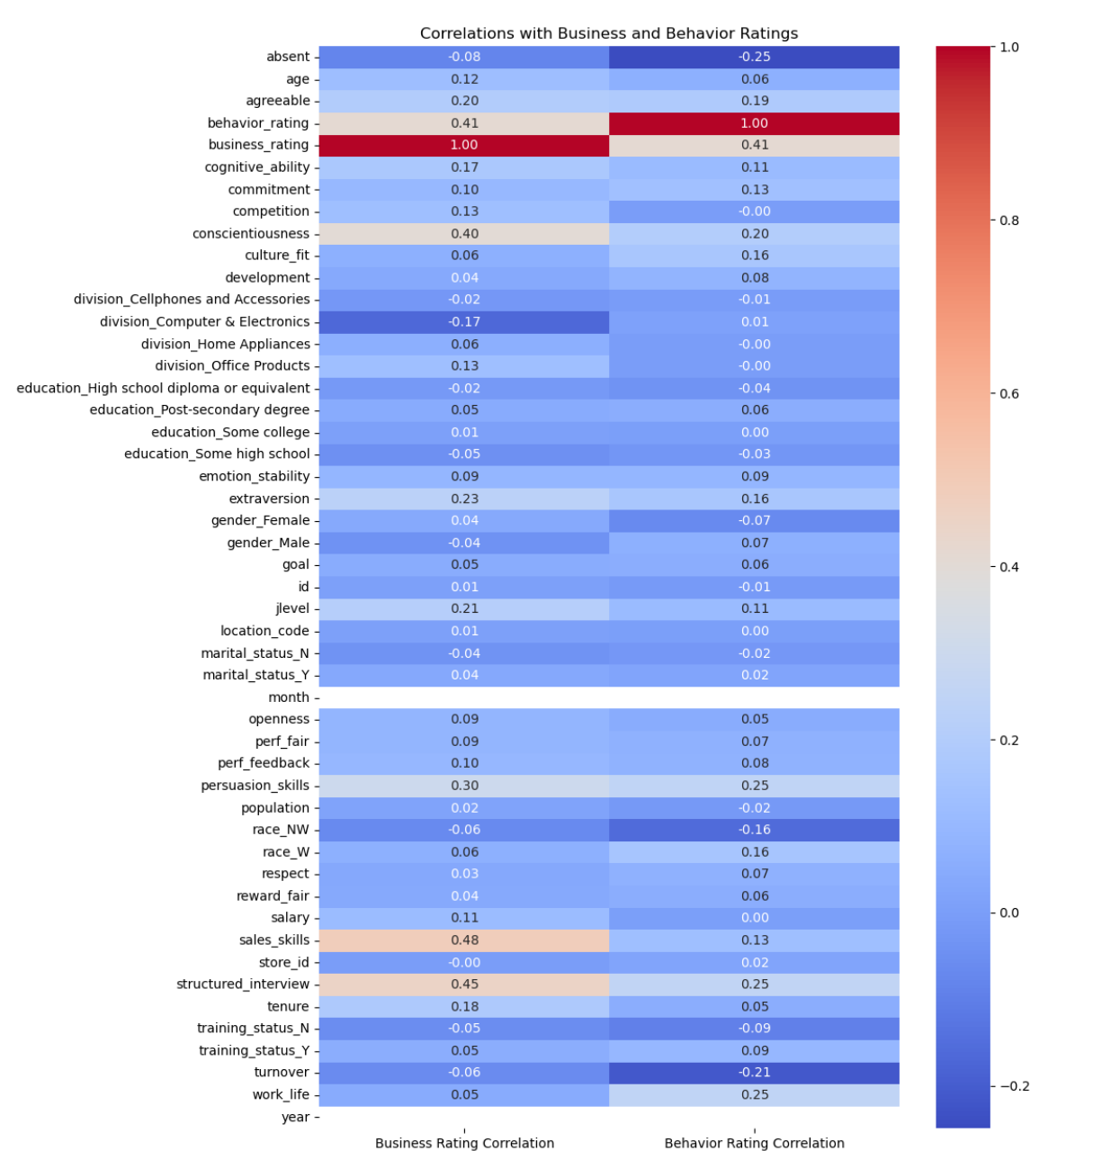
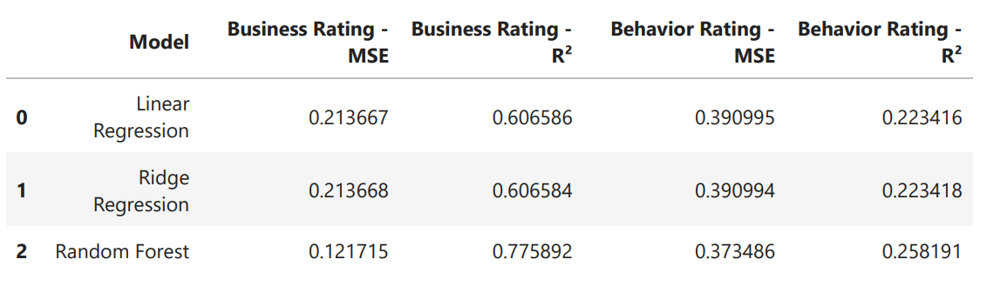
Part 3 – Selection
Selected features
tenure, persuasion skills
work life , culture fit , sales skills
extraversion , conscientiousness
cognitive ability, structured interview
Random Forest Regression
Third
Second

Slide 9
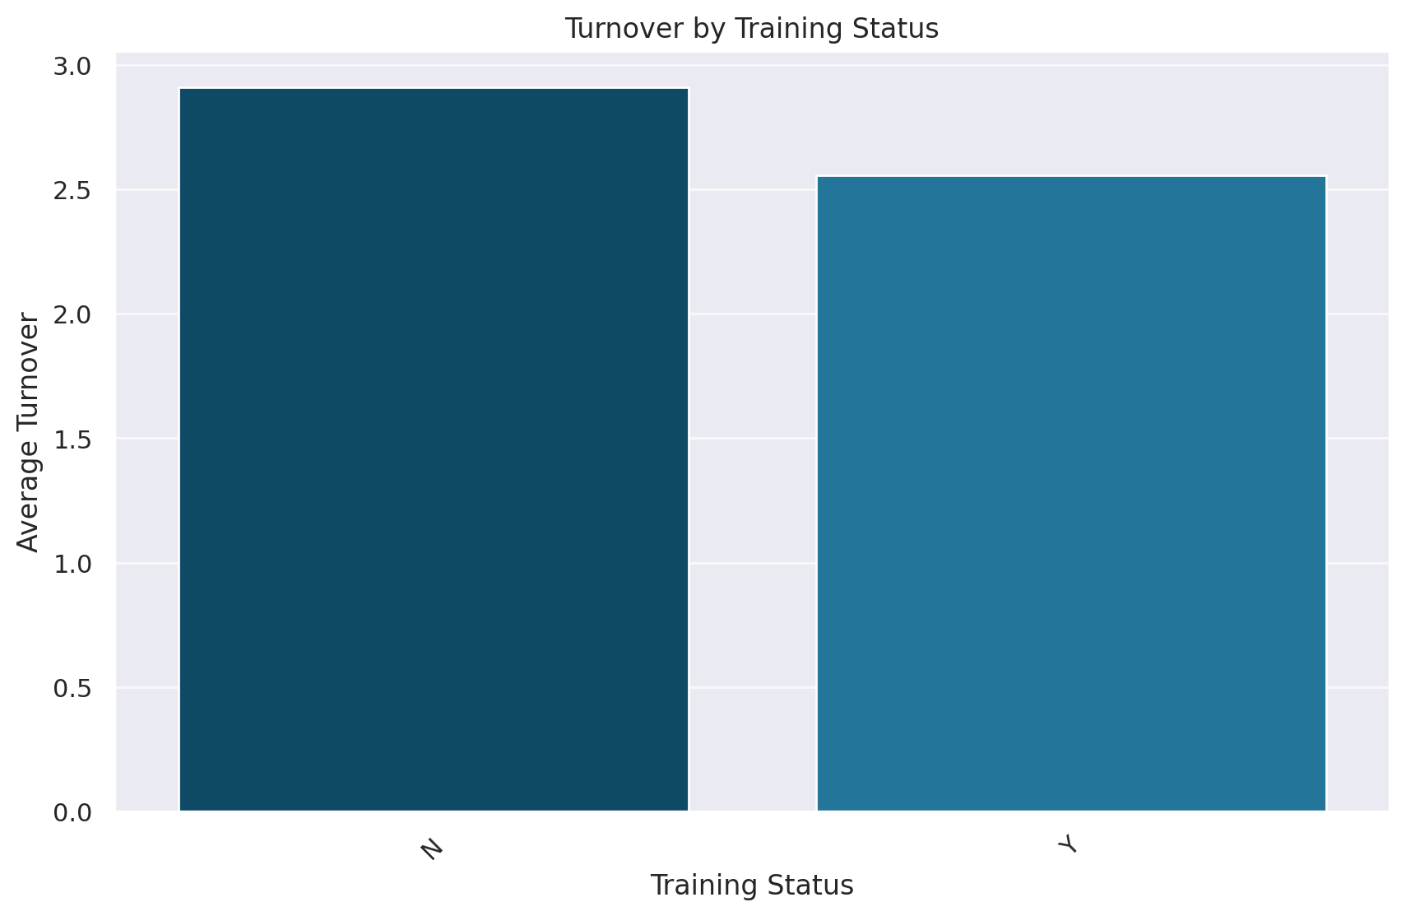
Part 4 – Training and development
Minimizing turnover through Role-specific training
Role-specific Training
Professional Development Opportunities

Slide 10
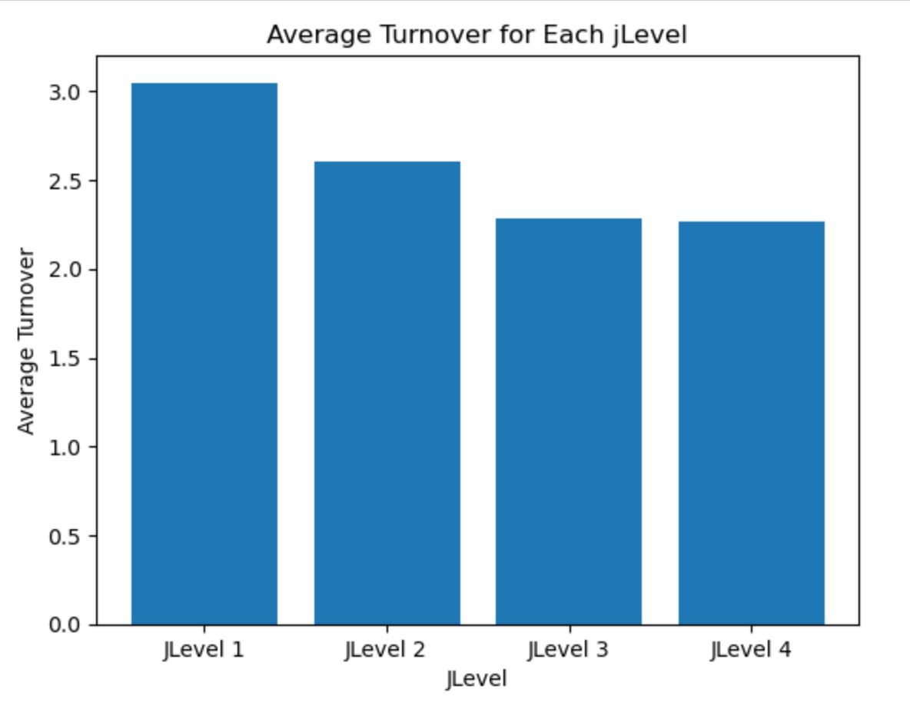
Part 4 – Training and development
Turnover Analysis by jLevel
Mentorship Program
Buddy System
Clearly defined career path

Slide 11
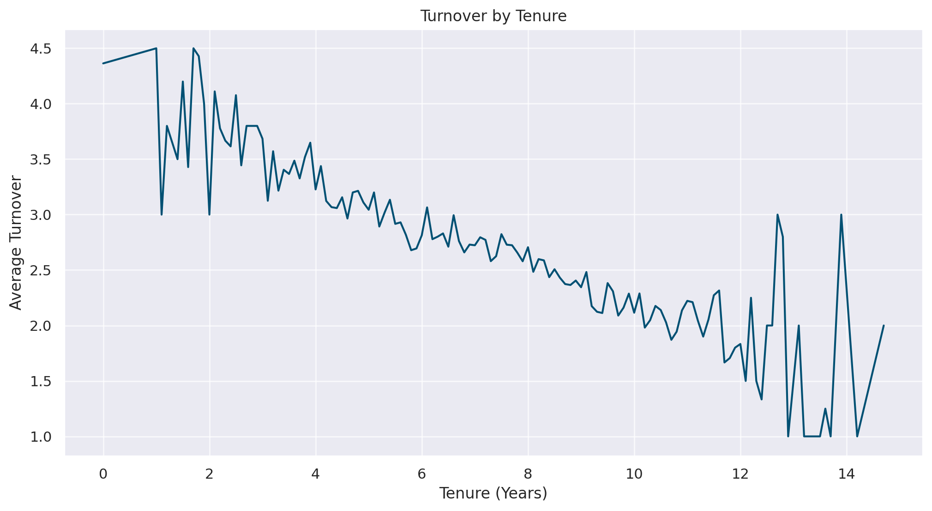
Part 5 – Payment and Compensation
Turnover Analysis by Tenure
Long term incentive tied to the length of service

Slide 12
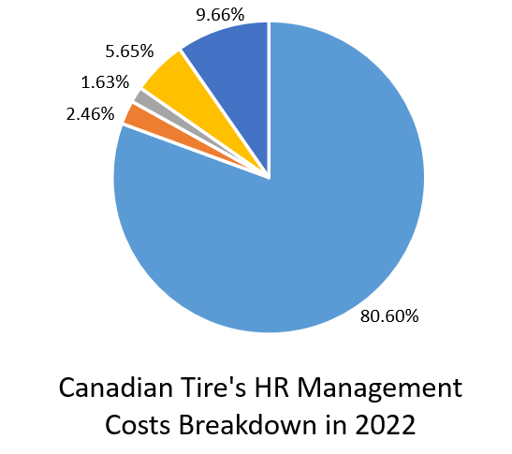
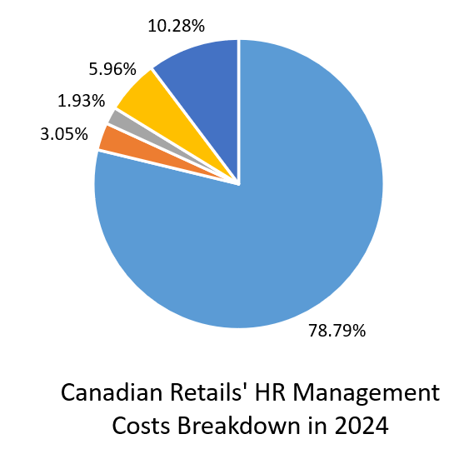
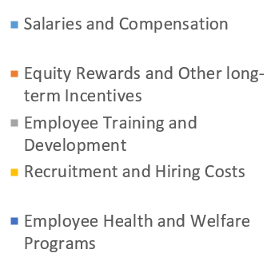
Part 5 – Payment and Compensation
Competitive analysis of HR management strategy

Slide 13
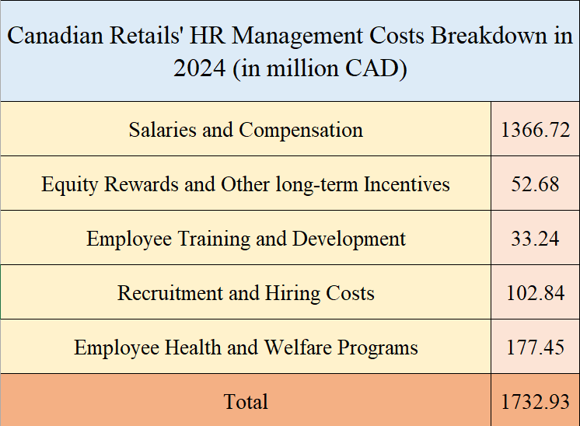
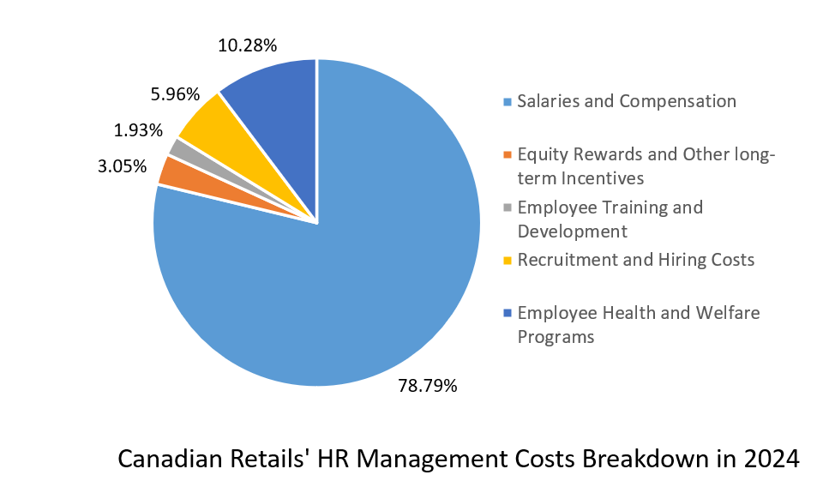
Part 5 – Payment and Compensation
Financial Budget of HR Management Costs

Slide 14
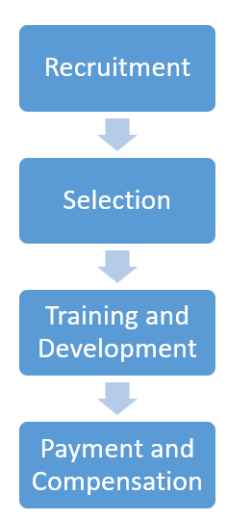

Part 6 – Conclusion
HR

Slide 15
Thank you

