Slide 1
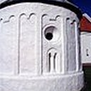



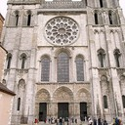


Classifying Culture - a Deep Learning Approach to Identifying Architectural Heritage Elements
Introduction to Deep Learning - Final Project by Arne Martin Fevolden

Slide 2

Brief Description of the Problem and Data
In this final project, we will …
create a Convolutional Neural Network (CNN) that can classify architectural heritage elements into classes, such as altar, apse, bell tower, column, dome (inner), dome (outer), flying buttress, gargoyle, stained glass and vault.
try out different types of neural network architectures and hyper parameter tuning, to gain insight into what factors most affect model performance.
Compare our results to previous studies that have used the same dataset.

Slide 3
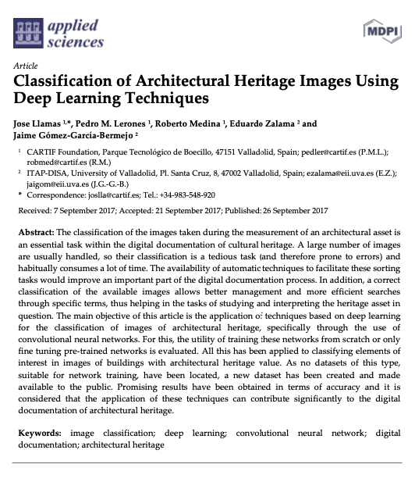
Brief Description of the Problem and Data
Classify architectural heritage elements is an especially interesting task for image classification, since it involves not only shape and position, but also a symbolic dimension
The project is inspired by the article: Llamas J, M. Lerones P, Medina R, Zalama E, Gómez-García-Bermejo J. Classification of Architectural Heritage Images Using Deep Learning Techniques. Applied Sciences. 2017; 7(10):992. https://doi.org/10.3390/app7100992

Slide 4
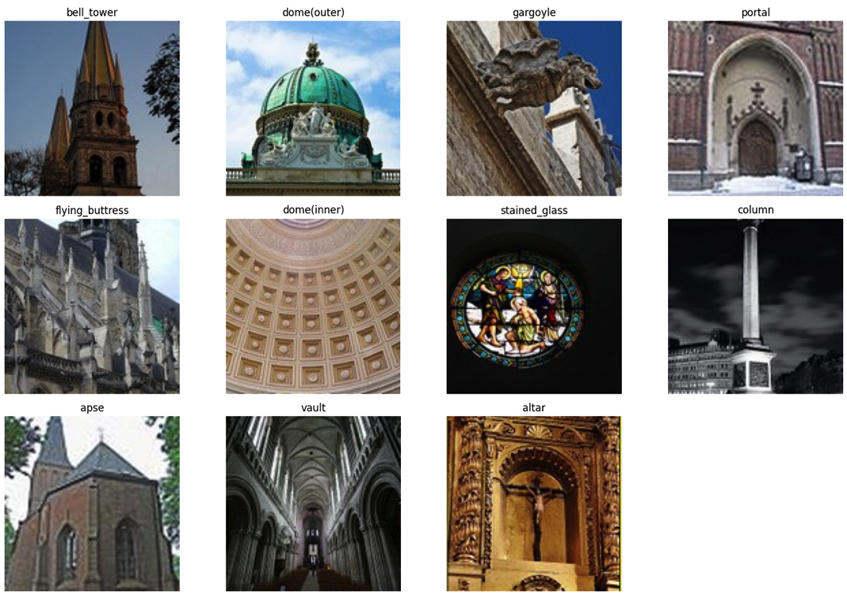
Brief Description of the Problem and Data
The dataset was created and made available as part of the Llamas et al. (2017) article mention before.
The dataset consists of 10543 images classified into 11 categories
The dataset can be found several places and in several versions. This project used https://correo.cartif.es/home/joslla@cartif.es/Briefcase/Architectural_Heritage_Elements_image_Dataset

Slide 5
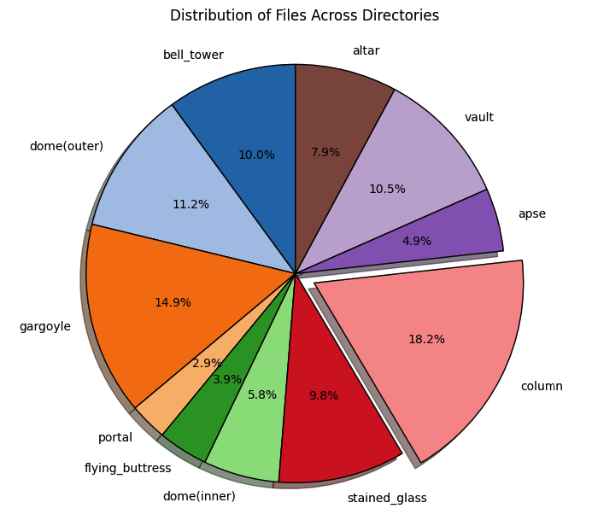
Brief Description of the Problem and Data
The categories are somewhat unevenly distributed – which can make some categories harder to classify
Since portals are not part of the original study and it is the smallest category, we will remove it from our study

Slide 6
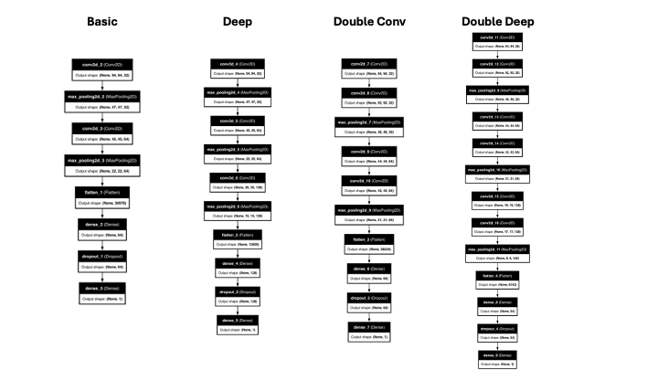
Model Architecture
We try to improve the accuracy of our prediction by making use of two specific architectural principles – depth and doble convolution layer
Notes:
Adding more layers to a CCN-model should enhance its capacity to learn more complex features from the data.
And adding double convolution layers should allow the network to perform more complex feature extraction before pooling and enable it to better recognize and combine detailed patterns within the input data.

Slide 7
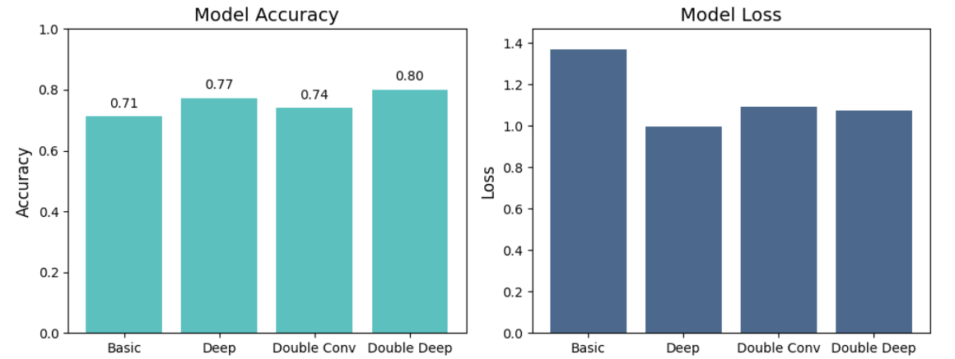
Model Architecture
The Double Deep model outperforms the other three architectures (at least when we look at accuracy).
An even deeper model architecture could perhaps have resulted in even better results.

Slide 8
Results and Analysis
There are many methods one can use to improve the performance of a CNN
trying out different optimizers,
adding L2 regularization to the neurons in the network,
altering the number of neurons dropped by the dropout layers,
carrying out batch normalization and trying out different learning rates
We will focus on testing the impact of optimizers and L2 regularization.
RMSprop
L2 regularization factor of 0.001 and 0.0001

Slide 9
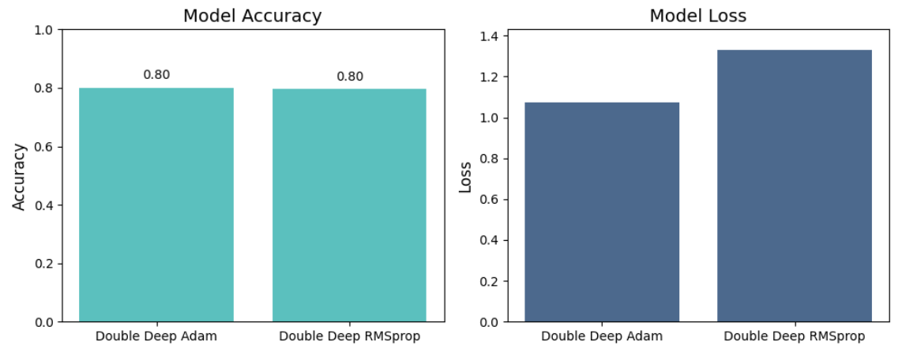
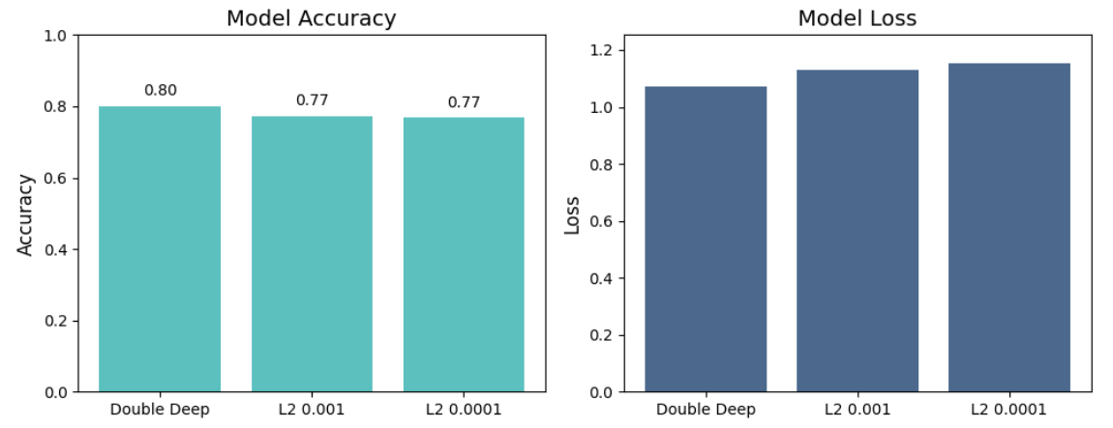
Results and Analysis
Altering the optimizer to RMSprop did not improve model performance. Adam, had the same accuracy, but with a slightly lower loss.
L2 regularization did not lead to any improvement either. The combination of a lot of data, a dropout layer and a l2 regularization seem to have resulted in over-regularization.

Slide 10
Comparison with AlexNet and Inception-ResNet-v2
Comparing our best performing model - the Double Deep - with two of the models used in the paper by Llamas et al. (2017) - Alex net and Inception-Res-v2.
Alex net is a model that among others utilize stacked convolutional layers, ReLU activations and dropout for regularization. It achieved a remarkable performance on the ImageNet dataset in 2012. In our case, and also more commonly, Alex net is not pre-trained.
Inception-ResNet-v2, on the other hand, is a model that is pre-trained on ImageNet data, which consists of 1000 object classes and contains 1,281,167 training images.

Slide 11
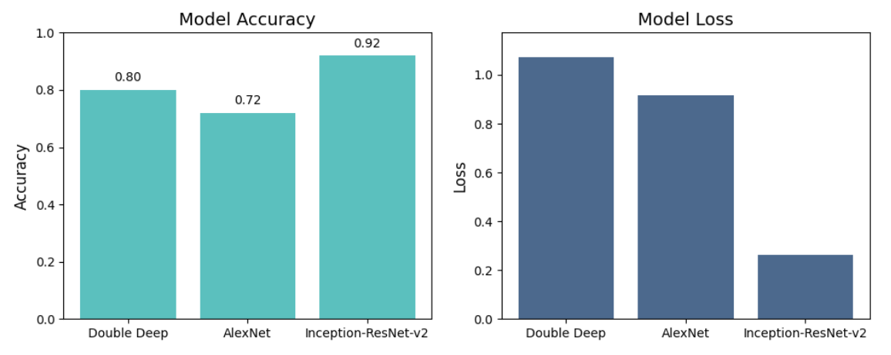
Comparison with AlexNet and Inception-ResNet-v2

Slide 12
Conclusion
It is possible to build a CNN model that can classify architectural heritage elements into classes with a reasonably good accuracy (about for our best model 80%).
Architecture seems to be more important than conventional hyper parameter tuning and regularization.
Both depth and double convolution layers add positively to performance and the combination produces very good results.
Pre-trained models, such as InceptionResNet v2, tend to outperform model which have not been trained in advance. In our case, the InceptionResNet model managed to classify 92% of the elements correctly.

