Slide 1
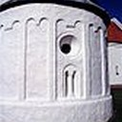



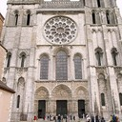


Classifying Culture - a Deep Learning Approach to Identifying Architectural Heritage Elements
Introduction to Deep Learning - Final Project by Arne Martin Fevolden

Slide 2

Brief Description of the Problem and Data
In this final project, we will …
create a Convolutional Neural Network (CNN) that can classify architectural heritage elements into classes, such as altar, apse, bell tower, column, dome (inner), dome (outer), flying buttress, gargoyle, stained glass and vault.
try out different types of neural network architectures and hyper parameter tuning, to gain insight into what factors most affect model performance.
Compare our results to previous studies that have used the same dataset.

Slide 3
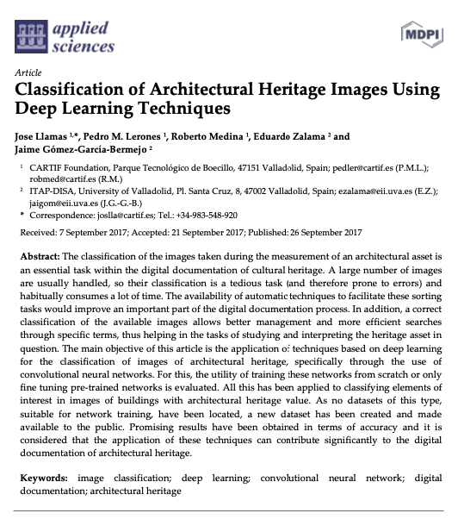
Brief Description of the Problem and Data
Classify architectural heritage elements is an especially interesting task for image classification, since it involves not only shape and position, but also a symbolic dimension
The project is inspired by the article: Llamas J, M. Lerones P, Medina R, Zalama E, Gómez-García-Bermejo J. Classification of Architectural Heritage Images Using Deep Learning Techniques. Applied Sciences. 2017; 7(10):992. https://doi.org/10.3390/app7100992

Slide 4
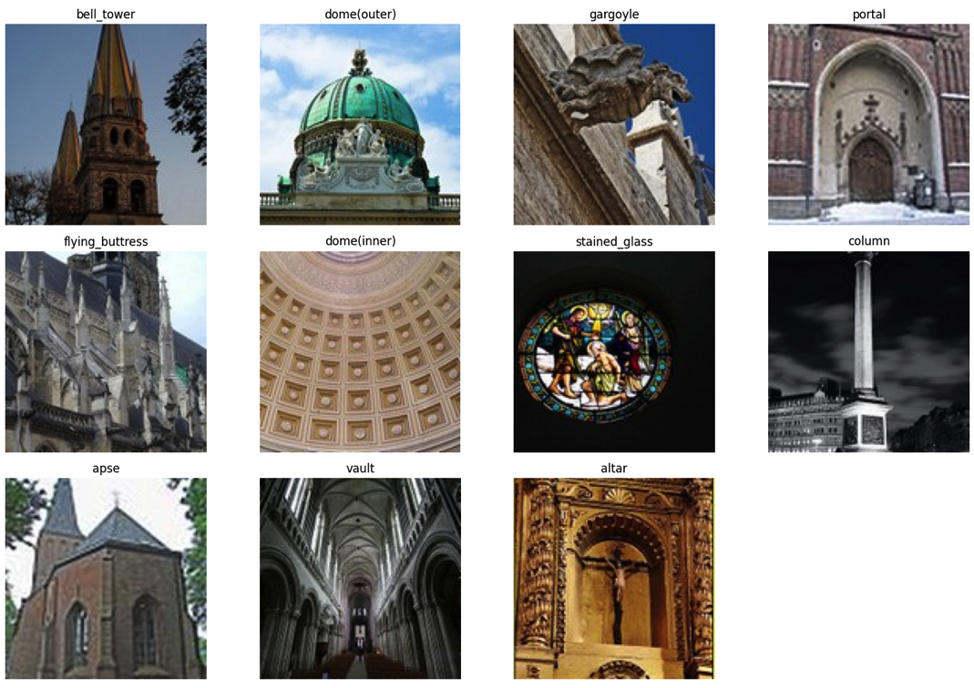
Brief Description of the Problem and Data
The dataset was created and made available as part of the Llamas et al. (2017) article mention before.
The dataset consists of 10543 images classified into 11 categories
The dataset can be found several places and in several versions. This project used https://correo.cartif.es/home/joslla@cartif.es/Briefcase/Architectural_Heritage_Elements_image_Dataset

Slide 5
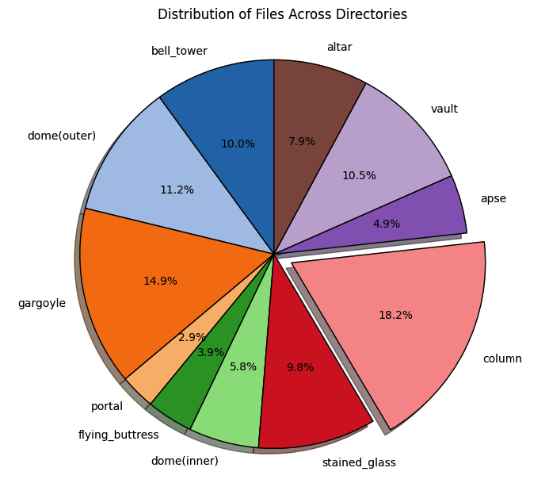
Brief Description of the Problem and Data
The images are unevenly distributed among the categories
Since portal makes up such a small amount of the total dataset (2.9%) and was not part of the Llamas et al. (2017) study, we will drop this category when we develop our model

Slide 6
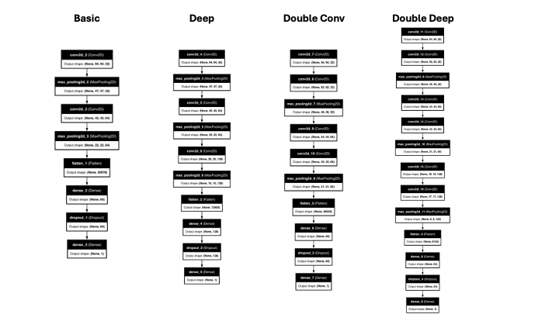
Model Architecture

Slide 7
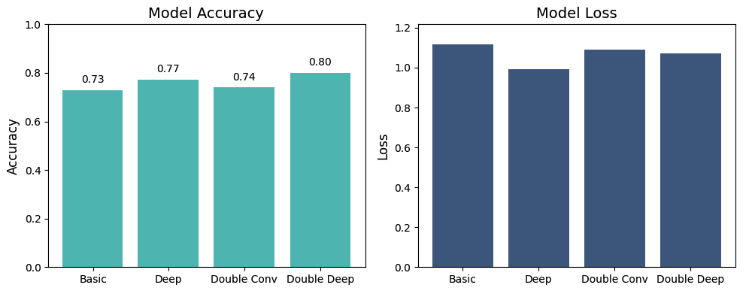
Model Architecture

Slide 8
Results and Analysis
In this part of the assignment, we will try out different techniques to improve the training or performance. There are many methods one can use to improve the performance of a CNN - such as trying out different optimizers, adding L2 regularization to the neurons in the network, altering the number of neurons dropped by the dropout layers, carrying out batch normalization and trying out different learning rates - to mention a few.
However, the time to train a CNN can be fairly long, and we will not be able in this assignment to test all of these techniques. We will focus on testing the impact of optimizers and L2 regularization. More specifically, we will test whether another optimizer - RMSprop - can produce better results, and we will see if L2 regularization factor of 0.001 and 0.01 can increase the accuracy. In all cases, we will use our top performing model, which is the Double Deep CNN model.

Slide 9
Comparison with AlexNet and Inception-ResNet-v2

Slide 10
Conclusion

Slide 12
The project is inspired by the article ‘Classification of Architectural Heritage Images Using Deep Learning Techniques’ by Llamas et al. (2017). In this article, the authors try out several CNN models – which were state-of-the-art at the time of publication – to classify architectural heritage elements. The dataset that this project uses is (almost) the same the dataset used by the article authors, which they created and made available as part of the publication project. The dataset can be found several places and in several versions. However, the dataset used in this project was downloaded from https://correo.cartif.es/home/joslla@cartif.es/Briefcase/Architectural_Heritage_Elements_image_Dataset
References
Llamas J, M. Lerones P, Medina R, Zalama E, Gómez-García-Bermejo J. Classification of Architectural Heritage Images Using Deep Learning Techniques. Applied Sciences. 2017; 7(10):992. https://doi.org/10.3390/app7100992
The aim of this final project is somewhat different from the aforementioned article. While the aim of the article was to investigate how well state-of-the-art models could classify architectural heritage elements, this project wants to explore how different network architectures and hyper parameter tuning affect performance. Nevertheless, we will also at the end of the notebook compare how our best performing model compares to the worst (AlexNet) and the best (Inception-ResNet-v2) performing models in the article.

