Slide 1


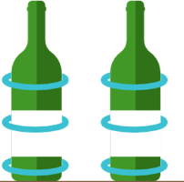
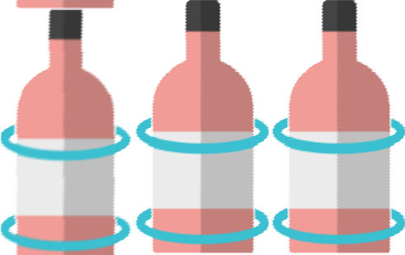




Supermarkets Are Getting
IoT Project AA 2020/21
SMARTER
$4
$5
$1
$19
IoT Project A.Y. 2020/21
Enrico Nello, Giacomo Pacini

Slide 2
Today, technology is proliferating in nearly every industry, including the retail industry.
Technology has revolutionized both the way people shop, and the way businesses market their products.
Our project aims to make a Supermarket «Smart»:
Smart Shelves [CoAP] :
Sensors: Weight
Actuators: Price Displays
Smart Fridges [MQTT]:
Sensors: Temperature
Actuators: Remote Alarm

Slide 3
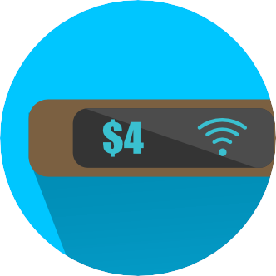

What are smart shelves?
In brief, smart shelves are composed by two elements:
a weight sensor and a smart price display.
Shelves are designed to automatically keep track of inventory in any retail establishment (in our case, supermarkets).
$4
$5

Slide 4
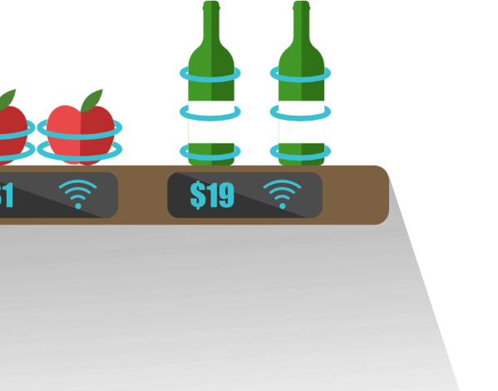



Real-Time Engagement
With smart shelves, supermarket owners can collect real-time data about their products. Infact, the shelves are able to gather information about which products have or haven't been bought, in which period of time.

Slide 5


Products Analytics
Business owners are therefore more informed about products selling ratios / buying trends. They now know what they should offer their customers and how they should supply their stores.
Intelligent Restock Detection
Smart shelves can optimize in-store operations. Sensors can alert employees to things like low inventory, allowing them to restock/refill shelves right away.
$1
low inventory

Slide 6

Automatic Sale Pricing Strategies
Smart shelves can schedule coupons, discounts and more, thanks to the statistics coming from the selling ratios.
sale
More Employee Free Time
Smart shelves can get this done automatically, so personnel can pay better attention to customer needs. This helps make team management easier because they are going to have more freedom and time to complete other tasks.

Slide 7
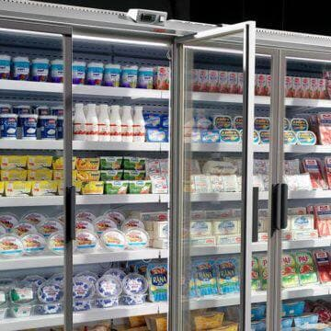
Smart Fridge Sensor
We also developed refrigerator temperature sensor to increase energy saving, and avoid long periods of opened doors caused by peoples’ negligence.
Smart Fridge Sensor are composed by two type of devices:
A temperature sensor and a remote light alarm
Temperature sensor
Remote Alarm Light

Slide 8
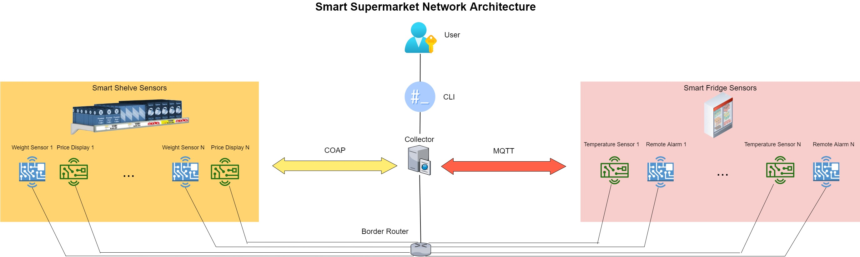
System Architecture

Slide 9
Collector
The Collector, written in Python, implements:
A CoAP server that registers the smart nodes and starts monitoring them through the CoAP observing.
2. A Command Line Interface that the user can exploit to send request to each node of the network
3. A Visual Log that shows the output of all the messages from nodes

Slide 10
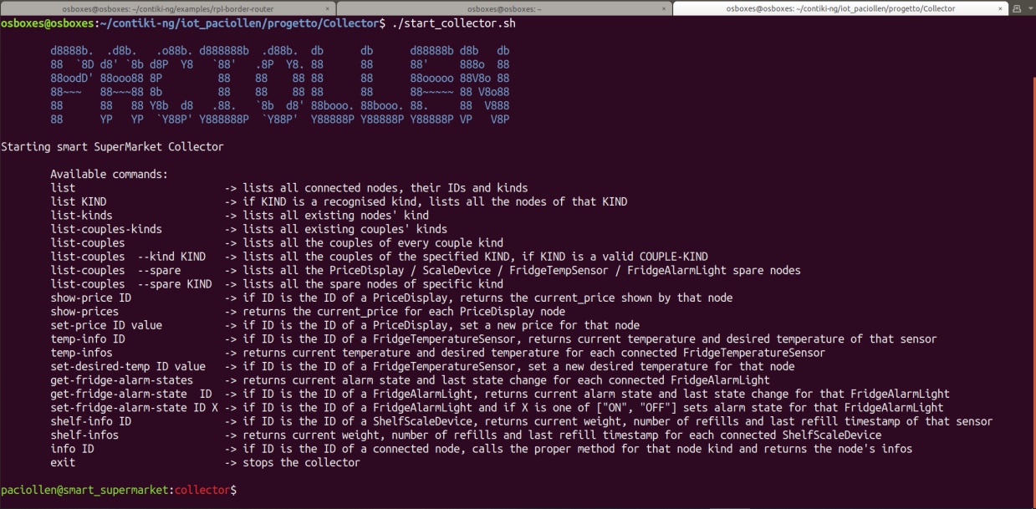
Collector – CLI

Slide 11
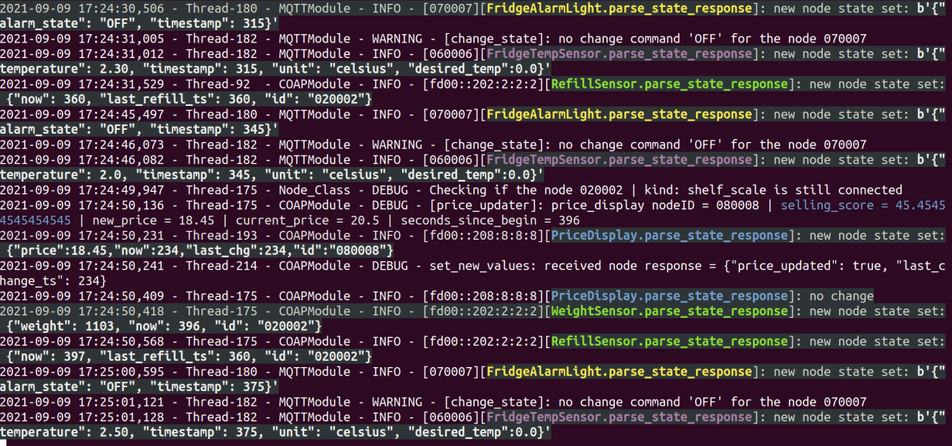
Collector – Visual Log

