Slide 1

HR Form Creator
By Enrico and Daniel

Slide 2
Presentation Areas Covered
Purpose of the Application
Home Page and Possible Uses
Fill Form and Possible Uses
Explanation of Form1 and Data Gathered
View Data and Possible Uses
Edit Form

Slide 3
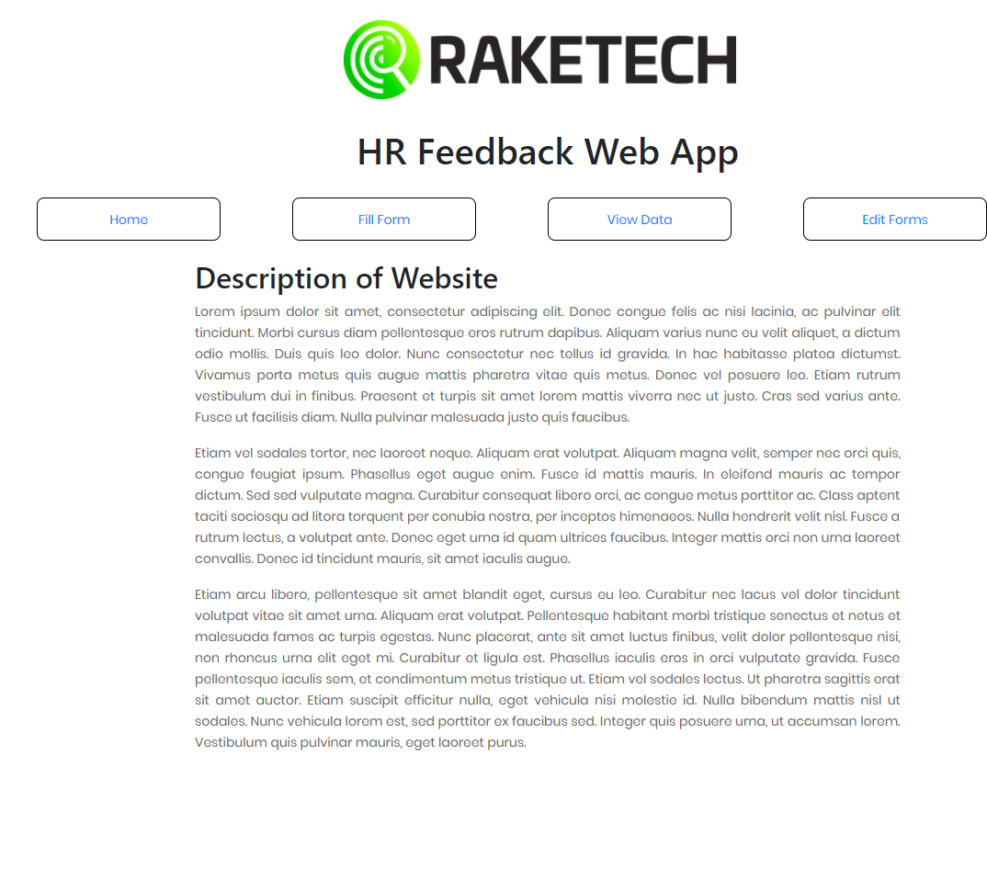
Homepage

Slide 4
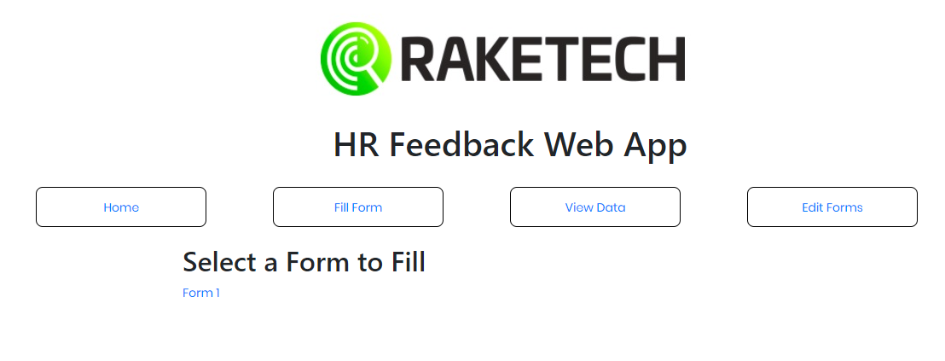
List of Available Forms

Slide 5


Slide 6
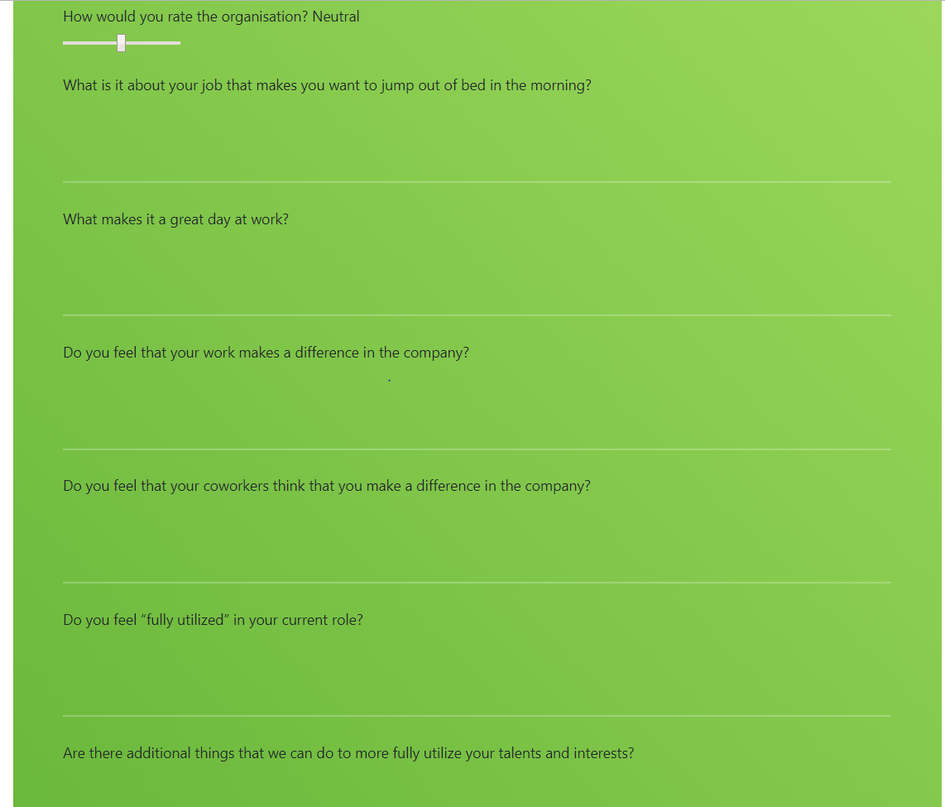

Slide 7
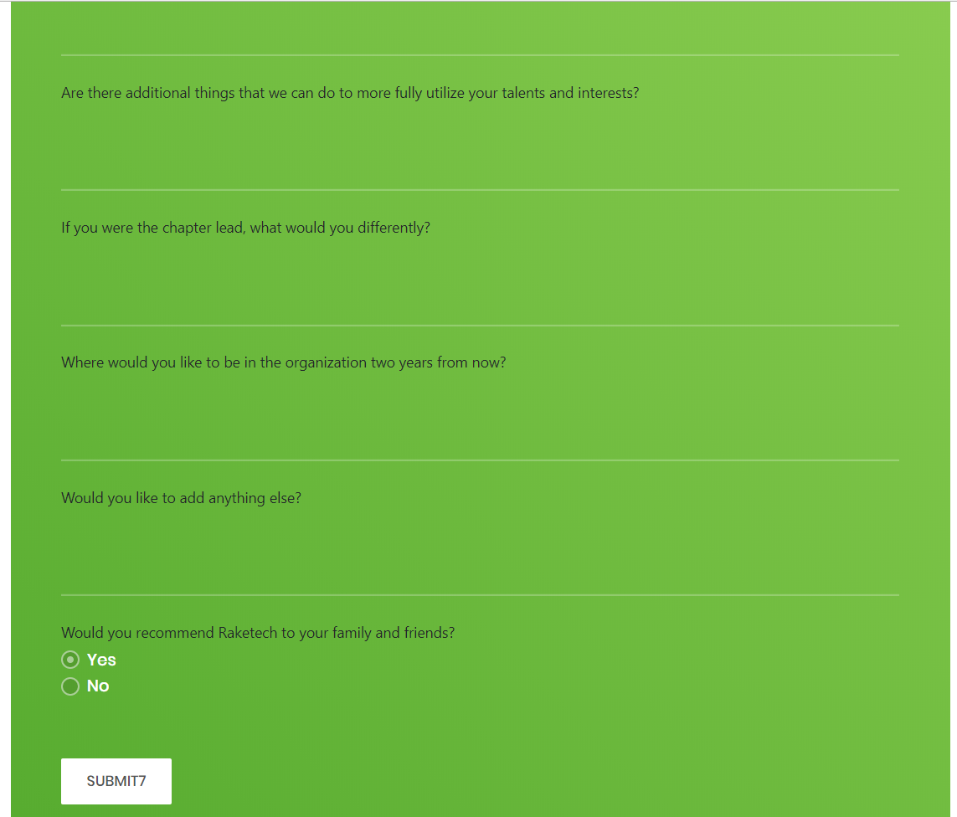

Slide 8

View Data

Slide 9
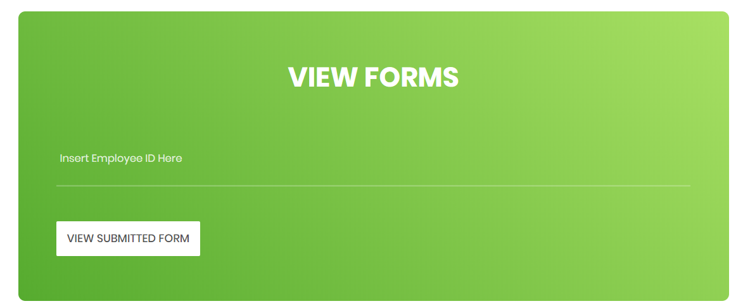

Slide 10

Viewing a Form

Slide 11
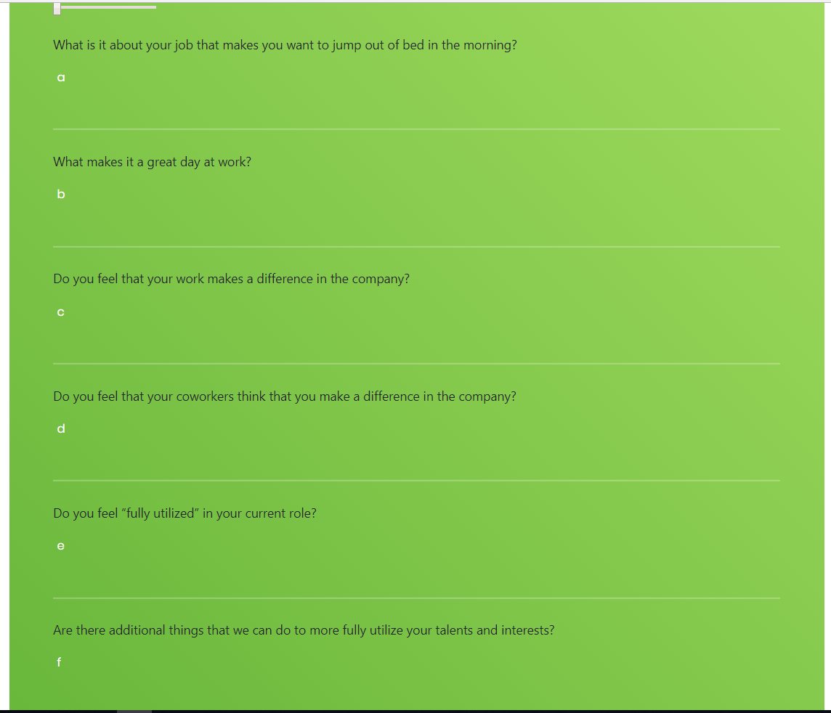

Slide 12
