Slide 1
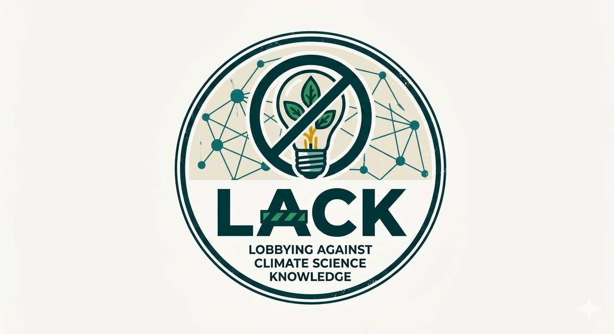
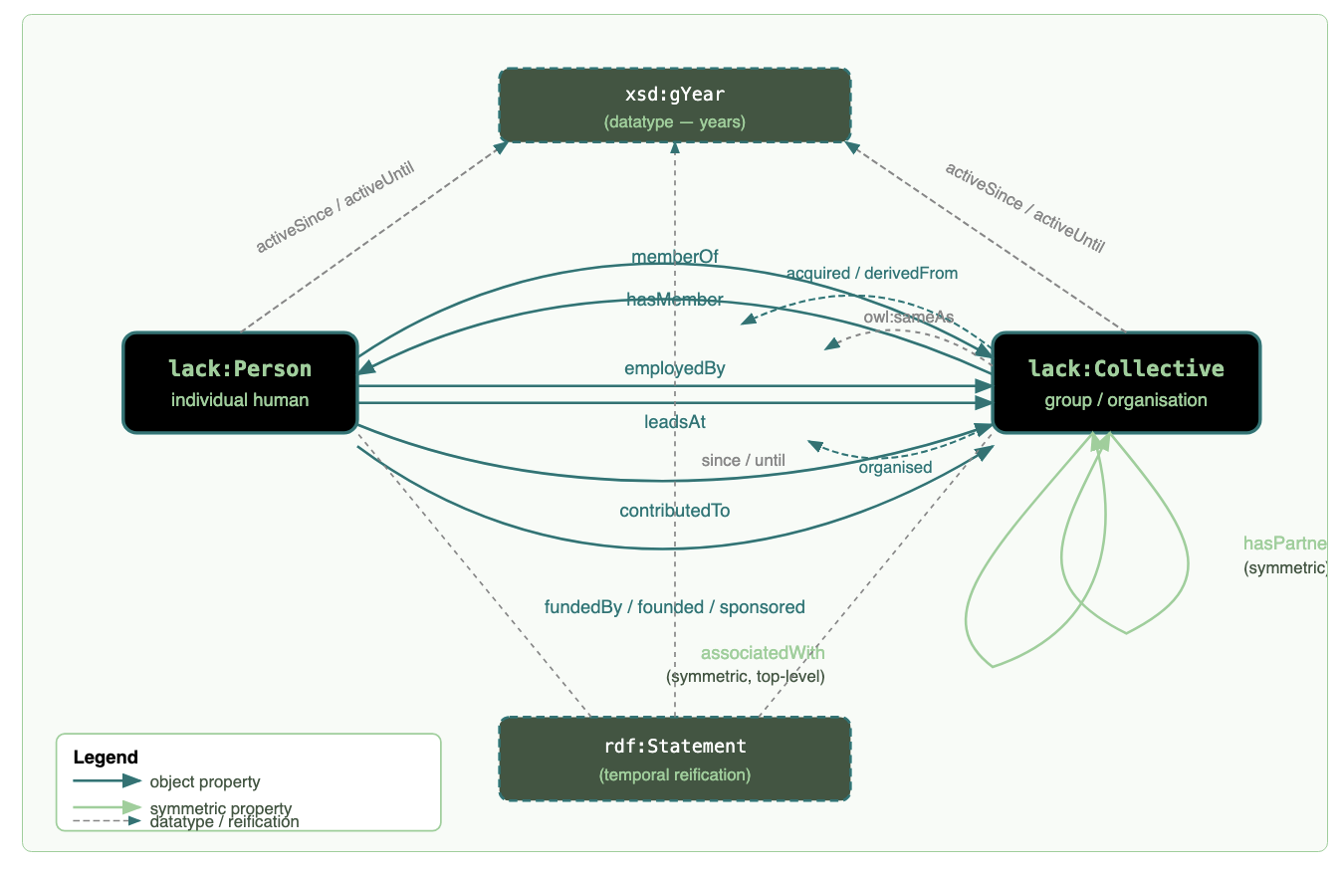
LACK
Lobbying Agents, Climate, and Knowledge
A knowledge graph of agents, organisations, and relationships involved in lobbying against climate science and policy.
LACK maps the networks of people and organisations that work to undermine climate science awareness and climate policy, drawing on real-world sources and extracting structured relationships using a purpose-built ontology.
What LACK lets you ask
1
Who is lobbying against climate science — and which organisations?
2
Who funds them, and what's the evidence?
3
Who leads these organisations, and when?
4
Which organisations partner with, founded, or spun off from each other?
5
Who is connected to whom — directly or indirectly across the network?
6
Which connections were active during a given period?
The LACK ontology: people and organisations linked by typed, time-stamped relations.
7
When does one name, alias, or rebrand hide the same real-world actor?
Every answer is backed by linked, sourced evidence. climatesense-project.eu/lack

