Slide 1
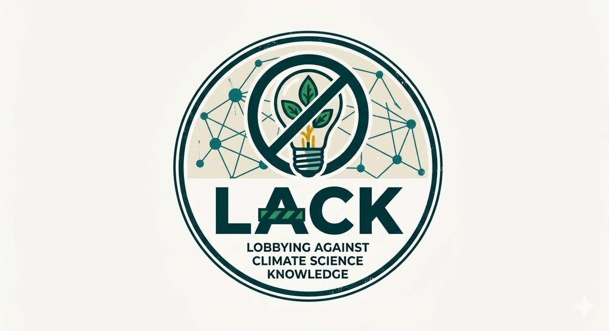
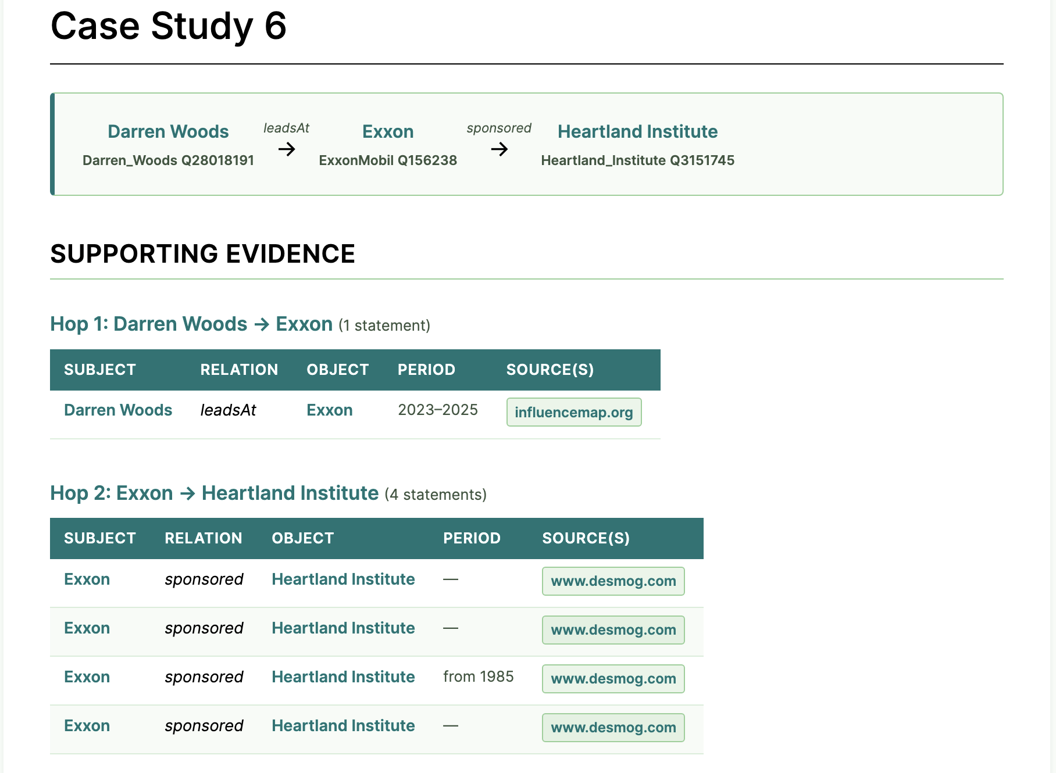
LACK
Lobbying Agents, Climate, and Knowledge
A knowledge graph of agents, organisations, and relationships involved in lobbying against climate science and policy.
LACK maps the networks of people and organisations that work to undermine climate science awareness and climate policy, drawing on real-world sources and extracting structured relationships using a purpose-built ontology.
From question to evidence
1
Multi-hop connections — follow chains across the network — a person, the company they lead, and the think tank it sponsors.
2
Every relation is sourced — each link cites the evidence it was extracted from (DeSmog, InfluenceMap, and more).
3
Time-stamped where known — relations carry the period they were active, so you can reason about when.
4
Linked to Wikidata — people and organisations are disambiguated to stable identifiers, not just names.
Worked example: a two-hop chain, each step backed by sourced, time-stamped evidence.
Every answer is backed by linked, sourced evidence. climatesense-project.eu/lack

