Slide 1
Cardiovascular Disease
Enrique Bustamante, Sara St. Jean, Ali Merchant, Anna Shvilpe,
Ricardo Vasquez, Victor Rodriguez IV
Notes:
Enrique:

Slide 2
Why Cardiovascular Disease?
Leading cause of death in the U.S.
665,000 U.S. deaths every year
  1 in every 4 deaths
Can be avoided with:
  Lifestyle changes
  Early detection
Notes:
Enrique:

Slide 3
Symptoms
Chest pain/discomfort
Upper body discomfort
Heart palpitations
Shortness of breath
Fatigue
Heartburn/nausea/vomiting
Swelling of feet, ankles, legs, abdomen or neck veins
Notes:
Enrique:

Slide 4
Prevention
Limit alcohol intake
Healthy Diet
Exercise
Limit Stress
Quit Smoking
Annual Dr. Visit
Notes:
Enrique:

Slide 5
Questions We Hope to Answer
What group of factors have the largest impact on presence of Cardiovascular Disease?
Can we create a model that would predict presence of Cardiovascular Disease?
Can we improve model by focusing on top level factors?
Notes:
Victor:

Slide 6
Data Source Description
The Cardiovascular Disease dataset is open-source and found on Kaggle. The dataset contains 70,000 records (34,979 who have cardiovascular disease and 35,021 who do not have cardiovascular disease) and contains 11 features (consisting of 4 demographic, 4 examination and 3 social history).
Behavioral Factors
  Smoking, alcohol intake, physical activity
Medical Factors
  Age, Height, Weight, Gender, Systolic/Diastolic blood pressure, Cholesterol, Glucose
Notes:
Victor:

Slide 7
Tools for Dashboard
Back End:
Flask App
Python
PostGRES
AWS
Front End:
HTML
CSS
JS
Bootstrap
Notes:
Ali:

Slide 8
Cardiovascular Dashboard
Objective/Purpose
-------------------------------
Findings
--------------------------------
Machine Learning Analysis
--------------------------------
Find out if you might have a cardiovascular disease:
Height *:
Age *:
Weight *:
Blood Pressure *:
Glucose *:
Submit
Results:
Image 1: (Static)
Image 2: (Static)
Image 3: (Static)
At Risk
Please consider visiting your cardiologist
Not at Risk
Continue with your healthy choices
Notes:
Ali:

Slide 9
Interactive Features of Dashboard
As an interactive element we will be providing UDF fields that would output a prediction of cardiovascular disease. The user will visit the dashboard and be able to enter their height, weight, age and other factors to see their probability of having a cardiovascular disease.
Age
Gender
BMI
Systolic
Diastolic
Cholesterol
Glucose
You are potentially at risk for Cardiovascular Disease
Please consider visiting your cardiologist
Height
Weight
BMI
You may not be at risk for Cardiovascular Disease
Continue with your healthy choices
Notes:
Ali:

Slide 10
Machine Learning
Preprocessing
  Clean up data
  Removing the outliers
  Separate the dataset into attributes & labels
Feature Engineering and Selection
  Standardized the data using StandardScaler
  Ensuring the one feature did not skew the data
Splitting, Training, & Testing Set
  Train_test_split used to split data into training & testing sets
  Setting the default at 75/25 split
  Considered the default at 80/20
Model Selection: Benefits & Limitations
  The Random Forest Model was used
  Limitations of potential for overfitting & a moderate level of interpretability

Slide 11
Machine Learning
Scaled Data
  Scaler
  cardioAttributes
  cardioLabels
  cardioAttributesScaled
Split Training/Test Datasets
  trainingCardioAttributes
  testingCardioAttributes
  trainingCardioLabels
  testingCardioLabels = train_test_split cardioAttributesScales
  cardioLabels
  random_state=78
Create a Random Forest Classifier
  rfModel = RandomForestClassifier(n_estimators=200, random_state=2)
Matrix
  matrix = confusion_matrix(testingCardioLabels, cardioLabelPredictions) [6389 2189], [2872 5481]
Notes:
Ali:

Slide 12
Description of Exploratory Data Analysis (EDA)
Changed age column from days to years
Took absolute value for ap_hi/low columns
  ap_hi -
  ap_lo -
Removed outliers
  4’10” - 7’ - height
  90 lbs - 300 lbs - weight
  100 - 200 - ap_hi
  70 - 120 - ap_lo
Calculated BMI
Notes:
Enrique:

Slide 13
Notes:
Anna:

Slide 14
Description of Analysis
Blood Pressure
  Relationship of being outside of normal range and having a cardiovascular event
Cholesterol
  Higher percentage of having a cardiovascular event with higher than normal cholesterol levels
Unuseful Habits
  Self reported data: smoking, alcohol intake, physical activity
BMI, Cholesterol and Blood Pressure are the likely factors in successfully predicting a cardiovascular outcome
Notes:
Sara:

Slide 15
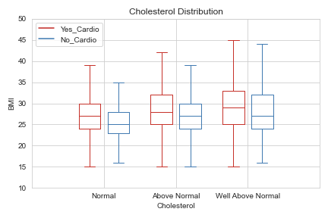
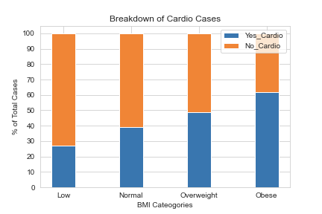
Description of Analysis Continued
Higher chance of cardiovascular event if individual has above and well above normal cholesterol levels
Higher chance of cardiovascular event if individual is overweight/obese
Notes:
Sara:

Slide 16
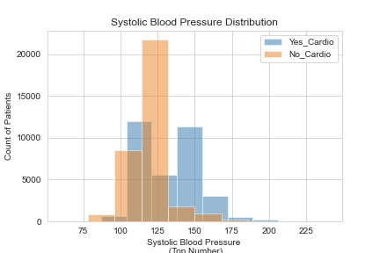
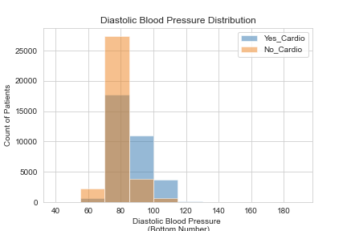
Notes:
Sara:

