Slide 1
f(x)
x₀
x₁
x₂
x_{n-1}
x_{n}

Slide 2
f(x)
x₀
m₁
x₁
m₂
x₂
m₃
x₃

Slide 3
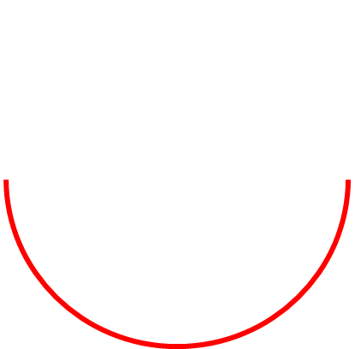


y
(1,0)
$$h\left(x\right)=\sqrt{{1−x}^{2}}$$
x
$$g\left(x\right)=−\sqrt{{1−x}^{2}}$$

Slide 4


(-1,0,e)
$$e^{r}, r=\sqrt{{x^{2+}y}^{2}}$$
(1,0,0)
$$y^{2}+x^{2}=1$$

Slide 5

$$y^{2}+x^{2}=1$$
$$e^{r}, r=\sqrt{{x^{2+}y}^{2}}$$
(-1,0,e)
(1,0,0)

Slide 6

(-1,0,e)
$$e^{r}, r=\sqrt{{x^{2+}y}^{2}}$$
(1,0,0)
$$y^{2}+x^{2}=1$$

