Slide 1

Effective Graphs with
Microsoft R Open
28 April 2016

Slide 2

Who are we?
Naomi
Offers short courses and seminars on effective charts and graphs
Author of Creating More Effective Graphs
Organizer of Data Visualization New York Meetup
Immediate Past-Chair of Statistical Graphics Section of the American Statistical Association
naomi@nbr-graphs.com
www.nbr-graphs.com

Slide 3

Who are we?
Joyce
Ph.D. sociologist
Freelance R programmer specializing in data visualization
Expert in qualitative and quantitative analyses

Slide 4
Summary of session
Graphs we like that you may not know:
Month plots
Bar percent charts
Dot plots
Linked micromaps
Diverging stacked bar charts
Drawing these graphs with Microsoft R Open

Slide 5
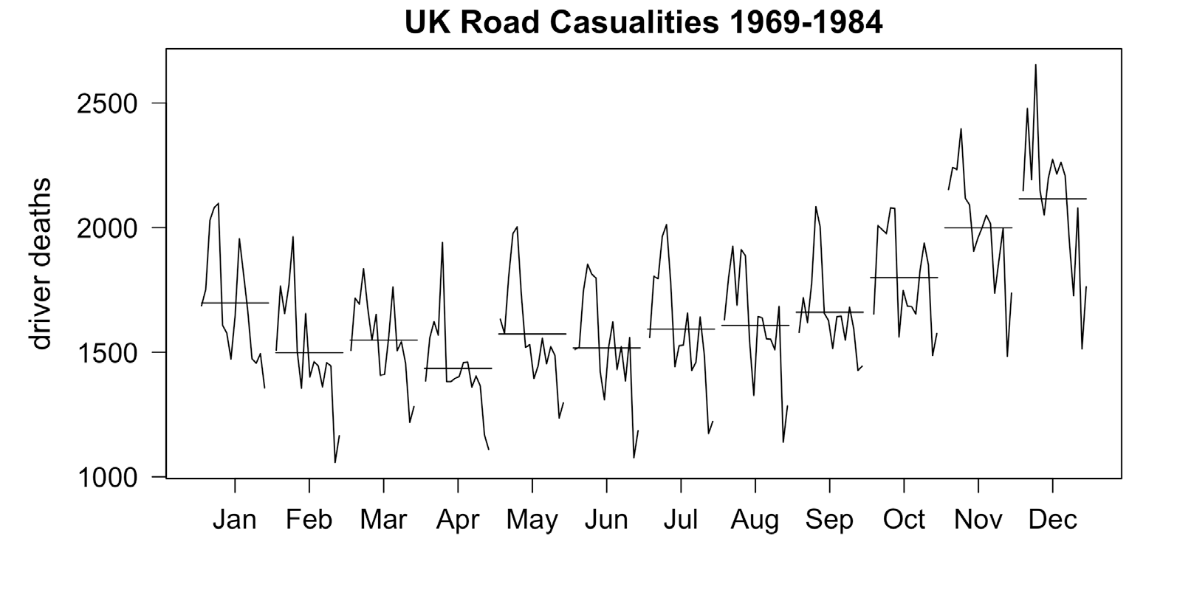
Month plot

Slide 6
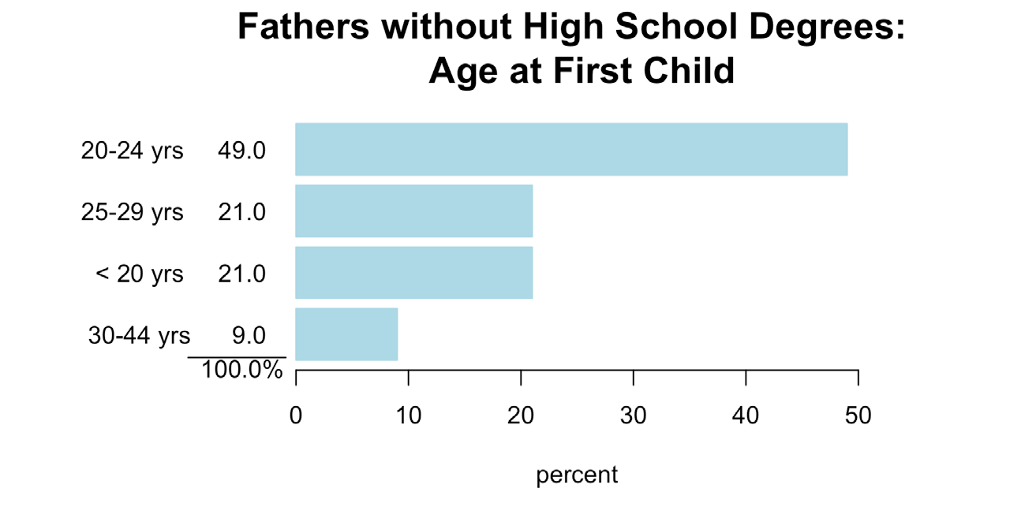
Bar percent chart

Slide 7
Dot plot

Slide 8
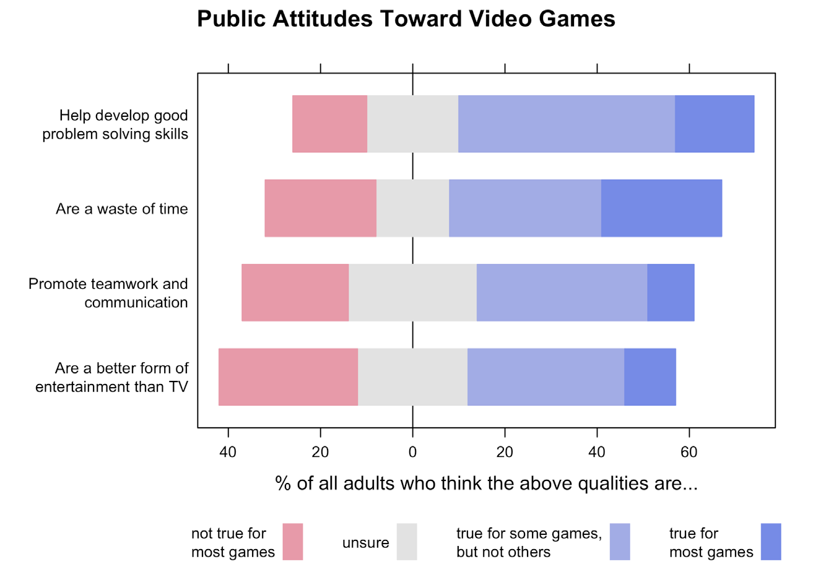
Diverging stacked bar chart

Slide 9
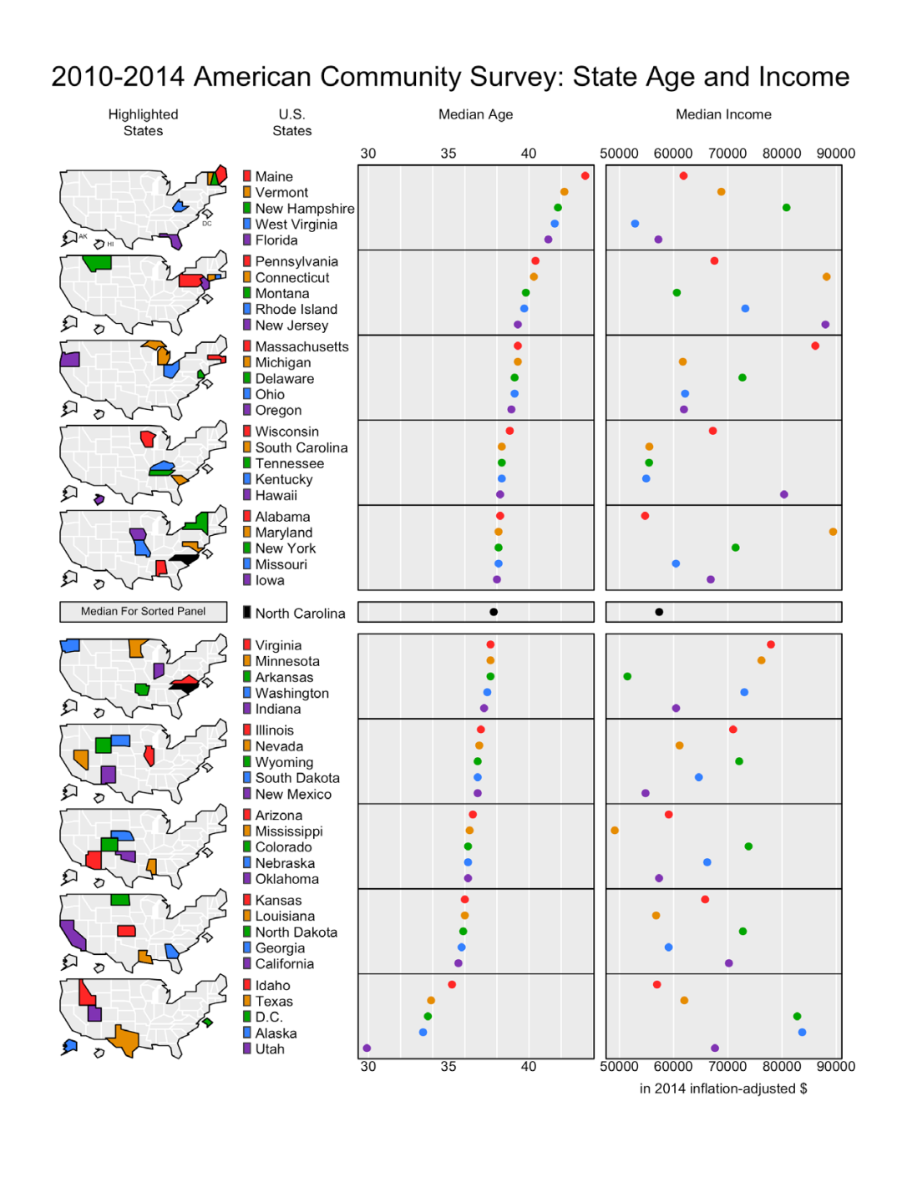
Linked micromap

Slide 10
Data Visualization in R
Packages
general: base / lattice / ggplot2
specialized
Which package?
type of graph
today: base, ggplot2, HH, micromapST

Slide 11
Outline
month plot
bar percent chart
dot plot
diverging stacked bar chart
linked micromaps

Slide 12
Month plot
monthplot(x, …)
dataset: UKDriverDeaths

Slide 13
Month plot
class(UKDriverDeaths)
## [1] "ts"
str(UKDriverDeaths)
## Time-Series [1:192] from 1969 to 1985: 1687 1508 1507 1385 1632 ...

Slide 14
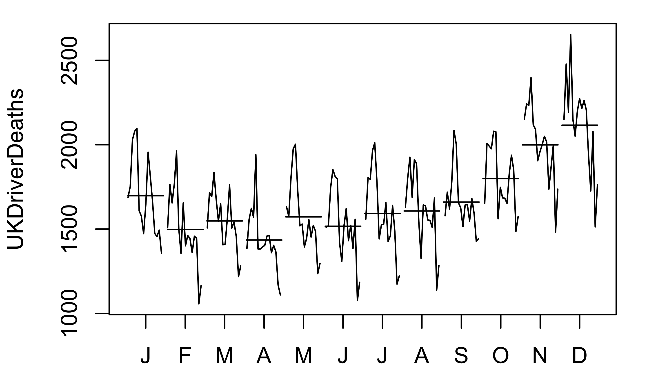
Month plot
monthplot(UKDriverDeaths)

Slide 15
Month plot
par(mar = c(5,6,2,2))
monthplot(UKDriverDeaths,
main = "UK Road Casualities 1969-1984",
las = 1, labels = month.abb,
cex.axis = 1.2, cex.main = 1.4,
ylab = "")
mtext("driver deaths", side = 2, line = 4, cex = 1.3)

Slide 16
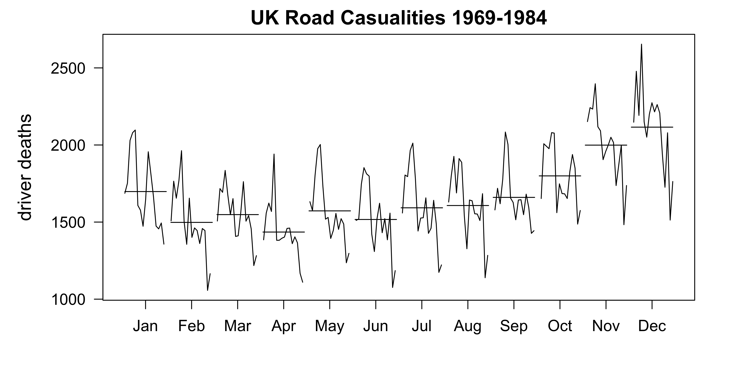
Month plot

Slide 17
Creating a time series object
data <- ts(data,
start = c(2010,7),
frequency = 12)

Slide 18
Outline
month plot
bar percent chart
dot plot
diverging stacked bar chart
linked micromaps

Slide 19
Bar percent chart

Slide 20
Bar percent chart
source("barpercent.R")
data <- c(21, 49, 21, 9)
names(data) <- c("< 20 yrs", "20-24 yrs",
"25-29 yrs", "30-44 yrs")
barpercent(data)
mtext(paste("Fathers without High School",
"Degrees: \nAge at First Child"),
side = 3, line = 1, font = 2, cex = 1.5)

Slide 21
Bar percent chart

Slide 22
barpercent() function
barpercent (x, names = NULL, col = "lightblue")
Arguments
x a vector of values (raw or %s)
names a vector of bar labels, if omitted, names(x)
will be used
col bar color (default is light blue)

Slide 23
Bar percent plot
barpercent(c(2,1,3),
c("City A", "City B", "City C"),
col = "lightgreen")

Slide 24
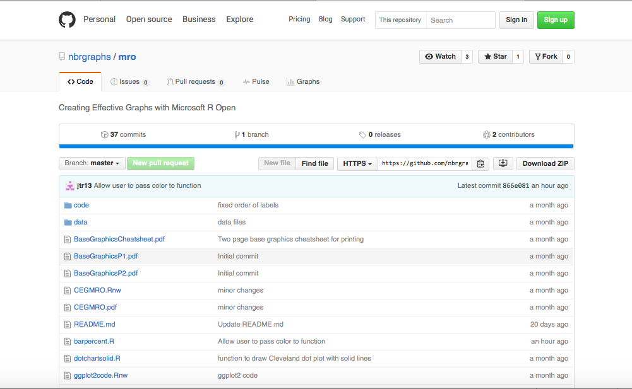

Bar percent chart
barpercent.R is available on Github:
https://github.com/nbrgraphs/mro

Slide 25
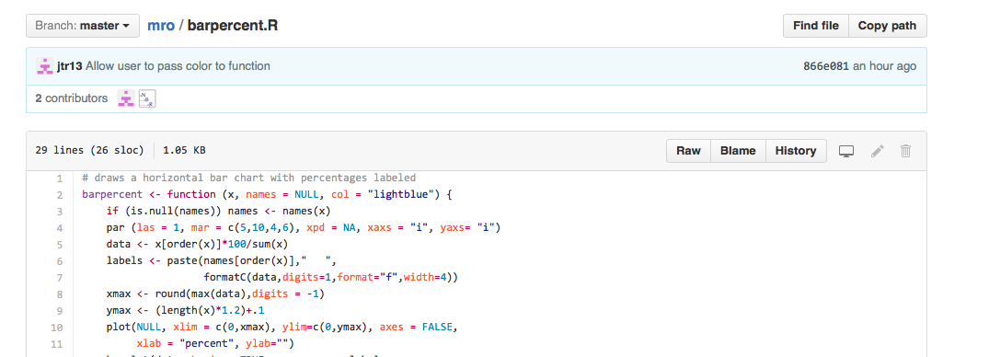
Bar percent chart
https://github.com/nbrgraphs/mro/blob/master/barpercent.R
Raw

Slide 26
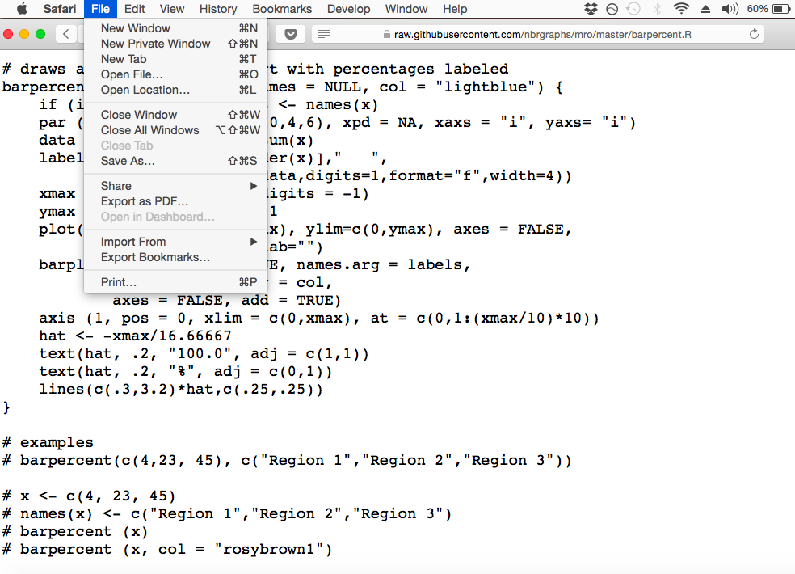
Bar percent chart
https://raw.githubusercontent.com/nbrgraphs/mro/master/barpercent.R
Save As…

Slide 27
Outline
month plot
bar percent chart
dot plot
diverging stacked bar chart
linked micromaps

Slide 28
Dot plot

Slide 29
Dot plot code (1)
library(ggplot2)
data <- read.csv("countries2012.csv")
index <- seq(from = 1, to = 179, by = 8)
sample <- data[index,]
sample$COUNTRY <- reorder(sample$COUNTRY, sample$TFR)
g <- ggplot(sample, aes(TFR, COUNTRY))
g <- g + geom_point()
g

Slide 30
Dot plot (1)

Slide 31
Dot plot code (2)
g <- g + scale_x_continuous(limits = c(1,7),
breaks = 1:7) + theme_bw(18) +
theme(panel.grid.major.y =
element_line(size = 0.5),
panel.grid.major.x = element_blank(),
panel.grid.minor.x = element_blank(),
axis.ticks.y = element_blank())
g

Slide 32
Dot plot (2)

Slide 33
Dot plot code (3)
g + xlab("average births per woman") +
ylab("") +
ggtitle("Total Fertility Rate by Country") +
geom_vline(xintercept = 2, color = "red") +
annotate("text", x = 2.1, y = 4.5,
label = "replacement rate",
color = "red", size = 5, hjust = 0)

Slide 34
Dot plot

Slide 35
Outline
month plot
bar percent chart
dot plot
diverging stacked bar chart
linked micromaps

Slide 36
Diverging stacked bar chart
rows
columns

Slide 37
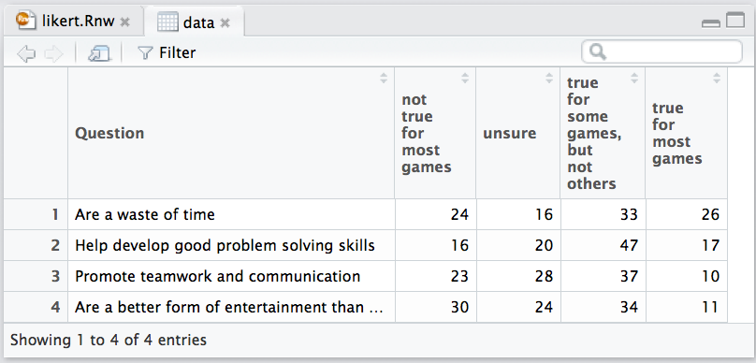
Diverging stacked bar chart
> View (data)

Slide 38
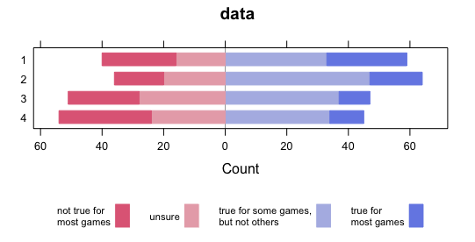
Diverging stacked bar chart
> likert (data)

Slide 39
Diverging stacked bar chart
likert(Question ~ ., data,
ReferenceZero = 2,
positive.order = TRUE,
main = "Public Attitudes Toward Video Games",
xlab = paste("% of all adults who think the",
"above qualities are..."),
ylab = "")

Slide 40
Diverging stacked bar chart

Slide 41
Outline
month plot
bar percent chart
dot plot
diverging stacked bar chart
linked micromaps

Slide 42
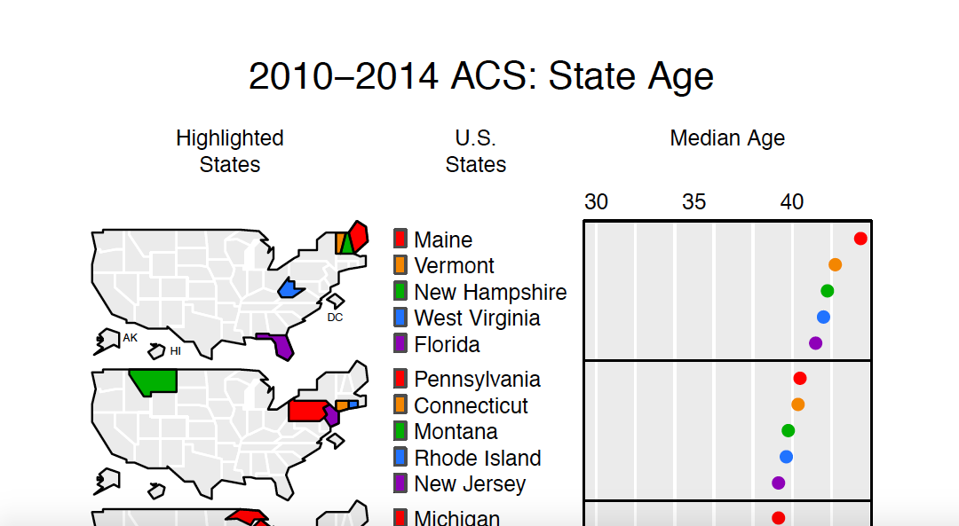
Linked micromap

Slide 43
Linked micromap
library(micromapST)
data <- read.csv("acs2014.csv", row.names = 1)
panelDesc <- data.frame(
type = c("map", "id", "dot"),
lab1 = c("", "", "Median Age"),
col1 = c(NA, NA, "Age"))
micromapST(data, panelDesc, rowNames = "full",
sortVar="Age", ascend = FALSE,
title = "2010-2014 ACS: State Age",
details = list(Title.cex = 1.2))

Slide 44
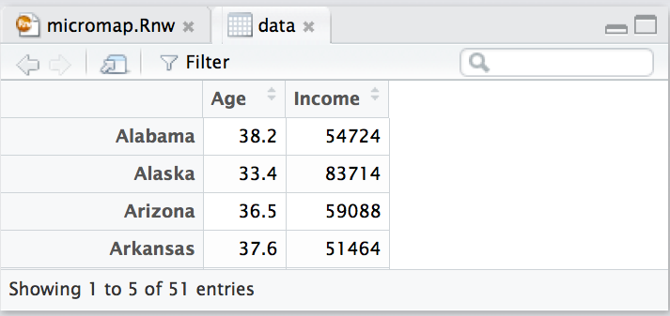
Linked micromap
data <- read.csv("acs2014.csv", row.names = 1)

Slide 45
Linked micromap
panelDesc <- data.frame(
type = c("map", "id", "dot"),
lab1 = c("", "", "Median Age"),
col1 = c(NA, NA, "Age"))

Slide 46
Linked micromap
micromapST(data,
panelDesc,
rowNames = "full",
sortVar="Age",
ascend = FALSE,
title = "2010-2014 ACS: State Age",
details = list(Title.cex = 1.2))
(other options:
"ab", "fips")

Slide 47
Linked micromap

Slide 48
Conclusion
Effective plots are not difficult to code
Many more options are available for all the graphs we’ve shown
Be creative

