Slide 1
What must be verified in an estimation process: Overview
(Chapter 4)
Alain Abran
(Tutorial Contribution: Dr. M. Villavicencio)

Slide 2
Topics covered
Introduction
Verification of the inputs to the estimation process
Verification of the productivity model
Verification of the adjustment phase
Verification of the budgeting phase
Re-estimation & continuous improvement

Slide 3
4.1 Introduction
This chapter presents an overview of the verification steps that should be carried out through out the estimation process.
The detailed verification activities will be presented in the subsequent 3 chapters of the book (chapters 5 to 7).

Slide 4

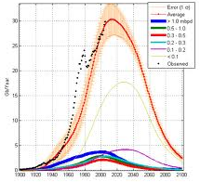
Verify the quality & understand the limitations of these estimation models
The Web (No-fee estimation software)
Vendors of estimation software tools
  (black box estimation software tools)
Books & magazines,
Estimation model
http://isorequirements.com/iso_9001_7.4.3_verification_of_purchased_product.html

Slide 5
4.2 Verification of the inputs

Slide 6
Identification of the estimation inputs & of their quality as Inputs
What is their quality as inputs to and estimation process?
Quantitative product information (for the independent variable).
Descriptive process information (for the selection of a specific model).

Slide 7
Product information
The functional requirements
  see next example.
The non functional requirements:
  are they detailed enough?
The relationships between the system view and the software view:
  have the functions to be allocated to software already been identified and corresponding software-hardware interfaces specified?

Slide 8
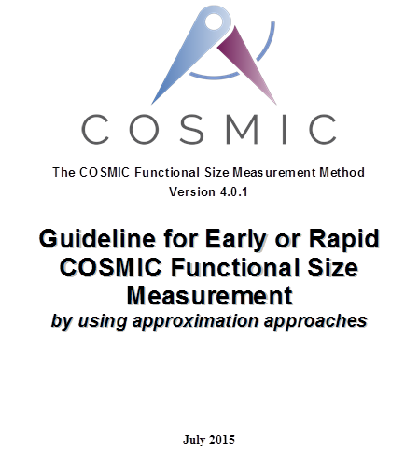
Example: Are Function Points accurate as estimation input?
For projects to be estimated:
When all the requirements are detailed & available, Function Points can be measured quite accurately & used with confidence as inputs to an estimation process.
When not all the requirements are detailed: there are techniques for approximating candidate size ranges – see:
www.cosmic-sizing.org

Slide 9

Process information available?
Expected characteristics of the development process & implementation platform.
Known constraints: technical environment, such as DBMS, programming languages, programming standards, etc.
https://www.easyuni.com/en/advice/388/10-programming-languages-you-should-learn-in-2014/

Slide 10
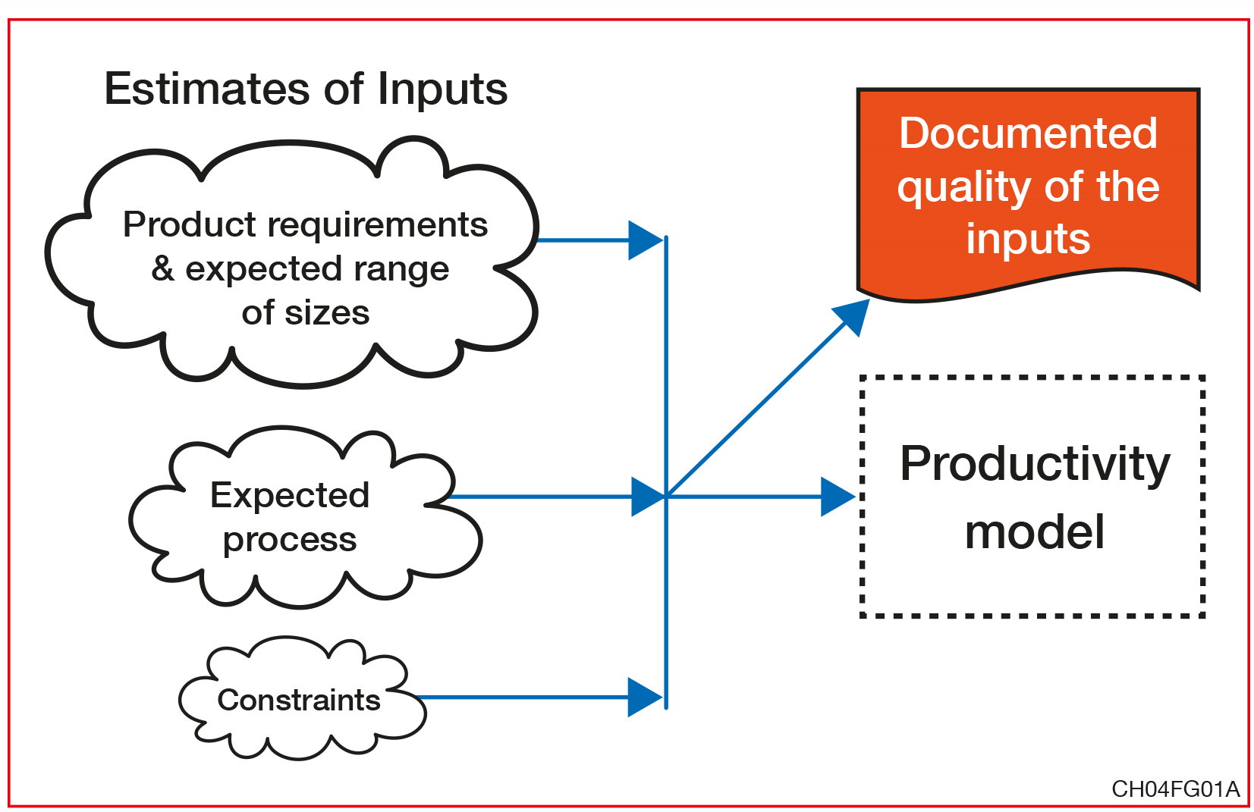
Documenting the quality of the inputs

Slide 11
4.3 Verification of the productivity model

Slide 12

In-house productivity models
These models are built:
Using the organization’s own historical data.
  The quality relies on the basis of such historical data.

Slide 13
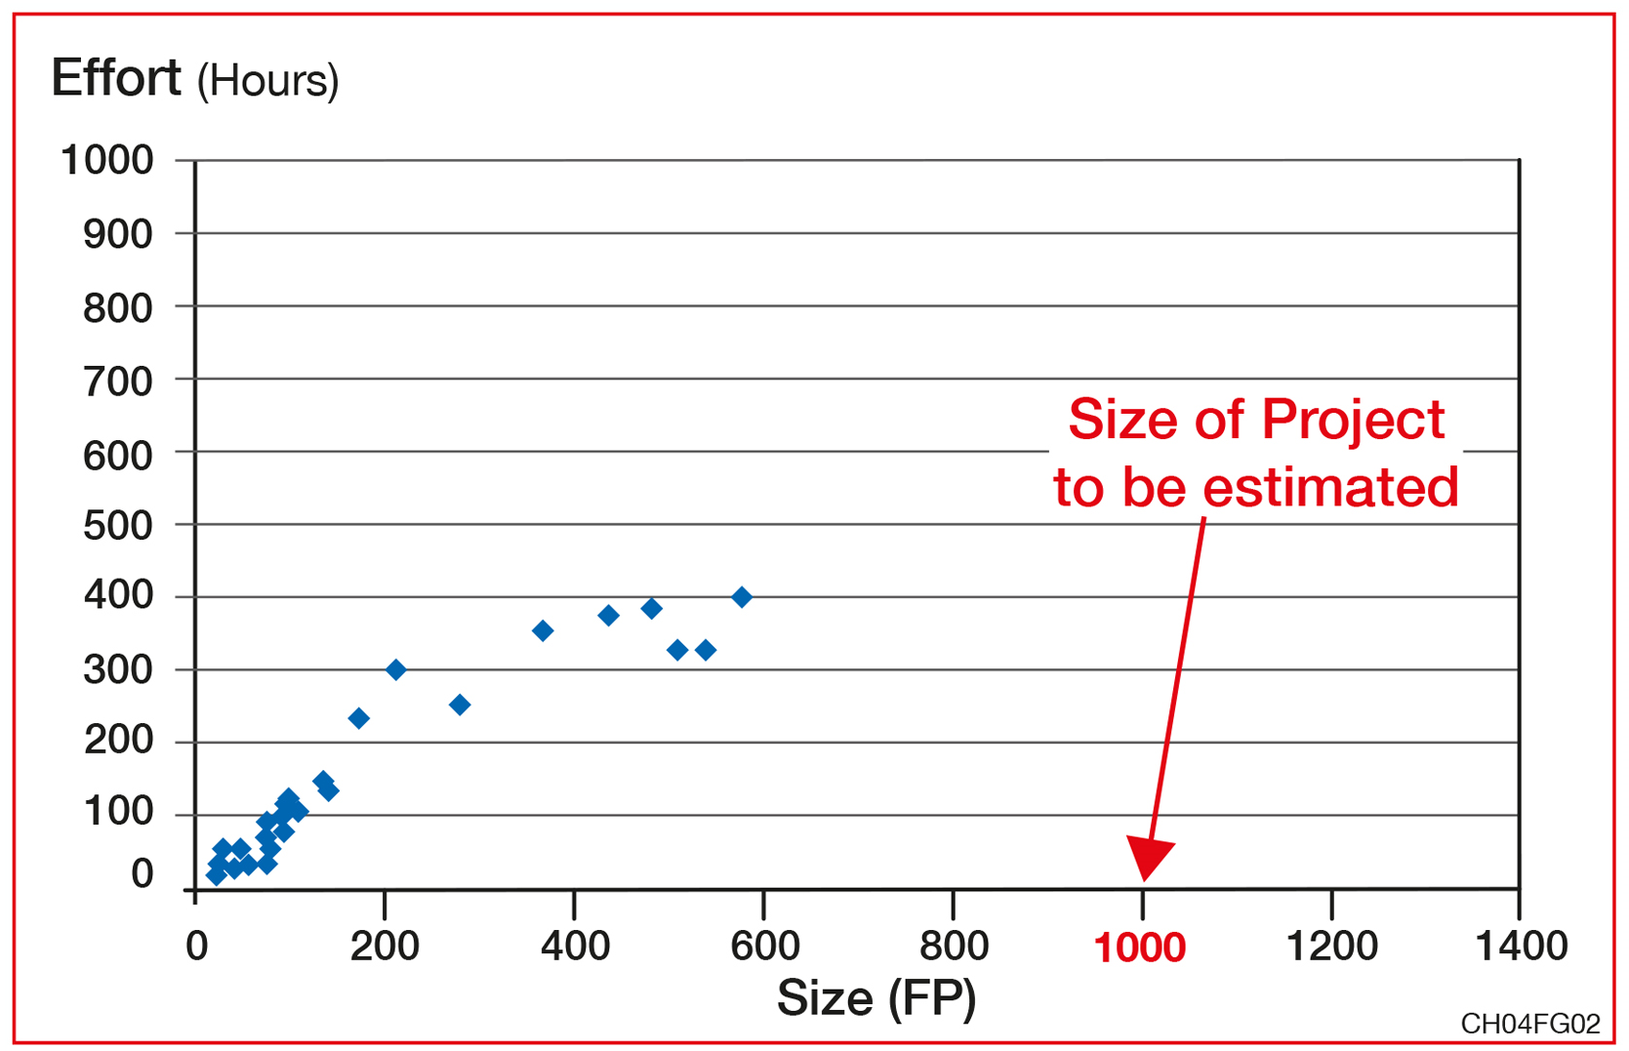
Representativeness & Population sample
= Outside of range!

Slide 14
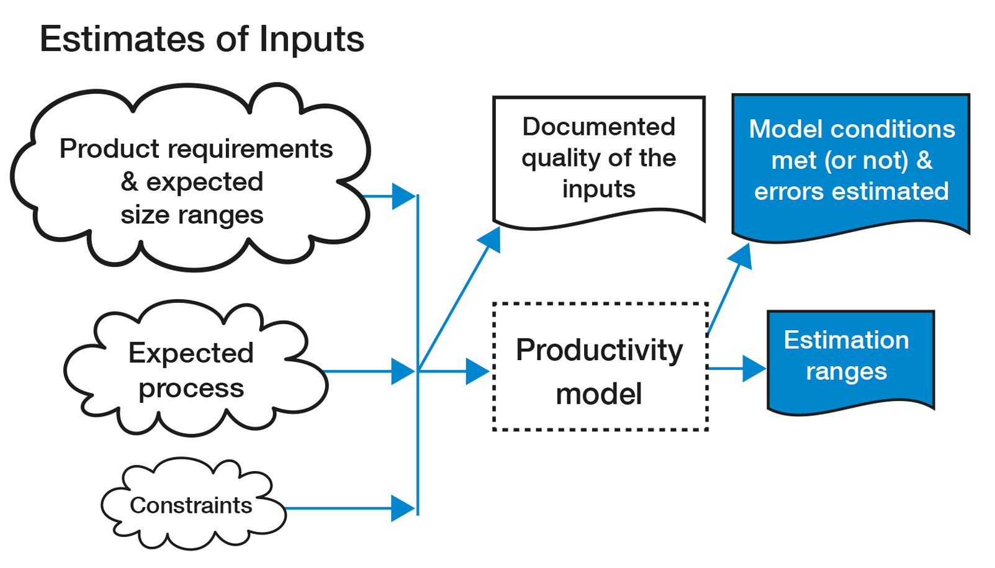
Verification of the Productivity Model used in an Estimation context

Slide 15

Externally provided estimation models
http://www.rankuno.com/outsource-internet-marketing.asp
Used when organizations do not have their own repository of completed projects.
These models are:
  Stored in repositories (e.g. ISBSG – see chapter 8)
  Embedded within software estimation tools from vendors or from the Web.
  Based on models & mathematical formulae from the literature (e.g. the COCOMO’81 & COCOMO’II models).

Slide 16
Considerations for Using External Models
Determine the predictability of the model for the organization usage.
Calibrate the model to the business environment of the organization.
Commit resources on the basis of the outcomes of the calibrated model.

Slide 17

How to analyze predictability of an external model ?
Take information from one or more recently completed projects
Use this information as inputs to the external model, and compare the results of the estimate against the actual effort.
Compare
http://www.aliexpress.com/price/couple-things_price.html

Slide 18
4.4 Verification of the adjustment phase

Slide 19
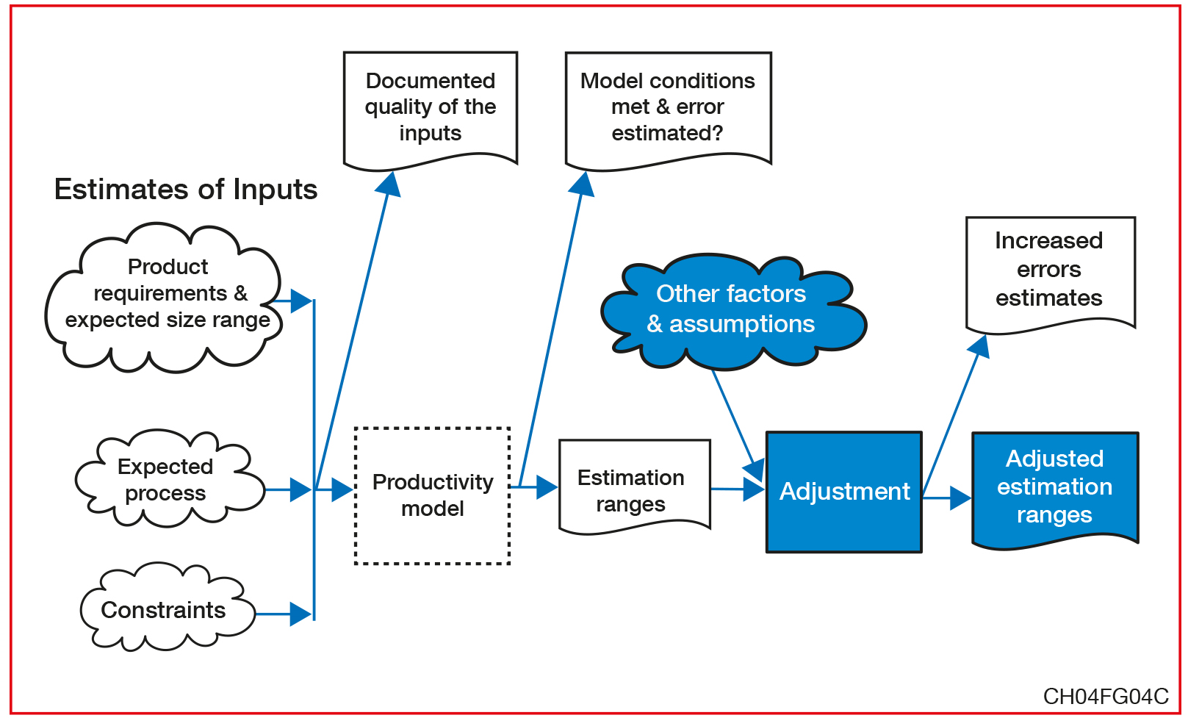
Verification of the adjustments

Slide 20

Verification of adjustments: Why ?
To identify, document, & ‘size’ the additional variables, information & constraints.
To prepare an assessment of the individual impact of the additional variables.
To introduce the adjustments to the models used (in-house or external).

Slide 21
4.5 Verification of the budgeting phase

Slide 22

Additional considerations
http://www.fotosearch.com/illustration/consideration.html
Technological
  A selected technology might not deliver on time.
Organizational
  Key employees availability.

Slide 23
4.6 Re-estimation and continuous improvement

Slide 24
What determines the improvement of the estimation process ?
The data collected at the completion of a project (no uncertainty).
The skills of the people integrating this information into the productivity models to be improved.

Slide 25
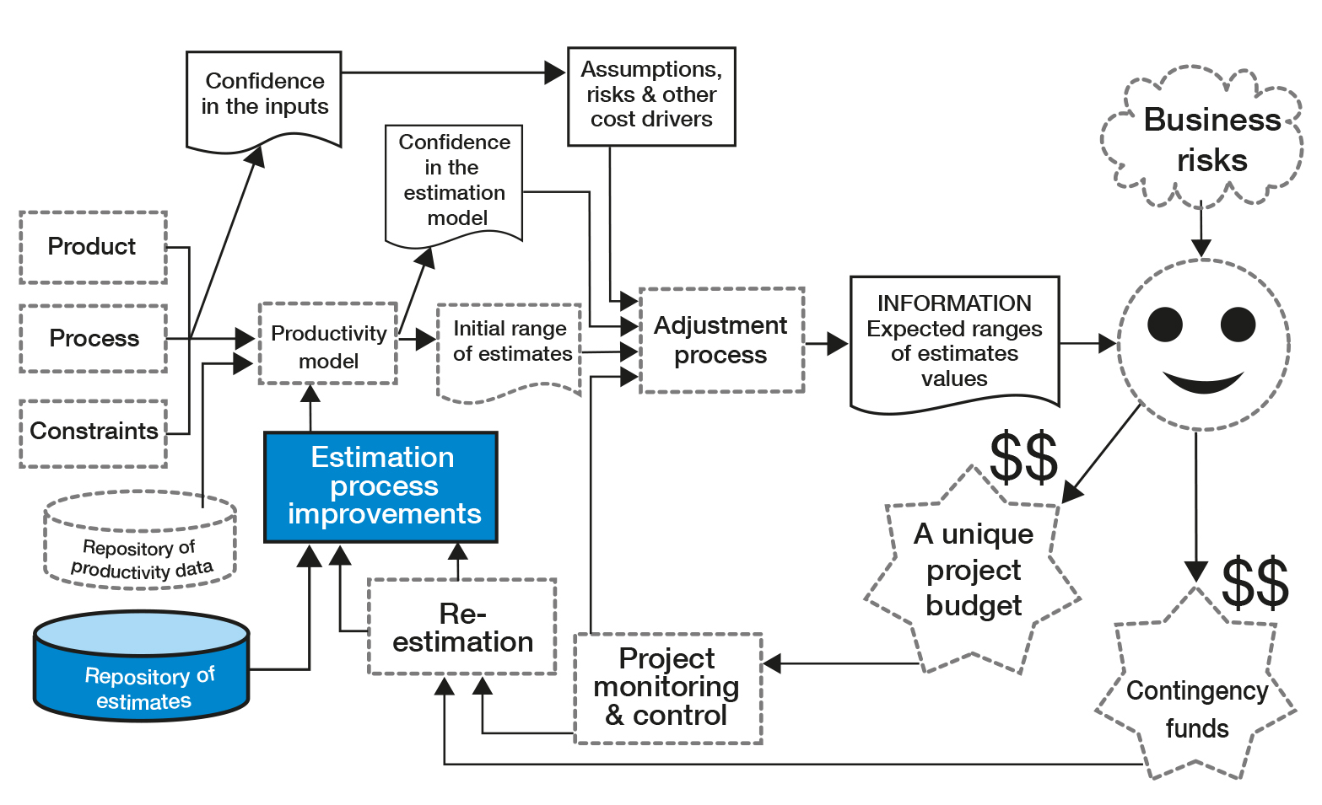
Estimation Process Improvement

Slide 26
Challenges faced to improve the models
There is rarely a single estimated budget.
  The project budget in often re-estimated a number of times over the course of the project’s life cycle.
The information used as input to the estimation process is often not documented.
  The quality and completeness are neither recorded nor analyzed.
Assumptions made during the estimation process are not all documented.
‘Scope creep’ during the life cycle is rarely measured or controlled

Slide 27
Topics covered
Introduction
Verification of the inputs to the estimation process
Verification of the productivity model
Verification of the adjustment phase
Verification of the budgeting phase
Re-estimation & continuous improvement

Slide 28
Exercises
Can all the aspects of verification be performed at the same time in an estimation process? What should the sequence of those aspects be?
What should be included in the verification of the variables in the inputs to an estimation process?
What should be included in the verification of the use of an in-house productivity model?
What should be included in the verification of the use of a vendor estimation model?
How can you verify an estimation model picked up free of charge from a book or from the Web?
What should be verified in the Adjustment phase of the estimation process?
What should be documented when a specific decision is made on a project budget?
What type of information must be kept to analyze the performance of project estimates and to make improvements to the full estimation process?

Slide 29
Term Assignments
Document the quality controls in the estimation process in your organization.
Identify the strengths and weaknesses of your organization’s estimation process.
Identify the improvement priorities for your organization’s estimation process.
Propose an action plan to address the top 3 priorities.
Design a template for the quality assurance of a productivity model.
Design a template for the quality assurance of a full estimation process.
Select 3 estimation models proposed in the literature. Even though the authors may claim that their models are to be used for estimation, are those models based on productivity studies or on opinion? If the latter, what would be your confidence level using them for estimation purposes?

Slide 30
Term Assignments
Compare the verification steps in Figure 4.6 with the verification recommended in the literature on software estimation. Comment on the similarities and differences. Identify strengths and weaknesses of the model analyzed.
What has been done in your organization over the past 12 months to analyze the quality of its productivity model and estimation process? Why? Is it because estimates are (or are not) important to your organization?
For estimation purposes, how would you handle cost drivers not included in the productivity model?
For estimation purposes, how would you handle risk factors not included in the productivity model?

