Slide 1

INF755 Méthodes d’analyse et de conception Hiver 2018 Séance-12
Bonsoir !
Chargé de cours: Alain Cardinal

Slide 2
Plan de la séance-12
Retour séance-12
Maintenance des SI
Problèmes avec la maintenance
Définition de la maintenance
Perception de la maintenance
Environnement de la maintenance

Slide 3
Retour séance-11
SAP
ERP
ASAP
ABAP

Slide 4
Plan de la séance-12
Maintenance des SI
Problèmes avec la maintenance
Définition de la maintenance
Perception de la maintenance
Environnement de la maintenance

Slide 5
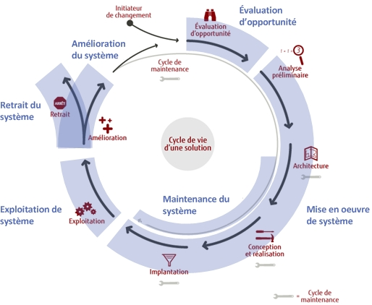
Étapes du cycle de vie

Slide 6
Problème avec la maintenance vue par le client
Coût élevé de la maintenance
Service de maintenance lent
Ressources vs. @Backlog@
Ne comprend pas comment le service de maintenance est priorisé et assigné
Notes:
From the customers’ (external) point of view, the main issues reported are [Pigosky 1997] high cost, slow delivery of services and fuzziness of prioritisation (internal IS/IT priorities versus users’ priorities).

Slide 7
Opinion d’experts
La maintenance logicielle souffre plus d’un manque de gestion que d’un simple problème de connaissances techniques
On ne reconnait pas la maintenance
On ne structure pas la maintenance
On ne mesure pas la maintenance
Notes:
During 1987, Colter [Colter 1987] made the following observation: “The biggest problem in software maintenance is not technical, but it is rather its management”. Lets examine both viewpoints in more detail.

Slide 8
Collecte inadéquate des données
Les gestionnaires de la maintenance ont de la difficulté à expliquer leurs coûts.
Que peuvent 'ils utiliser ?
Les gestionnaires de la maintenance ont de la difficulté à expliquer la valeur ajoutée de la maintenance.
Notes:
It is also reported that a significant part of the user’s perception of the high cost of maintenance may stem from inadequate communication by maintenance managers about the type of maintenance work performed on the customer’s behalf. Maintenance managers too often group enhancement and corrective work together in their management reports, statistics and budgets, which warps costs, in both maintenance budgets and reports. This aggregation maintains customer misconceptions about maintenance services and perpetuates the misleading perception that software maintenance is mainly concerned with correcting defective software.

Slide 9

Maintenance matérielle VS Maintenance logicielle?
Remplacer une composante
On pèse sur le bouton pour vérifier
?
VS.
Notes:
Schneidewind’s [Schneidewind 1987] opinion is that users’ perceptions of the slowness of service is partially based on a misunderstanding of the fundamental difference between electronic/computer hardware maintenance and the software maintenance domains. He finds that the user does not have a clear idea of what constitutes a software maintenance activity, describing, for example, how the repair of a broken printer or computer component may simply involve a modular component replacement activity. He also notes that electronic equipment design, being more mature than software design, is based on a thorough “modularization” of components, which does not create side-effects during maintenance activities. Moreover, when well designed, hardware allows complete testing and diagnostics of components at the touch of a button! Many users, unfamiliar with the software domain, may perceive that software is maintained in a similar fashion. Unfortunately, software has not yet matured to this stage. There remain many challenges to the existence of modularity and auto-testing in software, in particular because of its lack of maturity, and, furthermore, most software currently in use is more than a decade old and would not incorporate this type of architectural technology.

Slide 10
Maintenance matérielle VS Maintenance logicielle?
Le matériel se dégrade sans maintenance
Le logiciel se dégrade lorsqu’il est maintenu!!!
Notes:
Software maintenance has some peculiarities when compared to maintenance in other domains: while hardware and mechanical components deteriorate when there is no maintenance, software, by contrast, deteriorates as a result of multiple maintenance activities [Glass 1992] Because software practices have not matured to the extent that hardware practices have, maintenance is performed by identifying one or many components and fixing them. Software maintenance often requires reworking in many, if not all, parts of the software. Multiple maintenance activities are blamed for further degrading its internal structure and making future maintenance activities progressively more difficult. If no strategy is put in place to control these effects, the software structure and quality continue to deteriorate.

Slide 11


Maintenance matérielle VS Maintenance logicielle?
Matériel
Logiciel
Photocopier Repair $15/hr
PC Repair $20/hr
Camera Repair $20/hr
TV Repair $20/hr
Audio Repair $25/hr
Web maintenance $45/hr
Cobol Maintenance $55/hr
Database maintenance $65/hr
OS maintenance $75/hr
ERP maintenance $130/hr

Slide 12
Plan de la séance-12
Retour séance-11
Maintenance des SI
Problèmes avec la maintenance
Définition de la maintenance
Perception de la maintenance
Environnement de la maintenance

Slide 13
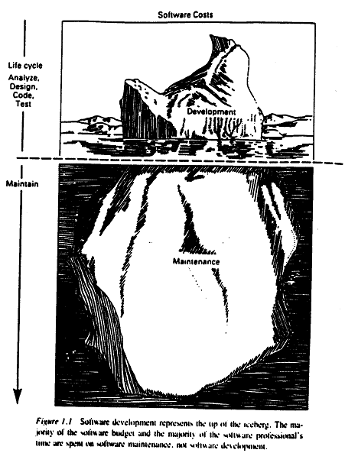

Slide 14
Perception
Coût élevé et mauvais service
Le client paie beaucoup
Il ne voit pas la valeur pour son argent
Pannes en production
Erreurs logicielles
Longs délais d'attente
Coût élevé associé à un petit changement

Slide 15
SLA flous
La personne à la maintenance doit mettre fin à tous les autres travaux lorsqu'une défaillance en production se produit
Perception : l’entretien ne se fait pas selon la priorité des utilisateurs
Les utilisateurs ont tendance à classer toutes les demandes en tant que hautes
Les utilisateurs envoient beaucoup de demandes (comité de gestion des demandes!)
Notes:
Without agreed-upon and mature queue management mechanisms supported by detailed service level agreements (SLAs), users will fail to obtain service based on their real and stated priorities. In this situation, users have a tendency to rank all requests as high priority. Some users also demand that all problems and requests be addressed at the same time. Given that production system failures are random events, and that they need to be addressed first, such users will perceive that work on their requests is not progressing as they would expect. Bennett [Bennett 2000] also points out that, when customers become frustrated with the slow delivery of services, they will consider developing local solutions to solve their problems, or might consider a sub-contract or outsourcing maintenance work altogether.

Slide 16
￼
Entente de service

Slide 17
Est-ce que ces perceptions sont réelles?
Plusieurs réponses possibles!
Maturité du mainteneur
Maturité du client
Quel type de logiciel

Slide 18
Temps de développement vs. Temps de maintenance
Un projet de développement typique prend entre 1 et 2 ans
La maintenance requiert un temps additionnel de 5 à 6 ans
Règle du 80-20 (Pareto):
20 % de l’effort dans le développement
80 % de l’effort dans la maintenance.

Slide 19
Mauvaise perception
Oui, la maintenance est le coût le plus élevé!!

Slide 20
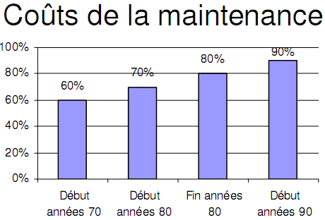
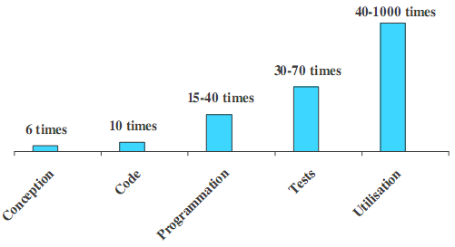
Les coûts de la maintenance
2000
Yann-Gaël Guéhéneuc, IFT3902 :Gestion de projet pour le développement et la maintenance des logiciels

Slide 21
Coût de la maintenance
Habituellement plus élevé que le développement
2 à 100 fois plus, dépendant de l’application
Touché par des facteurs techniques et non techniques
Augmente au fur et à mesure que le logiciel est maintenu.
La maintenance dégrade la structure du logiciel, rendant la maintenance plus difficile.
Les vieux systèmes peuvent avoir des coûts plus élevés
vieux langages, compilateurs

Slide 22
Fausse perception des coûts
Le service de maintenance n’est pas clair lorsque:
Les parties et les processus sont immatures (pas de SLA);
Symptômes
priorités confuses, délais, coûts non justifiés
Oui, la main d’œuvre est chère, mais lorsqu’elle est utilisée pour ajouter de nouvelles fonctionnalités…
Notes:
To better justify maintenance costs, management must do a better job of communicating the many maintenance activities, especially the value-added ones. To do this, it is important that management understand the maintainers’ processes and services and their many challenges.
To ease the mounting pressure, maintainers must better communicate that there is a fair and efficient queue and priority process in place that manages and monitors the status of each maintenance request/event. This process has many inputs and concurrent interrupting sources, such as: 1) operators who report system failures; 2) users who notice service degradation; 3) development project managers who require current software information and inputs in re-engineering studies; and 4) customers who require urgent information. A maintainer must clearly point out that there is a process and an SLA based on the priorities of everyone involved to obtain his resources, and that this sometimes leads to contention in requests for his services [Dorfman 2002].

Slide 23
Perception interne
Logiciel très mal conçu et programmé
Conception douteuse
Absence de documentation
Pas de système de test automatisé
Notes:
Maintainers are often confronted with a million lines of somebody else's source code. They must familiarise themselves quickly and process urgent changes without disrupting service

Slide 24
Réalité de mainteneur
Logiciels large et complexe avec peu de documentation;
Doit être changé rapidement sans interrompre le service;
Notes:
To make things more difficult, the newly developed software often has a number of urgent changes pending that the software developers could not include in the initial development, as they had been under pressure to deliver.
The average age of software under maintenance is 15-19 years old

Slide 25
Les lois de Lehman
Changement continue
Un logiciel doit continuellement être adapté. Sinon la satisfaction du client diminuera.
Ces changements se font sous l’effet de la pression de l’environnement (les utilisateurs) dans lequel le système évolue et par l’écart qui existe entre les caractéristiques du système et les besoins du domaine.
Complexité croissante
La complexité du logiciel augmente à chaque évolution à moins que cette évolution soit faite pour maintenir ou diminuer cette complexité. Les interactions et les dépendances augmentent, le couplage croit et le risque d’erreur croit.
Si beaucoup d’effort est consacré à éviter la croissance de la complexité, alors ce sont moins de ressources et de temps disponibles pour la transformation du système.
Notes:
Lehman [Lehman 1985, 1997] reports that, in addition to age, the structure of software undergoing maintenance becomes increasingly complex as it is modified over time. The size and complexity of the software increases, and an increasing number of resources is required to maintain it.
Lehman [Lehman 1980] states that “being unavoidable, changes force software applications to evolve, or else they progressively become less useful and obsolete.” Maintenance is therefore considered inevitable for application software which is being used daily by employees everywhere in a changing organisation.
3) (Gosh! – in English it means that the process of the evolution has behavioral and statistical features that can be forecasted and measured)

Slide 26
Lois de Lehman
Croissance continue
Le contenu fonctionnel d’un logiciel doit continuellement croître afin de satisfaire les besoins des utilisateurs durant toute sa vie utile.
Qualité décroissante
La qualité d’un logiciel va être perçue comme décroissante à moins d’une maintenance rigoureuse et adaptée aux changements dans l’environnement opérationnel.
Notes:
4) It means: after some time of maintenance effort the ratio resources/result stabilizes optimally. Adding more resources will only worsen an effort.
5) means: each new release adds less to the system's functionality than the previous one, to finally reach the level of “functional saturation”

Slide 27
Conclusion sur les lois
Observations:
Les logiciels évoluent ou disparaissent
Un logiciel qui grossit implique une complexité qui va limiter sa capacité de croître.
Solutions:
Nécessité de gérer la complexité
Revoir périodiquement le design
Activités de refactoring pour rajeunir le logiciel

Slide 28
Classification des problèmes selon Dr. Bennet
Problèmes d’alignement (A)
Problèmes de processus (P)
Problèmes techniques (T)
(A) Et (P) sont des problèmes de management
(T) Sont des problèmes techniques
Est-ce qu’il est vrai que la plupart des problèmes de maintenance sont des problèmes de management?
Notes:
Bennett [Bennett 2000] stipulates that software maintenance problems can be grouped into three categories: 1) problems of alignment with the organisation’s objectives; 2) process problems; and 3) technical problems.

Slide 29
Le système est imposé
Imposé aux mainteneurs
Il a souvent beaucoup de problèmes
Un grand nombre de problèmes à résoudre
Un backlog qui vient avec
Pas de support du management pour vous aider dans cette situation
Faites-le!
Notes:
Maintenance engineers also claim that their professional status is perceived as being inferior to that of developers [Landsbaum 1992] and that they have no choice but to accept the newly developed software, which is being forced on them whatever its level of quality. From their point of view, the software is transferred to the maintenance organisation with a backlog of changes and problems which, in their opinion, should have been addressed by the developers and which are hard to handle with a small number of individuals. The maintainers also report being poorly equipped, supported and understood by management, while being responsible 24/7 for the proper functioning and management of software and, more importantly, for the support of all customer-related issues.

Slide 30

Le conflit
Les clients ont besoin d’un système maintenant! Les attentes sont élevées.
Les développeurs construisent rapidement (plus vite et en deçà du budget si possible)
Les mainteneurs veulent un système sans défaut, venant avec une documentation pour la maintenance du système pour les prochaines années…
La DDC???
Notes:
It has long been recognised that an immature software development process creates a number of problems in the final product delivered to the customer and to the maintenance organisation. Various authors have claimed that a mature process which clearly captures and manages requirements and specifications resulting in a stable design will lower maintenance costs [Khan 2005 p. 345, Schach 2000, MICAH 1990]. Use of immature development processes creates an initial maintenance backlog which needs to be addressed, on a priority basis, during the first months/year of operation of the new software. It is observed that processing this backlog creates a large increase in the number of lines of code during the first three years of software maintenance. Gibbs [Gibbs 1994] reports this situation as a major cause of increased maintenance costs and initial dissatisfaction of customers.
Bennett [Bennett 2000 s6] indicates that, in a context where financial resources are limited, the analysis, design and testing phases of the initial software development project are all put under pressure and are often only partially completed. Such omissions necessarily lead to dire consequences for software maintenance.

Slide 31
￼
DDC

Slide 32
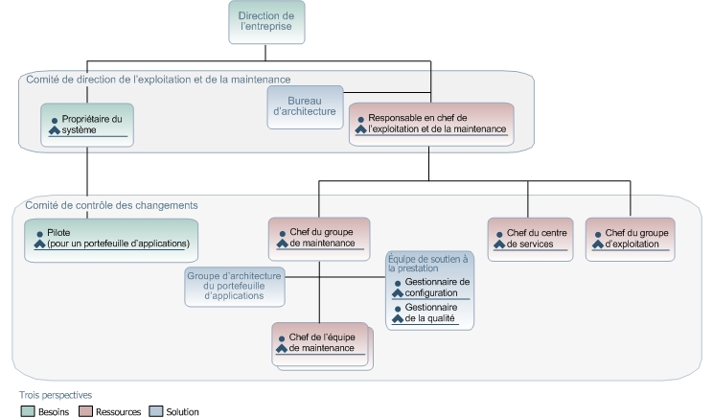
Comité de controle des changements

Slide 33
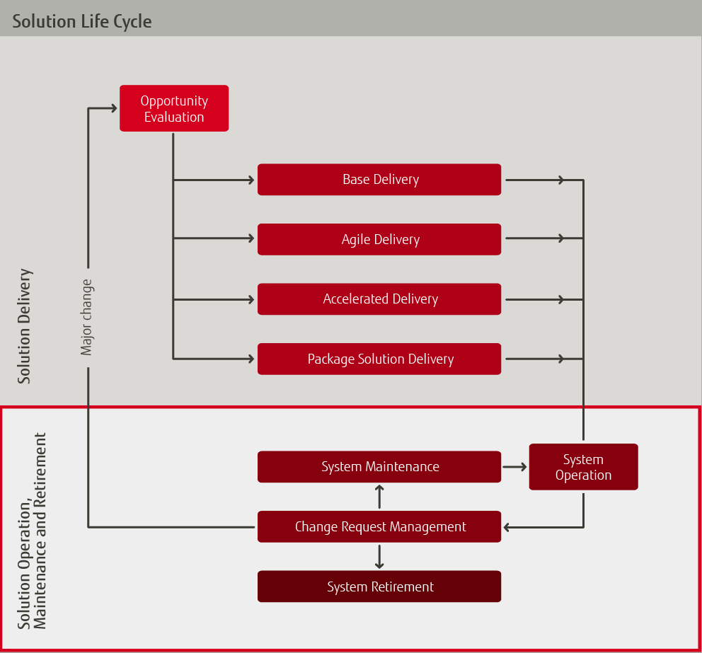
Macroscope une solution ?

Slide 34
Points de pression
REQUIREMENTS
ANALYSIS
La pression sur le développement résulte en un logiciel de mauvaise qualité qui est transféré à la maintenance lors de la phase de transition
SYSTEM
DESIGN
PROGRAM
DESIGN
CODING
UNIT & INTE-
GRATION TESTING
SYSTEM
TESTING
Transition
ACCEPTANCE
TESTING
OPERATION
& MAINTENANCE
Notes:
A second group of problems have been identified as originating from the software development process itself (items 4, 6, 11 and 12 of Table II). Schneidewind [Schneidewind 1987, Pigoski 1997 s2] also identifies other maintenance problems stemming from the same source:
poor traceability to the processes and products that created the software;
changes rarely documented;
difficulty of change management and monitoring, and
ripple effects of software changes.

Slide 35
Coûts d’une faute
Le coût de correction d’une faute croît avec le temps
Si trouvée, combien elle coûte à réparer?
Prenons un problème dans les exigences, mais que nous identifions plus tard…
4x si trouver et corriger pendant le design
10x si trouver et corriger pendant l’implémentation
30 – 52 x si trouver…lors de l’intégration
200 – 368 x si trouver … lors de la maintenance

Slide 36
Processus immatures
Âge moyen des codeurs
en inde: 26-27
En afrique du sud : 28-32
Il y a toujours une grande proportion de développeurs/processus de développement immatures.
Les processus matures permettent de créer des logiciels plus faciles à maintenir
Ces logiciels arrivent souvent avec un gros backlog
Clients insatisfaits
Notes:
Average age of a software developer is :
India 26-27
South-Africa 28-32
It has long been recognised that an immature software development process creates a number of problems in the final product delivered to the customer and to the maintenance organisation. Various authors have claimed that a mature process which clearly captures and manages requirements and specifications resulting in a stable design will lower maintenance costs [Khan 2005 p. 345, Schach 2000, MICAH 1990]. Use of immature development processes creates an initial maintenance backlog which needs to be addressed, on a priority basis, during the first months/year of operation of the new software. It is observed that processing this backlog creates a large increase in the number of lines of code during the first three years of software maintenance. Gibbs [Gibbs 1994] reports this situation as a major cause of increased maintenance costs and initial dissatisfaction of customers.

Slide 37
Plan de la séance-12
Retour séance-11
Maintenance des SI
Problèmes avec la maintenance
Définition de la maintenance
Perception de la maintenance
Environnement de la maintenance

Slide 38




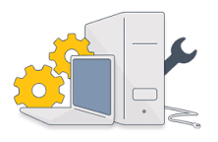


L’environnement de travail de la maintenance
Développeur
Mainteneur
Notes:
Tom De Marco [DeMarco 1985] has investigated the impact of the work environment on programmer productivity, and reported that the physical environment (noise and interruptions) hinders their performance. Also present in literature is the issue of the lack of software maintenance skills being taught in schools [Cardow 1992, Kajko-Mattsson 2001a]. Authors recognize that what is taught there does not reflect what software maintenance is in reality. This leads to a workforce with a lack of knowledge of maintenance-related processes and techniques.
Could there also be a cultural factor that would explain why software maintenance is not as visible, and not promoted, in software development? Bennett [Bennett 2000] conducted a study in Japan, during 1993, as a result of which he describes how the managers’ perceptions, based on the notion that software improvement increases customer satisfaction on a daily basis, seem a more important concept in a Japanese organisation than it is in a European or American one. Without good software maintenance, these Japanese organisations report that they would rapidly lose market share. The quality culture being stronger in Japan [Azuma 1994], maintenance activities benefit from more visibility and achieve greater recognition: maintenance engineer morale is higher and maintenance management is more visible, both to managers and customers.

Slide 39
Problème: Le morale
11.9 % des problèmes pendant la maintenance sont le résultat d’un mauvais moral
Pendant la maintenance, 8 % des problèmes proviennent d’un programmeur poussé dans trop de dossiers, l’empêchant de se concentrer suffisamment longtemps pour régler un seul problème.
Sari Lawrence Pfleeger

Slide 40
Inexpérience
Qui fait la maintenance:
25 % des étudiants
61 % des programmeurs d’expériences (Swanson-Beath)
Dans une autre étude
60 % à 80 % - personnes récemment engagées.

Slide 41
Qui fait la maintenance
Parfois des développeurs:
Moins d’intérêts, il veulent quitter pour un meilleur travail (créatif)
Difficile d’embaucher
Problème de continuité (roulement)
Moins d’indépendance
Moins bonne qualité
Moins de transparence
Notes:
A maintainer is defined, in ISO12207, as an organisation which performs maintenance activities. In the industry, software organisations currently favour two organisational structures with regard to the location of the software maintenance function. The first model favors maintenance of the software by its developer. In another model, a software maintenance organisation, independent of the developer, takes care of the organisation’s software maintenance needs. Pigoski [Pigoski 1997 s2] describes each organisational model, along with their advantages and disadvantages as follow.
There are a number of disadvantages to letting the development team maintain the software after it has been put into production: 1) developers do not like performing maintenance and are more likely to leave for more interesting work; 2) new hires in the development team will be both surprised and dissatisfied to discover that they also need to maintain existing software; 3) developers are often re-assigned to other development projects and prefer this kind of work; and 4) when the individuals who developed the software leave, the other employees will probably not be qualified to maintain it.

Slide 42
Qui fait la maintenance
Parfois des mainteneurs:
Grandes organisations
Plus d’indépendance
Qualité et transparence accrues
Compétition pour résoudre les problèmes entre développeurs et mainteneurs
Besoin d’établir la frontière entre le développement et la maintenance
Notes:
A maintainer is defined, in ISO12207, as an organisation which performs maintenance activities. In the industry, software organisations currently favour two organisational structures with regard to the location of the software maintenance function. The first model favors maintenance of the software by its developer. In another model, a software maintenance organisation, independent of the developer, takes care of the organisation’s software maintenance needs. Pigoski [Pigoski 1997 s2] describes each organisational model, along with their advantages and disadvantages as follow.
There are a number of disadvantages to letting the development team maintain the software after it has been put into production: 1) developers do not like performing maintenance and are more likely to leave for more interesting work; 2) new hires in the development team will be both surprised and dissatisfied to discover that they also need to maintain existing software; 3) developers are often re-assigned to other development projects and prefer this kind of work; and 4) when the individuals who developed the software leave, the other employees will probably not be qualified to maintain it.

Slide 43
Sommaires
Point de vue divergent avec client/utilisateur
Grande proportion de problèmes de management
Les rapports de maintenance ne montrent pas réellement ce qui se passe.
La complexité des logiciels est croissante
Le coût de la maintenance est élevé et en croissance
La mauvaise qualité du développement est toujours un problème (Agile…)
La maintenance n’est pas un travail intéressant (morale)
Manque de méthodologies/Outils/Formation

Slide 44
Processus de la maintenance
Nécessité d’identifier le travail correspondant à une maintenance versus un projet de développement
Une modification qui prend 5 mois n’est sûrement pas de la maintenance
Le processus n’est pas le même

Slide 45
Catégoriser les billets
Définitions:
Haute
Le problème est sérieux
Le client ne peut plus travailler
Il n’y a pas de voie de contournement connue
Élevée
La majorité des problèmes des applications
Représente 80 % du volume
Basse
Problèmes mineurs
http://www.lgc.com/customersupport/supportservices/servicelevels/default.htm

Slide 46
Résolution d’un billet
Résolution: L’intervalle de temps entre la demande de support et lorsque l’analyste technique trouve une solution et ferme le billet.
Répondre à une question
Expliquer un processus
Proposer une solution de rechange
Signaler un défaut à corriger ou une amélioration à apporter pour le compte du client.
http://www.lgc.com/customersupport/supportservices/servicelevels/default.htm

Slide 47
Centre de support
Centre de service centralisé ou:
Tous les problèmes et les demandes de services sont acheminés
Ces problèmes et demandes sont réglés ou assignés
Ces problèmes et demandes de services sont suivis

Slide 48
Processus
Gestion des problèmes et des demandes
Communiquer
Documenter
Évaluer (en fonction des politiques)
Résoudre ou assigner
Suivre
Clore / Fermer

Slide 49
Niveau de service à l’interne
Peut-être très utile pour prioriser la maintenance des systèmes patrimoniaux
Peut aussi être utilisé pour mettre au rencart graduellement un vieux système.

Slide 50
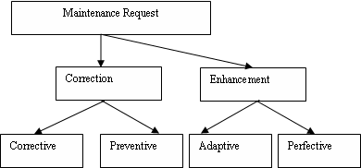
Catégorie de requête

Slide 51
Types de maintenance
Corrective
La correction d’une défectuosité découverte par la clientèle
Préventive
Modifier un logiciel pour détecter et corriger des fautes avant qu’elles ne deviennent des défaillances
Perfective
Améliorer les fonctionnalités d’un logiciel
Adaptative
Modifier un logiciel afin de le mettre en relation avec d’autres applications

Slide 52
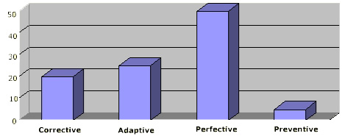
Types de maintenance
Perfective: 50 %
Adaptative: 25 %
Corrective: 21 %
Préventive: 4 %
http://www.massworkforce.org/ResourceCenter/SteeringCommMinutes/2006/Word/June06A.doc

Slide 53
Les défaillances ne sont pas la première source
Les défaillances ne représentent pas le plus gros pourcentage de maintenance.
Lorsque correctement mesuré:
55 % requêtes sont des améliorations (Lientz)
Le plus gros pourcentage d’effort est dépensé dans l’ajout de fonctionnalité en réponse à un besoin d’affaires (Pressman)
Notes:
But, is this user perception representative of the actual maintainers’ workload? On the basis of a survey of 487 software maintenance specialists, Lientz and Swanson [Lientz 1980] were the first to point out that 55% of requests routed to maintenance organisations concerned new functions rather than failure correction. Another study [Abran 1991], based on data collected over a few years and for each maintenance activity category, further confirmed this fact. Pressman [Pressman 1997, s27.2.1] also notes, based on feedback collected from maintenance engineers, that, rather than spending from 50% to 80% of their effort on correcting problems, they spend the biggest portion of their effort on software evolution, on adding user-requested functionality and on answering all kinds of questions about the business rules of application software. Unfortunately, such value-added activities are poorly communicated and rarely reported in detail to the clients as monthly maintenance accomplishments.
“The more substantial portion of maintenance costs is devoted to accommodating necessary functional changes to the software in order to keep pace with changing user needs. Based on the data we had reviewed, we also noted that systems with well-structured software were more able to accommodate such changes.” [Fornell 1992]

Slide 54
Similitude avec logiciel
Processus définis
Il y a du code et des tests
Il y a de l’assurance qualité
Il y a de la gestion de la configuration
Alain April & al., Software Maintenance MaturityModel,: the software maintenance process model

Slide 55
Activités distinctes
Gestion du service et des évènements
Existence d’un SLA (parfois…)
Transition
Support opérationnel
Résolution de problème
Analyse d’impact
Évolution et retrait
Alain April & al., Software Maintenance MaturityModel,: the software maintenance process model

Slide 56
Caractéristiques de la maintenance
Réception des requêtes aléatoires
Budget difficile à évaluer
Charge de la maintenance
Gestion par files d’attente et non par gestion de projet
Taille des requêtes limitées
Assignation du travail dynamique
Arrêt des travaux quand il y a une panne
Contraintes face à une application déjà développée
Attentes du client élevées

Slide 57
Différence avec le développement
La situation est beaucoup moins favorable pour le mainteneur.
Le système existe, avec ses défauts et ses contraintes architecturales. Il faut vivre avec.
Les outils sont parfois désuets et ne supportent pas les techniques modernes de maintenance.
Conséquemment, il y a moins d’options pour les améliorations.
Les délais sont souvent courts.
ASL, Application Service Library – A Management Guide , p55

Slide 58

Ressources
S3M
April, A. et Abran, A. Améliorer la maintenance du logiciel. Loze-Dion éditeur, ISBN 292118088X, 2006, 337 p.

Slide 59

Questions?

Slide 60
TRAVAIL-2

