Slide 1
Using Sentiment Analysis to Keep Brand E3 Reputation

Slide 2
Table of contents
01
02
03
04
Introduction
Problem Statement
Why Our Solution
05
06
Project Methodology
Data processing
Model building and evaluation

Slide 3
01
Introduction
Using Sentiment Analysis to Keep Brand E3 Reputation

Slide 4
02
Problem Statement
Using Sentiment Analysis to Keep Brand E3 Reputation

Slide 5
Problem Statement
No events recently
Save high reputation
Stablish mesaures for next events
Data taken from: https://www.ign.com/articles/e3-has-been-canceled

Slide 6
03
Why Our Solution

Slide 7
Why chose our solution
Customizable
Integration with Existing Systems
Continuous Improvement and Support
Customizable solution for each company
Our solution is in conditions to integrate with different kind of database
Company will count with a expert team to support the platform

Slide 8
Dwight D. Eisenhower, former U.S. President
«Plans are nothing; planning is everything.»

Slide 9
04
Methodology Project

Slide 10
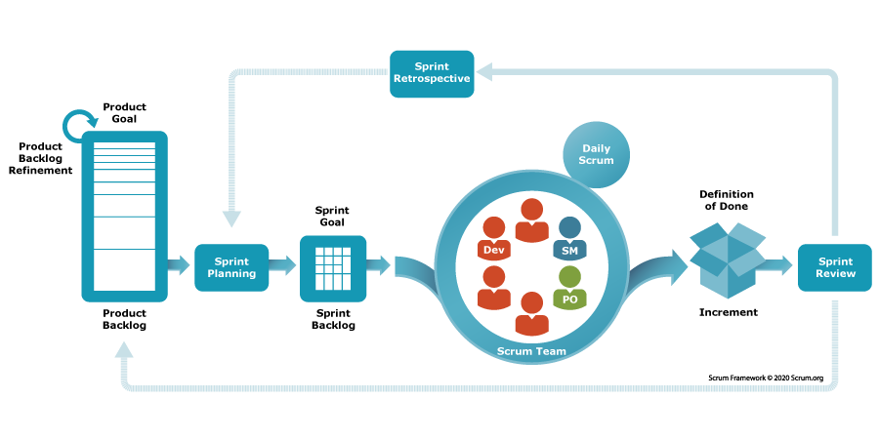
Framework
Image taken from: https://www.scrum.org/resources/what-scrum-module

Slide 11
Our team
Javier Melo Scrum Master
Tega Orido Product Owner
Enrique Gonzalez Software Developer
Yajur Sethi Software Developer
Harcharan Singh Software Developer
Ankit Goswami Software Developer
Anargha Minoj QA Analyst
Gitik GKauushik Software Developer

Slide 12
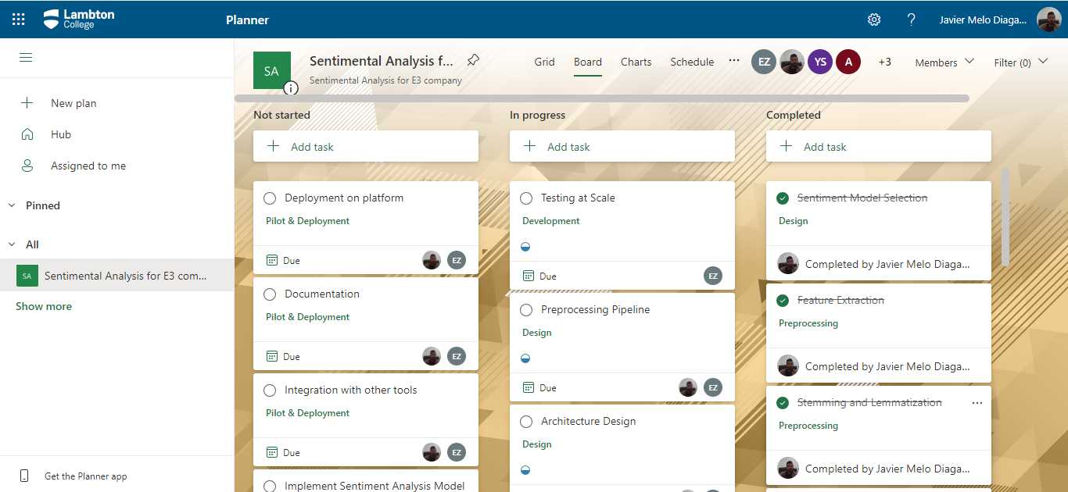
PROJECT BOARD
Visual Representation
Real-time Updates
Efficient Task Management
Enhanced Collaboration

Slide 13
05
Data Processing

Slide 14
Data Preprocessing
Kaggle.com
Structured Data CSV File
230 MB
More tan 1.600.000 records
Data Collection
Exploratory Data Analysis
Define Sentiment Categories
Text Cleaning
Processing
Feature Extraction
Data Splitting
Data Vectorization

Slide 15
06
Model Building and Evaluation

Slide 16
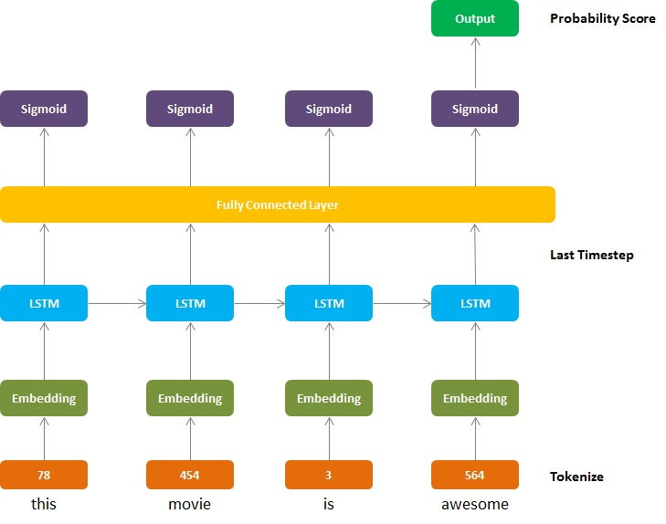
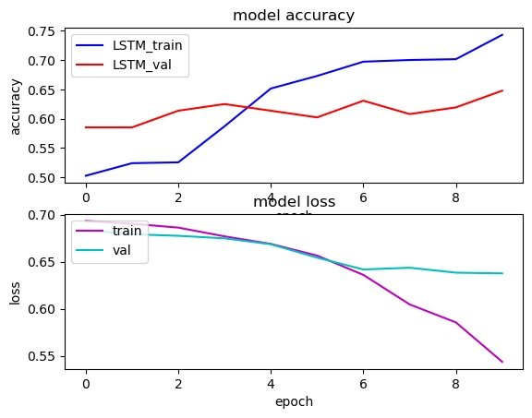
Model Building and Evaluation
LSTM Modelo secuencial

Slide 17
Thanks

