Slide 1
Case study
Student Success Prediction

Slide 2
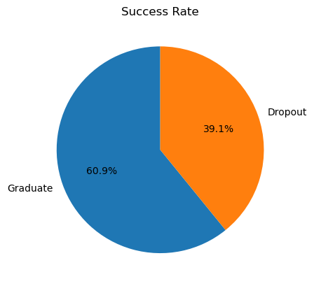
Target of the study: Determine whether students will Graduate or Dropout and causes of it.

Slide 3
Variables to be used for the models
Debtor.
Tuition fees up to date.
Gender.
Scholarship holder.
Age at enrollment.
Curricular units 1st sem (approved)
Curricular units 1st sem (grade)
Curricular units 2nd sem (approved)
Curricular units 2nd sem (grade)
These variables are chosen due to their correlation with the Dropout and Graduate rate.

Slide 4
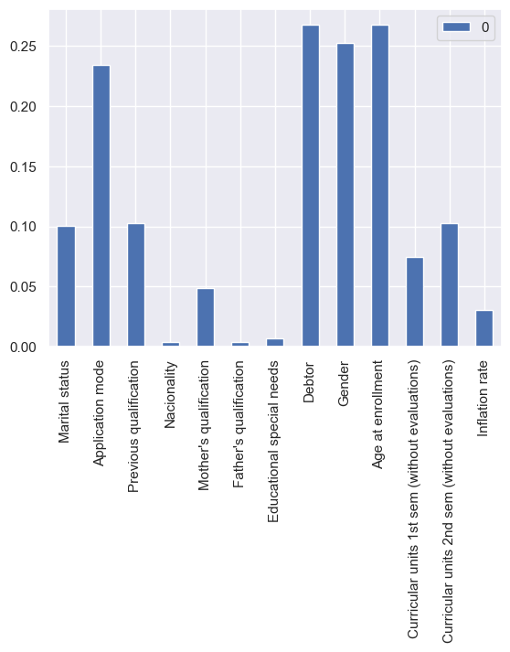
Variables directly correlated to the Dropout rate.

Slide 5
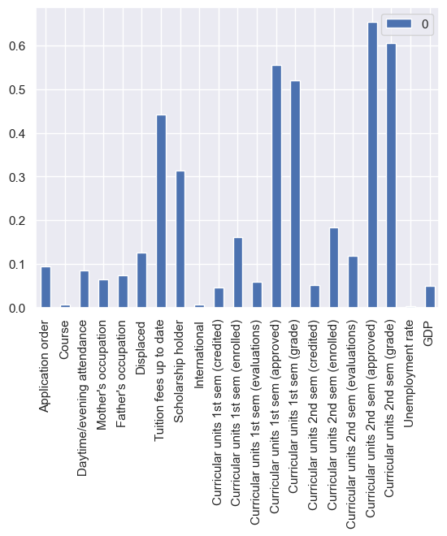
Variables directly correlated to the Graduate rate.

Slide 6
Removing redundant variables.
Curricular units 1st sem (approved) and Curricular units 1st sem (grade) are highly correlated 0.71
Same with Curricular units 2nd sem (approved) and Curricular units 2nd sem (grade) 0.79
We can ignore 2 of them and our model's perfomance should not be affected.

Slide 7
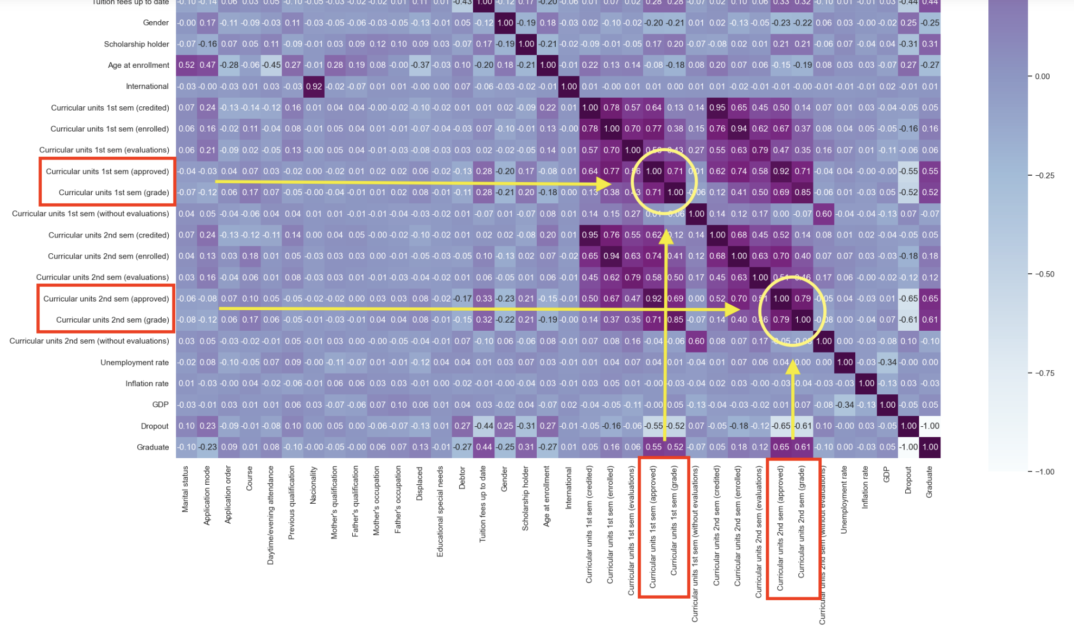

Slide 8
Important variables for Dropout
Gender.
Age of Enrollment.
Debtor: Having some sort of debt increases the chances of dropping out of college.

Slide 9
Important variables for achieving Graduation.
Tuition Fees up to date.
Being a Scholarship holder.
Curricular units 1st sem (approved)
Curricular units 2nd sem (approved)

Slide 10
Our prediction model.
The base metric used for model evaluation is Accuracy. Accuracy describes the number of correct predictions over all predictions.
Precision is a measure of how many of the positive predictions made are correct (true positives)
Recall is a measure of how many of the positive cases the classifier correctly predicted, over all the positive cases in the data.
F1-Score is a measure combining both precision and recall.

Slide 11
Our results for Accuracy
Logistic Regression Accuracy: 0.8846376639563178
K-Nearest Neighbors Accuracy: 0.8774081547866344
Decision Tree Accuracy: 0.8605282212594219
Support Vector Machine Accuracy: 0.887742892753279
Gradient Boosting Accuracy: 0.8922161552614399
Random Forest Accuracy: 0.8777476408095437
Neural Network Accuracy: 0.8925603893406138

Slide 12
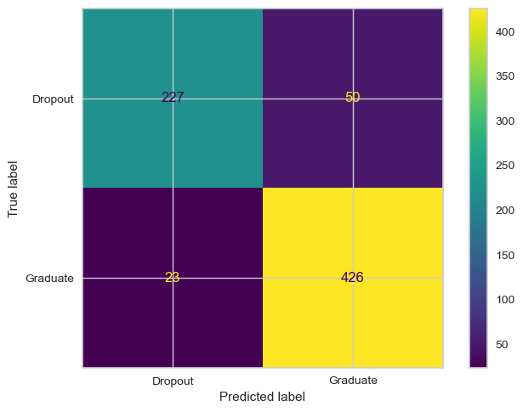
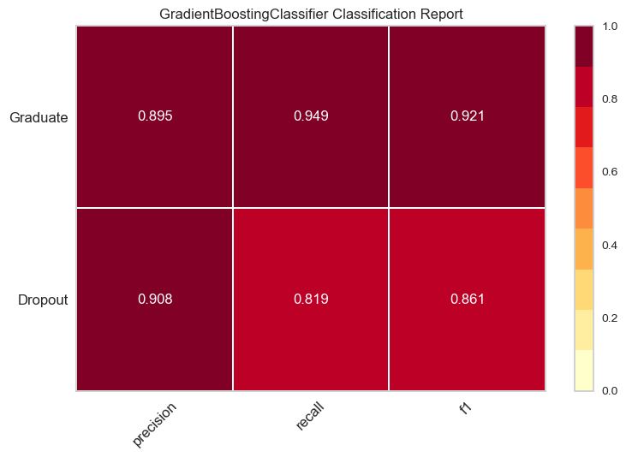
Gradient Boosting model Heatmap.
False positives
False
negatives

Slide 13

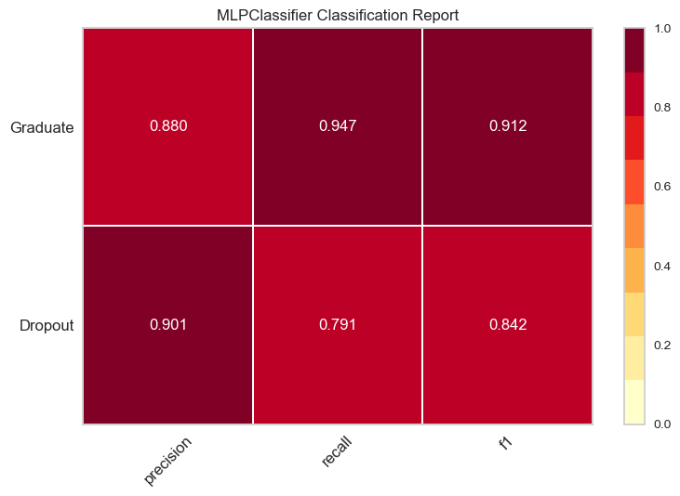
Neural Network model Heatmap.
False
positives
False
negatives

Slide 14
Models chosen
Gradient Boosting and Neural Network.
These two models are offering the best performance.
However the execution time for Gradient Boosting is notably better than Neural Network over the same amount of data.
GB - Execution time: 0.0903 seconds.
NN - Execution time: 1.3601 seconds.
The number of False Positives and False Negatives is also better for Gradient Boosting.

Slide 15
Conclusions
Depending on who is the final customer we could choose other models offering, almost similar Accuracy and lower numbers on False Positives or False Negatives.
Example 1: A model with lower number of False Dropouts could be preferred by the Marketing Department of an University.
Example 2: A model with lower number of False Graduates could be preferred by the Academic Department of the same University

Slide 16
Thank you for your attention.

