Slide 1
Bayesian Inference
MsC in Data Science – University of Barcelona

Slide 2

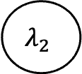

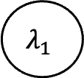



$$λ_{1}$$
$$λ_{2}$$
$$Unif(0,5)\sim$$
$$\sim Unif(0,5)$$
or
or
$$Exp(10)\sim$$
$$\sim Exp(3)$$
Observed data
$$\sim Poiss(λ_{1},λ_{2})$$

Slide 3
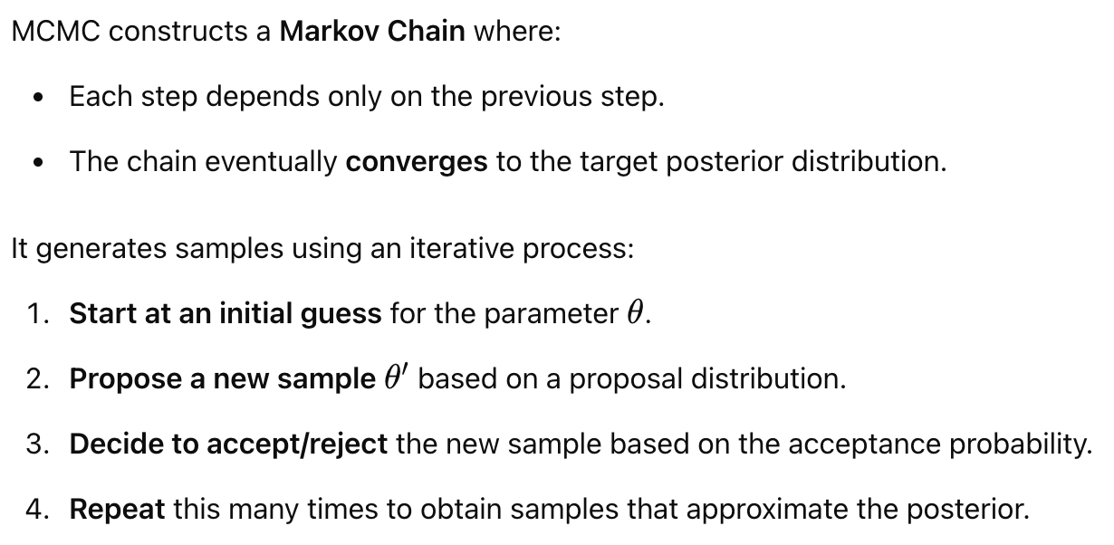
The MCMC Algorithm

Slide 4
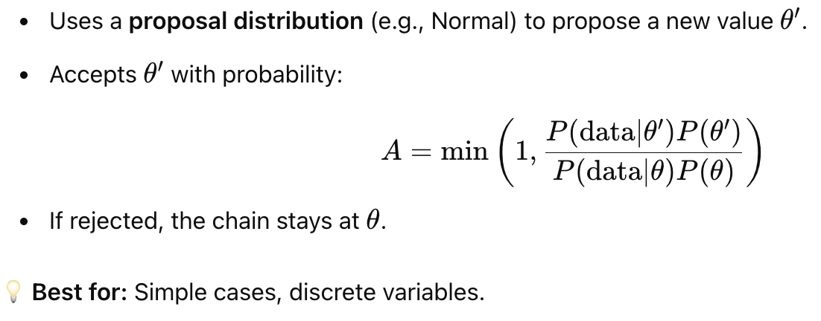
Metropolis-Hastings Algorithm

Slide 5
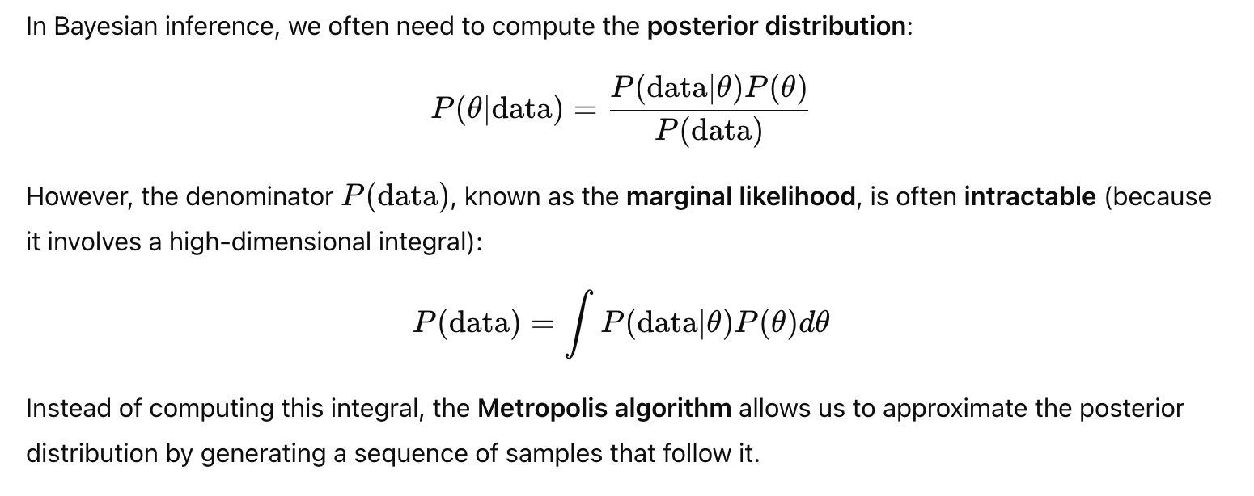
Deep Dive into Metropolis Algorithm

Slide 6
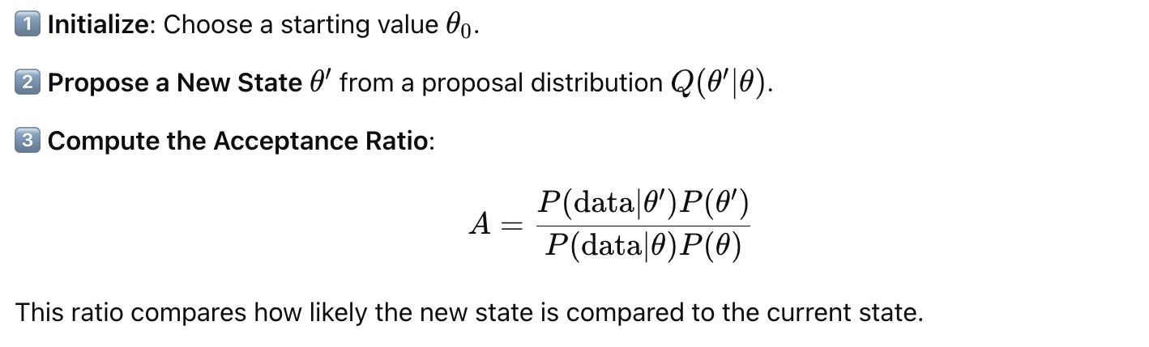
How does it work? (I)

Slide 7
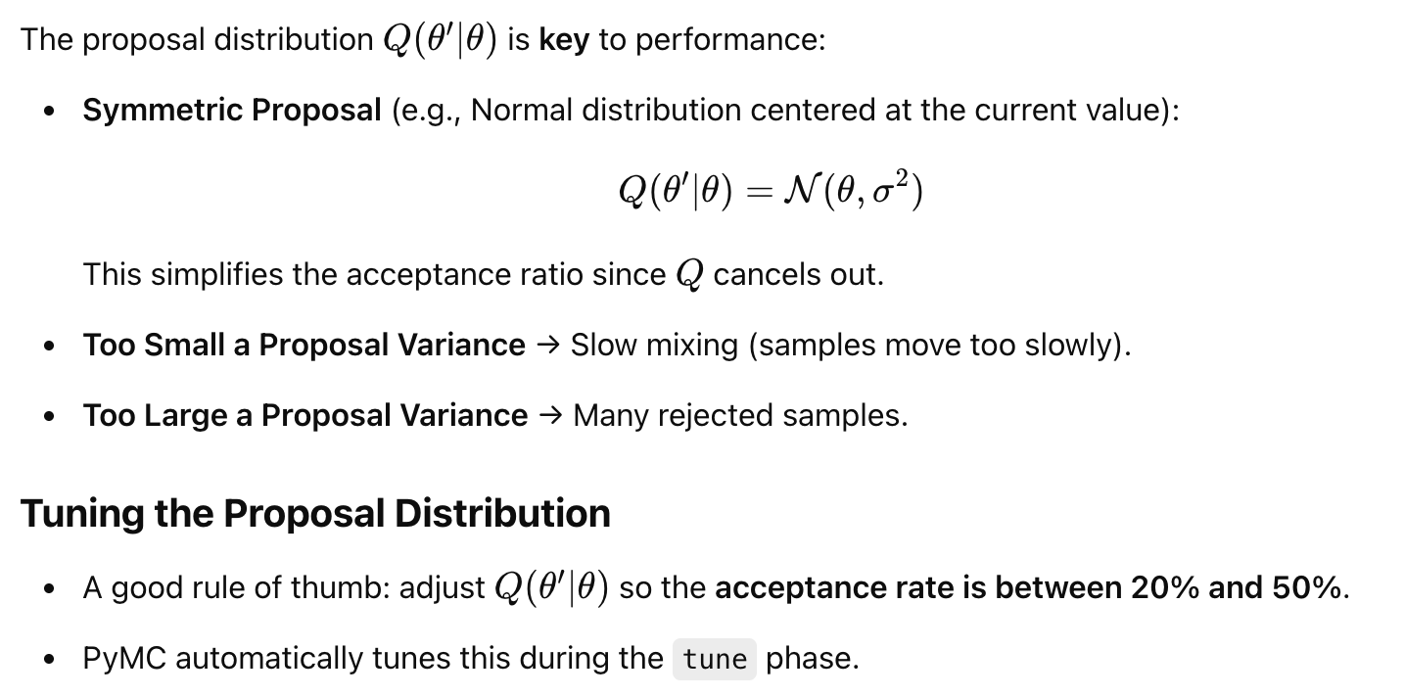
Choosing the Q distribution

Slide 8
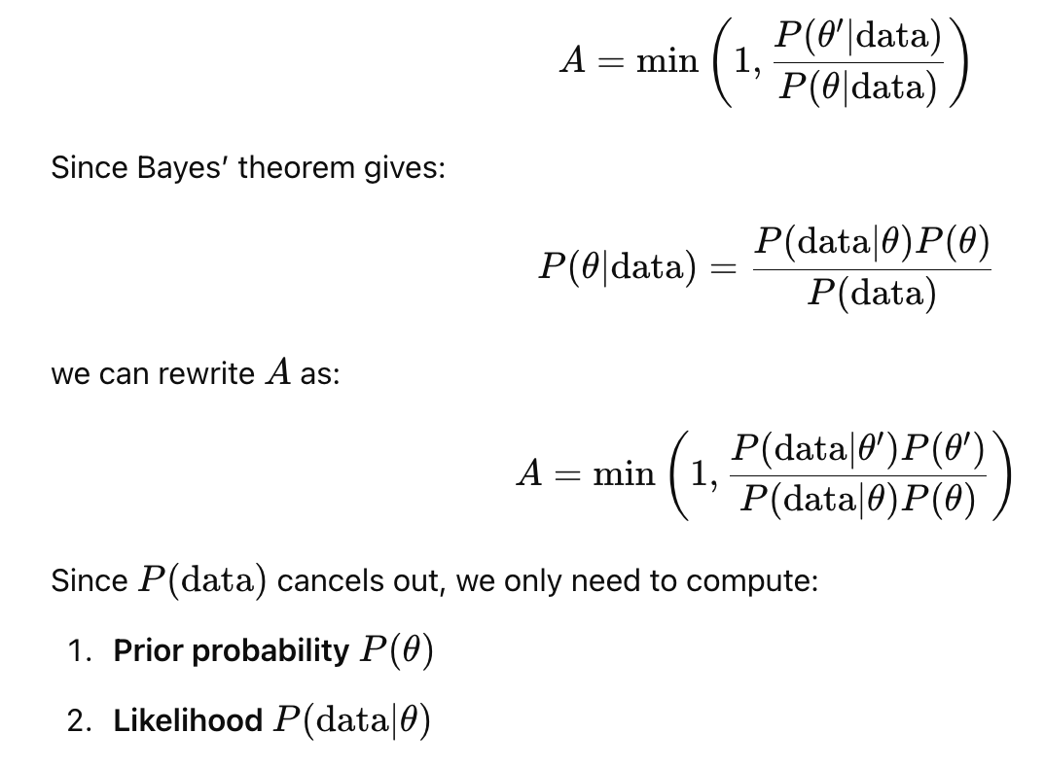
How to calculate the A?

Slide 9
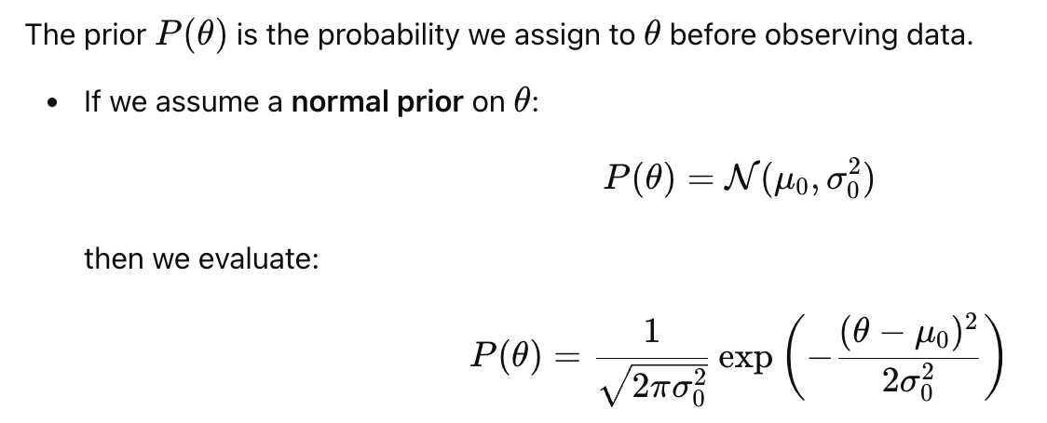

How to calculate de prior $P\left(θ\right)and P\left(θ^{′}\right)?$

Slide 10
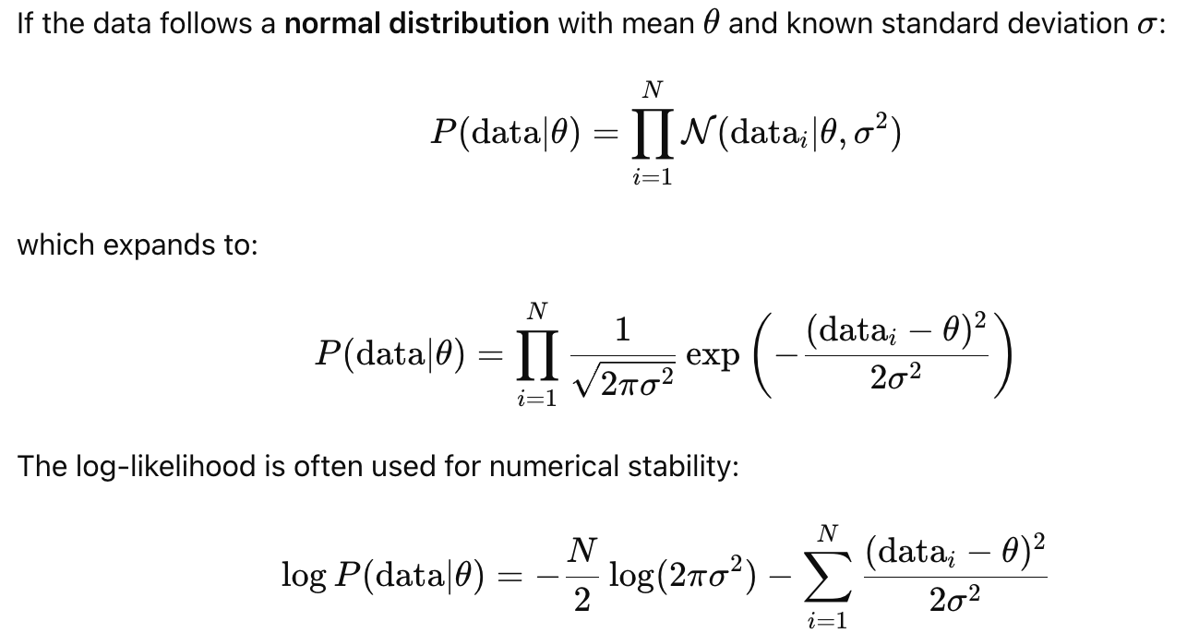

How to compute the likelihood $P\left(data | θ\right)?$

Slide 11
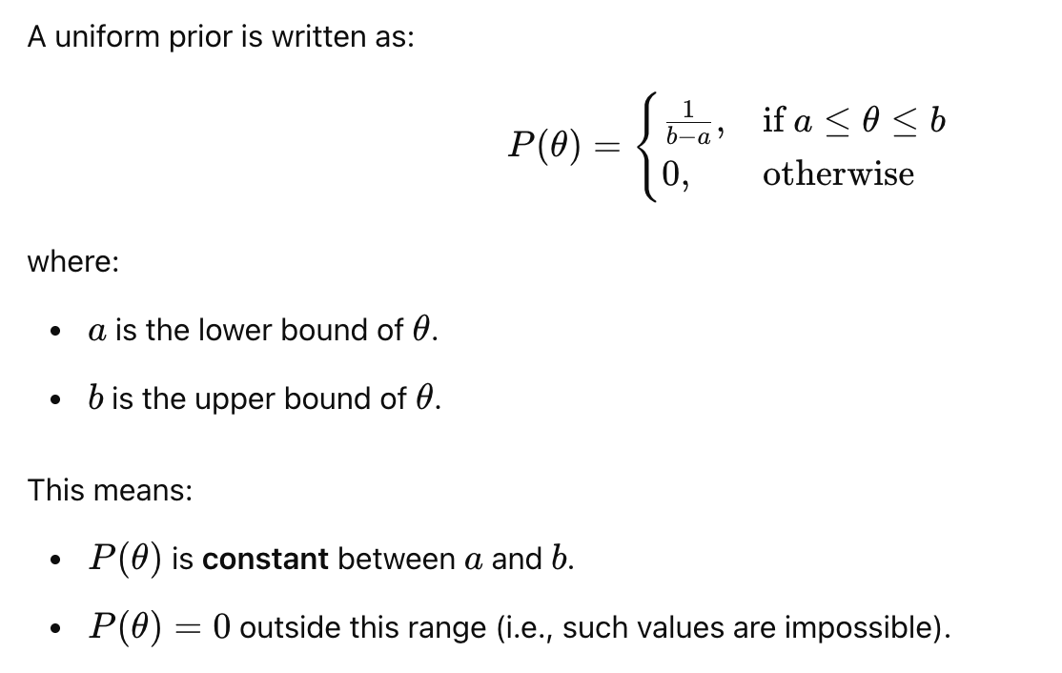
If the prior is a Uniform…

Slide 12
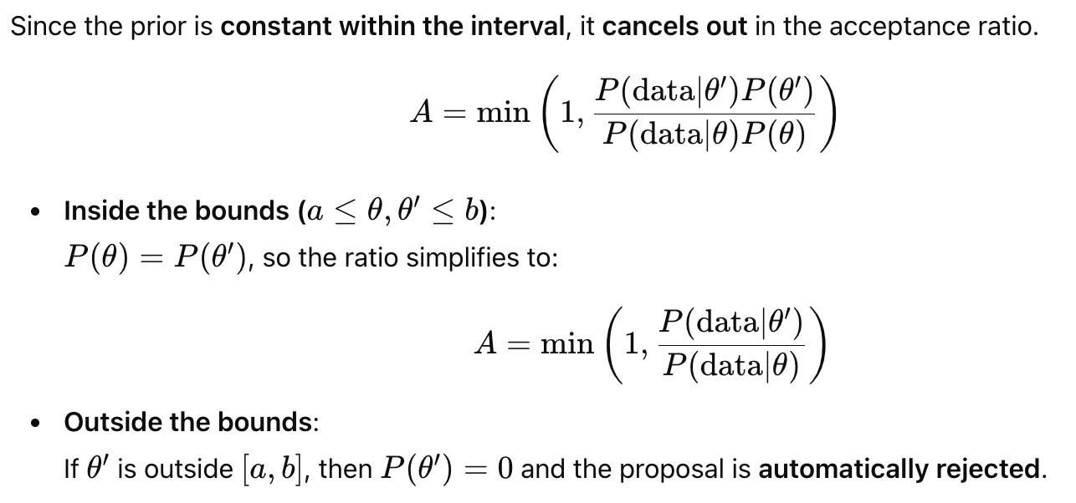
If the prior is a Uniform…

Slide 13
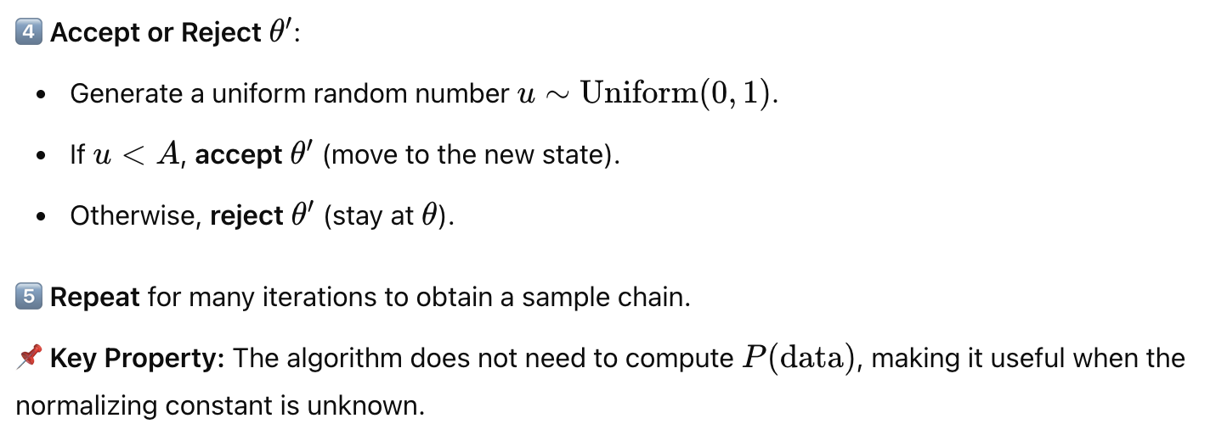
How does it work? (II)

Slide 14
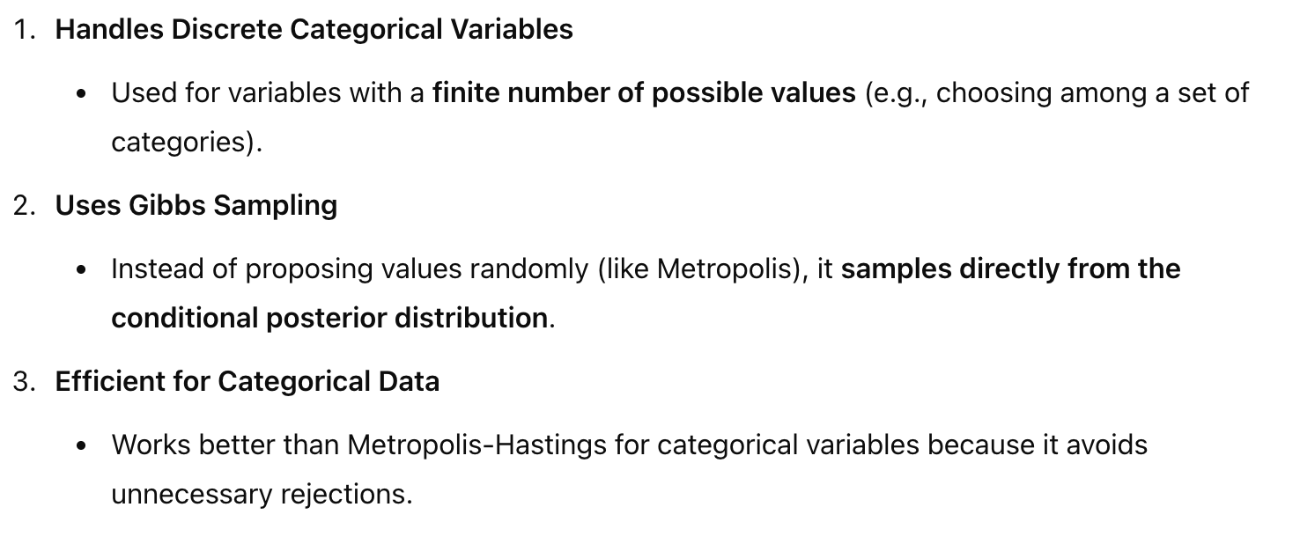
Categorical Gibbs Metropolis Algorithm

