Slide 1
GROUP 14 PRESENTS
EMPLOYEE ATTRITION
WHY DO WORKERS QUIT?
University of California, San Diego
Department of Electrical and Computer Engineering
Team Members : Nikhil Mohan, Xuezhu Hong, Qi Ma, Changhan Ge
03.13.2019
Notes:
Good Afternnoon, We are group 14, I am XXX, they are my fellow teammates: XXX, XX, XXX

Slide 2
Contents
Introduction
Dataset
Analysis
Prediction
Conclusion

Slide 3

Introduction
Attrition is basically the turnover rate of employees within an organization. Our goal is to analyze the factors which determine attrition and suggest possible remedial measures.
Variety of factors can determine attrition, and these are, but not limited to
Hostile environment
Long work hours with less pay
Employees looking for better opportunities.
Poor management

Slide 4
Contents
Introduction
Dataset
Analysis
Prediction
Conclusion

Slide 5


Dataset
IBM Attrition Dataset
A US Science and Technology Company
Source: Kaggle
https://www.kaggle.com/pavansubhasht/ibm-hr-analytics-attrition-dataset
BRC Attrition Dataset
A Chinese real estate & tourism investment group
Source: Provided by Ms. Jane Liu who served as a HR at BRC
Employee Review Dataset
Company reviews written by employees of several silicon valley companies
Source: Kaggle
https://www.kaggle.com/petersunga/google-amazon-facebook-employee-reviews
Basics about dataset
 | Total Sample | Left the Company | Still in the Company | Attrition Rate
IBM | 1470 | 237 | 1233 | 16%
BRC | 838 | 752 | 86 | 90%
Review | 67000 | N/A

Slide 6
Contents
Introduction
Dataset
Analysis
Prediction
Conclusion

Slide 7
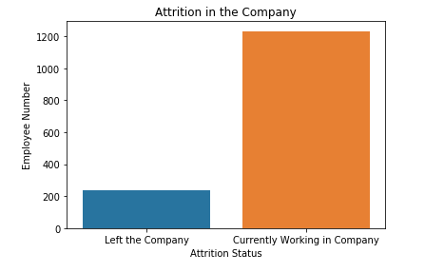
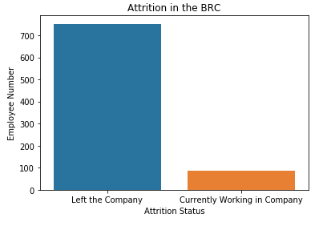
Distribution of features - Attrition
IBM DATASET BRC DATASET
An important aspect to consider is the fact that we are dealing with an imbalanced dataset in both the cases. This is crucial when we consider the accuracy of our prediction models.
Due to the contrasting nature of the two datasets, we will try to draw suitable conclusions from both datasets wherever possible.

Slide 8
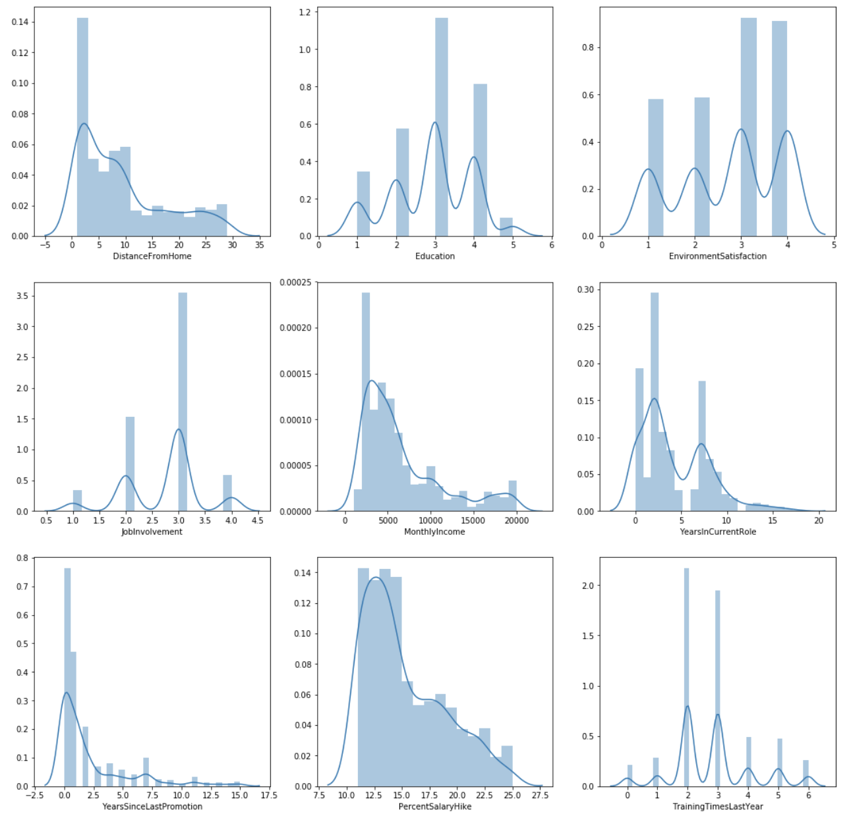
Distribution of auxiliary features - IBM Dataset
A good practice is to look at the spread of features within a dataset.
We use the IBM dataset as the data is more clean and thorough.
The curves are more or less a mixture of gaussians and this is a good indicator that our dataset consists of mainly independent samples and is therefore unbiased.
Notes:
split slide 8 into 4 or more slides.

Slide 9
Gender Analysis
Points to consider
What is the gender distribution within our dataset of those employees who have quit?
Are there any disparities with respect to gender and income?
On an average what is the correlation between gender and years served at the company?

Slide 10
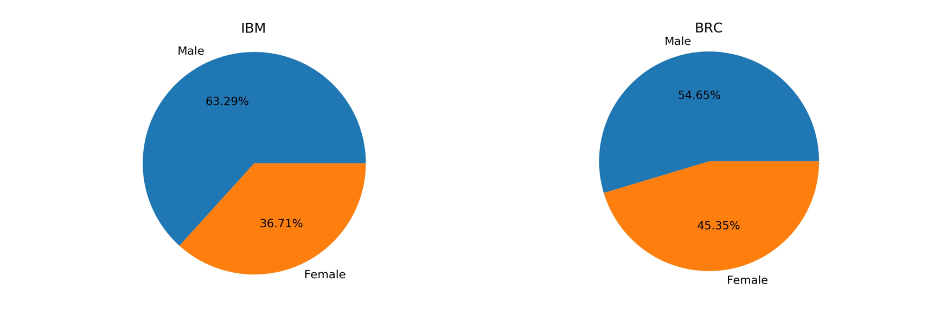
Overall distribution of Gender among Employees who have quit
IBM DATASET BRC DATASET
In general the percentage of males in our dataset is more than females.
The difference is not enough to be statistically significant though, so we can say with a fair amount of confidence that both our datasets are balanced with regard to gender

Slide 11
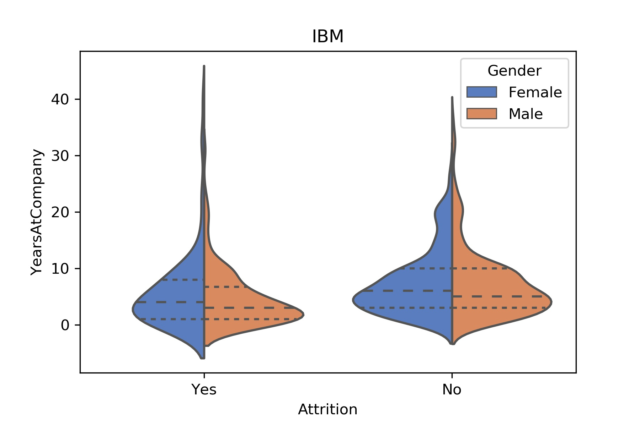
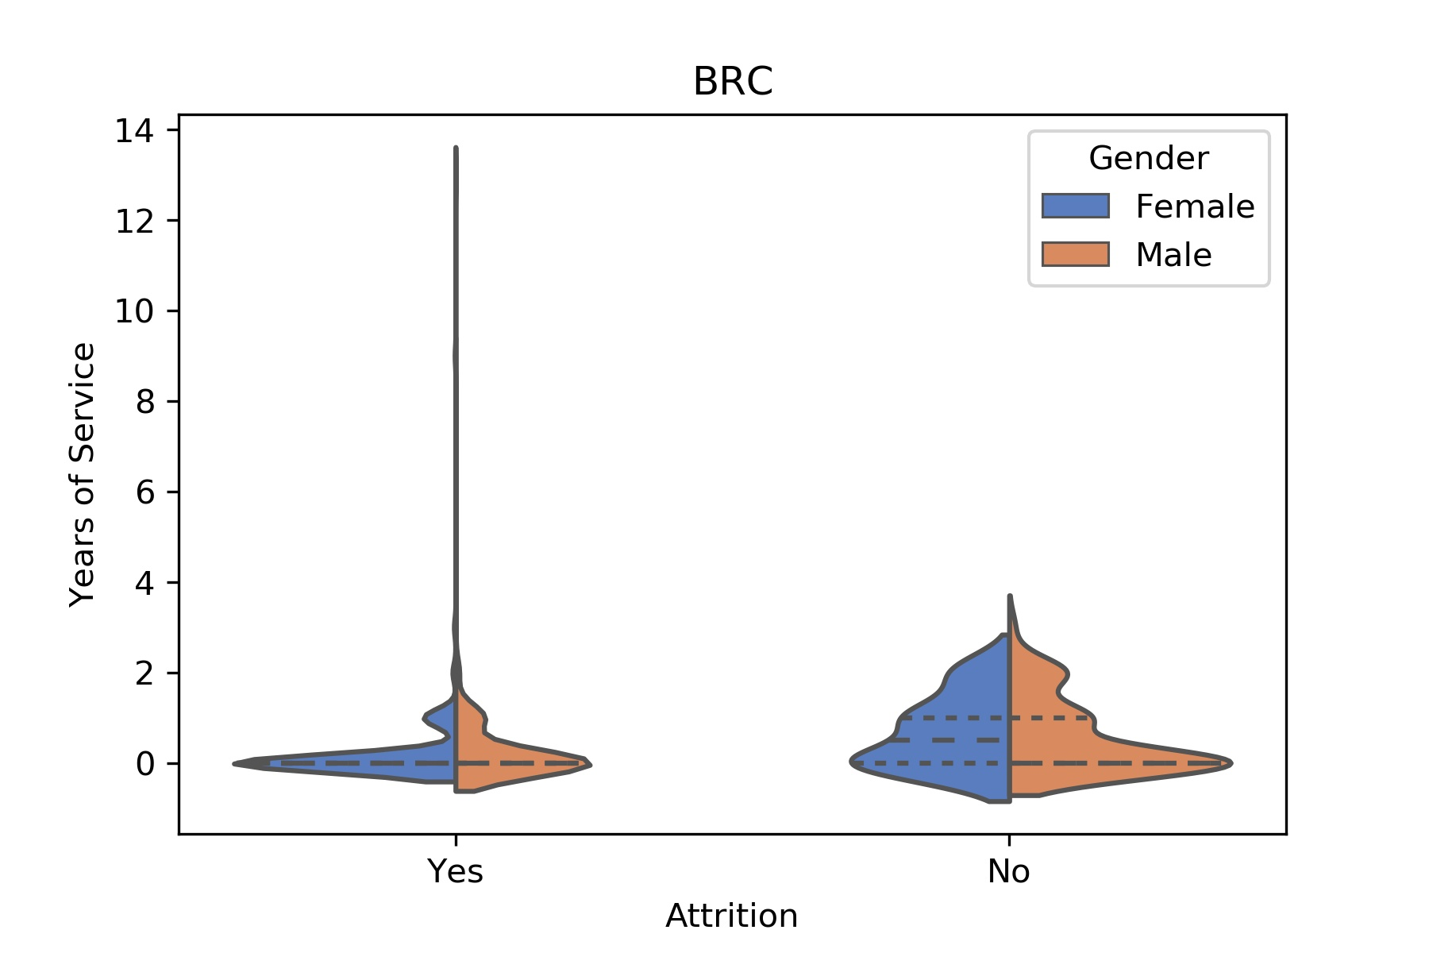
Correlation between Gender and Years of Service
We see that on an average years of service doesn’t depend much on gender.
However we note that the longer an employee has served in a company, the less likelier he is to quit which makes a lot of intuitive sense!

Slide 12
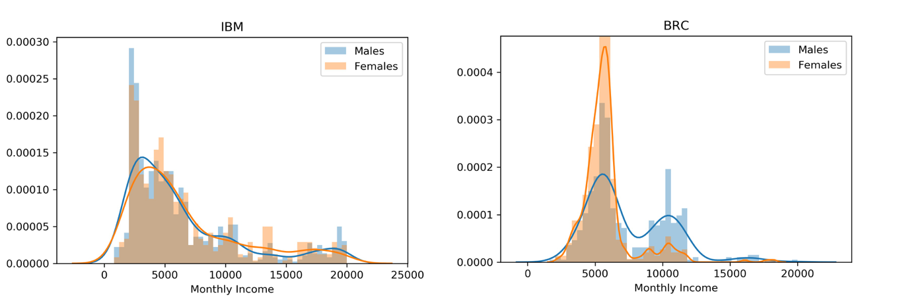
Correlation between Gender and Income
We observe that in the IBM dataset there’s not much correlation between gender and income.
However in the BRC dataset males are paid a little more than females.
An interesting conclusion to note can be that the percentage of females who have left the company is higher when we consider the BRC data in contrast with the IBM dataset.
This naturally suggests that income influences attrition!

Slide 13
Analysis by Age and Educational Background
Points to consider
Is there any link between age of an employee and their likelihood to quit?
What is the correlation between an individual’s education level and their attrition rate?

Slide 14
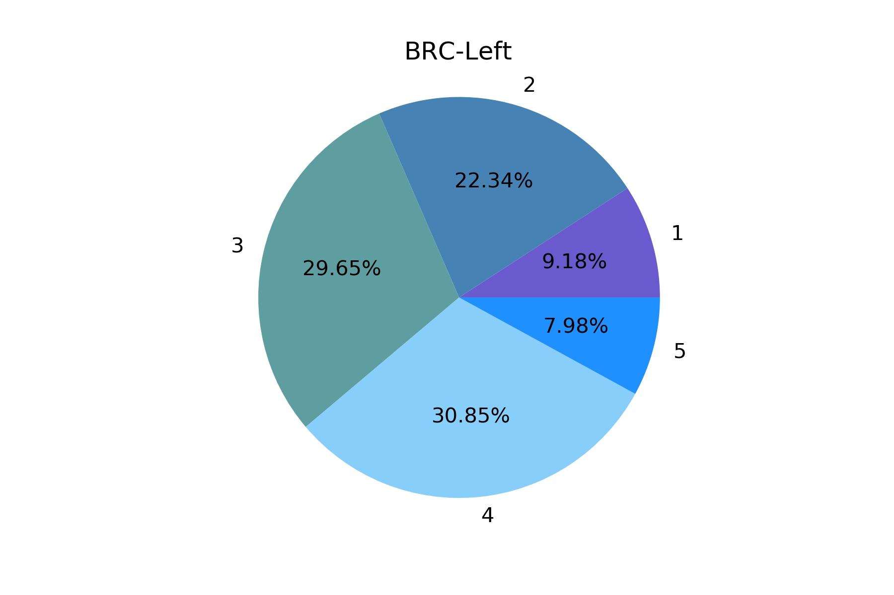
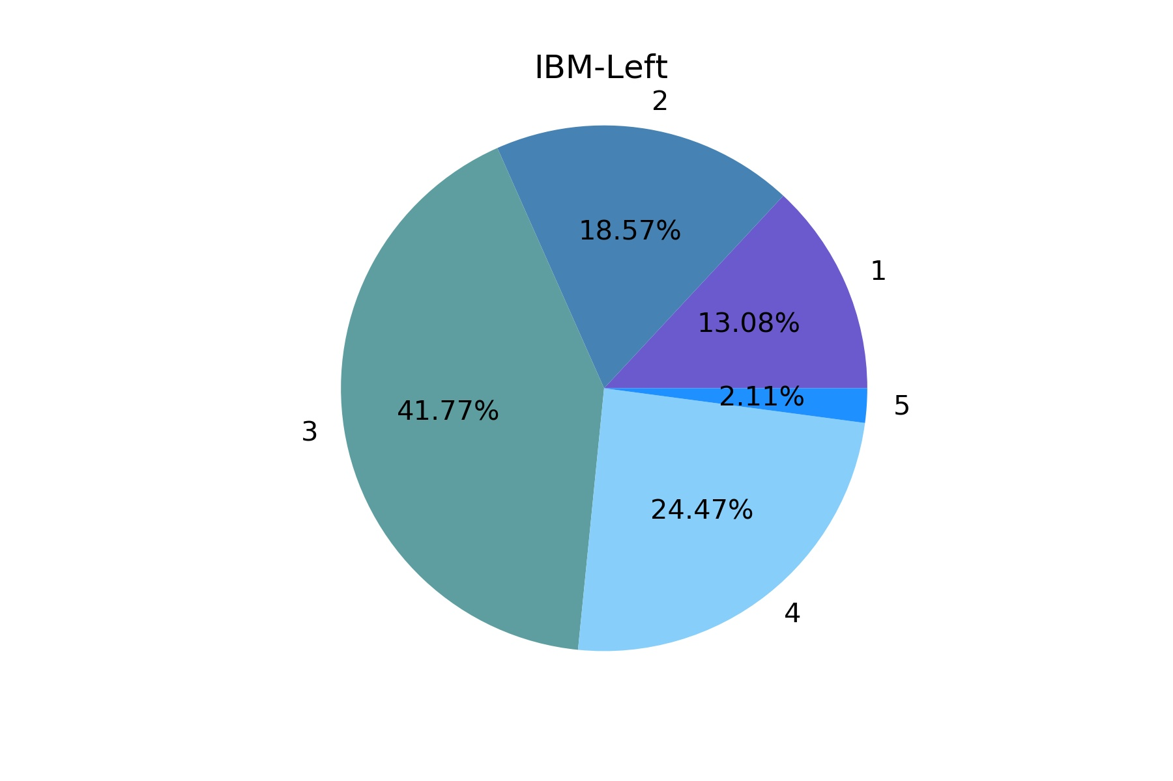
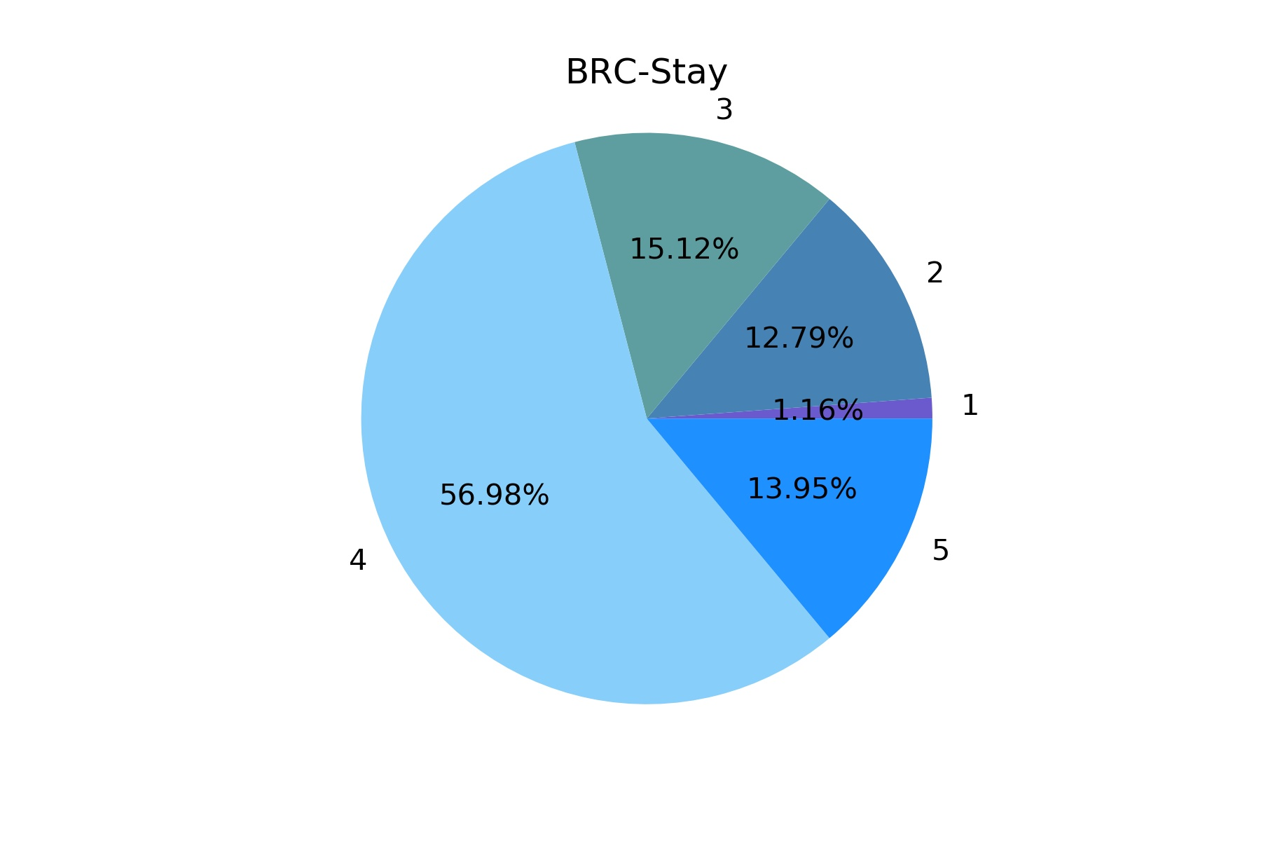
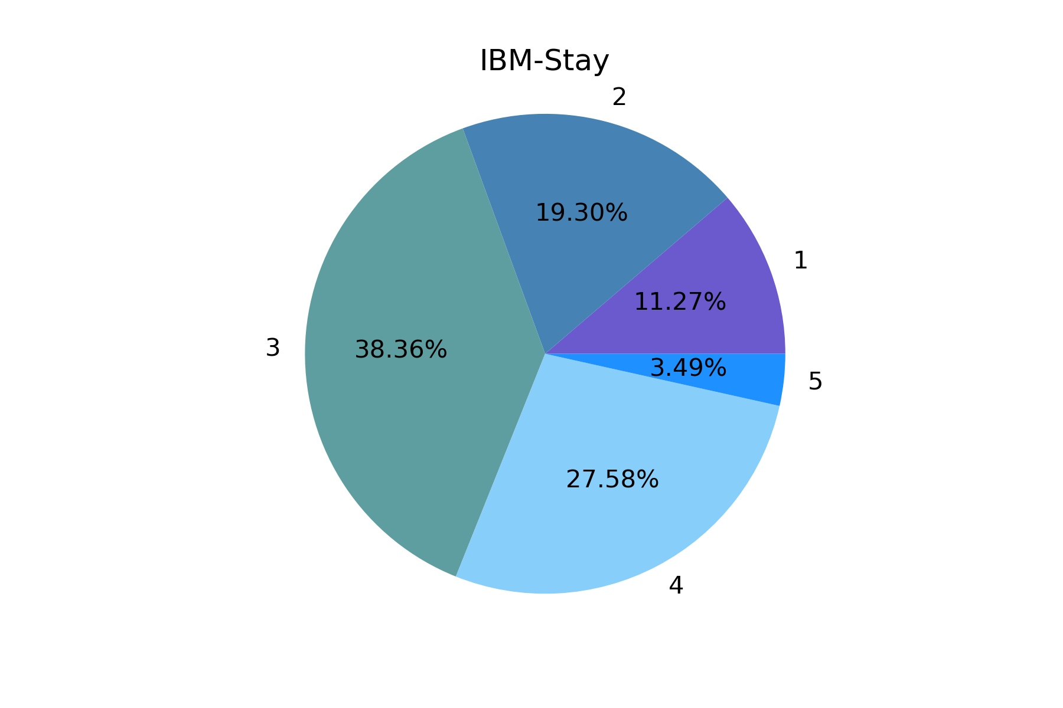
Correlation between Educational level and Attrition rates
Education level is categorized from 1( High School) to 5 (Ph.D.)
We observe that overall education level is not a firm determiner of attrition status.
To summarize a highly educated employee is not any less likely to leave the company as compared to a less educated employee and vice versa!

Slide 15
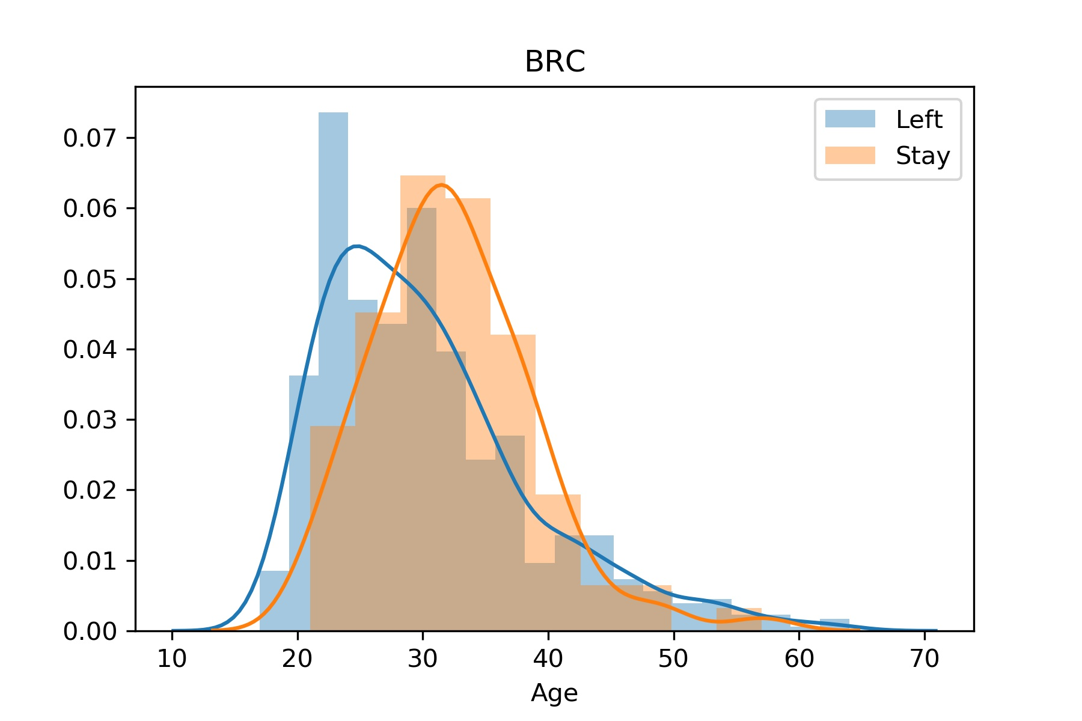
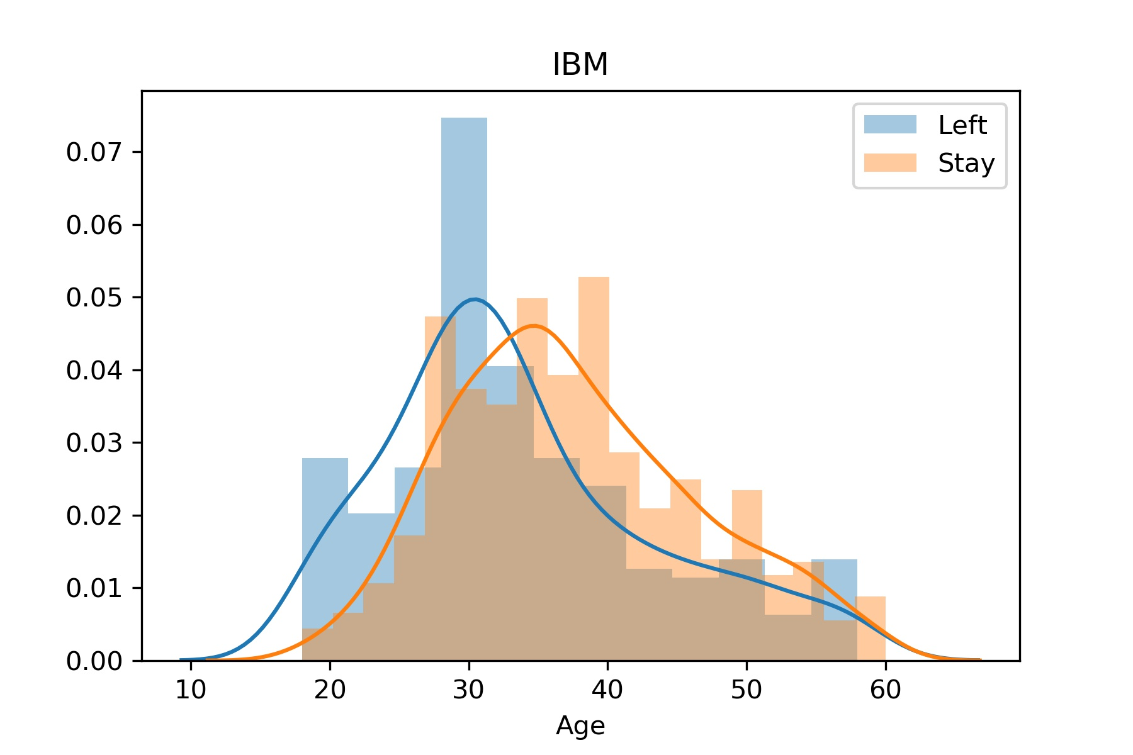
Age vs Attrition - Are millennials more likely to quit?
We observe that there IS a correlation between age and attrition!
The average age of employees who eventually leave the company is lesser than the employees that stay.
One possible reason for this observation could be that older employees look to settle down which is in contrast with their younger counterparts who are still looking for a job that they are passionate about.
Still begs the question whether there are other factors at play?

Slide 16
Analysis by Income - Just how important IS money?
Points to consider
How does monthly income affect attrition?
What factors does monthly income depend on? Is there any correlation between age, job role and education level on income?
In the coming slides we shall try to answer these questions.

Slide 17
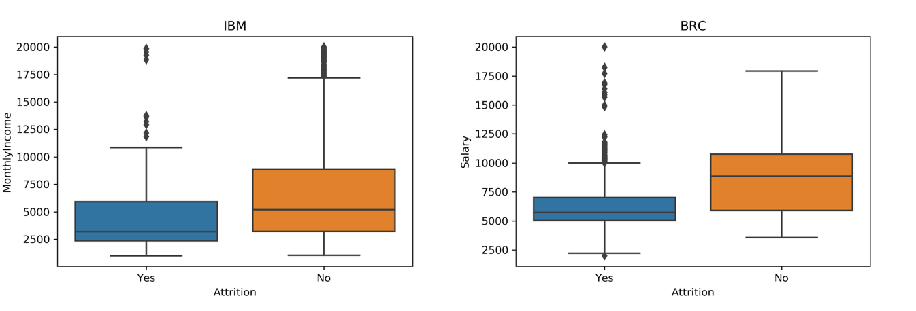
Monthly Income vs Attrition
The average income of the employees who quit is considerably lesser than those who stayed on.
It is extremely evident from the above plots that income plays a very clear role in determining attrition!
It now becomes crucial to consider the factors that income depends on.
Notes:
slide 9 into 2 slides.

Slide 18
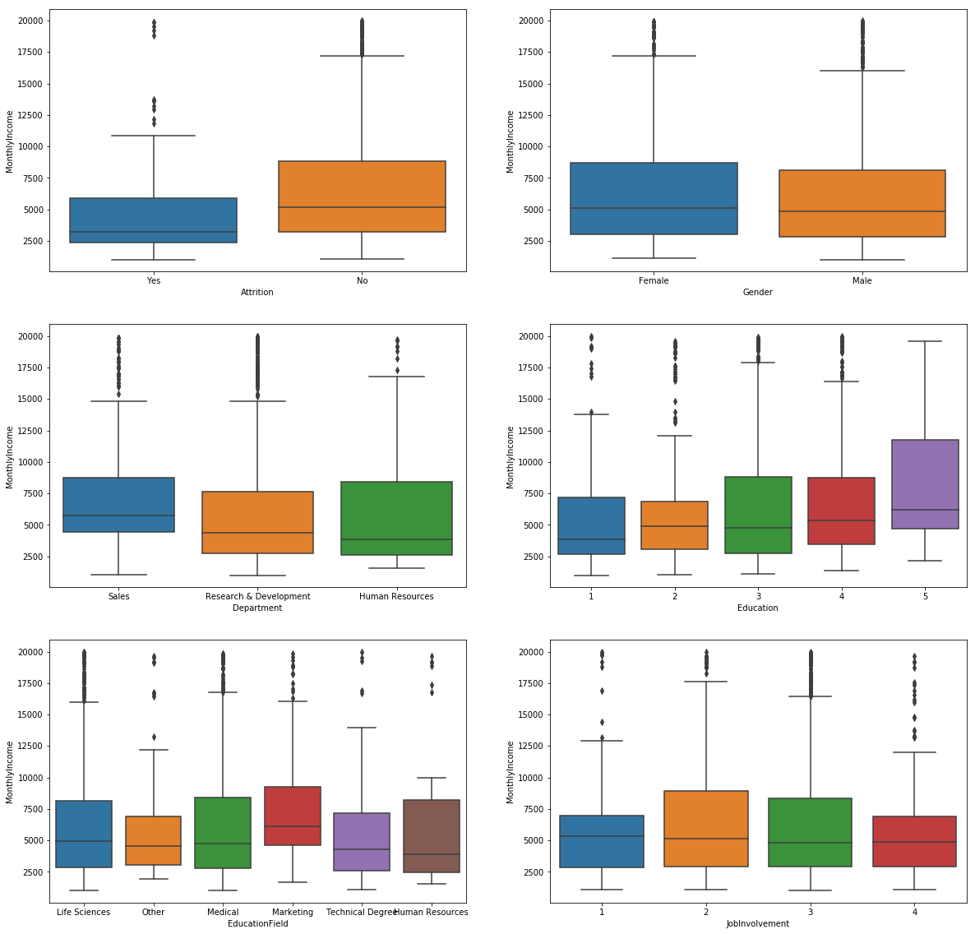
Income vs Background/ Technical Areas-IBM Dataset
There is positive correlation between education level and income.
The income spread about different educational fields are more or less the same
Counterintuitively higher job involvement does not always correspond to higher pay!
Employees in Sales are often paid higher than other sectors.

Slide 19
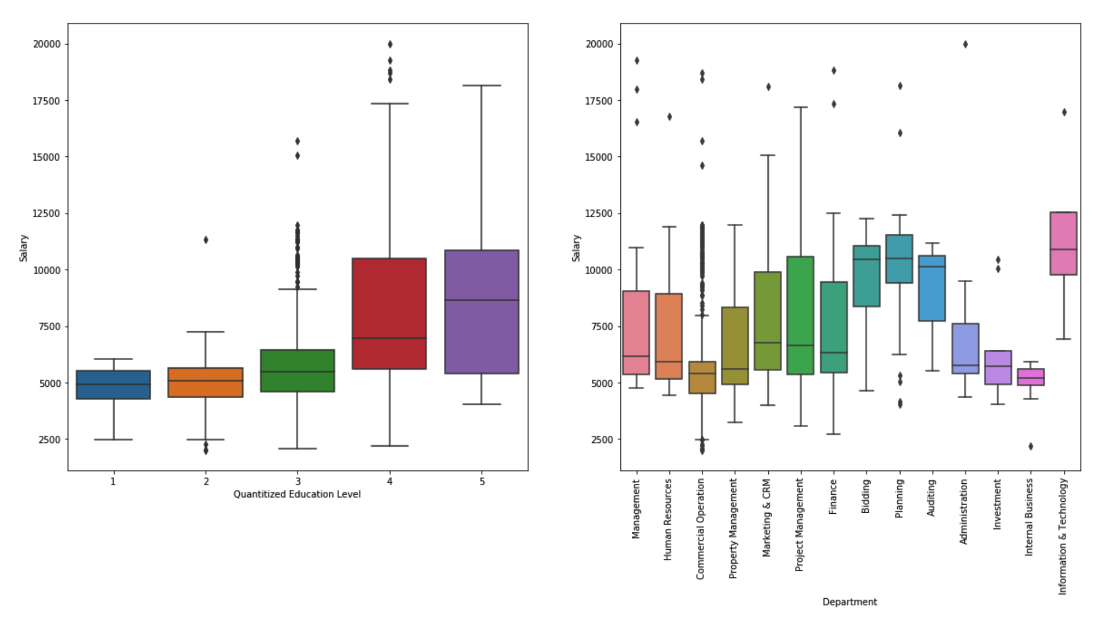
Income vs Background/ Technical Areas-BRC Dataset
Education level is positively correlated with monthly income.
On average the employees in IT sector receive the highest pay in BRC.

Slide 20
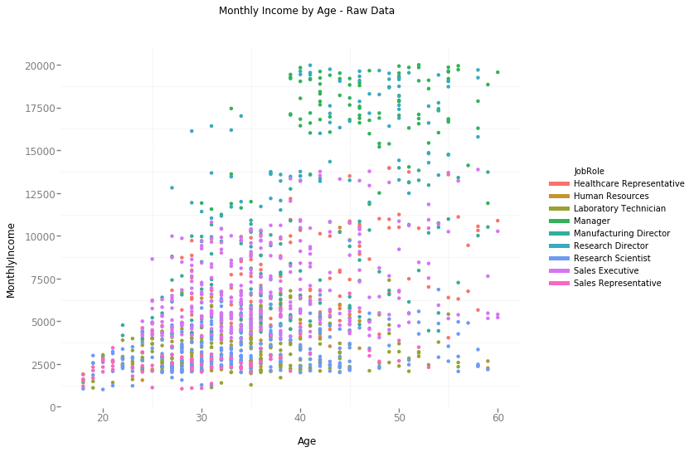
Income vs Age - IBM dataset
Younger employees are typically paid lesser than the more experienced employees.
This can be accounted for, by observing that more experienced employees tend to hold more prestigious job roles.

Slide 21
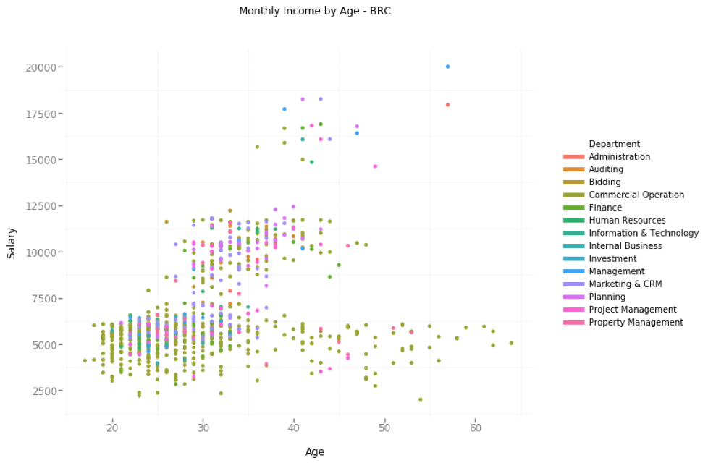
Income vs Age - BRC dataset
The similar trend is also observed in the BRC dataset.
BRC's salary distribution is more hierarchical

Slide 22
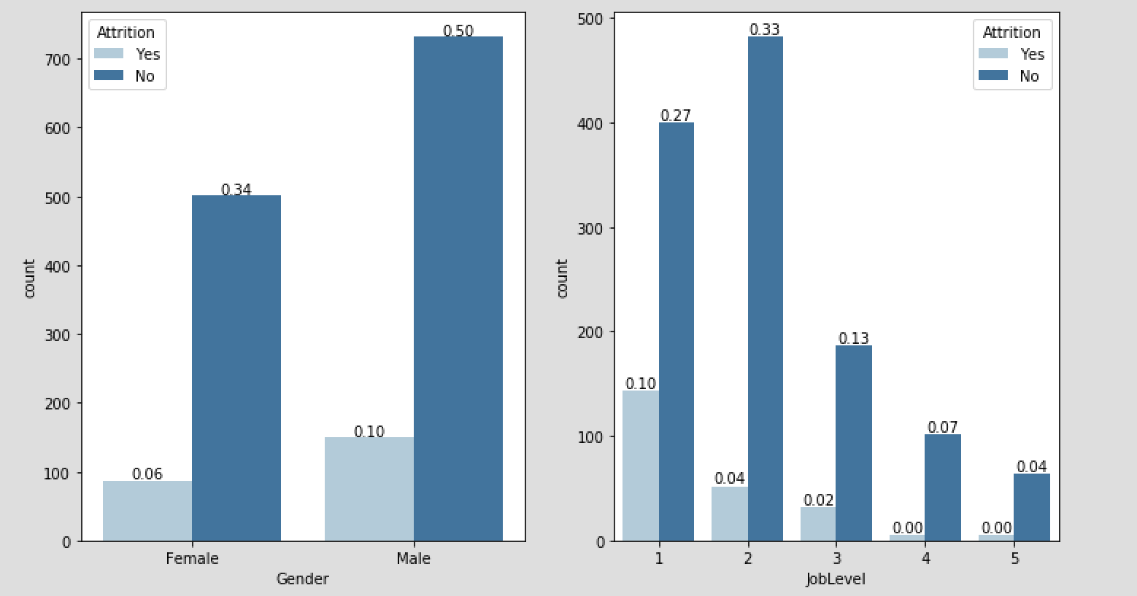
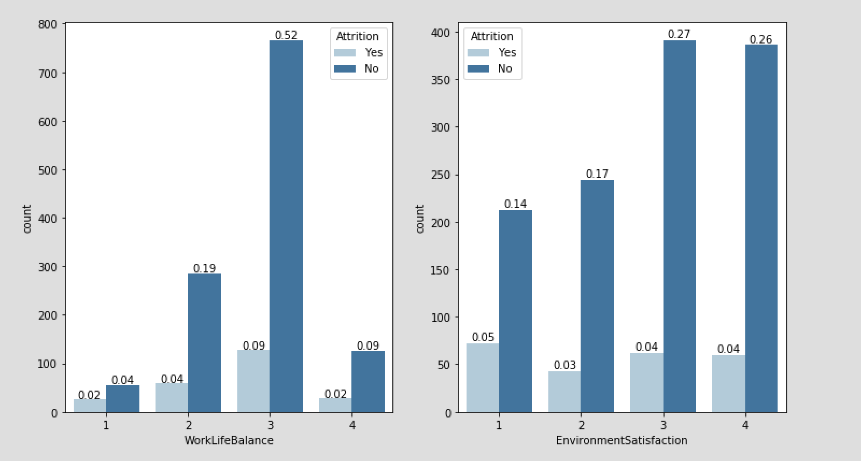
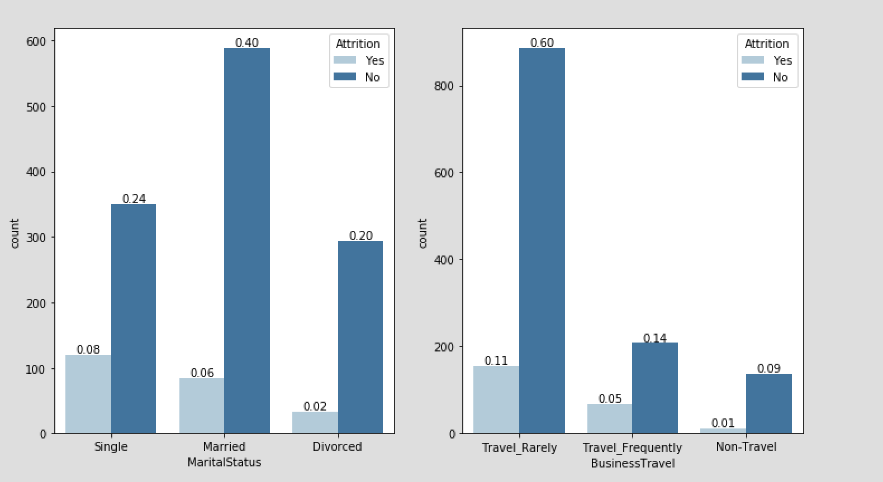
Attrition vs Auxiliary features - IBM dataset
Those with more demanding work have a much lower attrition rate.
Work life balance and Environment satisfaction are independently not very discerning features but contribute to the holistic experience of an employee.
Those who travel less and are settled down in life tend to show a lower attrition rate as well.

Slide 23
Analysis of Employee reviews
This presentation would not be complete without taking into account of what the opinions of current employees are, and determining their likes and dislikes about their company.
From a dataset sourced from Glassdoor of 67000 employee reviews we have analyzed and determined what the employees feel about their company and our aim is to suggest preemptive measures to prevent employee attrition.
Using the concept of threading and distributed systems we were able to analyze this huge voluminous data.

Slide 24
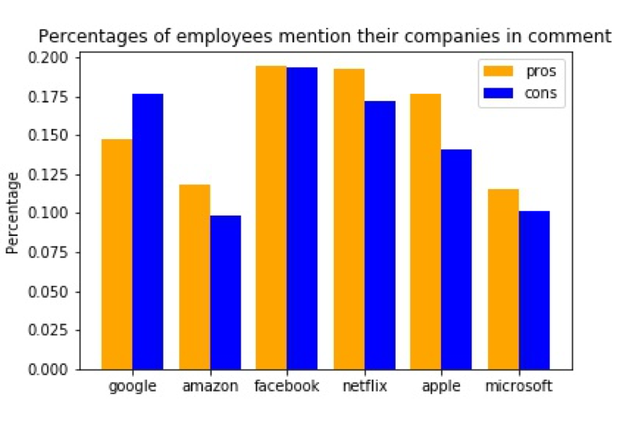
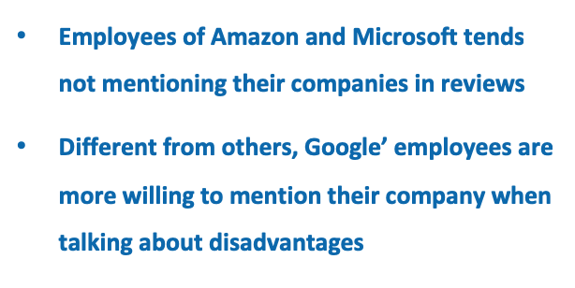
Review Dataset - How do People Mention Their own Companies

Slide 25
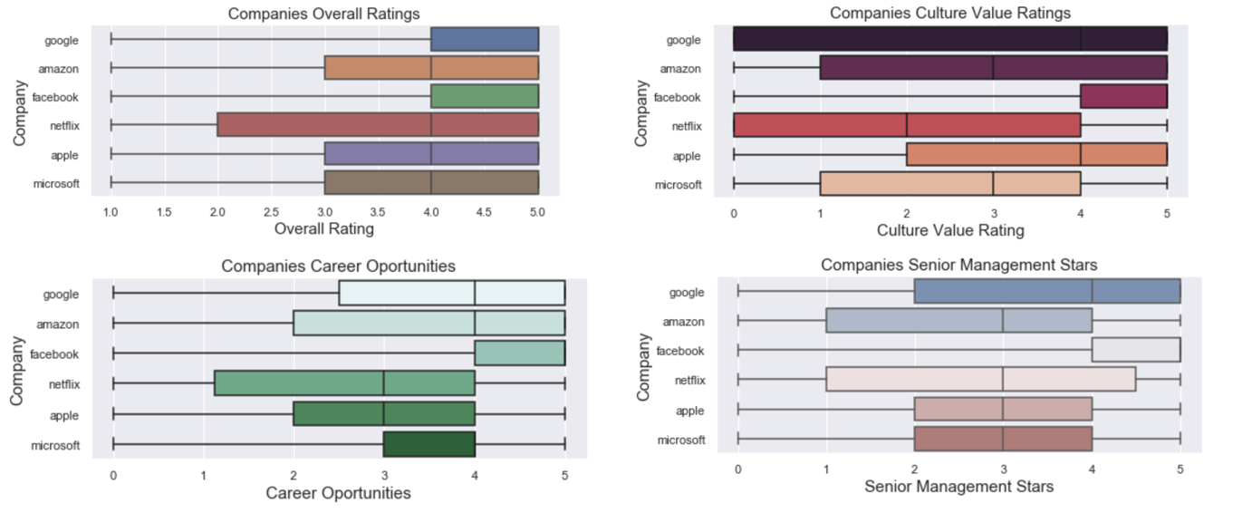
Review Dataset-Ratings on different features

Slide 26
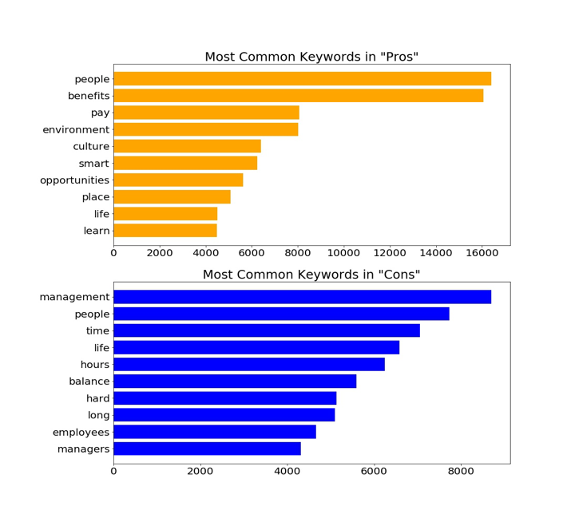
Summary of People’s comments
Common ‘good’ features:
Colleague, Benefits, Salary, Environment, Culture, Opportunities, Place,Learn, Life
Common ‘bad’ features:
Management, Colleague, WorkingTime, Life, Balance, Hard

Slide 27
Contents
Introduction
Dataset
Analysis
Prediction
Conclusion

Slide 28
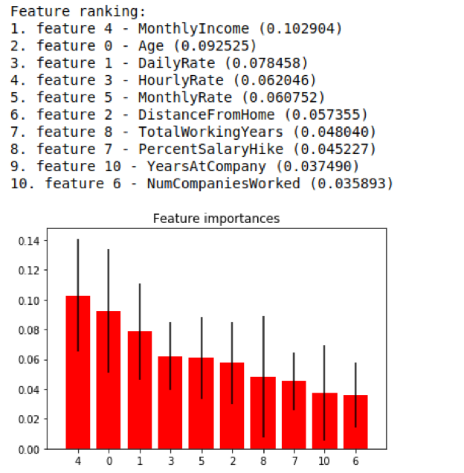
Feature Importance via Extra Decision Tree Classifier
Performance analysis on the IBM dataset using extremely randomized trees.
Features ranked on the basis of Gini importance which counts the number of times a feature is used to split a node weighted by the number of samples it splits

Slide 29
Contents
Introduction
Dataset
Analysis
Prediction
Conclusion

Slide 30
Conclusion
Contribution 1
Major reasons to quit
Age of the employee : The employee might be relatively young and still exploring his/her passions
Salary : Employees should be paid competitive wages as this is a very crucial factor that determines attrition rate
Contribution 2
Results given by the Machine Learning Model
We see that the features deemed important by decision trees are very similar to what we concluded by our data visualization.
Using these key features we were able to achieve a testing accuracy rate of 86.34% in determining attrition.
Contribution 3
Measures to be taken to prevent attrition
Employees must be paid competitive wages!
The younger employees must be allowed to explore a variety of departments within the company to ensure that they have the requisite freedom to explore their passions.
Travel time for employees needs to be cut down as this contributes to a considerable amount of stress on the employees.
Younger employees should be given higher job roles if their work is good, despite the fact that they are young.

Slide 31


