Slide 1
BLOCKCHAIN
Easy Tracking
DECENTRAL
AUTHENTIC
SCALABLE
EnsuriFy
Preventing Frauds in Farm Insurance

Slide 2
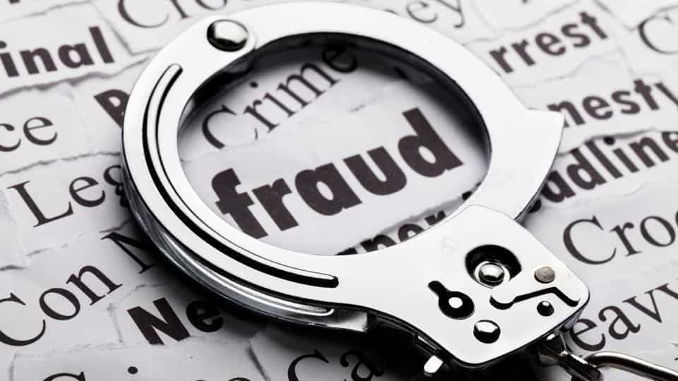

Problem Statement
Fraudulent activities in government’s crop loan schemes like PMFBY.
Both farmers and insurance companies cheats due to opacity in the system.
Farmers do fraud by taking multiple loans for single land or showing large cultivation area.
Insurance companies delays in claim settlements and many times reject them.
Very hard for government to keep track of loan settlements and payments by insurance companies.

Slide 3

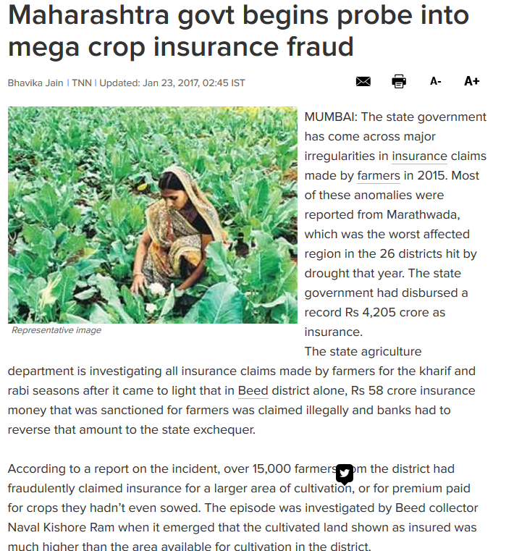
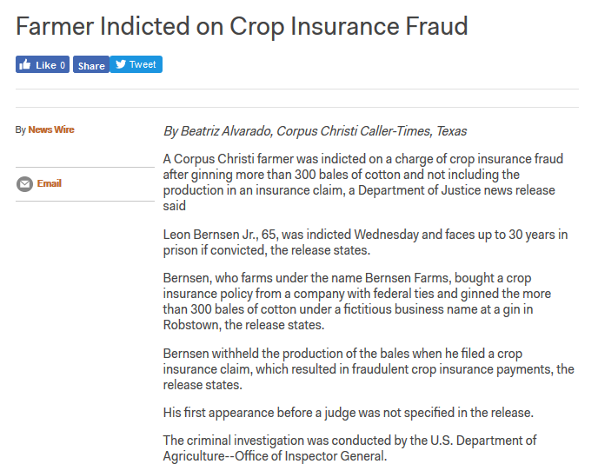
Case Studies

Slide 4


Problems in Current System
Impossible to keep track of how many certificates a farmer has taken or if he has inflated the area of his cultivated land on these certificates
No record of which crops are being cultivated on which plot.
No tracking mechanism for government to look into loan claim settlement by insurance companies and also track delays and rejections by them.
System has a lot of opacity which paves way for frauds.

Slide 5
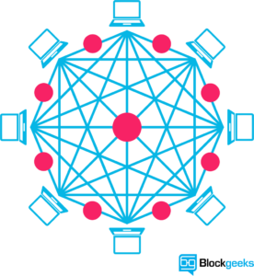
Proposed solution
We are proposing a block chain based secure, immutable and transparent solution.
Our system keeps all the transactions related to a field in block chain.
Transactions includes:
land purchase, issuing of crop sowing certificate, purchasing crop insurance, claiming the insurance and disbursement of it.
With this, we can keep track of cultivation land area, all the crop sowing certificates, number of insurances per field and the claim status of insurances.

Slide 6
Proposed solution
The local revenue official who issues crop sowing certificates can easily track the previous certificates owned by farmers.
The insurance companies can check if the farmer has already claimed an insurance in another company.
Government can easily track how many insurances are claimed and how are they being disbursed.

Slide 7
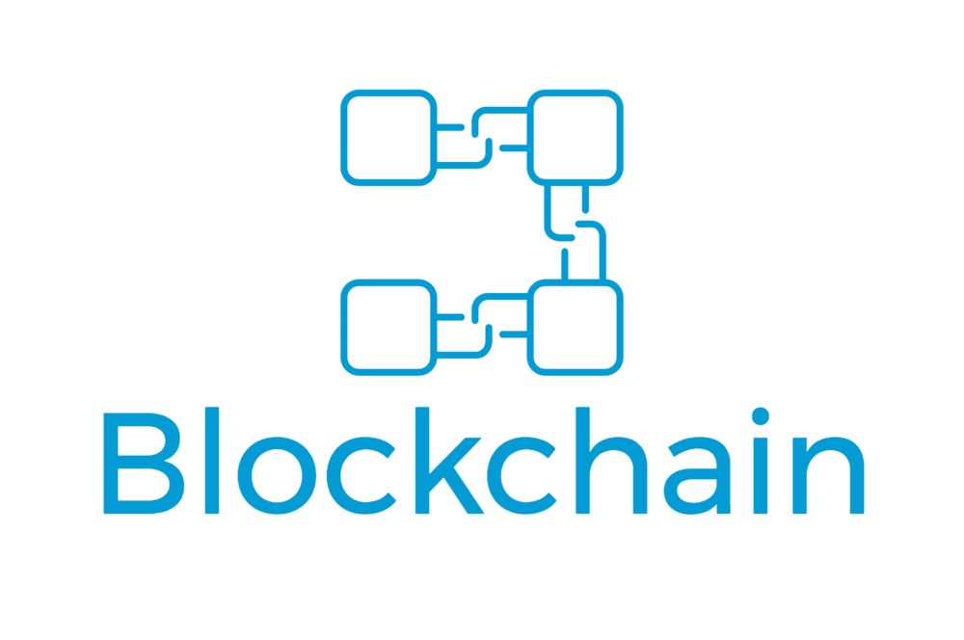




Technologies used
Block Chain
Ethereum
Solidity
Web application
SQL Database

Slide 8

Future aspects
Insurance and Claim disbursement Payment integration in block chain only.
Using biometric authentication to add more to the security.

Slide 9
Thank you
Team : AlphaMinds

