Slide 1

ECY · ARCHITECTURE & BIM
01 / 14
OFFSHORE BIM PRODUCTION PARTNER · UNITED KINGDOM
The production engine
behind UK practices.
You keep the client and the design intent. We take the modelling load.
Enes Cemil Yağcı — Founder & BIM Manager · Autodesk Expert Elite · ~250 worldwide
UK contact: Rami Daşkın · +44 7786 410586 · rami@ecy.com.tr · ecy.com.tr

Slide 2

WHY ECY
02 / 14
THREE REASONS, UP FRONT
A UK contact, an elite credential, proven delivery.
~250
UK
218
EXPERT ELITE WORLDWIDE
REPRESENTATIVE, 26 YRS
PROJECTS · 17 COUNTRIES
Autodesk Expert Elite-led production — a recognition held by only ~250 professionals worldwide.
Rami Daşkın, 26 years in the UK. Same time zone, local meetings, no language gap.
A track record that travels — 15 years' team experience, standards-led throughout.

Slide 3


UK EXPERIENCE
03 / 14
FOLKESTONE, KENT
Leas Pavilion — led by ECY's BIM Manager.
A UK project led by Enes Cemil Yağcı as BIM Manager — the 1902 Grade II listed tea room, restored beneath a new nine-storey, 91-home development.
— As BIM Manager, Enes led RIBA Stage 5–7 execution-drawing coordination — structural, mechanical and electrical.
— He ran the BIM model and subcontractor drawing review for dimensional accuracy and tolerances.
PROJECT CONTEXT
Project context · BIM delivery led by ECY's BIM Manager
133,715
SQ FT
91
APARTMENTS
9
STOREYS

Slide 4

WHY NOW
04 / 14
UK MARKET CONDITIONS · 2025–2026
The modelling load is rising. The people aren't.
— Hardest hiring market in years — construction & engineering are the UK's worst-hit sector for recruitment difficulty (BCC, 2024).
— BIM headcount is a heavy fixed cost — a Coordinator runs c.£34k–£54k, a Manager up to c.£80k, before on-costs and software.
— Pipeline is recovering as build costs climb — more delivery, less room to staff up permanently (RICS).
— Standards are non-negotiable — ISO 19650 on UK public work; the Building Safety Act 'golden thread' on higher-risk buildings.
82%
CONSTR. & ENG. FIRMS
hiring difficulty · BCC Q2 2024
+17%
FORWARD WORKLOAD
RICS · infra +32%
~251.5k
EXTRA WORKERS BY 2028
CITB skills network

Slide 5

WHERE WE FIT
05 / 14
THE GAP IN UK DELIVERY
A production engine, not a competitor.
YOU
Client relationship · design intent · your brand
the modelling load →
ECY
BIM production · on your standards
— The squeeze: rising ISO 19650 duties, scarce and expensive BIM talent, deadline spikes you can't permanently staff for.
— Our answer: a dedicated, standards-led production team that works to your BEP, your naming and your CDE — white-label.

Slide 6

WHAT WE DO
06 / 14
FIVE SERVICES
From point cloud to coordinated, costed model.
01 BIM Modelling · Revit · arch / struct / MEP
LOD 300–400 · AS-BUILT TO 500
02 Scan-to-BIM · point cloud to as-built
E57 / RCP → REVIT
03 Coordination & Clash Detection
NAVISWORKS FEDERATED
04 4D / 5D · programme & cost
PRIMAVERA P6
05 BEP & CDE setup
ISO 19650

Slide 7

UK STANDARDS
07 / 14
ISO 19650 BY DEFAULT
Built to UK standard, not retrofitted to it.
FRAMEWORK
ISO 19650-1 to -5 — delivery, operational, exchange & security-minded information management
NAMING EXAMPLE
WBP-EDO-00-XX-SP-Z-0001
NAMING
BS EN ISO 19650-2 UK convention (Project-Originator-Volume-Level-Type-Role-Number); supersedes BS 1192
Project · Originator · Volume
Level · Type · Role · Number
CDE WORKFLOW
Controlled suitability codes S0 WIP → S1–S4 Shared → A/B Published — full revision traceability
STAGE-ALIGNED
RIBA Plan of Work 2020 stages 0–7; proven at Stages 5–7 execution

Slide 8

DE-RISKING OFFSHORE
08 / 14
YOUR THREE FEARS, ANSWERED
Quality, revision risk, communication — each with a mechanism.
QUALITY
Every model is QA-gated against the BEP and EIR — model-health checks, Navisworks clash validation and a documented review at the S0 → S1/S2 transition. No model is issued to your CDE until it passes the QA gate against the agreed LOD.
REVISION RISK
ISO 19650 CDE workflow with controlled status codes (S0→S4→A/B): every issue traceable, single-source-of-truth, full revision history per container. No overwriting, no lost markups.
COMMUNICATION
A UK-based representative — same time zone, local meetings, no language gap. Work flows to the BEP and MIDP/TIDP dates, with issue-tracked clash reports.

Slide 9

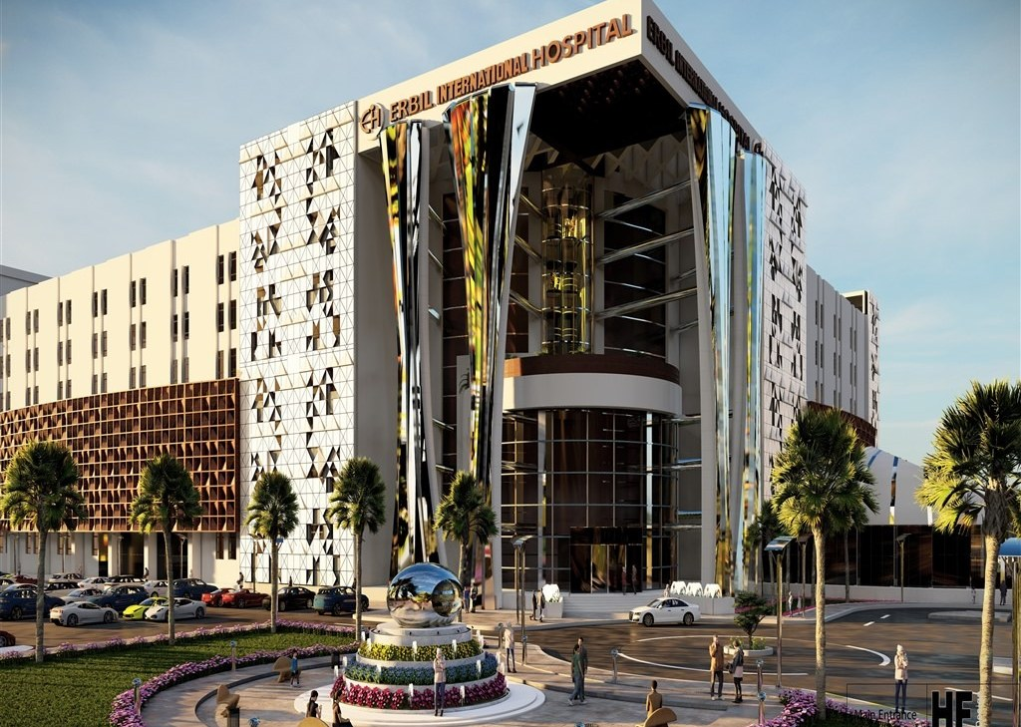
CASE STUDY · 01
09 / 14
ERBIL INTERNATIONAL HOSPITAL · IRAQ
Caught in the model, not on site.
Structural BIM and federated multi-discipline coordination on a large, complex healthcare structure — issues resolved before construction.
LOD 350
MODEL DETAIL
829
CLASHES RESOLVED
20 wk
TURNAROUND

Slide 10

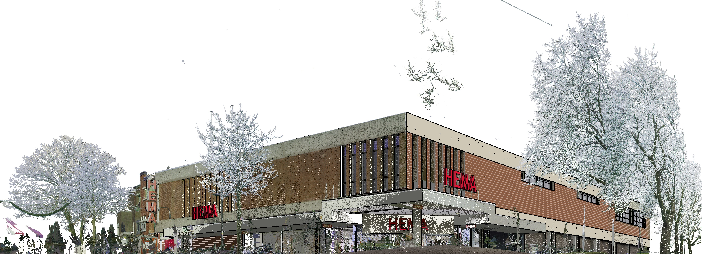
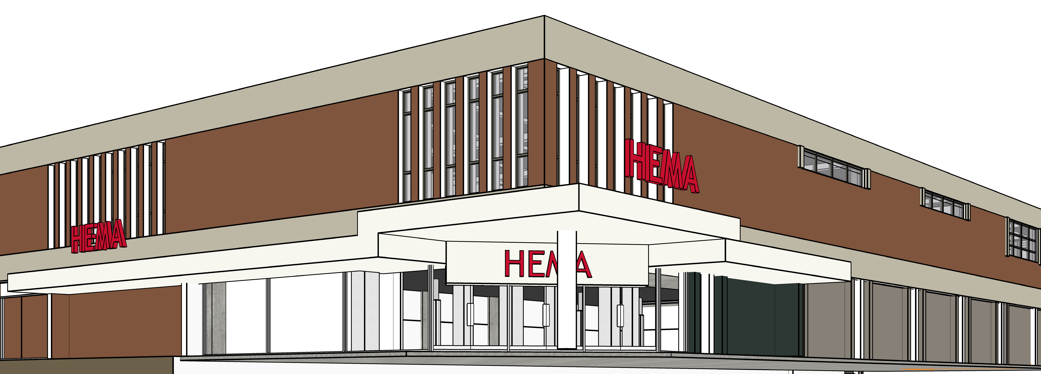
CASE STUDY · 02
10 / 14
BEFORE · REGISTERED POINT CLOUD
HEMA, EMMEN · NETHERLANDS
Point cloud in. As-built model out.
The literal before/after — a registered scan of a building corner, beside its parametric Revit twin.
AFTER · AS-BUILT REVIT MODEL
3,500 m²
CAPTURED
LOD 300
AS-BUILT
8 wk
DELIVERY

Slide 11

HOW WE WORK
11 / 14
TO YOUR BEP, NAMING AND CDE
Five steps, all on your standards.
01
Onboard
02
Produce
03
QA
04
Deliver
05
Report
Adopt your BEP, naming & CDE; confirm scope vs the EIR.
Model to agreed LOD on the MIDP / TIDP schedule.
Model-health & standards checks, clash validation, review.
Issue through the CDE with controlled status codes.
Issue-tracked clash reports & progress vs plan.

Slide 12

ENGAGEMENT
12 / 14
THREE WAYS TO WORK · GBP
Pick the model that fits the work.
MOST POPULAR
A Fixed-fee per project
B Dedicated BIM resource
C Per-unit
BEST FOR
Bounded, defined-scope deliverables
Ongoing capacity as part of your team
High-volume Scan-to-BIM
COMMITMENT
Per project
Monthly FTE, scalable
None — pay per item
BILLING
Milestone payments
Predictable monthly fee
Per model / sheet / m²
SCALING
Fixed to scope
Add or release resources
Flexes with volume
Priced in GBP · NDA + simple service agreement · deposit + milestones · UK reverse-charge VAT applies

Slide 13

YOUR CONTACTS
13 / 14
UNITED KINGDOM AND TÜRKİYE
One UK call away. One production team behind it.
UNITED KINGDOM
Rami Daşkın
UK Representative
+44 7786 410586
rami@ecy.com.tr
26 years in the UK · same time zone · local meetings
TÜRKİYE · HEAD OFFICE
Enes Cemil Yağcı
Founder & BIM Manager
+90 533 566 67 80
info@ecy.com.tr
Autodesk Expert Elite · openBIM · Primavera P6 · Adana

Slide 14

NEXT STEP
14 / 14
LOW-RISK BY DESIGN
Start with a pilot.
One bounded deliverable, on your standards, so the proof is yours before the commitment is.
— Send us a defined scope — a model, a scan, a coordination package.
— We deliver it to your BEP, naming and CDE, QA-gated and issue-tracked.
— Judge us on the output, then scale only if it earns it.
Book a 15-minute call Rami +44 7786 410586 · rami@ecy.com.tr · ecy.com.tr

