Slide 1
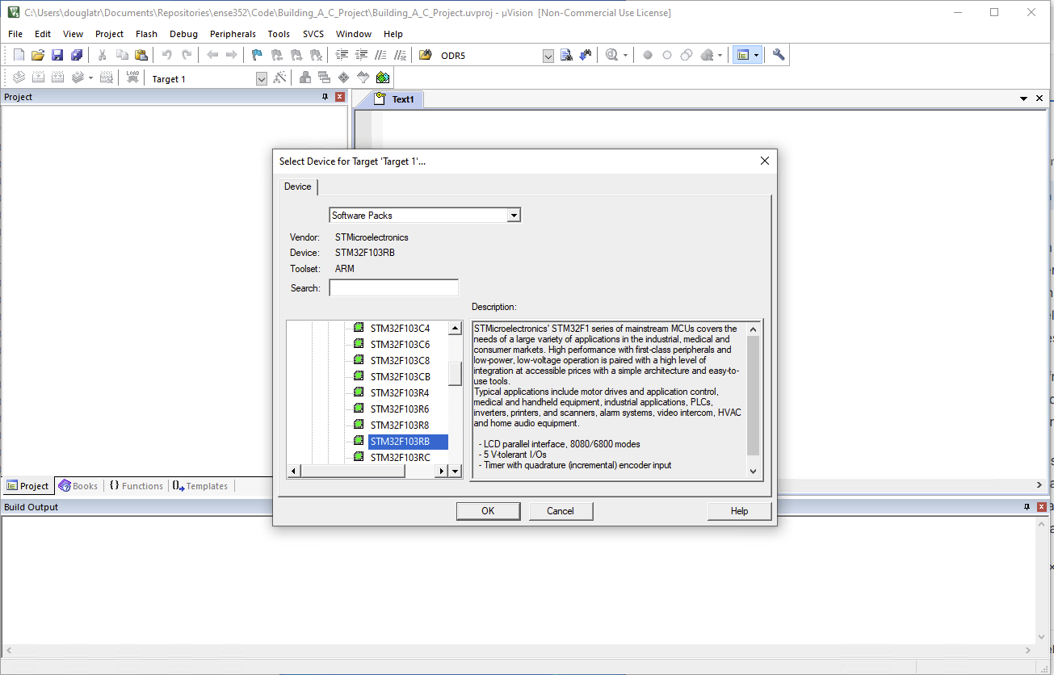
Building a C Project
Create a new Project

Slide 2
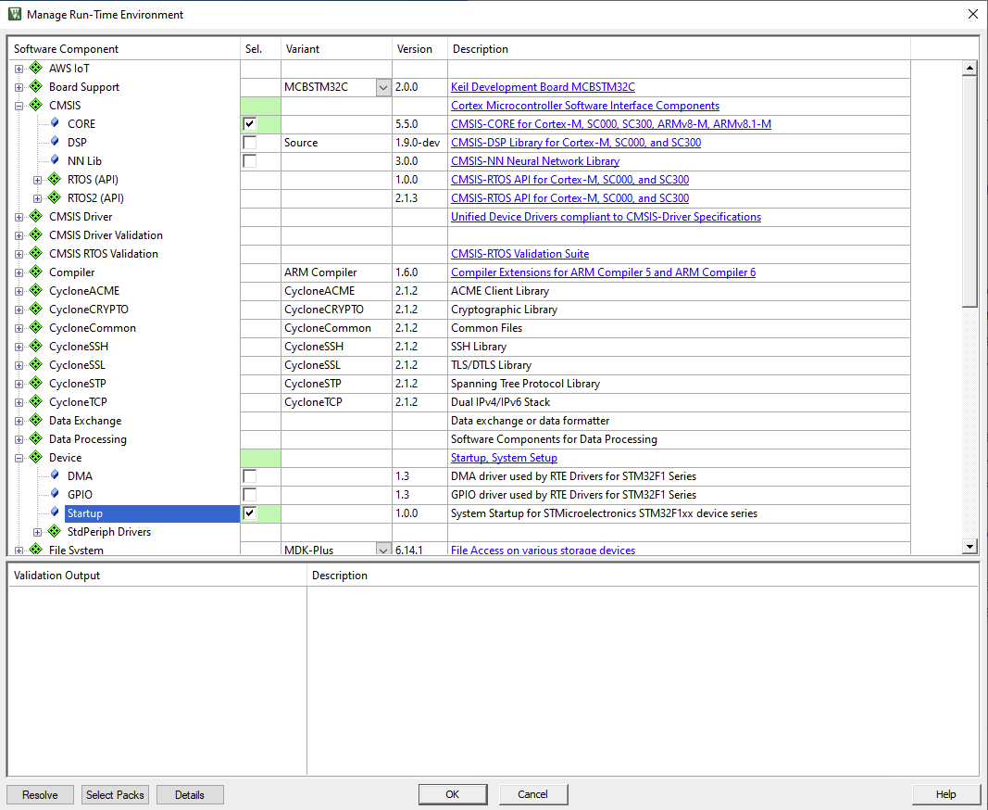
Building a C Project
Select CMSIS - Core
Select Device - Startup

Slide 3
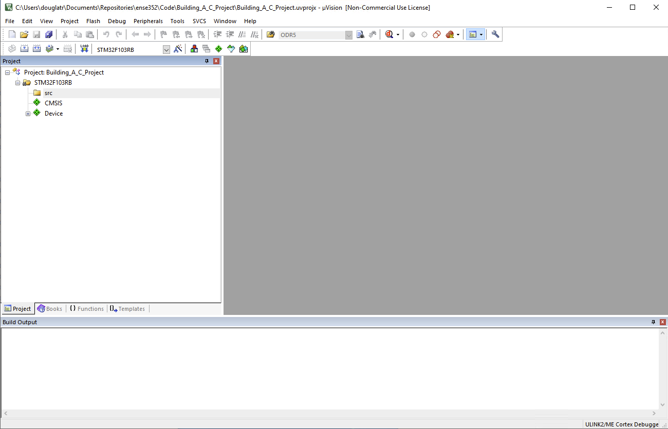
Building a C Project
Rename the target if you like and create a src folder.

Slide 4
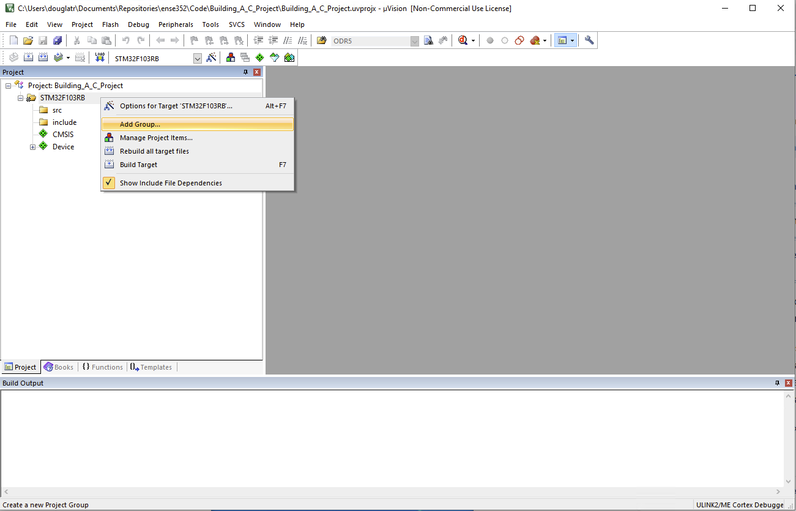
Building a C Project
Right click on the target and Add Group
Name the group include

Slide 5
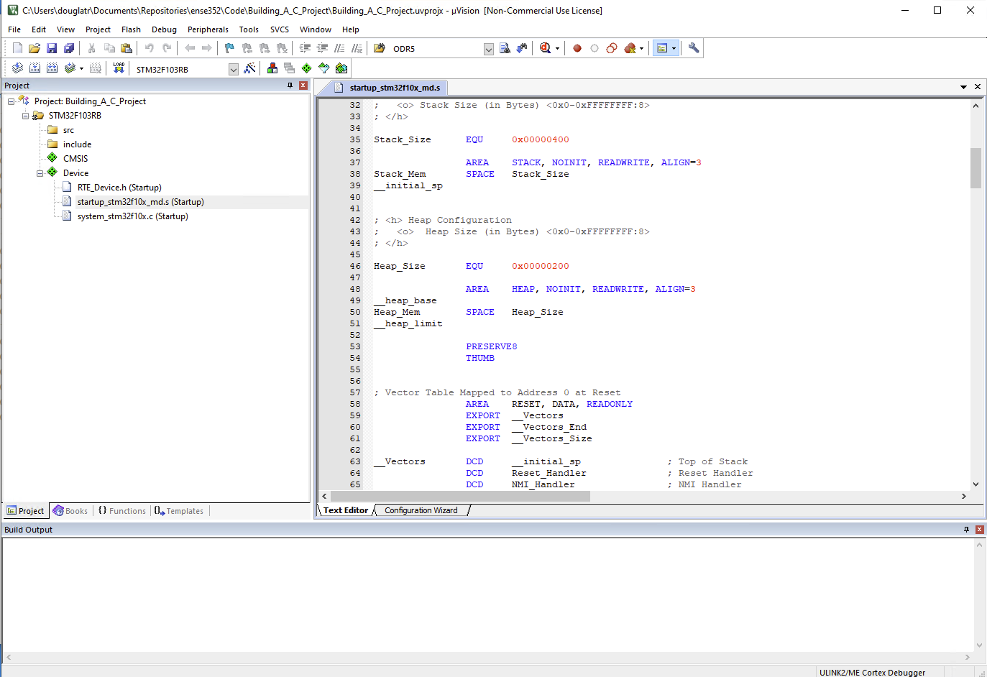
Building a C Project
Look at the startup code. It should look familiar to you

Slide 6
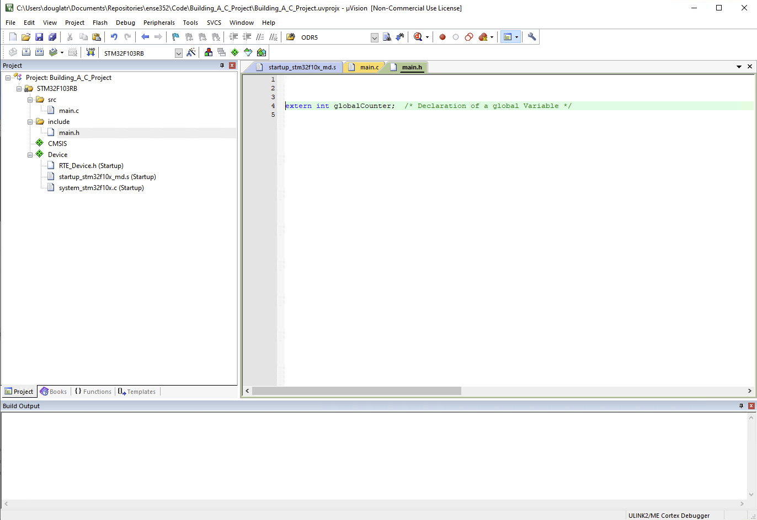
Building a C Project
Declaring a global variable in a header file

Slide 7
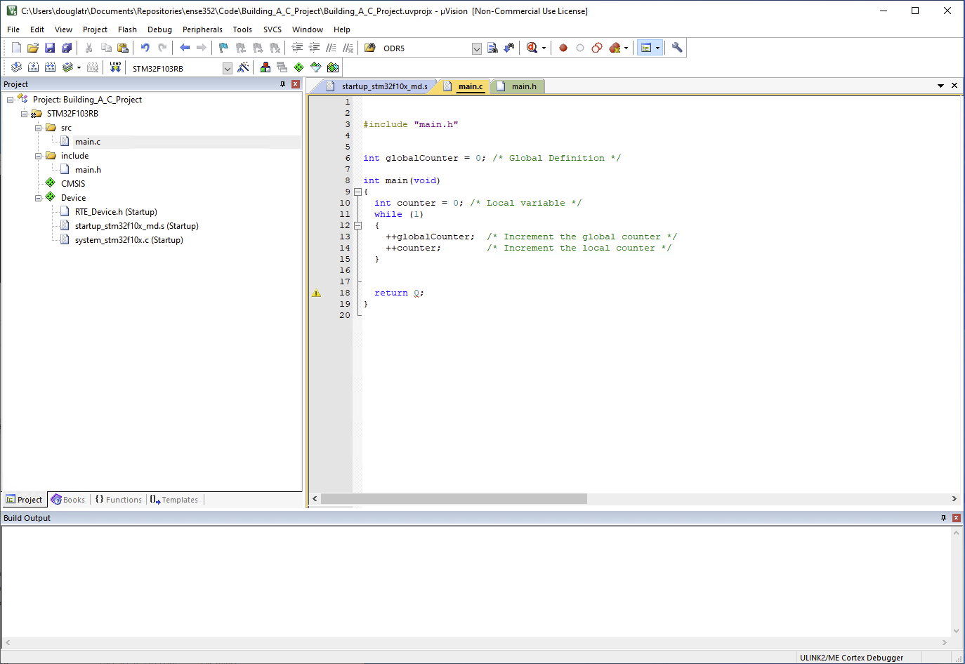
Building a C Project
Defining a global variable and a local variable

