Slide 1
WHAT IS DENSITY FUNCTIONAL THEORY?

Slide 2
1.1 EXAMPLES OF DFT IN ACTION
1.1.1 Ammonia Synthesis by Heterogeneous Catalysis
The core reaction in ammonia production is very simple:
N₂ +3H₂ → 2NH₃
Can a direct connection be made between the shape and size of a metal nanoparticle and its activity as a catalyst for ammonia synthesis?

Slide 3
Honkala and co-workers, using DFT calculations, showed that the net chemical reaction above proceeds via at least 12 distinct steps on a metal catalyst and that the rates of these steps depend strongly on the local coordination of the metal atoms that are involved.
One of the most important reactions is the breaking of the N₂ bond on the catalyst surface. On regions of the catalyst surface that were similar to the surfaces of bulk Ru (more speciﬁcally, atomically ﬂat regions),a great deal of energy is required for this bond-breaking reaction.

Slide 4
1.1.2 Embrittlement of Metals by Trace Impurities
It has been known for over 100 years that adding tiny amounts of certain impurities to copper can change the metal from being ductile to a material that will fracture in a brittle way. This occurs, for example, when bismuth (Bi) is present in copper(Cu) at levels below 100 ppm.
Can the changes in copper caused by Bi be explained in a detailed way?

Slide 5
Schweinfest, Paxton, and Finnis used DFT calculations to offer a definitive description of how Bi embrittles copper. They first used DFT to predict stress–strain relationships
for pure Cu and Cu containing Bi atoms as impurities. They explicitly calculated the cohesion energy of a particular grain boundary that is known experimentally to be embrittled by Bi.

Slide 6
1.1.3 Materials Properties for Modeling Planetary Formation
The extreme conditions that exist inside planets pose some obvious challenges to probing these topics in laboratory experiments.
DFT calculations can play a useful role in probing material properties at these extreme conditions.

Slide 7
Umemoto et al. wanted to understand what happens to the structure of MgSiO₃ at conditions much more extreme than those found in Earth’s core–mantle boundary.
These calculations predicted that at pressures of ~11 Mbar,
MgSiO₃ dissociates in the following way:
MgSiO₃ [CaIrO₃ structure] → MgO [CsCl structure]
+ SiO₂ [cotunnite structure].

Slide 8
These transformations in the structures of MgO and SiO₂ allow an important connection to be made between DFT calculations and experiments since these transformations occur at conditions that can be directly probed in laboratory experiments.
The transition pressures predicted using DFT and observed experimentally are in good agreement, giving a strong indication of the accuracy of these calculations.

Slide 9
1.2 THE SCHRöDINGER EQUATION
Since the mass of the nucleus is much larger than the mass of the electron, the response of electrons to environmental changes is much faster than that of nucleus.
As a result, we can split our physical question into two pieces. First, we solve, for fixed positions of the atomic nuclei, the equations that describe the electron motion. For a given set of electrons moving in the field of a set of nuclei, we find the lowest energy configuration, or state, of the electrons.

Slide 10
If we have M nuclei at positions R1, . . . , RM,
we can express the ground-state energy, E, as a function of the positions of these nuclei, E(R1, . . . , RM)
we are able to calculate this potential energy surface we can tackle the original problem posed above—how does the energy of the material change as we move its atoms around?

Slide 11

Schrödinger equation under the interaction system of multiple
electrons and polyatomic nucleus：
Here, m is the electron mass. For the Hamiltonian we have chosen, c is the electronic wave function, which is a function of each of the spatial coordinates of each of the N electrons, so c ¼ c(r1, . . . , rN), and E is the groundstate energy of the electrons.

Slide 12

The quantity of physical interest is really the probability that a set of N electrons in any order have coordinates r1, . . .rN. A closely related quantity is the density of electrons at a particular position in space, n(r). This can be written in terms of the individual electron wave functions as
The point of this discussion is that the electron density, n(r) contains a great amount of the information that is actually physically observable from the full wave function solution to the Schrödinger equation.

Slide 13
1.3 DENSITY FUNCTIONAL THEORY—FROM WAVE FUNCTIONS TO ELECTRON DENSITY
The entire field of density functional theory rests on two fundamental mathematical theorems proved by Kohn and Hohenberg and the derivation of a set of equations by Kohn and Sham.
The first theorem is: The ground-state energy from Schrödinger’s equation is a unique functional of the electron density.

Slide 14
This theorem states that there exists a one-to-one mapping between the ground-state wave function and the ground-state electron density.
we can restate Hohenberg and Kohn’s result by saying that the ground-state energy E can be expressed as E[n(r)],
where n(r) is the electron density.
Another way to restate Hohenberg and Kohn’s result is that the ground-state electron density uniquely determines all properties, including the energy and wave function, of the ground state.

Slide 15
Why is this result important?
It means that we can think about solving the Schrödinger equation by finding a function of three spatial variables, the electron density, rather than a function of 3N variables, the wave function.

Slide 16
The second Hohenberg–Kohn theorem defines an important property of the functional: The electron density that minimizes the energy of the overall functional is the true electron density corresponding to the full solution of the Schrödinger equation.

Slide 17

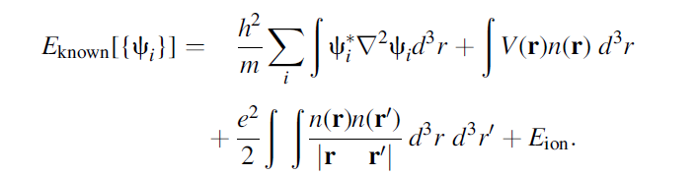
The energy functional can be written as ：
Where we have split the functional into a collection of terms we can write down in a simple analytical form, E_{known}[{Ψ_{i}}], and everything else, E_{XC}. The“known” terms include four contributions:

Slide 18
The terms on the right are, in order, the electron kinetic energies, the Coulomb interactions between the electrons and the nuclei, the Coulomb interactions between pairs of electrons, and the Coulomb interactions between pairs of
Nuclei.
The other term in the complete energy functional, E_{XC}[{Ψ_{i}}], is the exchange–correlation functional, and it is defined to include all the quantum mechanical effects that are not included in the “known” terms.

Slide 19
Let us imagine for now that we can express the as-yet-undefined exchange–correlation energy functional in some useful way. What is involved in finding minimum energy solutions of the total energy functional?
This difficulty was solved by Kohn and Sham, who showed that the task of finding the right electron density can be expressed in a way that involves solving a set of equations in which each equation only involves a single electron.

Slide 20
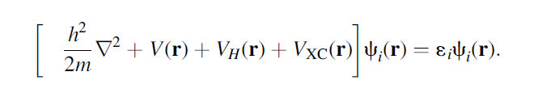
The Kohn–Sham equations have the form
On the left-hand side of the Kohn–Sham equations there are three potentials, V, V_{H}, and V_{XC}.

Slide 21
V
The first of these also appeared in the full Schrödinger equation and in the “known” part of the total energy functional given above. This potential defines the interaction between an electron and the collection of atomic nuclei.

Slide 22

V_{H}
The second is called the Hartree potential and is defined by
The Hartree potential includes a socalled self-interaction contribution because the electron we are describing in the Kohn–Sham equation is also part of the total electron density, so part of V_{H} involves a Coulomb interaction between the electron and itself.

Slide 23
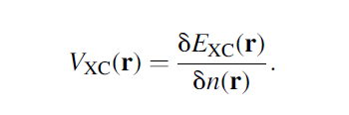
V_{XC} can formally be defined as a “functional derivative”
of the exchange–correlation energy:

Slide 24
If you have a vague sense that there is something circular about our discussion of the Kohn–Sham equations you are exactly right.
To break this circle, the problem is usually treated in an iterative way as outlined in the following algorithm:

Slide 25
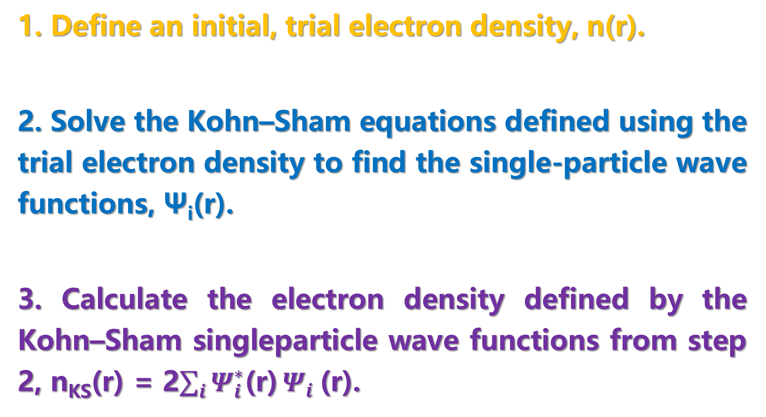
1. Define an initial, trial electron density, n(r).
2. Solve the Kohn–Sham equations defined using the trial electron density to find the single-particle wave functions, Ψ_{i}(r).
3. Calculate the electron density defined by the Kohn–Sham singleparticle wave functions from step 2, n_{KS}(r) = 2$\sum_{i}{Ψ_{i}^{∗}\text{(}\text{r}\text{)}}Ψ_{i}$(r).

Slide 26
4. Compare the calculated electron density, n_{KS}(r), with the electron density used in solving the Kohn–Sham equations, n(r). If the two densities are the same, then this is the ground-state electron density,
and it can be used to compute the total energy. If the two densities are different, then the trial electron density must be updated in some way.
Once this is done, the process begins again from step 2.

Slide 27

1.4 EXCHANGE–CORRELATION FUNCTIONAL
Local Density Approximation , LDA
we set the exchange–correlation potential at each position to be the known exchange–correlation potential from the uniform electron gas at the electron density observed at that position:
This approximation uses only the local density to define the approximate exchange–correlation functional.

Slide 28
The LDA gives us a way to completely define the Kohn–
Sham equations, but it is crucial to remember that the results from these equations do not exactly solve the true Schrödinger equation because we are not using the true exchange–correlation functional.

Slide 29
It should not surprise you that the LDA is not the only functional that has been tried within DFT calculations. The development of functionals that more faithfully represent nature remains one of the most important areas of active research in the quantum chemistry community.

Slide 30
Generalized Gradient Approximation , GGA
Two of the most widely used functionals in calculations
involving solids are the Perdew–Wang functional (PW91) and the Perdew–Burke–Ernzerhof functional (PBE). Each of these functionals are GGA functionals, and dozens of other GGA functionals have been developed and used, particularly for calculations with isolated molecules.

Slide 31
1.5 THE QUANTUM CHEMISTRY TOURIST
As you read about the approaches aside from DFT that exist for finding numerical solutions of the Schrödinger equation, it is likely that you will rapidly encounter a bewildering array of acronyms.
This section aims to present an overview of quantum chemical methods on the level of a phrase book or travel guide.

Slide 32
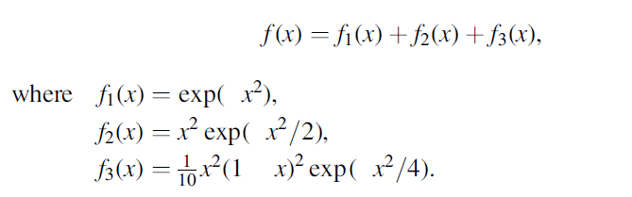
1.5.1 Localized and Spatially Extended Functions
As an example of a spatially localized function, Fig. 1.1 shows the function

Slide 33
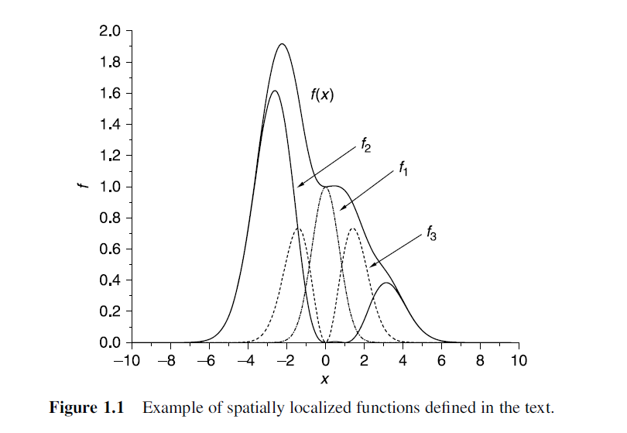

Slide 34
We could include more information in this final function by including more individual functions within its definition. Also, we could build up functions that describe multiple atoms simply by using an appropriate set of localized functions for each individual atom.

Slide 35
What if we are interested in a bulk material such as the atoms in solid silicon or the atoms beneath the surface of a metal catalyst?
A useful alternative is to use periodic functions to describe the wave functions or electron densities.

Slide 36
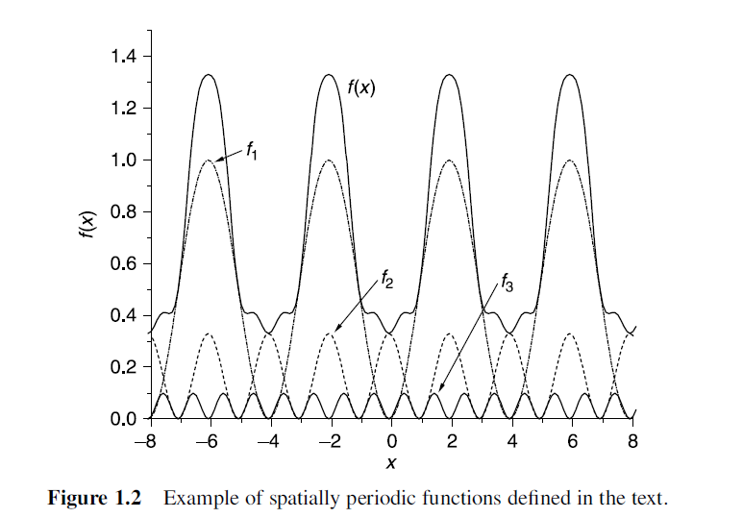

Slide 37
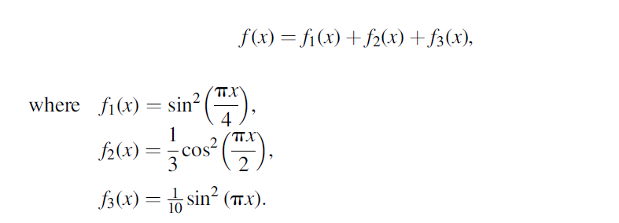

Figure 1.2 shows a simple example of this idea by plotting:
The resulting function is periodic; that is

Slide 38
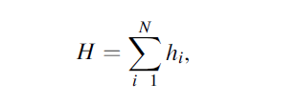
1.5.2 Hartree–Fock Method
Suppose we would like to approximate the wave function of N electrons. Let us assume for the moment that the electrons have no effect on each other. If this is true, the Hamiltonian for the electrons may be written as：
where h_{i} describes the kinetic and potential energy of electron i.

Slide 39

If we write down the Schrödinger equation for just one electron based on this Hamiltonian, the solutions would satisfy :
The eigenfunctions defined by this equation are called spin orbitals.

Slide 40

When the total Hamiltonian is simply a sum of one-electron operators, h_{i}, it follows that the eigenfunctions of H are products of the one-electron spin orbitals:
The energy of this wave function is the sum of the spin orbital energies, E = E_{j1}+…+E_{jN} .

Slide 41
Electrons are fermions, the wave function must change sign if two electrons change places with each other. Exchanging two electrons does not change the sign of the Hartree product, which is a serious drawback.
We can obtain a better approximation to the wave function by using a Slater determinant.

Slide 42
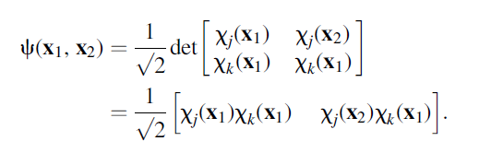

For two electrons, the Slater determinant is
The coefficient of (1/$\sqrt{2}$) is simply a normalization factor.

Slide 43
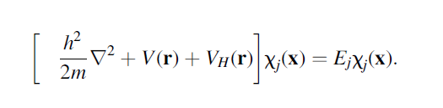
In a Hartree–Fock (HF) calculation, we fix the positions of the atomic nuclei and aim to determine the wave function of N-interacting electrons. The Schrödinger equation for each electron is written as：

Slide 44
How to express the solution of the above single electron equation? How do you combine these solutions into N electron wave functions?

Slide 45
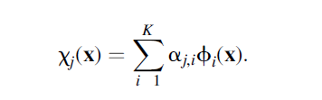
To do this, we define a finite set of functions that can be added together to approximate the exact spin orbitals. If our finite set of functions is written as Φ₁(x), Φ₂(x),…,Φ_{K}(x), then we can approximate the spin orbitals as:

Slide 46
When using this expression, we only need to find the expansion coefficients, a_{j,i}, for i 1, . . . , K and j 1, . . . , N to fully define all the spin orbitals that are used in the HF method. The set of functions Φ₁(x), Φ₂(x), . . . , Φ_{K}(x) is called the basis set for the calculation.

Slide 47

Like solving the Kohn-Sham equation, an HF calculation is an iterative procedure that can be outlined as follows:
Make an initial estimate of the spin orbitals
by specifying the expansion coefficients, a_{j,i.}
2. From the current estimate of the spin orbitals, define the electron density, n(r`):
3. Using the electron density from step 2, solve the single-electron equations for the spin orbitals.

Slide 48
4. If the spin orbitals found in step 3 are consistent with orbitals used in step 2, then these are the solutions to the HF problem we set out to calculate. If not, then a new estimate for the spin orbitals must be made and we then return to step 2.

Slide 49
1.5.4 Beyond Hartree–Fock
How do more advanced quantum chemical approaches improve on the HF method?
The approaches vary, but the common goal is to include a description of electron correlation. Methods based on a single reference determinant are formally known as “post–Hartree–Fock” methods.

Slide 50
The classification of wave-function-based methods has two distinct components: the level of theory and the basis set.
To illustrate the role of the level of theory and the basis set, we will look at two properties of a molecule of CH₄, the C–H bond length and the ionization energy. Experimentally, the C–H bond length is 1.094A˚ and the ionization energy for methane is 12.61 eV.

Slide 51
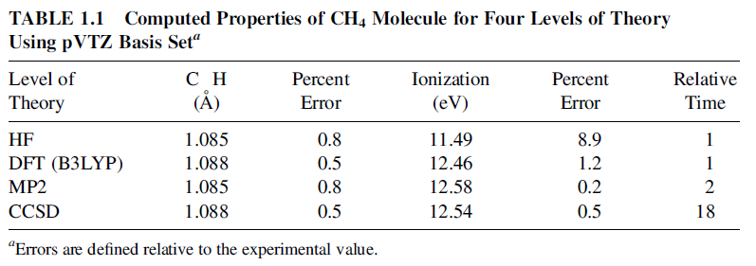

Slide 52
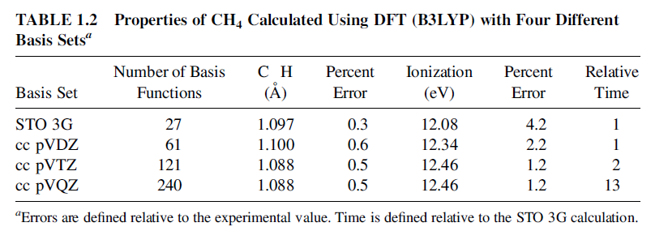

Slide 53
The classification of wave-function-based methods has two distinct components: the level of theory and the basis set.
To illustrate the role of the level of theory and the basis set, we will look at two properties of a molecule of CH₄, the C–H bond length and the ionization energy. Experimentally, the C–H bond length is 1.094A˚ and the ionization energy for methane is 12.61 eV.

Slide 54
1.7 WHAT CAN DFT NOT DO?
There are some important situations for which DFT cannot be expected to be physically accurate.
The first situation where DFT calculations have limited accuracy is in the calculation of electronic excited states.
The second case is that the bandgap of the semiconductor and insulator materials obtained in the DFT calculation is underestimated.

Slide 55
The weak attraction of van der Waals (vdW) between atoms and molecules leads to inaccuracies in calculation results.
The atomic magnitude in the calculation cannot match the actual atomic magnitude.

