Slide 1
NUTS AND BOLTS OF DFT CALCULATIONS

Slide 2

3.1 RECIPROCAL SPACE AND k POINTS
3.1.1 Plane Waves and the Brillouin Zone
If we solve the Schrödinger equation for this periodic
system, the solution must satisfy a fundamental property known as Bloch’s theorem, which states that the solution can be expressed as a sum of terms with the form:
where u_{k}(r) is periodic in space with the same periodicity as the supercell.

Slide 3
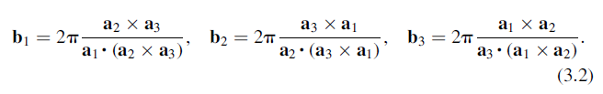
The space of vectors k is called reciprocal space (or simply k space).
We define three vectors that define positions in reciprocal space. These vectors are called the reciprocal lattice vectors, b₁, b₂, and
b₃, and are defined so that a_{i}·b_{j} is 2π if i=j and 0 otherwise. This choice means that

Slide 4
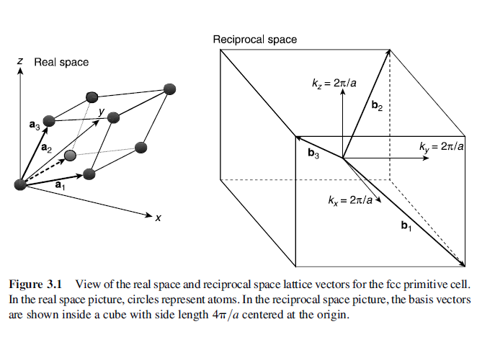

Slide 5
We can define a primitive cell in reciprocal space. Because this cell has many special properties, it is given a name: it is
the Brillouin zone (often abbreviated to BZ).

Slide 6
3.1.2 Choosing k Points in the Brillouin Zone
The solution that is used most widely was developed by Monkhorst and Pack in 1976. Most DFT packages offer the option of choosing k points based on this method.
In practice, how should we choose how many k points to use?

Slide 7
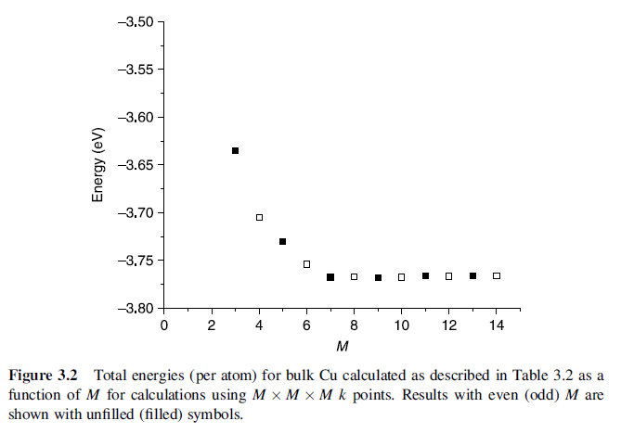

Slide 8
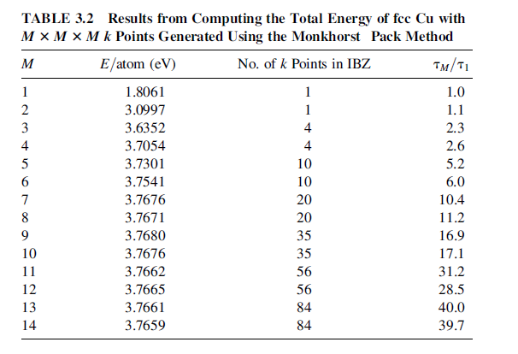

Slide 9
The last column in Table 3.2 lists the computational time taken for the total energy calculations, normalized by the result for M=1.
if M is an odd number, then the amount of time taken for the calculations with either M or (M+1) was close to the same.
This occurs because the calculations take full advantage of the many symmetries that exist in a perfect fcc solid.

Slide 10
This reduced region in k space is called the irreducible Brillouin zone (IBZ).
To show how helpful symmetry is in reducing the work required for a DFT calculation, we have repeated some of the calculations from Table 3.2 for a four-atom supercell in which each atom was given a slight displacement away from its fcc lattice position.

Slide 11
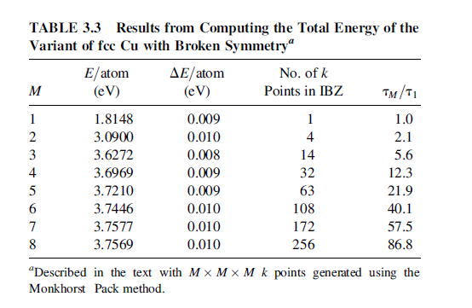

Slide 12
3.1.3 Metals—Special Cases in k Space
One useful definition of a metal is that in a metal the Brillouin zone can be divided into regions that are occupied and unoccupied by electrons. The surface in k space that separates
these two regions is called the Fermi surface.

Slide 13
We will describe the two best-known methods to solve the problem of slow convergence of metal calculations.
The first is called the tetrahedron method.
The idea behind this method is to use the discrete set of k points to define a set of tetrahedra that fill reciprocal space and to define the function being integrated at every point in a tetrahedron using interpolation.

Slide 14
A different approach to the discontinuous integrals that appear for metals are the smearing methods.
The idea of these methods is to force the function being integrated to be continuous by “smearing” out the discontinuity.

Slide 15

An example of a smearing function is the Fermi–Dirac function:
Figure 3.3 shows the shape of this function for several values of σ.

Slide 16
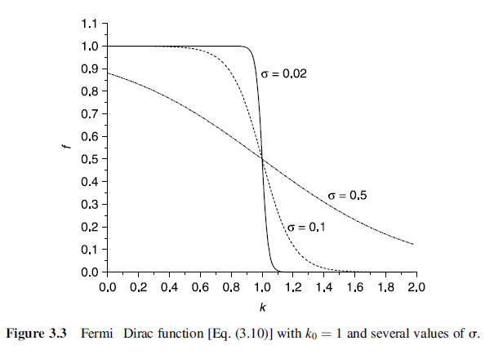

Slide 17
3.1.4 Summary of k Space
The key ideas related to getting well-converged results in k space include:
1. Before pursuing a large series of DFT calculations for a system of interest, numerical data exploring the convergence of the calculations with respect to the number of k points should be obtained.
2. The number of k points used in any calculation should be reported since not doing so makes reproduction of the result difficult.

Slide 18
3. Increasing the volume of a supercell reduces the number of k points needed to achieve convergence because volume increases in real space correspond to volume decreases in reciprocal space.
4. If calculations involving supercells with different volumes are to be compared, choosing k points so that the density of k points in reciprocal space is comparable for the different supercells is a useful way to have comparable levels of convergence in k space.

Slide 19
5. Understanding how symmetry is used to reduce the number of k points for which calculations are actually performed can help in understanding how long individual calculations will take. But overall convergence is determined by the density of k points in the full Brillouin zone, not just the number of k points in the irreducible Brillouin zone.
6. Appropriate methods must be used to accurately treat k space for metals.

Slide 20


3.2 ENERGY CUTOFFS
Our lengthy discussion of k space began with Bloch’s theorem, which tells us that solutions of the Schrödinger equation for a supercell have the form
where u_{k}(r) is periodic in space with the same periodicity as the supercell. It is now time to look at this part of the problem more carefully. The periodicity of u_{k}(r) means that it can be expanded in terms of a special set of plane waves:

Slide 21


Combining the two equations above gives:
The functions appearing in Eq.(3.13) have a simple interpretation as solutions of the Schrödinger equation: they are solutions with kinetic energy:

Slide 22


As a result, it is usual to truncate the infinite sum above to include only solutions with kinetic energies less than some value:
The infinite sum then reduces to :

Slide 23
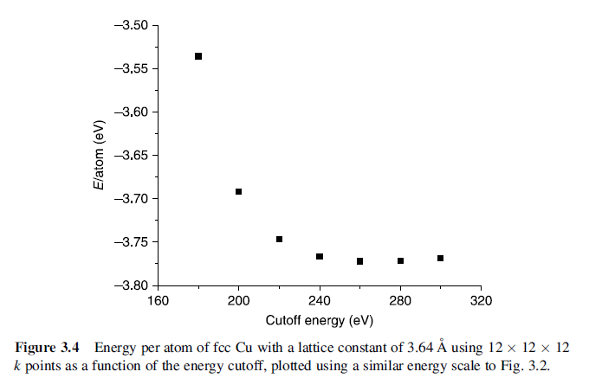

Slide 24
3.2.1 Pseudopotentials
A pseudopotential replaces the electron density from a chosen set of core electrons with a smoothed density chosen to match various important physical and mathematical properties of the true ion core.

Slide 25
A pseudopotential is developed by considering an isolated atom of one element, but the resulting pseudopotential can then be used reliably for calculations that place this atom in any chemical environment without further adjustment of the pseudopotential.

Slide 26
3.3 NUMERICAL OPTIMIZATION
To make practical use of our ability to perform numerically converged DFT calculations, we also need methods that can help us effectively cope with situations where we want to search through a problem with many degrees of freedom.

Slide 27
3.3.1 Optimization in One Dimension
How to find a local minimum of f (x)?
The first approach is the bisection method.
The second approach is Newton’s method.

Slide 28
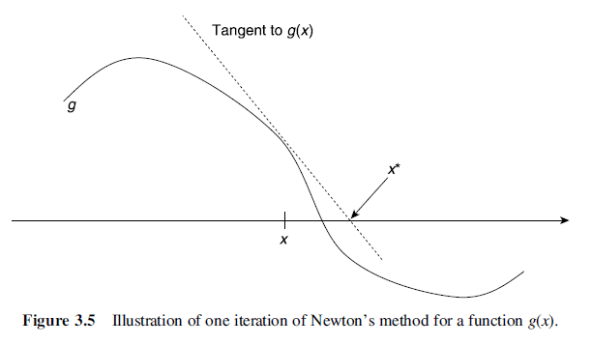

Slide 29
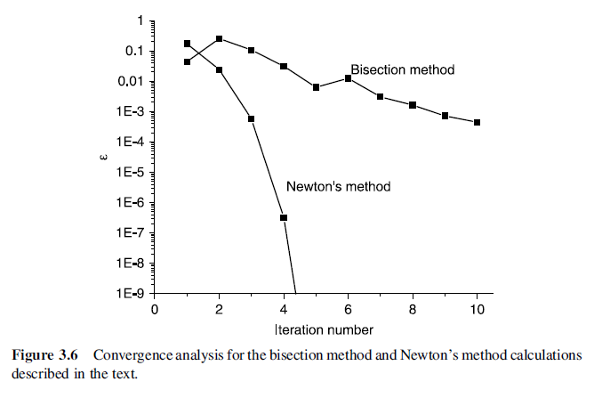
A striking difference between the bisection method and Newton’s method is how rapidly the solutions converge.
Newton’s method is better than the bisection method

Slide 30

How do we know when to stop?
A typical choice is to continue iterating until the difference between successive iterates is smaller than some tolerance:

Slide 31
there are several general properties of numerical optimization that are extremely important to appreciate. They include :
1. The algorithms are iterative, so they do not provide an exact solution; instead, they provide a series of approximations to the exact solution.
2. An initial estimate for the solution must be provided to use the algorithms.The algorithms provide no guidance on how to choose this initial estimate.

Slide 32
3. The number of iterations performed is controlled by a tolerance parameter that estimates how close the current solution is to the exact solution.
4. Repeating any algorithm with a different tolerance parameter or a different initial estimate for the solution will generate multiple final approximate solutions that are (typically) similar but are not identical.
5. The rate at which different algorithms converge to a solution can vary greatly, so choosing an appropriate algorithm can greatly reduce the number of iterations needed.

Slide 33
6. These methods cannot tell us if there are multiple minima of the function we are considering if we just apply the method once. Applying a method multiple times with different initial estimates can yield multiple minima, but even in this case the methods do not give enough information to prove that all possible minima have been found.
7. For most methods, no guarantees can be given that the method will converge to a solution at all for an arbitrary initial estimate.

Slide 34
3.3.2 Optimization in More than One Dimension
The one-dimensional Newton method was derived using a Taylor expansion, and the multidimensional problem can be approached in the same way.
Newton’s method defines a series of iterates by:

Slide 35
Unfortunately, Newton’s method simply cannot be applied to the DFT problem we set ourselves at the beginning of this section!

Slide 36
It is very difficult to directly evaluate second derivatives of energy within plane-wave DFT, and most codes do not attempt to perform these calculations.

Slide 37
As a result, we have to look for other approaches to minimize E(x). We will briefly discuss the two numerical methods that are most commonly used for this problem: quasi-Newton and conjugate-gradient methods.

Slide 38
The essence of quasi-Newton methods is to replace Eq. (3.15) by :
where A_{i} is a matrix that is defined to approximate the Jacobian matrix. This matrix is also updated iteratively during the calculation and has the form:

Slide 39

Conjugate gradient method:
We begin with an initial estimate, x₀. Our first iterate is chosen to lie along the direction defined by
the problem of choosing the best value of α₀ cannot be solved exactly. Choose the step size by some approximate method that may be as simple as evaluating E_{(x1)} for several possible step lengths and selecting the best result.

Slide 40
3.4 GEOMETRY OPTIMIZATION
3.4.1 Internal Degrees of Freedom
Example 1 : Obtain the energy of the gas phase N₂ molecule
Step 1 :Create a cubic super-cell with a side length of L
Step 2 :Place two N atoms at the fractional coordinates (0, 0, 0) and ( + d/L , O , 0) of this supercell.
Step 3:find the DFT-optimized bond length for N₂ by using either the quasi-Newton or conjugate-gradient methods defined above to minimize the total energy of our supercell.

Slide 41
Example 2 : Optimize the geometry of a molecule of CO₂
Step 1 :Create a cubic super-cell with a side length of L
Step 2 :Create a CO2 molecule by placing a C atom at fractional coordinates (0,0,0) and O atoms at (+d/L,0,0) and (-d/L,0,0).
Step 3:find the DFT-optimized bond length for CO₂ by using either the quasi-Newton or conjugate-gradient methods defined above to minimize the total energy of our supercell.

Slide 42
3.4.2 Geometry Optimization with Constrained Atoms
There are many types of calculations where it is useful to minimize the energy of a supercell by optimizing the position of some atoms while holding other atoms at fixed positions.

