Slide 1
AB INITIO MOLECULAR DYNAMICS

Slide 2
4.1 CLASSICAL MOLECULAR DYNAMICS
4.1.1 Molecular Dynamics with Constant Energy
To specify the configuration of the atoms at any moment in time, we need to specify 3N positions,{r₁, . . . , r_{3N}}, and 3N velocities, {ν₁, . . . , ν_{3N}}.

Slide 3
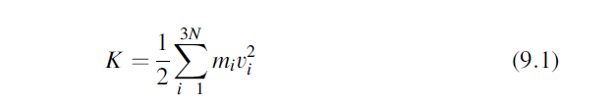
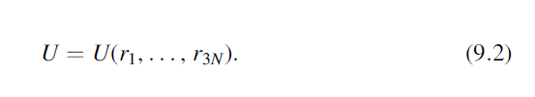
The total kinetic energy,
where m_{i} is the mass of the atom associated with the ith coordinate.
The total potential energy,

Slide 4
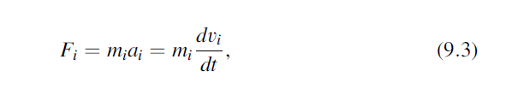
Newton’s laws of motion apply to these atoms since we are treating their motion within the framework of classical mechanics. That is,
where F_{i} and a_{i} are the force and acceleration, respectively, acting on the ith coordinate and t is time.

Slide 5
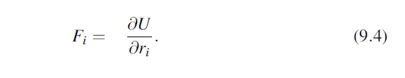
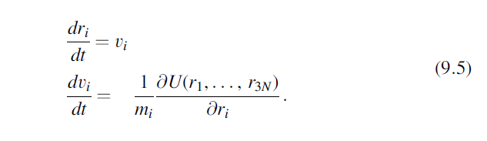
This force is also related to the derivative of the total potential energy by
These relationships define the equations of motion of the atoms, which can be written as a system of 6N first-order ordinary differential equations:

Slide 6
In a macroscopic collection of atoms that is in equilibrium at temperature T, the velocities of the atoms are distributed according to the Maxwell–Boltzmann distribution.

Slide 7
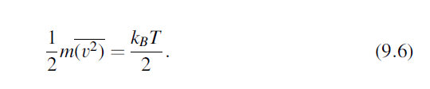
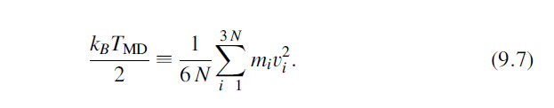
One of the key properties of this distribution is that the average kinetic energy of each degree of freedom is
In molecular dynamics, this relationship is turned around to define temperature by

Slide 8
In essentially all systems that are physically interesting, the equations of motion above are far too complicated to solve in closed form. It is therefore important to be able to integrate these equations numerically in order to follow the dynamics of the atoms.

Slide 9
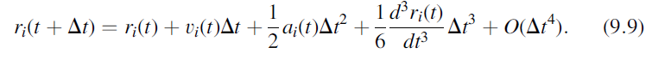

A simple way to do this is to use the Taylor expansion：
If you express Eq.(9.9) using a positive and a negative time step and take the difference of the two expressions, you can show that
This is known as the Verlet algorithm.

Slide 10
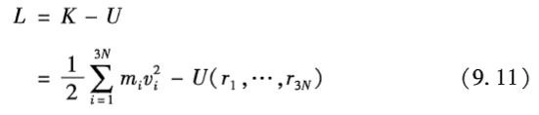

Another powerful approach to this task is to define a quantity called the Lagrangian, L, in terms of the kinetic and potential energies,
The equations of motion for each coordinate in terms of
the Lagrangian are

Slide 11
4.1.2 Molecular Dynamics in the Canonical Ensemble
Under typical experimental conditions, the atoms of a material of interest are able to exchange heat with their surroundings. In this situation, the atoms exist in a canonical ensemble, where N, V, and T are constant.

Slide 12
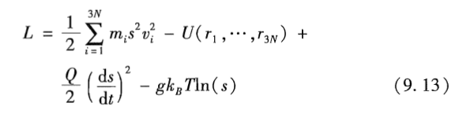

One of the most elegant was originally introduced by Nos$\acute{e }$, who began by using the Lagrangian for the microcanonical ensemble, Eq. (9.11), and forming an extended Lagrangian:

Slide 13
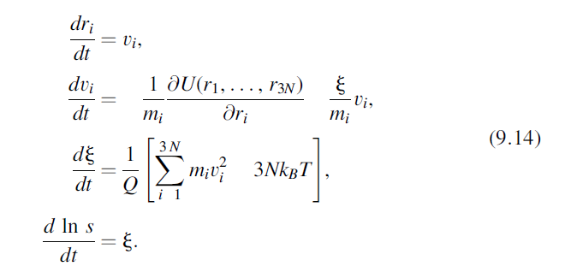
These equations were written by Hoover in a convenient form using slightly different variables than the extended Lagrangian above:

Slide 14

4.2 AB INITIO MOLECULAR DYNAMICS
The potential energy of the system of interest can be calculated “on the fly” using quantum mechanics. This is the basic concept of ab initio MD. The Lagrangian for this approach can be written as
where w(r₁, . . ., r_{3N}) represents the full set of Kohn–Sham one-electron wave functions for the electronic ground state of the system.

Slide 15
Because of the limited size of the time steps that can be taken with MD, finding methods to perform these calculations with great efficiency was extremely important for making them feasible for physically interesting problems.

Slide 16
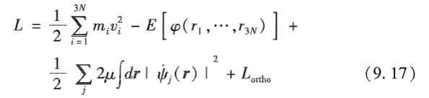
Car–Parrinello molecular dynamics (CPMD)
Car and Parrinello’s extended Lagrangian is
The first two terms on the right-hand side are the same as in Eq.(9.16), while the last two terms introduce fictitious degrees of freedom. The third term that has the form of kinetic energy introduces a fictitious mass, m, while the final term above is required to keep the one-electron wave functions orthogonal.

Slide 17
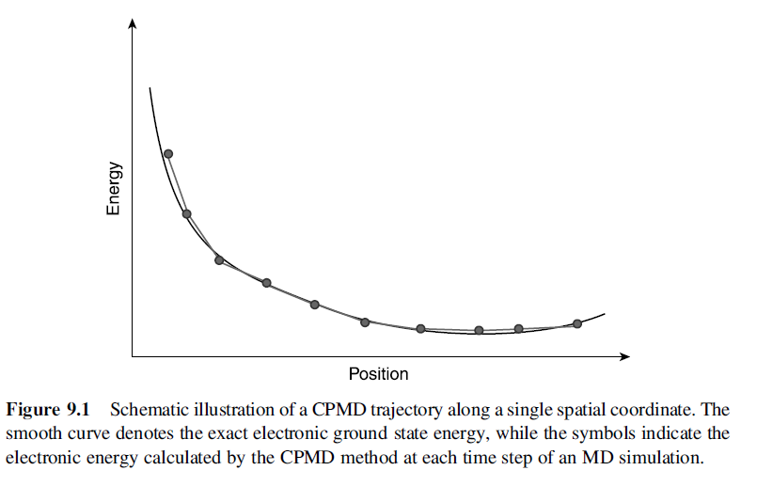

Slide 18
Born–Oppenheimer molecular dynamics (BOMD)
When used appropriately, the electronic information from a previous MD step can provide a good initial approximation for the ground state of the updated nuclear positions, enabling the energy and forces for a new time step to be computed in an efficient way.

Slide 19
4.3 APPLICATIONS OF AB INITIO MOLECULAR DYNAMICS
4.3.1 Exploring Structurally Complex Materials: Liquids and
Amorphous Phases
A detailed study by Lewis, De Vita, and Car of indium phosphide (InP)
Lewis et al. did calculations using a 64-atom supercell (32 In and 32 P atoms), with k space sampled at the Γ point. Molecular dynamics simulations were performed using a time step of 0.25 fs.

Slide 20
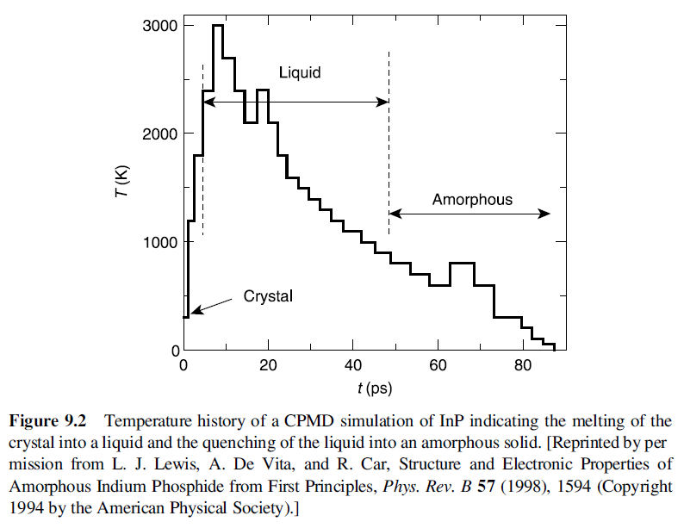

Slide 21
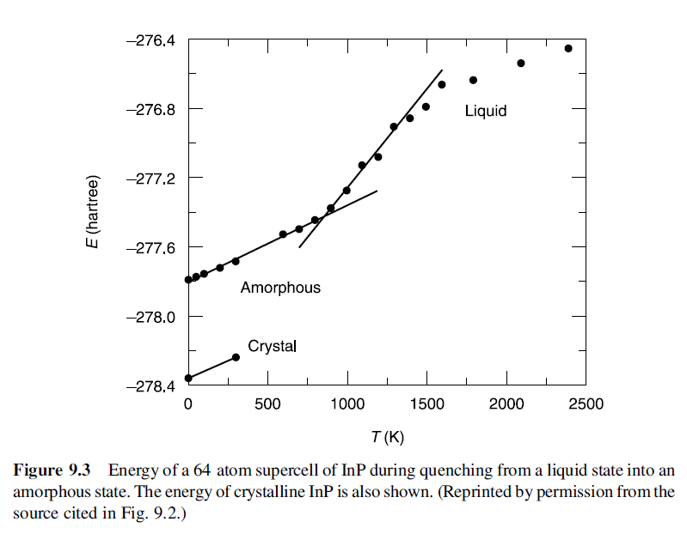

Slide 22
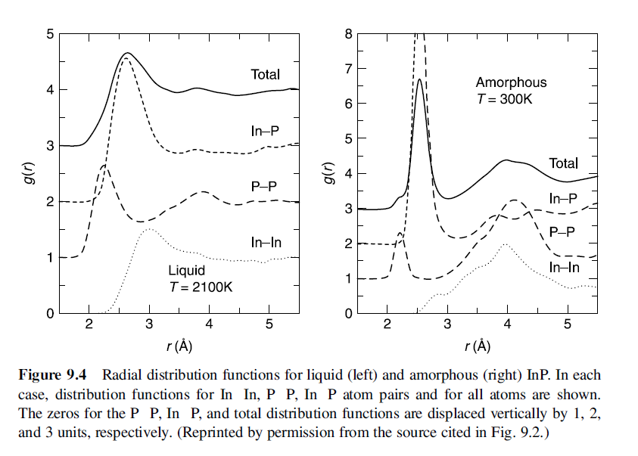

Slide 23
4.3.2 Exploring Complex Energy Surfaces
Finding structures of a nanocluster of 13 Pt atoms
Figure 9.5 shows three Pt13 nanoclusters with high levels of symmetry that were constructed “by hand” and then optimized with DFT.
Then, we followed an ab initio MDtrajectory for 3ps at 2000 K using time steps of 20fs with the symmetric cluster with O_{h} symmetry as the initial condition.

Slide 24
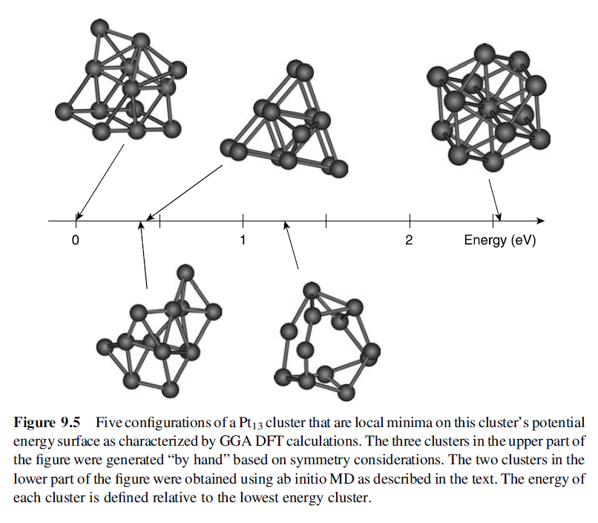

Slide 25
