Slide 1


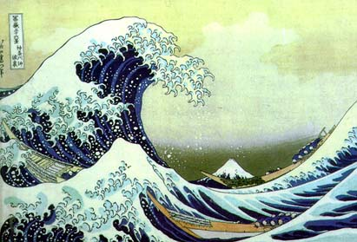
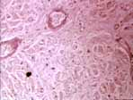
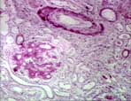
Multiresolution: What, Why, How?
compression
communications
biomedical applications
…
Jelena Kovačević
Center for Bioimage Informatics
Depts. of BME and ECE
Carnegie Mellon University
Notes:
Almost all the images and signals were obtained in Matlab, using the Wavelet Toolbox. When this is not the case, I will specify it.
In instructions on how to obtain them, first do
wavemenu
in Matlab. This brings up the mail Wavelet Toolbox GUI. I used four different functions:
Wavelet 1-D (W1D)
Wavelet Packet 1-D (WP1D)
Wavelet 2-D (W2D)
Wavelet Packet 2-D (WP2D)
I will refer to them as specified in parentheses.

Slide 2
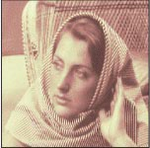

MR: What?
Analysis and processing at different resolutions
Resolution: amount of information
Lower or higher resolution?
Notes:
Image on the left: image_original.jpg
How obtained: W2D
File → Example Analysis → At level 2, with Haar → Woman
Choose the original image
Image on the right: image_lr_1.jpg
How obtained: W2D
File → Example Analysis → At level 2, with Haar → Woman
Choose 1 level
Choose the UL (upper left) image in the Image Selection box
Comments on the slide
This slide illustrates the concept of resolution as the amount of information in a signal. If one looks at the two images and they look as they were “equally sharp”, the one on the left is of higher resolution just by the virtue of the fact that it is larger. In fact, the image on the right was obtained as the LL subband in 1-level DWT.

Slide 3
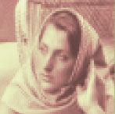
MR: What?
Analysis and processing at different resolutions
Resolution: amount of information
Lower or higher resolution?
Notes:
Image on the left: image_original.jpg
How obtained: W2D
File → Example Analysis → At level 2, with Haar → Woman
Choose the original image
Image on the right: image_lr_reconstructed.jpg
How obtained: W2D
File → Example Analysis → At level 2, with Haar → Woman
Select the UL (upper left) image in the Image Selection box
Click on Reconstruct in Operations on Selected Image (right panel)
Choose the image Recons. Approx. coef. of level 2
Comments on the slide
This slide continues the story from the previous one. Here, the one can say that the left is of higher resolution than the right since it is clear that the right one is missing some information (sharpness of detail). This is true since the right image is obtained by interpolating the right image from the previous slide.

Slide 4
MR: What?
Analysis and processing at different resolutions
Resolution: amount of information
Lower or higher resolution?
Notes:
Image on the left: image_lr_1.jpg
How obtained: W2D
File → Example Analysis → At level 2, with Haar → Woman
Choose 1 level
Choose the UL (upper left) image in the Image Selection box
Image on the right: image_lr_reconstructed.jpg
How obtained: W2D
File → Example Analysis → At level 2, with Haar → Woman
Select the UL (upper left) image in the Image Selection box
Click on Reconstruct in Operations on Selected Image (right panel)
Choose the image Recons. Approx. coef. of level 2
Comments on the slide
Same story as before. Now it is not as clear what one should pick and just by looking at them it is hard to be sure which one is of higher resolution and which one is lower. In this particular case, they are both of the same resolution as the right one is the interpolated version of the left one, and thus, no new information has been added.

Slide 5
MR: Why?
Localization
Adaptivity
Computational efficiency
Notes:
Comments on the slide
Some of the most important and useful characteristics of multiresolution are listed above. We now look at each individually.

Slide 6
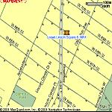
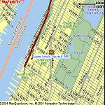



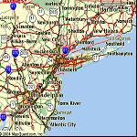
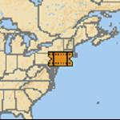


Localization
Zoom-in on
singularities
Notes:
MapQuest: Search for Loews Theatre on 68th & Broadway, NYC
Comments on the slide
Wavelets have the ability to zoom in on singularities. An example is MapQuest where if you search for something, you can look on which continent it is located, followed by a region, followed by a city and finally, followed by a street view. You refine your search by using a zooming tool.

Slide 7
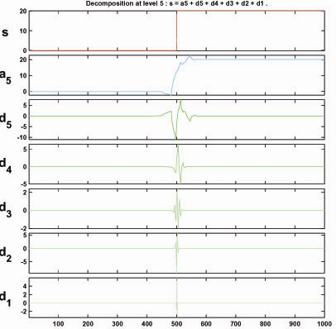
Localization
Zoom-in on singularities
Notes:
Graph: decomposition_step_db2_5.jpg
How obtained: W1D
File → Example Analysis → Basic Signals → w db2 at level 5
→ Step signal
Comments on the slide
Here is an example of a signal—step signal, and how the WT zooms in on the singularity—step. You can see that at the finest level, the detail coefficients d1 are all 0 except in the vicinity of the step. This analysis is performed with the db2 filters which are of length 4. As the level gets higher (coarser), the support of the filter operating on the signal gets longer and longer, and thus more and more coefficients in the vicinity of the step catch it, making the result fatter.

Slide 8
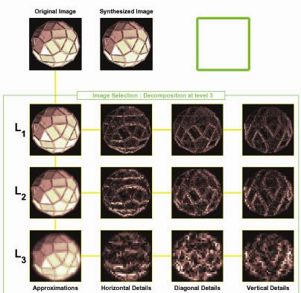
Localization
Zoom-in on singularities
Notes:
Image: decomposition_ball_bi5.5_3.jpg
How obtained: W1D
File → Example Analysis → At level 3, with bior5.5 → Facets
Choose View Mode: Tree
Comments on the slide
This slide shows the same as the previous except on images. Again, the singularities (edges) are best seen at the finest (lowest) level while they become blurred as the level becomes higher.

Slide 9
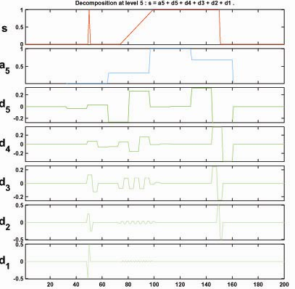
Localization
Characterize singularities
Notes:
Graph: singularities.jpg
How obtained: W1D
File → Load → Signal → singularities.mat
Choose Wavelet: Haar, Level: 5
Click Analyze
Comments on the slide
This slides demonstrates the ability of the wavelet transform not only to detect singularities but to characterize them as well. The graph has three different types of singularities and they all behave differently across scales. By measuring the amplitude and behavior of the singularity across scales, one can determine its location and type.

Slide 10
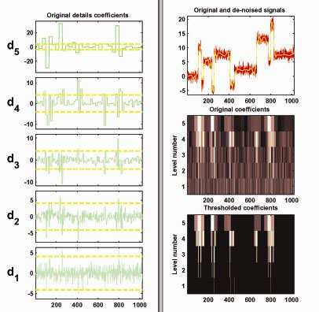
Denoising
Separate signal from noise
Notes:
Graph: decomposition_blocks_denoise.jpg
How obtained: W1D
File → Example Analysis
→ Noisy Signals – Constant Noise Variance
→ with sym8 at level 5 → Noisy blocks
Click De-noise
Click De-noise again in the new window that pops up
Comments on the slide
The power of multiresolution shows itself also in its ability to separate signal from noise. If something about the noise is known apriori, one can look at the behavior of coefficients across scales and decide which belong to noise and which to the signal. Those deemed to belong to noise are simply removed and the signal is reconstructed without them. The yellow lines on the left side of the graph denote the threshold below which the coefficients are eliminated. The original signal is given in red on the right side and the denoised one in yellow.

Slide 11
Adaptivity:
Holy Grail of Signal Analysis/Processing
FT
“Holy Grail” of Signal Analysis/Processing
  Understand the “blob”-like structure of the energy distribution in the time-frequency space
  Design a representation reflecting that
WT
WP
STFT
Dirac basis
f
t
Notes:
Comments on the slide
The adaptivity is a big advantage of MR techniques. The Fourier transform does analysis with a fixed window both in time and frequency and thus localizing features in either time or frequency is possible only within a fixed window.

Slide 12
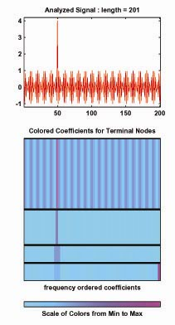
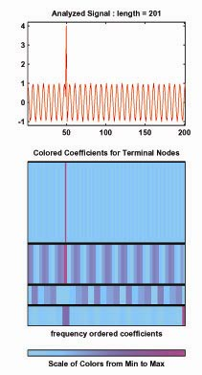
Adaptivity: Trade-offs
high frequency
lower frequency
Notes:
Graph on the left: sin_0.9pi_dirac.jpg
How obtained: WP1D
File → Load → Signal → sin_0.9pi_dirac.mat
Choose Wavelet: Haar, Level: 3
Click Analyze
Click Wavelet Tree
Graph on the right: sin_0.3pi_dirac.jpg
How obtained: WP1D
File → Load → Signal → sin_0.3pi_dirac.mat
Choose Wavelet: Haar, Level: 3
Click Analyze
Click Wavelet Tree
Comments on the slide
Here we have a similar example where on the left side we have a high frequency with an impulse and on the right a lower frequency and the impulse. Below are the time-frequency tilings obtained by using the DWT. It is obvious that on the right the frequency is identified to fall somewhere in the upper half of the spectrum while on the right it falls within the middle quarter or so.

Slide 13
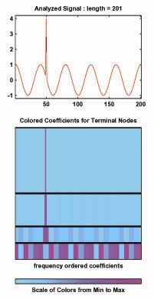
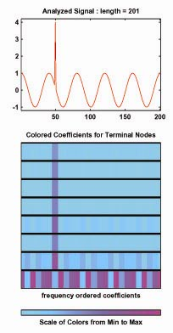
Adaptivity: Trade-offs
lowest frequency
DWT
lowest frequency
STFT
Notes:
Graph on the left: sin_0.05pi_dirac.jpg
How obtained: WP1D
File → Load → Signal → sin_0.05pi_dirac.mat
Choose Wavelet: Haar, Level: 3
Click Analyze
Click Wavelet Tree
Graph on the right: sin_0.05pi_dirac_stft.jpg
How obtained: WP1D
File → Load → Signal → sin_0.05pi_dirac.mat
Choose Wavelet: Haar, Level: 3
Click Analyze
Comments on the slide
Here we have a very low frequency and the impulse. On the left is analysis with the DWT and on the right with the Fourier. Both analyses isolate the frequency equally well; however, the DWT is more precise in isolating the impulse. Note how the precision with which the FT isolates the pulse is not as fine (the impulse if fatter) as that of the DWT at high frequencies.

Slide 14
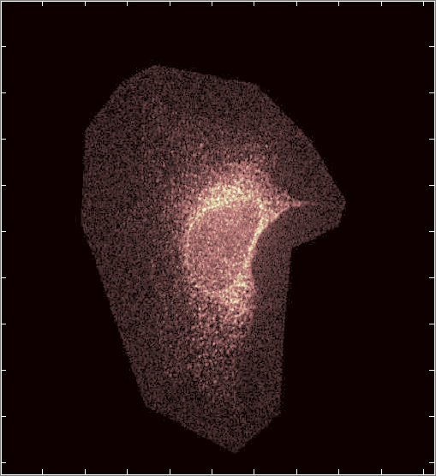
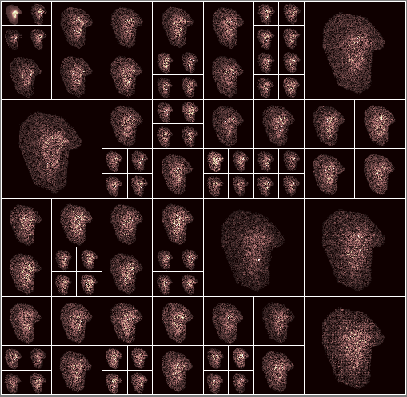
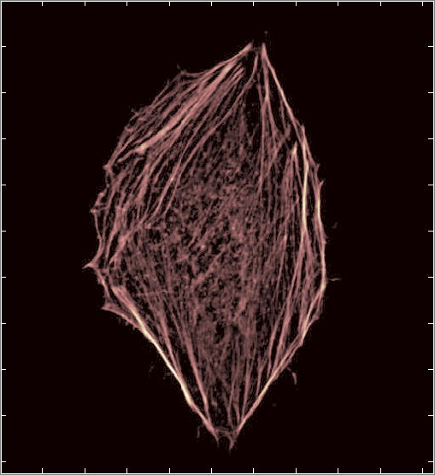
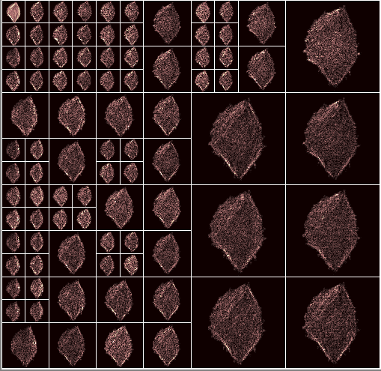
Adaptivity
Notes:
These were produced by Tad Merryman.
Comments on the slide
This slide illustrates the power of wavelet packets on an image. These images depict two different proteins in the cell (both are fluorescence microscopy images) and on the right is the best wavelet packet tree found by using the energy in the subband as the criterion.

Slide 15
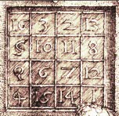




MR: How?
Decomposition into time-frequency atoms
=
*
+
*
+
+
*
+
*
Notes:
Image on the left: detail_original.jpg
How obtained: W2D
File → Example Analysis → At level 3, with sym4 → Detail Durer
Choose Wavelet: Haar, Level: 1
Choose Original Image
Small images on the right: detail_LL.jpg, detail_LH.jpg,
detail_HL.jpg, detail_HH.jpg
How obtained: W2D
File → Example Analysis → At level 3, with sym4 → Detail Durer
Choose Wavelet: Haar, Level: 1
Choose the four images in the Image Selection box
(UL=LL, UR=LH, LL=H, LR=HH)
Comments on the slide
This slide demonstrates how we do decomposition into time-frequency atoms. In this case, these are Haar, applied separately in both directions (thus you obtain the little 2x2 squares where black denotes a -1 and white denotes a 1). The image is obtained as a linear combination of these time-frequency atoms, where the coefficients in the expansion are the four images given above.

Slide 16
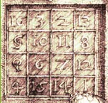
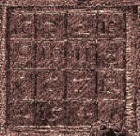
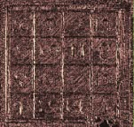
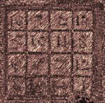
MR: How?
Decomposition into time-frequency atoms
=
+
+
+
+
Notes:
Image on the left: detail_original.jpg
How obtained: W2D
File → Example Analysis → At level 3, with sym4 → Detail Durer
Choose Wavelet: Haar, Level: 1
Choose Original Image
Images on the right: detail_LL_rec.jpg, detail_LH_rec.jpg,
detail_HL_rec.jpg, detail_HH_rec.jpg
How obtained: W2D
File → Example Analysis → At level 3, with sym4 → Detail Durer
Choose Wavelet: Haar, Level: 1
Select the UL/UR/LL/LR image in the Image Selection box
Click on Reconstruct in Operations on Selected Image
Choose the image Recons. Approx. coef./detail of level 1
Comments on the slide
When the products are computed, one can look at the decomposition also as the sum of 4 subimages. The first one keeps high frequencies (lowpassed both in horizontal and vertical directions, LL), the second one has been highpassed horizontally and lowpassed vertically (HL), the third one is the reverse LH and the fourth one has been highpassed in both directions HH.

Slide 17
MR: How?
x = synthesize (do something) analyze x
X = analyze x
=
x
Notes:
Same images as on Slide 16.
Comments on the slide
Mathematically, the analysis process is given as a vector/matrix operation, where we have a matrix operating on the input signal to produce the four middle signals (called subbands, channels, etc.)

Slide 18
MR: How?
x = synthesize (do something) analyze x
x = synthesize X
=
x
Notes:
Same images as on Slide 16.
Comments on the slide
On the synthesis side, we do the opposite. In the Haar case, the filters/basis functions used in analysis/synthesis are the same as the basis is orthonormal.

Slide 19
Aside: How X is Represented
=
Notes:
Same images as on Slide 16.
Comments on the slide
Digression: In image processing, and in Matlab, one often represents the four subimages in the same area as the image itself, with the LL subband in the upper left-hand corner.

Slide 20

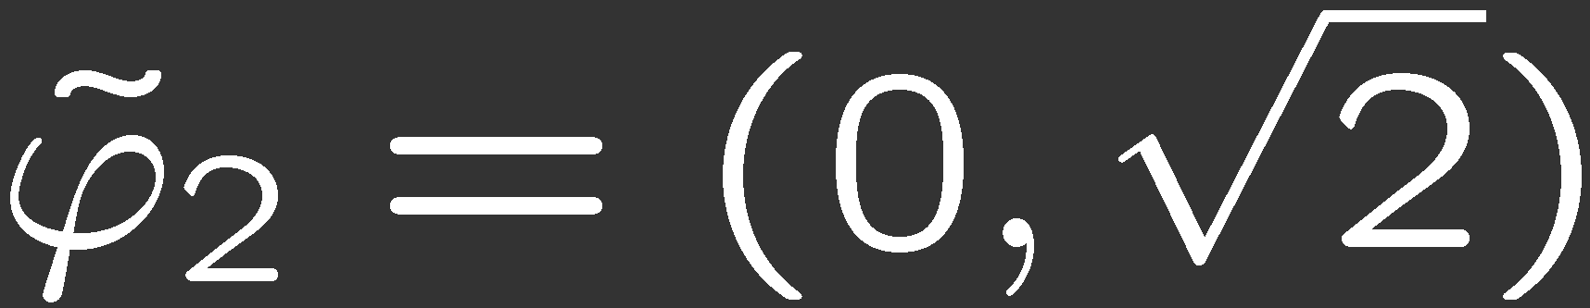
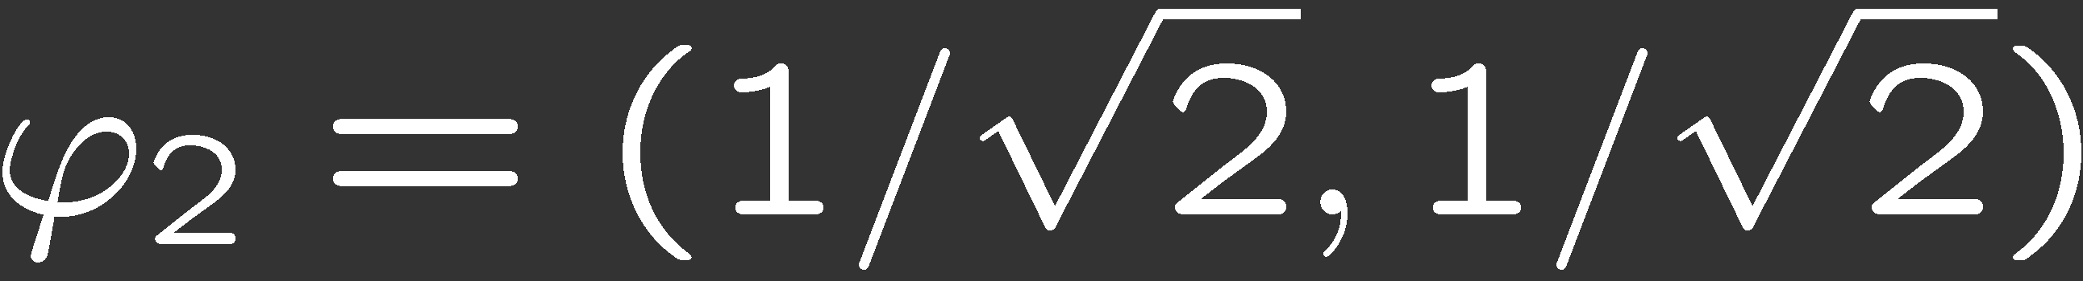



MR: How?
x = synthesize (do something) analyze x
Structure of analyze and synthesize given by TF
orthogonal
biorthogonal
Notes:
Comments on the slide
We have seen how one can analyze and synthesize. The way we choose these operators are given to us by time-frequency constraints. This slide illustrates two possible nonredundant bases, orthogonal and biorthogonal.

Slide 21
MR: How?
Filter banks: SP tools to implement these expansions
Develop filter banks by trying to implement an expansion having a better t-f resolution than Diracs
Notes:
Comments on the slide
We now answer how to implement these multiresolution expansions.

Slide 22
Slightly Better TF than Diracs
Split the frequency in half
means we can downsample by 2
to reconstruct upsample by 2
filter to remove unwanted images and add
Basic building block: Two-channel filter bank
analysis
processing
synthesis
f
h
h
x
x
g
g
t
Notes:
Comments on the slide
The motivation is to obtain a time-frequency analysis slightly better than that of Diracs (impulses). This means we want to refine the frequency resolution. A natural way is to try to divide the spectrum in two parts. As the Nyquist frequency has now been lowered, we can sample, and to reconstruct we have to upsample and filter again. This gives rise to a basic building block --- the two-channel filter bank. As you can see, the tf tiling is indeed better in frequency with a slightly worse one in time.

Slide 23
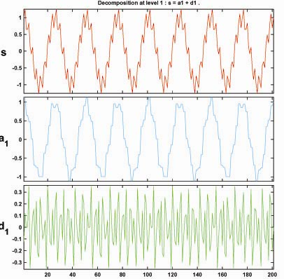
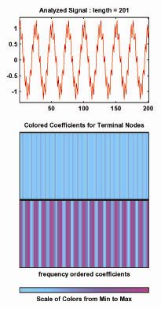
Slightly Better TF than Diracs
Notes:
Graph on the left: twosines.jpg
How obtained: W1D
File → Load → Signal → twosines.mat
Choose Wavelet: Haar, Level: 1
Click Analyze
Graph on the right: twosines_WP_1_STFT.jpg
How obtained: WP1D
File → Load → Signal → twosines.mat
Choose Wavelet: Haar, Level: 1
Click Analyze
Comments on the slide
An example of how this works. This graph has a sum of two sines, one large of low frequency, and one tiny of much higher frequency, superimposed on top of the large one. If you look at the second and third graph on the left side, you can see that the coarse channel gets the low-frequency sinusoid out and the other channel gets the tiny sinusoid almost out. Also in the tiling on the right side, it is obvious that the low-frequency sinusoid has been well separated. The high-frequency one is not that obvious since its amplitude is really small.

Slide 24
Slightly Better TF than Diracs
=
+
+
+
+
Notes:
Same images as on Slide 17.
Comments on the slide
In 2D, we typically use the filter banks first across the rows and then across the columns (although this is not really necessary). The result are four subbands as we have seen before.

Slide 25
What Else Can We Do?
Grow the full tree – STFT
f
t
Notes:
Comments on the slide
What else can we do? We can split into a full tree, splitting every subband further, resulting in a STFT splitting.

Slide 26
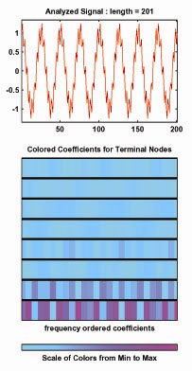
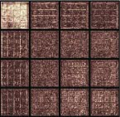
What Else Can We Do?
Grow the full tree – STFT
Notes:
Graph on the right: sin_0.05pi_dirac_stft.jpg
How obtained: WP1D
File → Load → Signal → sin_0.05pi_dirac.mat
Choose Wavelet: Haar, Level: 3
Click Analyze
Graph in the middle: twosines_WP_3_STFT.jpg
How obtained: WP1D
File → Load → Signal → twosines.mat
Choose Wavelet: Haar, Level: 3
Click Analyze
Images on the right: detail_WP_2_STFT.jpg
How obtained: WP2D
File → Example Analysis → db1-depth:1-ent:shannon → detail
Choose Wavelet: Haar, Level: 2
Click Analyze
Comments on the slide
This slides shows the STFT for the low frequency plus an impulse, two sinusoids and a 2D signal. One can see how the STFT isolates the sinusoids well but not the impulse.

Slide 27
What Else Can We Do?
Iterate only on the lowpass channel – DWT
f
t
Notes:
Comments on the slide
Another option is to iterate the splitting only on the lowpass channel, leading to the DWT.

Slide 28
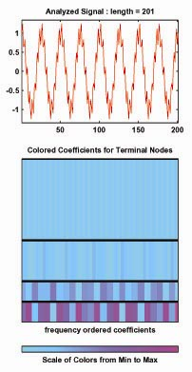
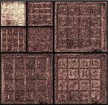
What Else Can We Do?
Iterate only on the lowpass channel – DWT
Notes:
Graph on the right: sin_0.05pi_dirac.jpg
How obtained: WP1D
File → Load → Signal → sin_0.05pi_dirac.mat
Choose Wavelet: Haar, Level: 3
Click Analyze
Graph in the middle: twosines_WP_3_DWT.jpg
How obtained: WP1D
File → Load → Signal → twosines.mat
Choose Wavelet: Haar, Level: 3
Click Analyze
Click Wavelet Tree
Images on the right: detail_WP_2_DWT.jpg
How obtained: WP2D
File → Example Analysis → db1-depth:1-ent:shannon → detail
Choose Wavelet: Haar, Level: 2
Click Analyze
Click Wavelet Tree
Comments on the slide
Here is an example of the DWT applied on the low frequency plus an impulse, two sinusoids and a 2D signal. Again, one can see the trade-off offered by the DWT, it isolates well both the low-frequency sinusoid and the impulse. However, it does not isolate well the high-frequency sinusoid in the second graph.

Slide 29
What Else Can We Do?
First grow the full tree
f
t
Notes:
Comments on the slide
Finally, to adapt ourselves to the signal, we first grow the full tree.

Slide 30
What Else Can We Do?
Then prune the tree – wavelet packets (WP)
f
t
Notes:
Comments on the slide
We then prune the tree based on some cost function. For example, we might ask ourselves, is it going to cost me more or less to code these two children or the parent? If it costs me less to code the children, I keep the children, if not, I keep the parent. This yields a time-frequency tiling adapted to the signal at hand.

Slide 31
What Else Can We Do?
Notes:
Same images as on Slide 16.
Comments on the slide
Here is an example with the two proteins and WP trees for each one.

Slide 32
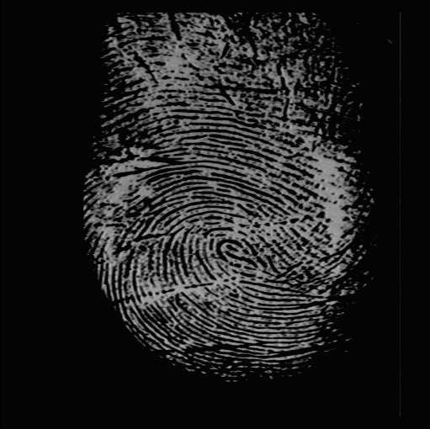
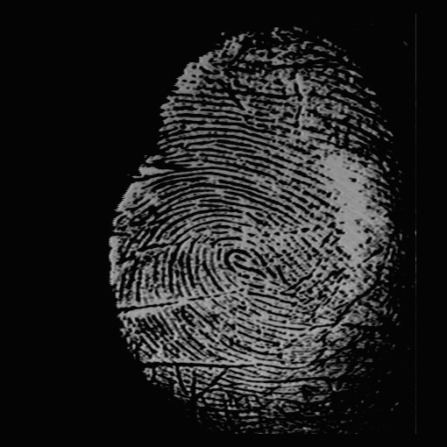
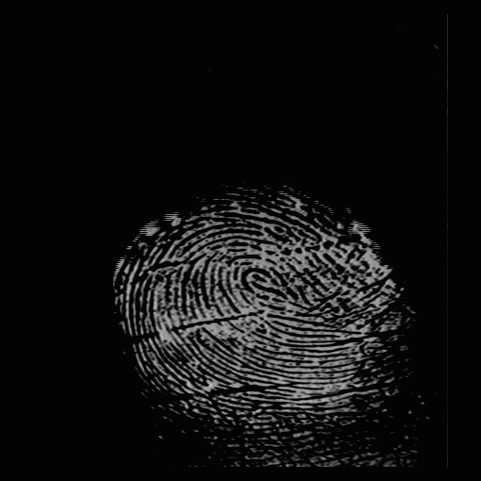
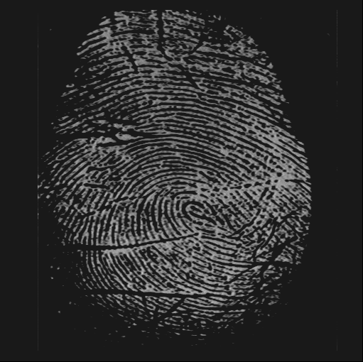
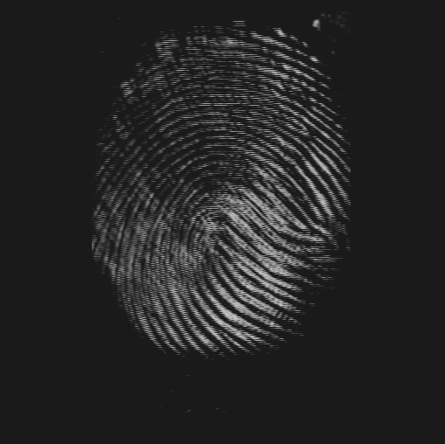
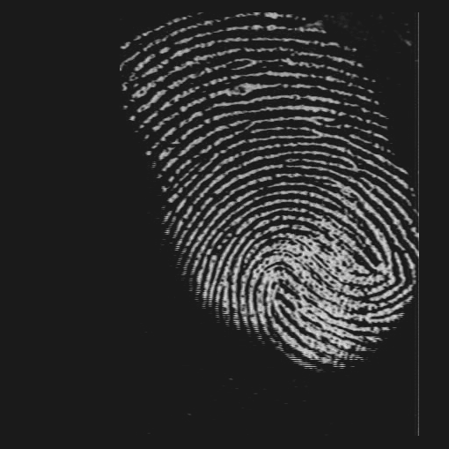
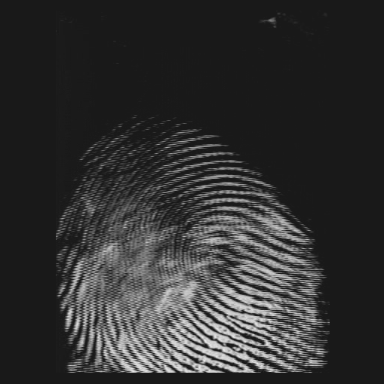
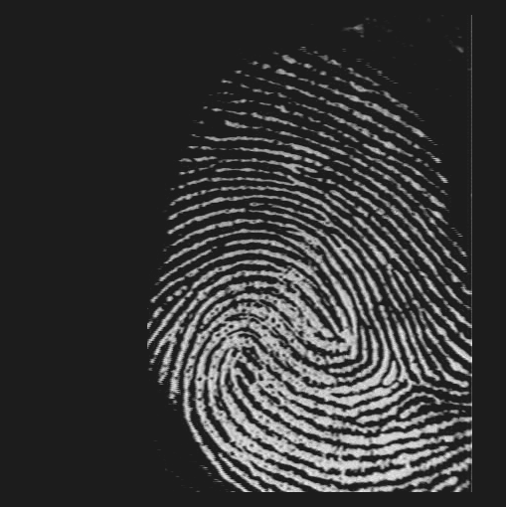
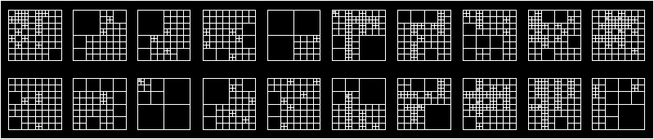
What Else Can We Do?
Notes:
These images were produced by Pablo Henning Yeomans and Jason Thornton.
This was in the context of the identification/verification for biometrics.
Comments on the slide
This example is for fingerprint images (8 of them given on top). The WP trees for all 20 classes are given on the bottom illustrating how WP trees actually serve to distinguish between different classes.

Slide 33
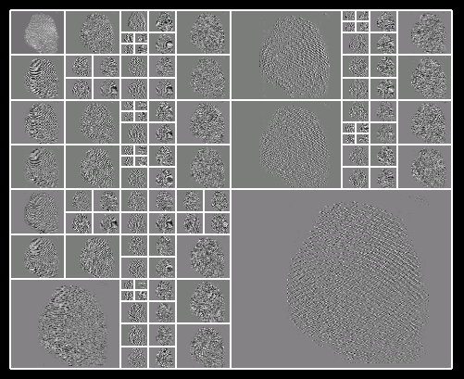
What Else Can We Do?
Notes:
This image was produced by Pablo Henning Yeomans and Jason Thornton.
This was in the context of the identification/verification for biometrics.
Comments on the slide
This is a particular example of a fingerprint with its wavelet packet tree.

Slide 34
References on MR
Light reading
  “Wavelets: Seeing the Forest -- and the Trees”, D. Mackenzie, Beyond Discovery, December 2001.
Books
  “A Wavelet Tour of Signal Processing”, S. Mallat, Academic Press, 1999.
  “Ten Lectures on Wavelets”, I. Daubechies, SIAM, 1992.
  “Wavelets and Subband Coding”, M. Vetterli and J. Kovacevic, Prentice Hall, 1995.
  “Wavelets and Filter Banks”, G. Strang and T. Nguyen, Wells. Cambr. Press, 1996.

Slide 35
Outline of the Tutorial
Euclid’s World
Multirate Signal Processing
Time-Frequency Constraints
Two-Channel Filter Banks
Applications

