Slide 1


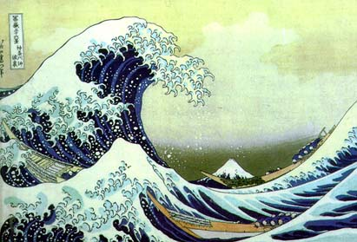
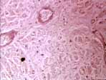
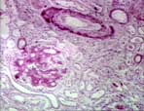
Multiresolution: What, Why, How?
Part 3: Multirate Signal Processing
compression
communications
biomedical applications
…
Jelena Kovačević
Center for Bioimage Informatics
Depts. of BME and ECE
Carnegie Mellon University

Slide 2




Building Blocks
+

Slide 3
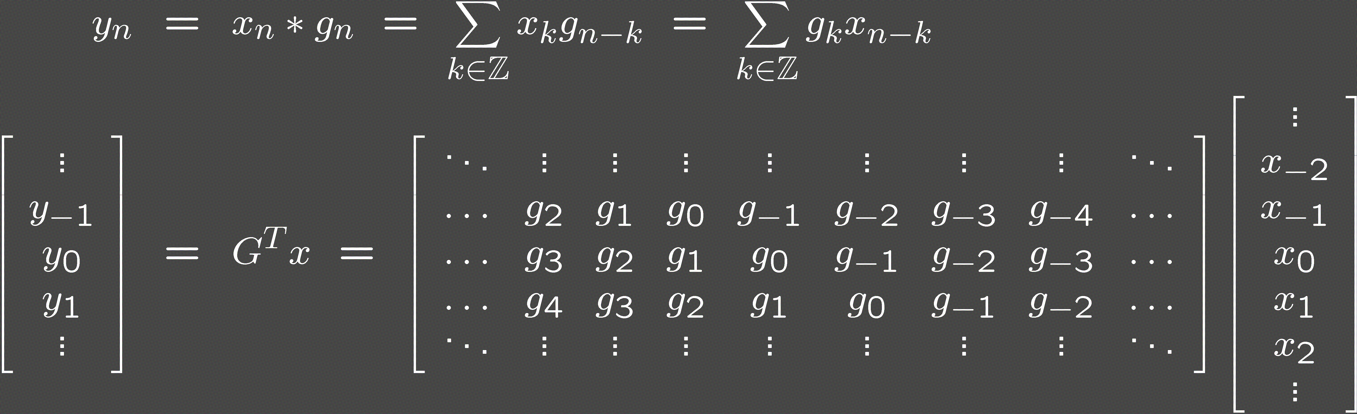
Filtering
Matrix view

Slide 4
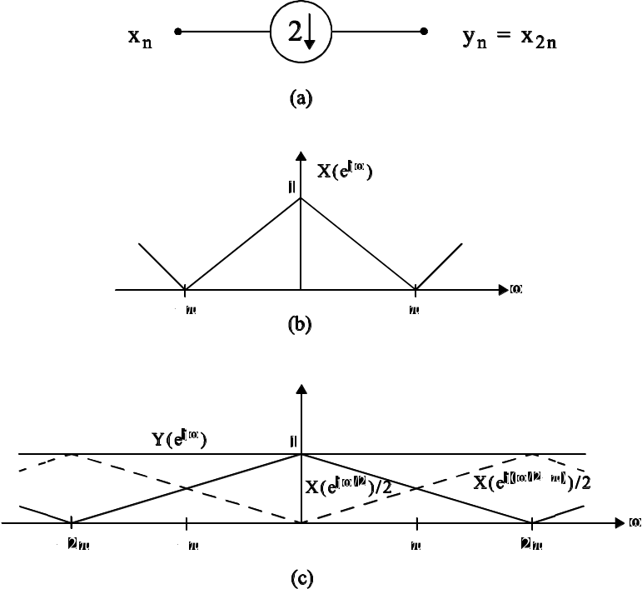
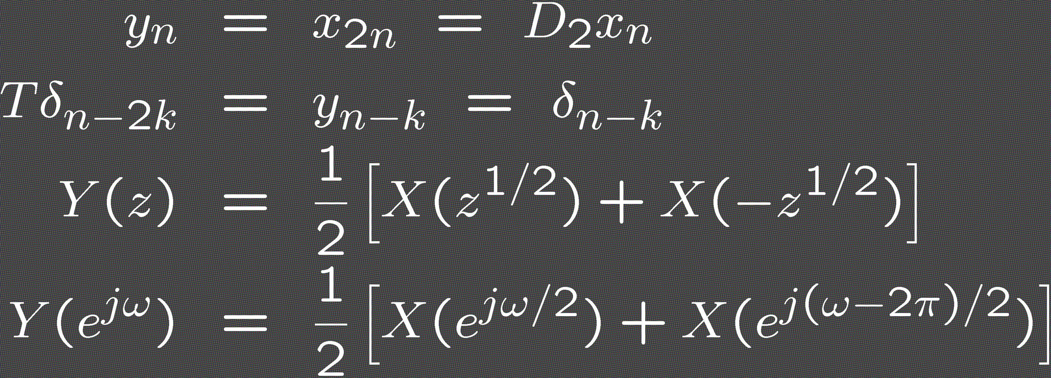
Downsampling
Shift-varying operation

Slide 5
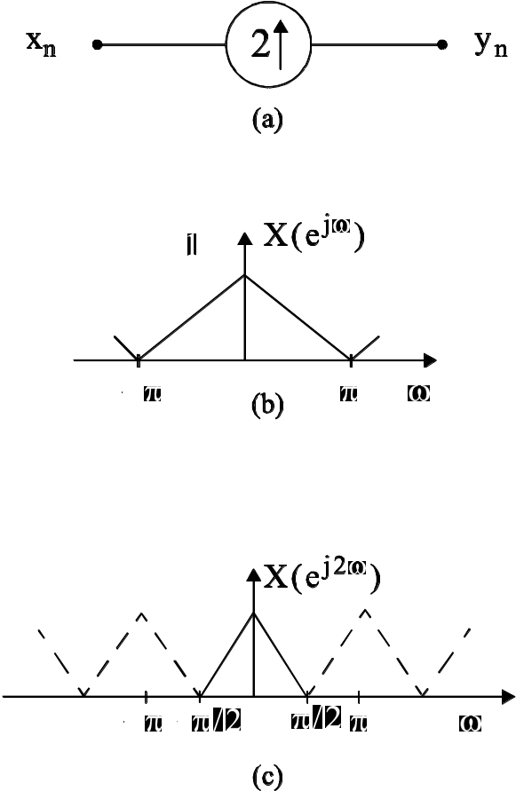
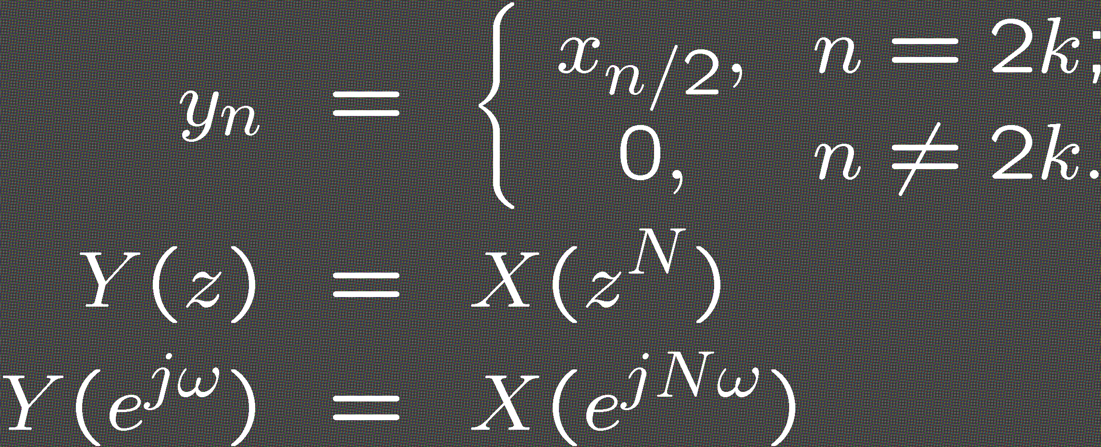
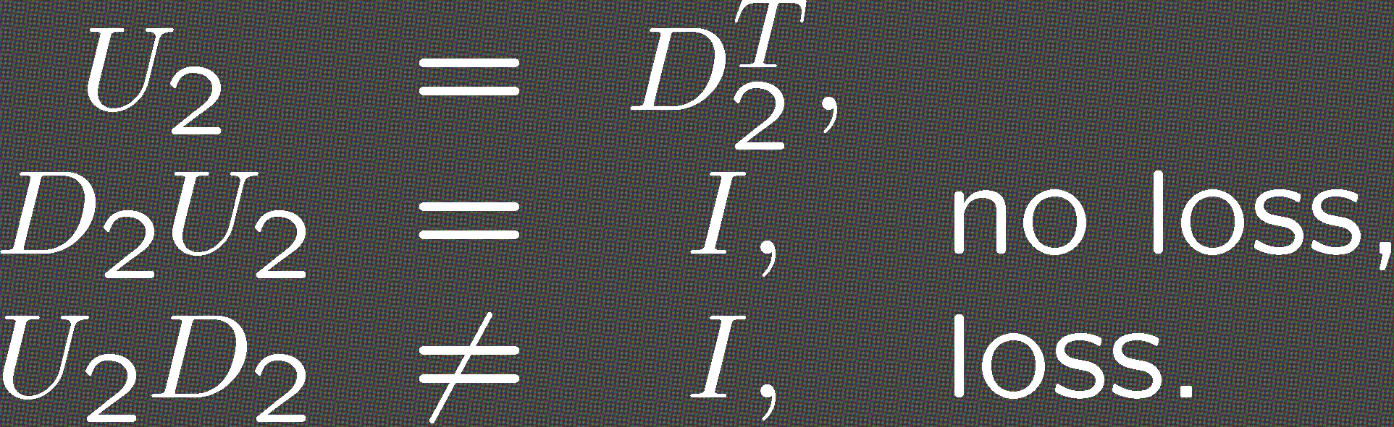
Upsampling
Upsampling and
downsampling operators

Slide 6
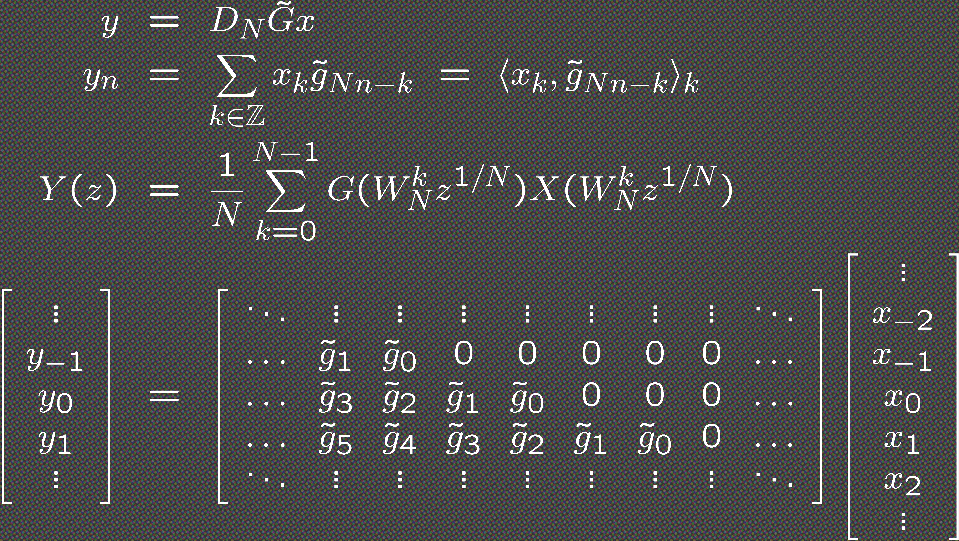
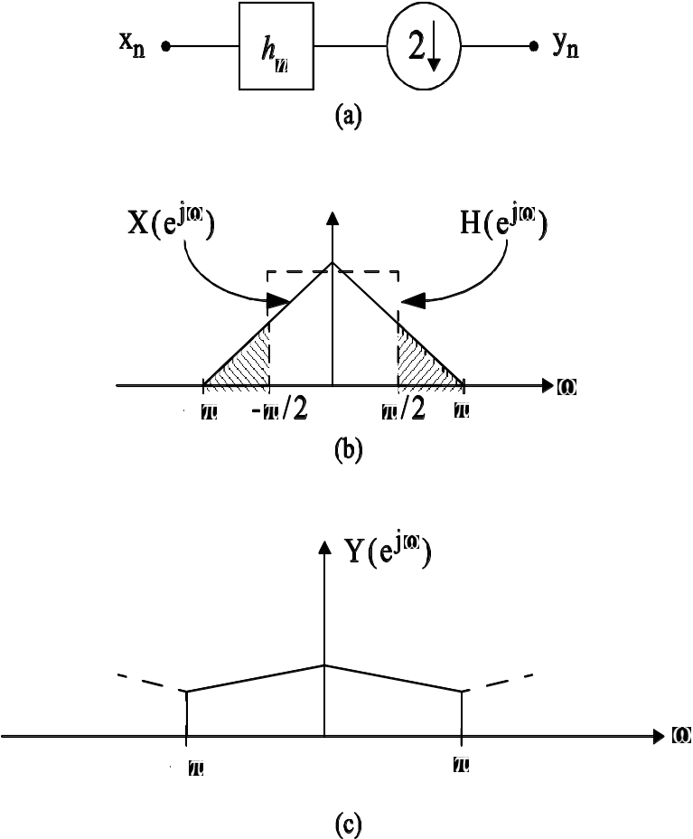
Filtering Followed by
Downsampling

Slide 7
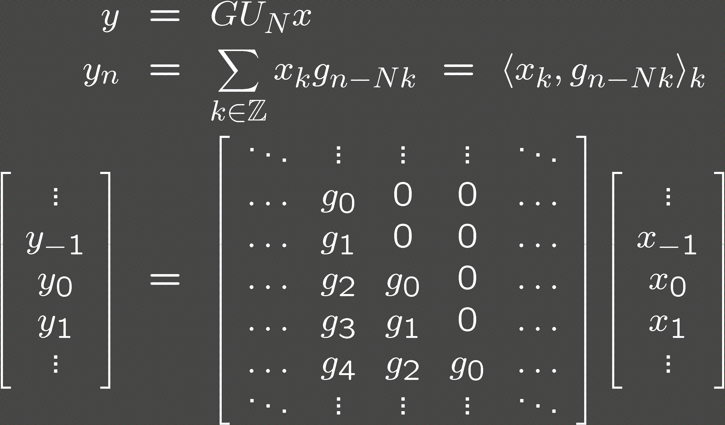
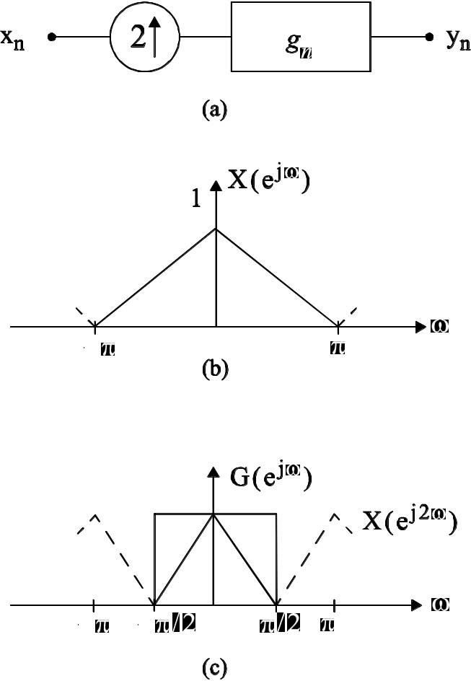
Upsampling Followed by
Filtering

Slide 8
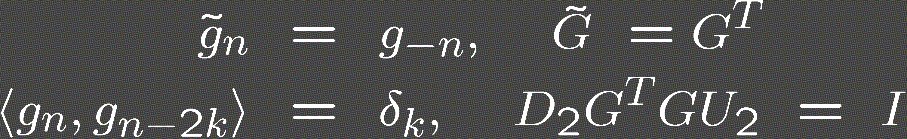
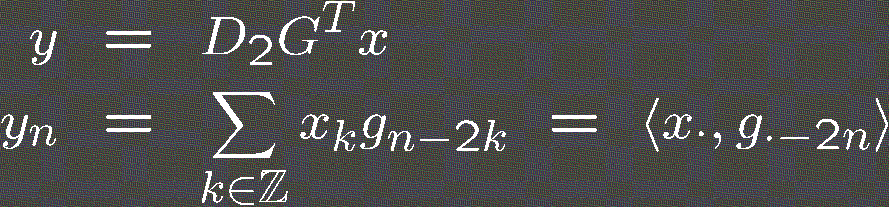
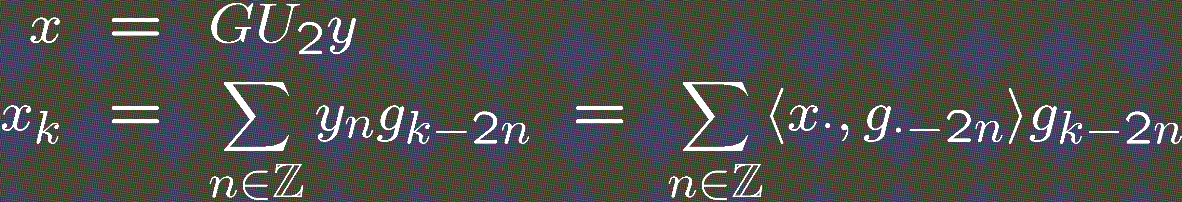
Projection
Operator
We assume
Value of the projection
Projection onto V

Slide 9

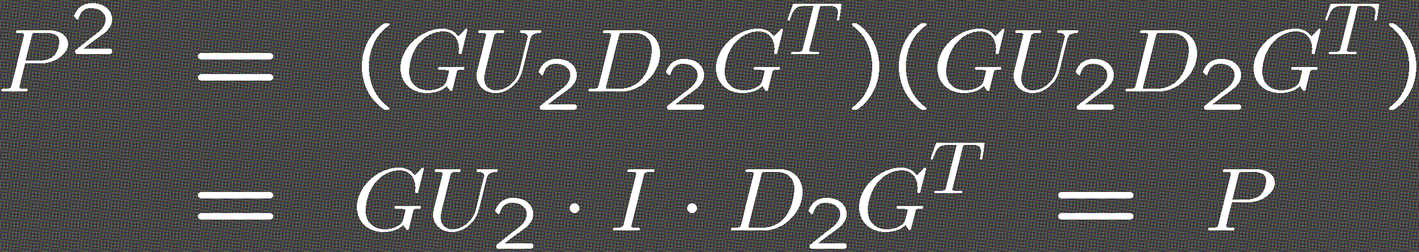
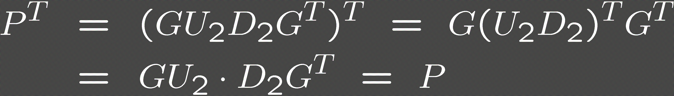
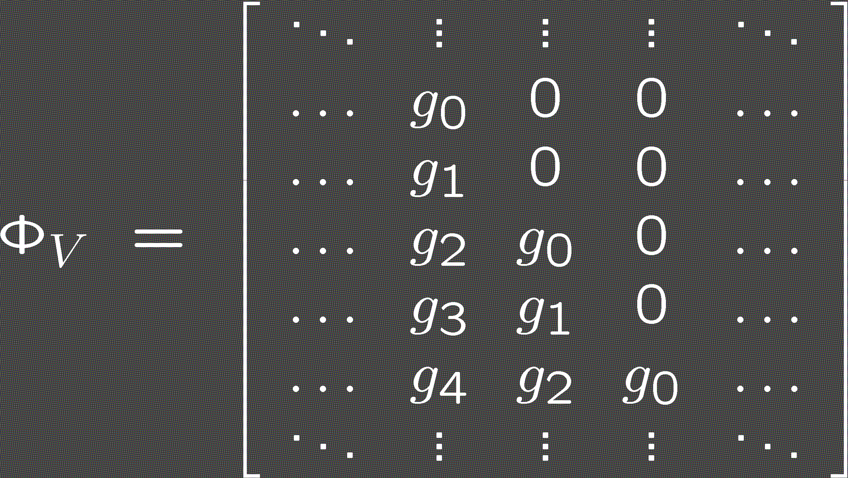
Projection
Operator
Projection operator
  Matrix corresponding to the basis for V

Slide 10
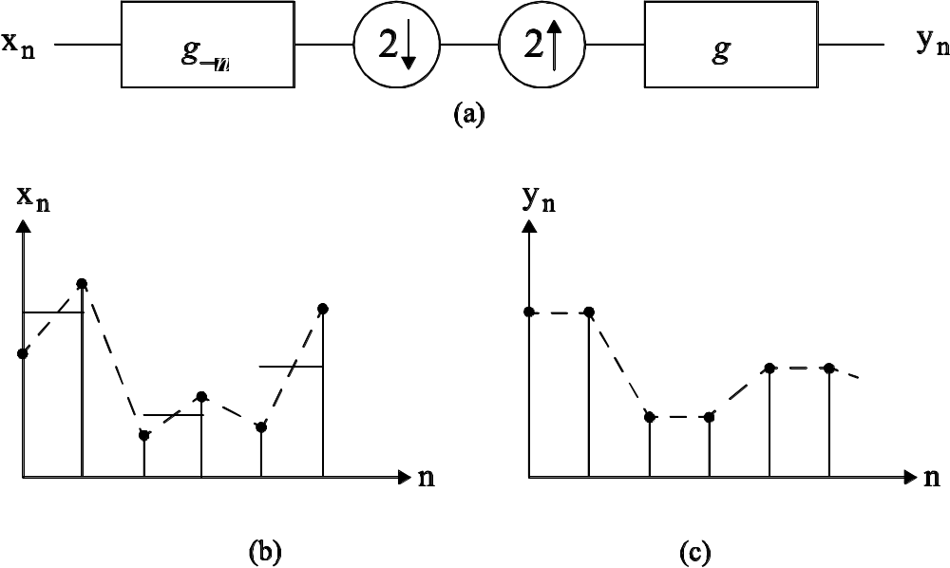
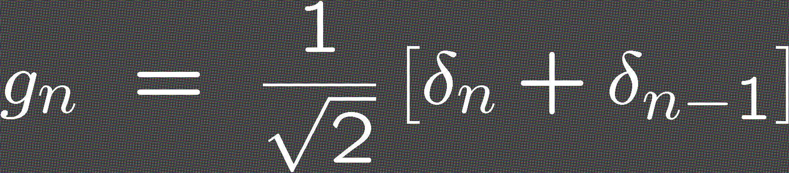
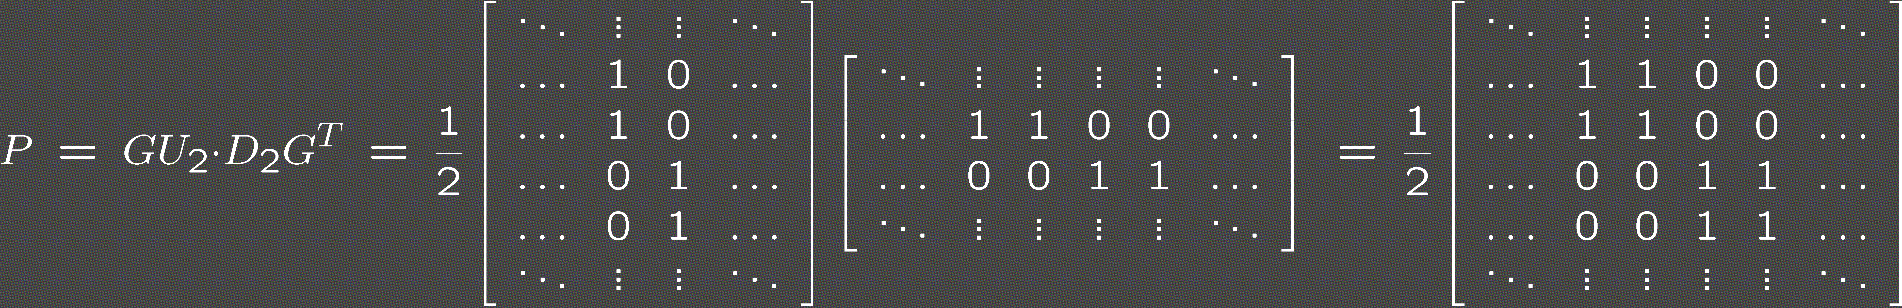
Smoothing
Operator
Given
Smoothing operator
Output

Slide 11

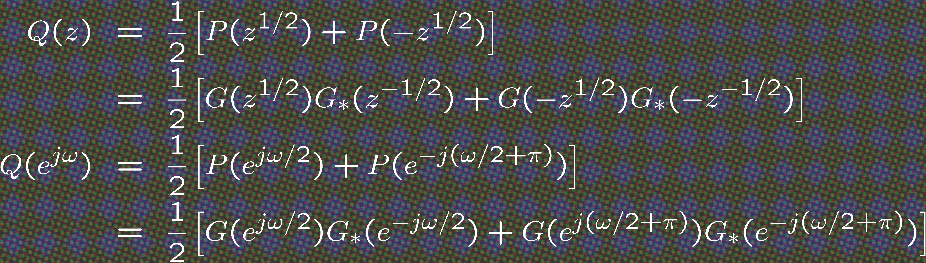
Useful Multirate Facts
Autocorrelation of a sequence orthogonal to its even translates
  Autocorrelation of g downsampled by 2

Slide 12
Useful Multirate Facts
Noble Identities
,
,

Slide 13
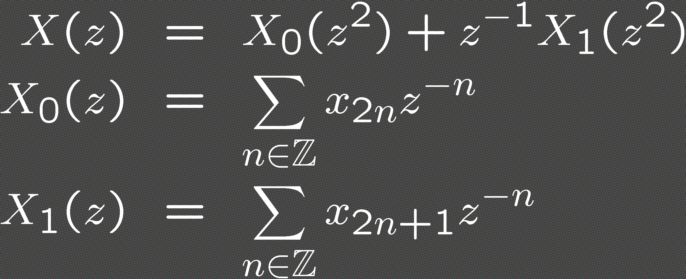
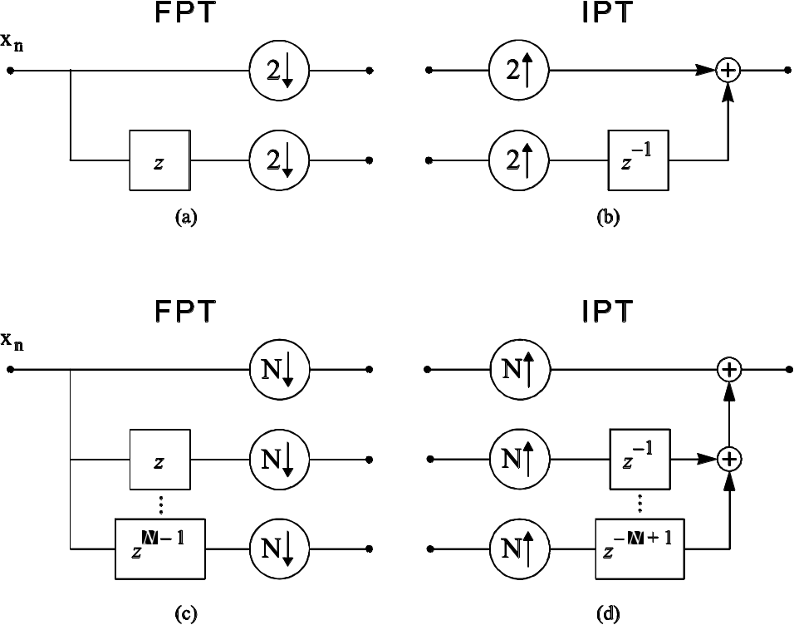
Polyphase Representation
Decomposition into subsequences

