Slide 1


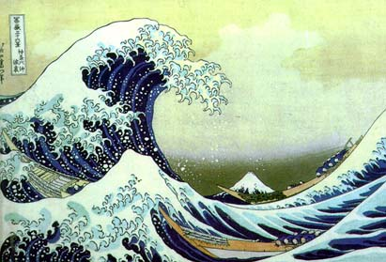
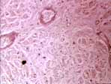
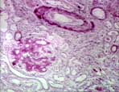
Multiresolution: What, Why, How?
Part 4: Time-Frequency Constraints
compression
communications
biomedical applications
…
Jelena Kovačević
Center for Bioimage Informatics
Depts. of BME and ECE
Carnegie Mellon University

Slide 2

Building Blocks
Are we solving x=x?
  Sort of: find matrices such that
  After finding those
    Decomposition
    Reconstruction
Do we know anything else about these matrices?
  The only hint: smoothing operator
  We now impose constraints on our matrices

Slide 3







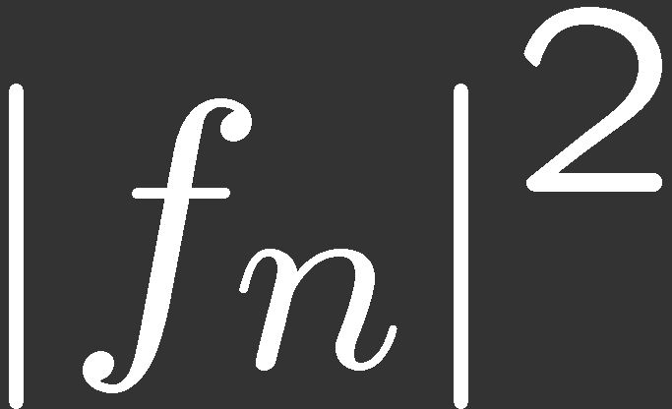
Time-Frequency Tile
Continuous time
Discrete time

Slide 4




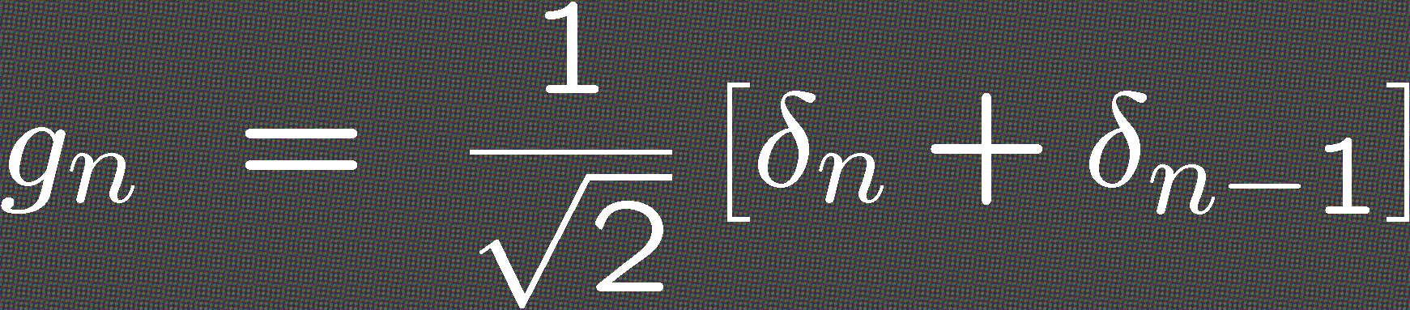
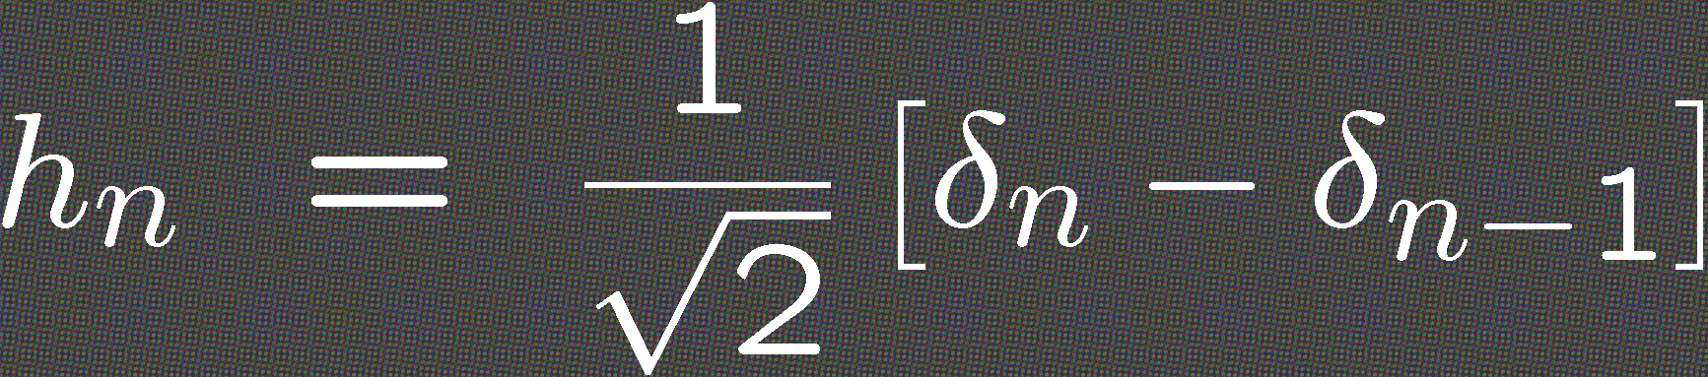
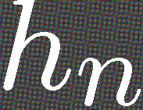
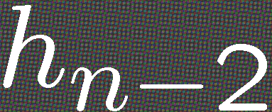
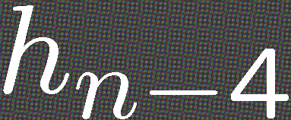
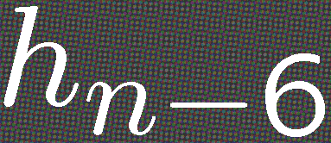


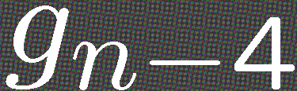
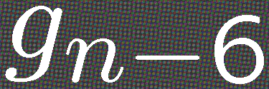
Time-Frequency Tiling as a Conceptual Tool
Smoothing operator
Total 2-channel Haar
Differencing operator
π
π/2
+
0
2
4
6
8

Slide 5
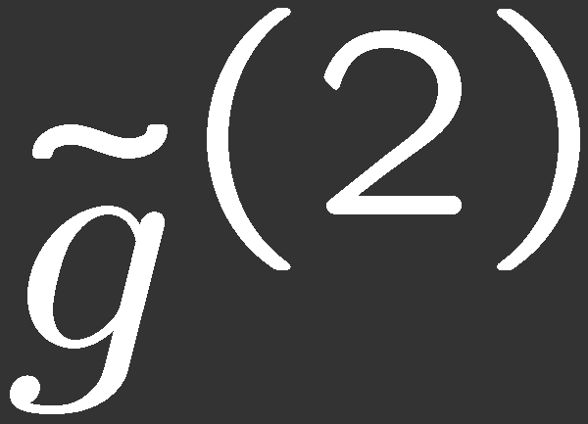
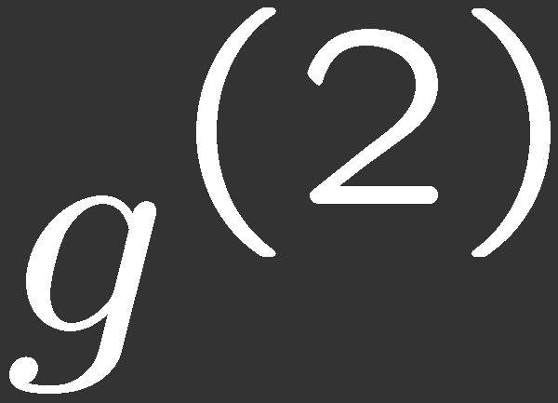
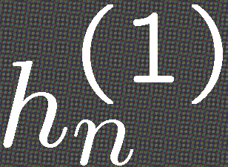
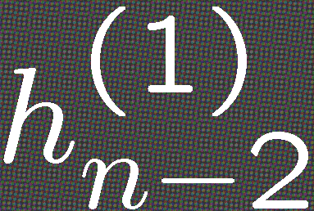
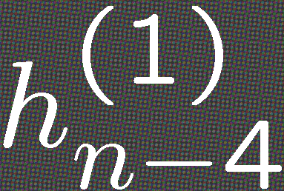
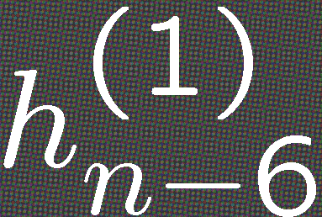
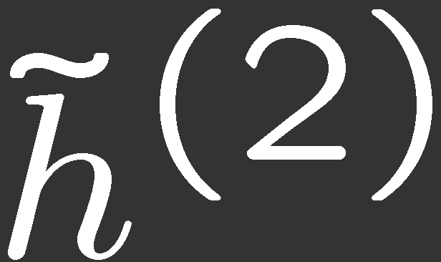
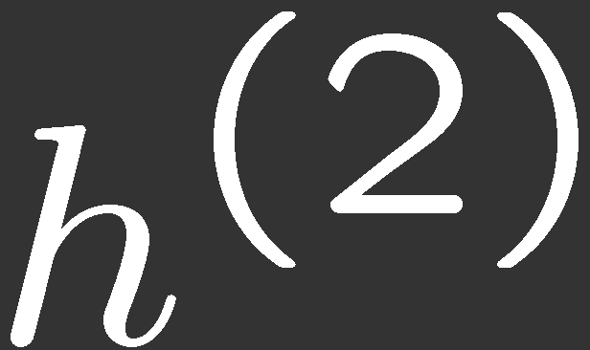
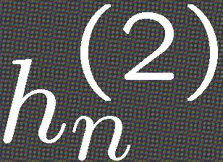
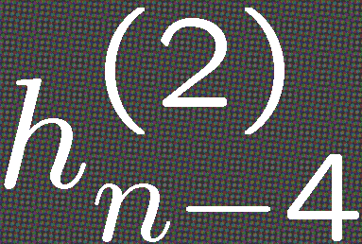
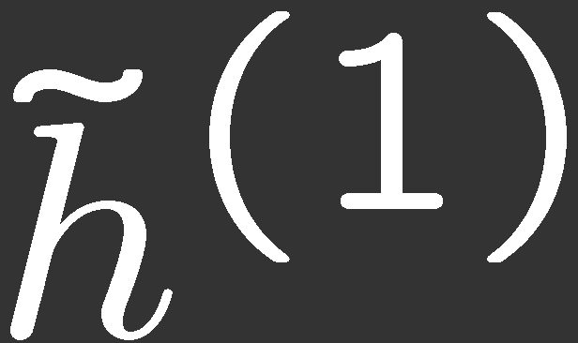
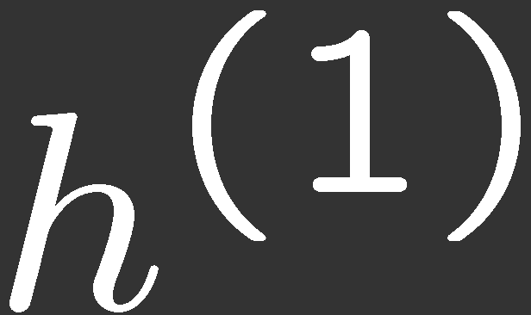
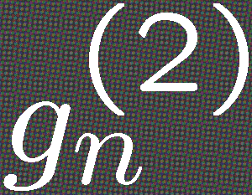
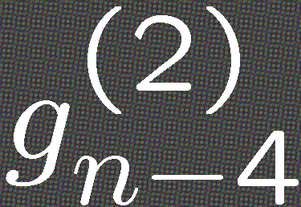
Can We Do Even Better?
Split the lowpass branch once more
+
+
4
4
π
4
4
+
π/2
π/4
2
2
0
2
4
6
8

Slide 6
What Next?
π
π/2
π/4
0
2
4
6
8
π
π/2
π
π/4
0
2
4
6
8
π/2
π/4
0
2
4
6
8

