Slide 1

Ensó
Language Workbench Challenge '13
Alex Loh (UT-Austin), Tijs van der Storm (CWI). 8 Apr 2013, Cambridge.

Slide 2
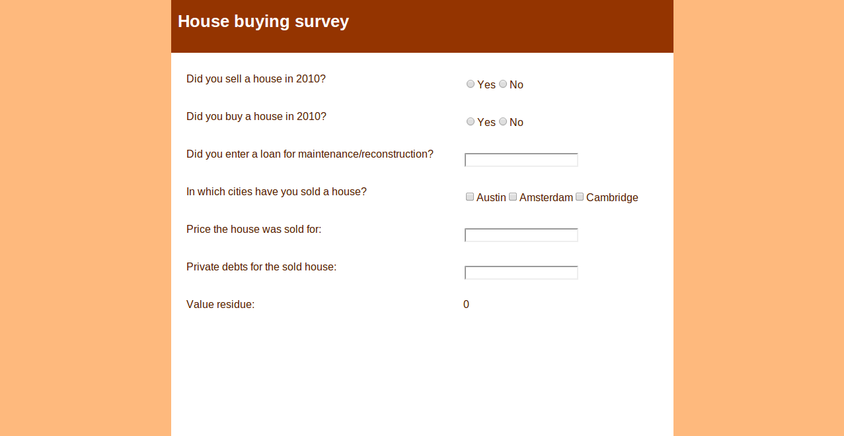
A Questionaire Language
housing.ql
ql.schema
ql.stencil
ql.grammar
QL lang definition
(84 SLOC)

Slide 3


Slide 4
Enso DSL workbench
84 SLOC for DSL, 0 SLOC of GPL
Language abstractions
No tooling lock-in, no special IDEs
  Visit http://enso-lang.org for more info!

Slide 5





?
?
?
?
?
?
?
Questions?

