Slide 1
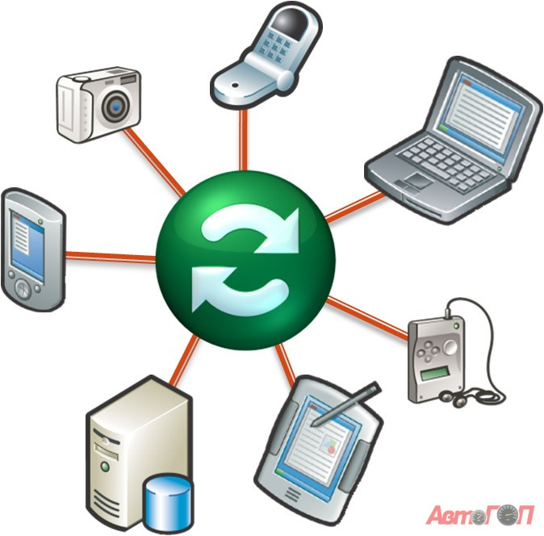
EnsoSync
Keeps multiple file locations up-to-date
Centralized file synchronization
Master copy on server
Clients can synchronize any part of the file system tree

Slide 2
Multi-DSL development
File management DSL
Security DSL
Web user interface DSL (EnsoWeb)
Total LOC:
  200 lines of model code + 260 lines of Ruby
= 560 lines of code

Slide 3
File Synchronization
Synchronization expressed as generic operations on managed data:
  Union,
  Difference,
  Patch, etc
  In this case the managed data is an abstract file system
Enso has a library of operators that are generic over schema

Slide 4
File Synchronization
def sync(base, s1, s2)
d1 = diff(base, s1)
d2 = diff(base, s2)
confs = conflict(d1, d2)
resolve!(confs) #possibly human intervention
d = union(d1, d2)
new_base = patch(base, d)
update1 = diff(s1, new_base)
update2 = diff(s2, new_base)
#write to disk
apply(update1)
apply(update2)
end

Slide 5
Permissions and user policy
Fine-grained user control, eg.
  allow update(f:File) if d.name = user.name
  (“Users can write to files in their home directory”)
  deny create(d:Dir)
  deny delete(d:Dir)
  (“Directory structure may not be changed”)

Slide 6
Permissions and user policy
Generic security DSL extends data manager with security wrapper, potentially at run-time
SecureFactory implements Factory, except
  Reads invisibly removes unauthorized objects from the results list
  Unauthorized updates, deletes and creates fail (either invisibly or throws exception)

